Slide 1


Module 2: Sex Workers
In-Reach Online Training
Increasing support and partnerships with key populations at risk of HIV

Slide 2
Introduction
Sex workers have been among the populations most affected by HIV since the beginning of the epidemic 40 years ago. In both concentrated and generalised epidemics, HIV prevalence is considerably higher among sex workers than in the rest of the population.
Improving HIV and sexual and reproductive health and rights outcomes for sex workers requires tailored activities in the health sector (as described in Module 1, Session 1.3) as well as measures to support community mobilisation and to improve societal enablers including addressing harmful laws, policies and harmful gender norms.
This module covers the elements of programmes and approaches that UN organisations can develop together with sex workers to promote their health and human rights.
MODULE 2 | INTRODUCTION

Slide 3
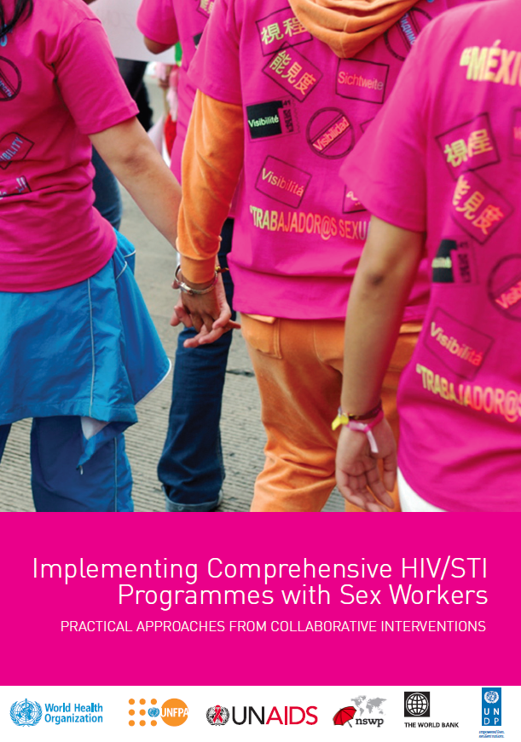
Introduction
This module draws largely on the Sex worker HIV implementation tool (the “SWIT”).
Published in 2013, the SWIT provides practical guidance on effective HIV and STI programming with sex workers. It provides evidence for the need to decriminalise sex work, involve sex workers in developing policy, and for the empowerment and self-determination of sex worker communities as a fundamental part of the fight against HIV.
This module also draws upon the WHO Key Populations Consolidated Guidelines, 2022, which endorse and update the SWIT’s approaches to health interventions and critical enablers.
MODULE 2 | INTRODUCTION

Slide 4

Video message from sex worker
community leader
MODULE 2 | INTRODUCTION

Slide 5
Module 2 Contents
Questions to frame this module
Some definitions
Vulnerability of sex workers
Sex worker organising for health and rights
Working with sex worker organisations
Legal and policy frameworks on sex work
The case for decriminalisation
UN frameworks and normative guidance on sex work
Take-home messages
Module review questions
Further information and resources

Slide 6
Framing questions
1. Sex workers can easily require their clients to use a condom.
Agree
Disagree
Unsure
2. Decriminalising sex work makes it easier for sex workers to access health services and housing.
Agree
Disagree
unsure
MODULE 2 | QUESTIONS TO FRAME THIS MODULE

Slide 7
Framing questions
3. UN Member states have made commitments to remove societal, legal and policy barriers against sex work.
Agree
Disagree
Unsure
4. The UN supports sex worker-led organisations to deliver services for their peers.
Agree
Disagree
Unsure
MODULE 2 | QUESTIONS TO FRAME THIS MODULE

Slide 8
Framing questions: Responses
Not necessarily. Fear of violence, or economic necessity, may make it difficult for a sex worker to demand that their client use a condom to protect them from HIV.
Correct. If their work is not criminalised, sex workers are less likely to be denied access to services such as health and housing.
Correct. These commitments are part of the 2021 Political Declaration on HIV and AIDS.
Correct. Sex-worker-led programmes can be efficient and effective ways to reach sex workers with needed services for HIV prevention.
MODULE 2 | QUESTIONS TO FRAME THIS MODULE

Slide 9
Module 2 Contents
Questions to frame this module
Some definitions
Vulnerability of sex workers
Sex worker organising for health and rights
Working with sex worker organisations
Legal and policy frameworks on sex work
The case for decriminalisation
UN frameworks and normative guidance on sex work
Take-home messages
Module review questions
Further information and resources

Slide 10
Some definitions
Sex workers include female, male, trans and gender-diverse adults (aged 18 years and above) who receive money or goods in exchange for sexual services, either regularly or occasionally.
Sex work is consensual sex between adults, can take many forms and varies between and within countries and communities. Sex work also varies in the degree to which it is more or less “formal” or organised.
As defined in the Convention on the Rights of the Child (CRC), children and adolescents under the age of 18 who exchange sex for money, goods or favours are “sexually exploited” and not defined as sex workers.
Community refers to sex workers, rather than the broader geographic, social or cultural groupings of which they may be a part.
Source: Consolidated guidelines on HIV, viral hepatitis and STI prevention, diagnosis, treatment and care for key populations (WHO, 2022)
MODULE 2 | SOME DEFINITIONS

Slide 11
Module 2 Contents
Questions to frame this module
Some definitions
Vulnerability of sex workers
Sex worker organising for health and rights
Working with sex worker organisations
Legal and policy frameworks on sex work
The case for decriminalisation
UN frameworks and normative guidance on sex work
Take-home messages
Module review questions
Further information and resources

Slide 12
HIV risk of sex workers
In 2021, sex workers had a 30-times greater risk of acquiring HIV than women in the general population.
12% of all HIV infections globally were among sex workers of all genders.
33% of sex workers do not know their HIV status.
A study in 10 sub-Saharan African countries showed that the odds of living with HIV were 7 times higher for a sex worker in a country that criminalises sex work compared with one that legalises sex work.
30 times
Female sex workers have 30 times greater risk of acquiring HIV than adult women (15-49) in the general population
Sources: Global AIDS Update 2022 (UNAIDS, 2022);
HIV and Sex Work. Human Rights Fact Sheet Series No. 5 (UNAIDS, 2021)
MODULE 2 | VULNERABILITY OF SEX WORKERS

Slide 13
What makes sex workers vulnerable?
Several overlapping factors make sex workers vulnerable to HIV, viral hepatitis and other STIs.
Structural and social stigma and discrimination, and punitive laws, policies and practices
Unsafe working conditions
Barriers to the negotiation of consistent condom use with clients
Discrimination by health-care workers
Lack of access to pre-exposure prophylaxis (PrEP)
Violence and harassment by law-enforcement officers
Social determinants of poor health
Lack of social protection and housing
Food insecurity
Reduced education opportunities
Disability
These factors create inequalities and prevent sex workers from accessing adequate health services and being able to protect their health, safety and well-being. This leads to poor health outcomes.
Source: Platt, L. S20:3. The Health Impact of Sex Work Criminalisation: A Review of the Evidence. Sexually Transmitted Infections 2019;95:A32-A33
MODULE 2 | VULNERABILITY OF SEX WORKERS

Slide 14
How does vulnerability intersect
with other factors?
Sex workers’ vulnerability often intersects with other factors that lead to exclusion, stigma and ill health:
Migration
Humanitarian settings
Substance use
Ethnic/racial minority status
Sexual orientation or gender identity
Age
MODULE 2 | VULNERABILITY OF SEX WORKERS

Slide 15
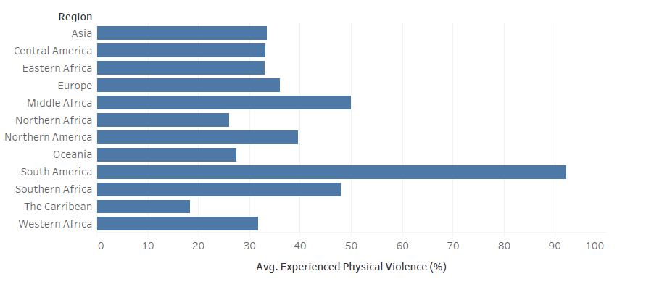
Sex workers commonly experience
physical violence
Average percentage of sex workers reporting experiences of physical violence, 2006-2017
Source: Baral S. Stigma, Human Rights, and HIV Measurement and Interventions. Presentation at Consultation on promoting human rights in the HIV response: Regional and subregional strategies and best practices. Geneva, 12-13 February, 2019.
MODULE 2 | VULNERABILITY OF SEX WORKERS

Slide 16
Sex workers and systemic violence
“Sex workers face particular situations of violence that begin with the criminalisation of their source of income (and sometimes their children are taken away from them for this reason), mandatory medical exams and pregnancy tests in order to be able to work, and in some extreme cases, disappearance and murder.”
“In the case of sex workers more than 70 per cent of violence comes from the State, as well as neighbours, journalists, church members and other local groups.”
A study in 2019 with 172 migrant women from Latin America – many earning a living from sex work – revealed the prevalence of violence and discrimination through dynamics created by patriarchal societies and families, racism and poverty.
Source: What a Way to Make a Living: Violence and Harassment Faced by Migrant Women in the World of Work in Argentina, Brazil, Peru, Colombia, Guatemala and Mexico (Global Alliance Against Traffic in Women, 2020)
MODULE 2 | VULNERABILITY OF SEX WORKERS

Slide 17
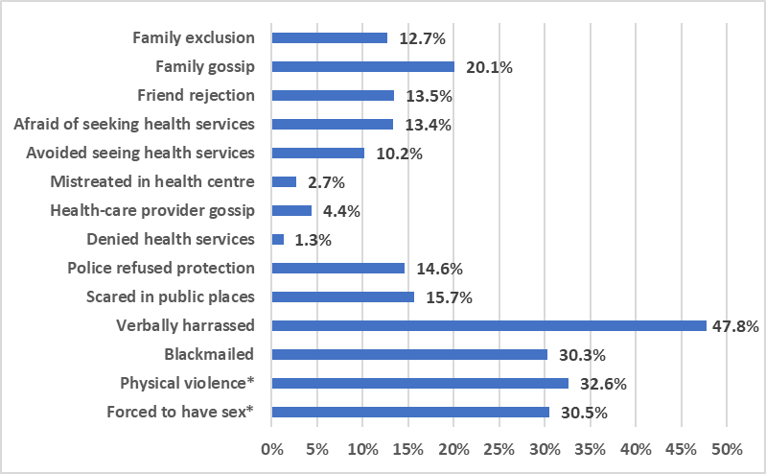
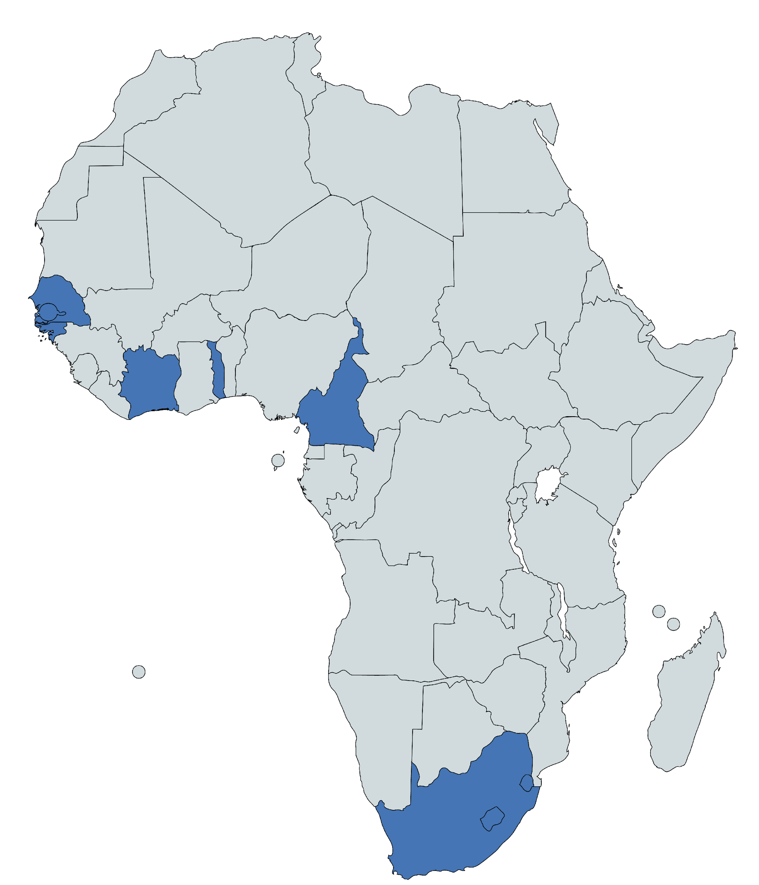
Sex workers experience multiple
kinds of stigmatisation
Types of stigma experienced by female sex workers in 10 countries in sub-Saharan Africa
* Not specified as attributable to sex work.
Source: Lyons, et al. The role of stigma in potentiating HIV risks among female sex workers across sub-Saharan Africa: A meta-analysis of ten countries. Nature Communications. 2020;11(1)773
MODULE 2 | VULNERABILITY OF SEX WORKERS

Slide 18
Module 2 Contents
Questions to frame this module
Some definitions
Vulnerability of sex workers
Sex worker organising for health and rights
Working with sex worker organisations
Legal and policy frameworks on sex work
The case for decriminalisation
UN frameworks and normative guidance on sex work
Take-home messages
Module review questions
Further information and resources

Slide 19
Sex workers and community
empowerment
Organisation and mobilisation of sex worker networks, and community empowerment are prerequisites for the success of health and human rights interventions.
Community-led (i.e. sex worker-led) processes and organisations are not synonymous with generic community-based organisations (CBOs). In community-led organisations, power and decision-making lie in the hands of community members (sex workers). Conversely in a CBO, power may reside only with some members of the community, or with non-community members who act as administrators.
It is the self-determining and self-governing nature of an organisation, and its commitment to pursue the goals that its own members have agreed upon, that make it community-led.
“Sex workers take charge of the community empowerment process by mobilising with other sex workers to develop solutions to the issues they face as a group, and by advocating for their rights as sex workers and as human beings.”
Source: SWIT
MODULE 2 | SEX WORKER ORGANISING FOR HEALTH AND RIGHTS

Slide 20

Case study: Sex worker community
organising for health and rights
Across the world, sex worker-led responses take different forms, and different models of organising may exist within a country.
Law reform: The Parliament of Australia’s Northern Territory voted to decriminalise sex work in 2019. The decision was a result of many years of advocacy by sex workers and their supporters, and of best-practice collaborations between the government and sex workers. The Sex Industry Bill 2019 enhances the safety of sex workers and their clients by applying public-health legislation to operators of sex service businesses and by allowing sex workers to work together.
Source: UNAIDS welcomes the decision by the Northern Territory of Australia to decriminalise sex work (UNAIDS, 2019)
Image Source: Scarlett Alliance
MODULE 2 | SEX WORKER ORGANISING FOR HEALTH AND RIGHTS

Slide 21

Case study: Supporting sex worker-led
efforts to improve access to justice
The Bar Hostess Empowerment and Support Program (BHESP) is a Kenyan sex worker-led organisation advocating for human rights and health access. In Kenya, violence against sex workers is an endemic issue, rooted in social stigma and discrimination. However, many cases of violence are not reported, denying survivors the opportunity to access health and psychosocial support. In 2020, BHESP noted an increase in violence coinciding with the COVID-19 pandemic. The closure of bars and entertainment venues led to a drop in income and made it harder for sex workers to report violence and seek support.
With a grant from PEPFAR, BHESP was able to accelerate use of alternative dispute resolution (ADR) process as a quick, effective and affordable path to justice for female sex workers who experienced violence. ADR was able to fast-track justice by getting all parties involved in disputes to agree on solutions out of court. The ADR process is recognised by law-enforcement authorities, who host settlement sessions in the presence of community paralegals from BHESP. During 2020, 31 sex workers were supported through this approach.
Source: Key-Population-Led organisation in Kenya fast tracks access to justice for sex workers affected by violence (FHI360 EpiC Project, 2021)
Image Source: BHESP
MODULE 2 | SEX WORKER ORGANISING FOR HEALTH AND RIGHTS

Slide 22
Module 2 Contents
Questions to frame this module
Some definitions
Vulnerability of sex workers
Sex worker organising for health and rights
Working with sex worker organisations
Legal and policy frameworks on sex work
The case for decriminalisation
UN frameworks and normative guidance on sex work
Take-home messages
Module review questions
Further information and resources

Slide 23
How UN agencies can support community empowerment of sex workers
Community empowerment of sex workers around the world faces many challenges, including social and legal barriers which impede the registration and growth of sex worker-led organisations.
Here are a few areas where UN agencies can sustain sex worker movements:
Analyse funding levels dedicated to sex workers in HIV and sexual and reproductive health, or COVID-19 relief programmes. Such data can be useful for sex worker organisations that wish to secure funding for their work on health and rights.
Support events to mark specific dates in the calendar year, e.g. the International Day to End Violence against Sex Workers (17 December) and International Sex Workers Rights Day (3 March).
Include sex workers in UN-sponsored events to end gender-based violence (such as the 16 Days of Activism).
The UN can support advocacy initiatives against abuses by law enforcement officers, by providing legal assistance and brokering dialogues with government agencies.
MODULE 2 | WORKING WITH SEX WORKER ORGANISATIONS

Slide 24
Working with sex worker organisations
Meaningful engagement of sex workers in policymaking or programming means that sex workers can choose how to be engaged, how they are represented and by whom.
Examples of good practice:
Group activities of sex workers should be organised at safe spaces, based on their interest.
Sex workers should be involved in all stages of law reform relating to sex work, from consultation and evidence-gathering to drafting and implementation.
Programmes should focus on needs identified by sex workers collectively, and should take on board solutions identified by them.
Sex workers and their organisations should be empowered to deliver a comprehensive package of interventions in the health sector (see Module 1, Session 1.3).
Social protection is an important component of HIV programming for sex workers.
Sex workers should be involved as equal partners in the conception, delivery and monitoring of programmes. As such they should be paid as employees or community outreach workers.
MODULE 2 | WORKING WITH SEX WORKER ORGANISATIONS

Slide 25
Module 2 Contents
Questions to frame this module
Some definitions
Vulnerability of sex workers
Sex worker organising for health and rights
Working with sex worker organisations
Legal and policy frameworks on sex work
The case for decriminalisation
UN frameworks and normative guidance on sex work
Take-home messages
Module review questions
Further information and resources

Slide 26
Legal and policy frameworks on sex work
Most countries have legal frameworks and policies on sex work, or aspects of sex work (often referred to as “prostitution”*).
There are many types of laws and policies regarding sex work, and a variety of laws which create barriers to accessing health and other services.
The Global Network of Sex Work Projects (NSWP) has conducted a mapping of sex work and the law (next slide).
*This term should be avoided in development work. Use “sex work”.
MODULE 2 | LEGAL AND POLICY FRAMEWORKS ON SEX WORK

Slide 27
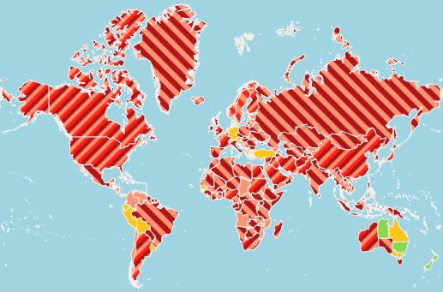
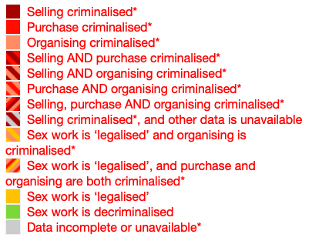
Legal and policy frameworks
on sex work
Source: Global Mapping of Sex Work Laws
(NSWP, 2021)
MODULE 2 | LEGAL AND POLICY FRAMEWORKS ON SEX WORK

Slide 28
Criminalisation of sex work
More than 114 countries around the world criminalise some aspects of sex work. A small number of countries have some protective laws and policies regarding sex work.
Many legal and policy frameworks do not name ‘sex workers’ or ‘prostitutes’. Instead, sex work is prohibited under a variety of statutes using terms such as “vagrancy”, “public nuisance”, “immorality”, “indecent dressing” or “loitering”.
Such statutes give permission for police to raid sex-work venues, arrest and detain sex workers and in some cases enforce compulsory health checks.
Criminal laws against sex work can be used to criminalise not only sex workers, but their families, clients and various third parties such as landlords.
MODULE 2 | LEGAL AND POLICY FRAMEWORKS ON SEX WORK

Slide 29
Approaches to criminalisation
In many cases, laws prohibiting sex work are ostensibly designed to “protect” sex workers. However often this is counterproductive and actually increases the risk for sex workers.
This is the case with:
Countries where anti-trafficking laws are written so broadly that the differences between consensual sale of sex and sexual exploitation are ill defined. This allows countries to interpret all sex work as trafficking/and or sexual exploitation. Sex work and trafficking need to be clearly differentiated.
Laws against “soliciting” or profiting from earnings of sex work. Criminalising any aspect of sex work makes it more hidden and sex workers more vulnerable
Criminalising clients (laws to end demand): This approach is based on the premise that criminalising the client and not the worker will progressively eliminate demand for sex work. This encourages clients to be more hidden and thus sex workers are more hidden, and more vulnerable to exploitation, violence and abuse - and less able to negotiate safer sex.
MODULE 2 | LEGAL AND POLICY FRAMEWORKS ON SEX WORK

Slide 30
Module 2 Contents
Questions to frame this module
Some definitions
Vulnerability of sex workers
Sex worker organising for health and rights
Working with sex worker organisations
Legal and policy frameworks on sex work
The case for decriminalisation
UN frameworks and normative guidance on sex work
Take-home messages
Module review questions
Further information and resources

Slide 31

The case for decriminalisation
The criminalisation of sex work is a barrier to the HIV response.
In a study by the HIV Policy Lab, criminalisation of sex work was associated with 10% lower knowledge of HIV status and 6% lower viral suppression among sex workers who were living with HIV.
Source: HIV Policy Lab
MODULE 2 | THE CASE FOR DECRIMINALISATION

Slide 32
The Global AIDS Strategy and
decriminalisation
The Global AIDS Strategy 2021-2026 has set the 10-10-10 targets to ensure that by 2025:
Less than 10% of countries have punitive legal and policy environments
Less than 10% of people living with HIV and key populations experience stigma and discrimination
Less than 10% of women, girls, people living with HIV and key populations experience gender inequality and violence.
Sub-targets include that by 2025:
Less than 10% of countries criminalise sex work
Less than 10% of health workers and law-enforcement officers report negative attitudes towards sex workers.
MODULE 2 | THE CASE FOR DECRIMINALISATION

Slide 33
What decriminalisation means
LEGALISATION
The complete removal of sanctions, making sex work legal and introducing laws that regulate and control sex work.
DECRIMINALISATION
The removal of sanctions that oppress sex workers under a country’s criminal laws (including sale or purchase of sex, running an establishment employing sex workers, or sex work organising). Alternate penalties could still be enforced.
The Global AIDS Strategy calls for countries to “introduce and enforce protective and enabling legislation and policies, and end the overuse of criminal and general laws to target people living with HIV and key populations.”
A variety of interventions are currently led by sex workers and advocates to destigmatise sex work, reduce violence and reform laws which criminalise sex work.
MODULE 2 | THE CASE FOR DECRIMINALISATION

Slide 34
Country examples of decriminalisation and
protection of sex work
New Zealand: In 2003, the country fully decriminalised sex work and extended to sex workers the labour-law and human-rights protections available to other workers.
India: In 2022, the Supreme Court issued a ruling recognising sex work as a “profession”.
Brazil: The government made sex work a legal profession in 2022, allowing sex workers to access social security and other work-related benefits.
MODULE 2 | THE CASE FOR DECRIMINALISATION

Slide 35
Module 2 Contents
Questions to frame this module
Some definitions
Vulnerability of sex workers
Sex worker organising for health and rights
Working with sex worker organisations
Legal and policy frameworks on sex work
The case for decriminalisation
UN frameworks and normative guidance on sex work
Take-home messages
Module review questions
Further information and resources

Slide 36
UN frameworks and normative guidance on sex work (1)
UN Political Declaration on HIV and AIDS (2021): In this document, drafted at the High Level Meeting on HIV and AIDS in 2021, governments, “express deep concern about stigma, discrimination, violence and restrictive and discriminatory laws and practices that target people living with, at risk of and affected by HIV … and laws that restrict the movement or access to services for people living with, at risk of and affected by HIV, including key populations … and in this regard, deplore acts of violence and discrimination in all regions of the world against them”.
Global AIDS Strategy 2021-2026 (2021): The strategy includes a commitment to work towards the decriminalisation of sex work as part of the 10-10-10 targets to remove societal and legal barriers to accessing services.
MODULE 2 | UN FRAMEWORKS AND NORMATIVE GUIDANCE ON SEX WORK

Slide 37
UN frameworks and normative
guidance on sex work (2)
Consolidated Guidelines on HIV, Viral Hepatitis and STI Diagnosis, Prevention, Treatment and Care for Key Populations (2022): Published by the World Health organisation, this is an updated version of the 2016 edition, and is designed to address HIV, viral hepatitis and STIs in key populations using a rights-based, integrated and person-centred approach. One of the recommendations is that “Countries should work toward decriminalisation of behaviours such as … sex work … and toward the elimination of the unjust application of civil law and regulations against … sex workers”.
HIV and the Law: Rights, Risk and Health (2012): Published by the Global Commission on HIV and the Law, the report recommends that: “Countries must reform their approach towards sex work. Rather than punishing consenting adults involved in sex work, countries must ensure safe working conditions and offer sex workers and their clients access to effective HIV and health services and commodities”.
MODULE 2 | UN FRAMEWORKS AND NORMATIVE GUIDANCE ON SEX WORK

Slide 38
UN frameworks and normative
guidance on sex work (3)
UNAIDS Guidance note on HIV and Sex Work (2012): This important resource was the first guidance from UNAIDS clarifying the rights of sex workers, the differences between sex work and trafficking, and the impact of anti-trafficking on the vulnerability of sex workers to HIV.
International Labour Organisation Recommendation 200 concerning HIV and AIDS in the world of Work (n.200) (2010). While sex work is not mentioned within Recommendation 200, The Report of the Committee on HIV/AIDS Provisional Record No.13 (Rev) contains a clear understanding that sex work is covered by this instrument (para. 200).
UN Protocol to Prevent, Suppress and Punish Trafficking in Persons, Especially Women and Children (2000) was adopted by a resolution and is intended to combat transnational organised crime in trafficking persons. The protocol is a legally binding document for member states, and it defines human trafficking. However, many sex worker advocates, human rights organisations and the Commission on HIV and the Law have recommended that language on “prostitution” within the protocol be revised.
MODULE 2 | UN FRAMEWORKS AND NORMATIVE GUIDANCE ON SEX WORK

Slide 39
Module 2 Contents
Questions to frame this module
Some definitions
Vulnerability of sex workers
Sex worker organising for health and rights
Working with sex worker organisations
Legal and policy frameworks on sex work
The case for decriminalisation
UN frameworks and normative guidance on sex work
Take-home messages
Module review questions
Further information and resources

Slide 40
Take-home messages
The vulnerability of sex workers to HIV, other sexually transmitted infections and violence results from a combination of social factors that cause marginalisation, discrimination and poor access to health services.
Community empowerment of sex workers is essential for the success of health and rights interventions. This means that sex worker-led organisations should be empowered to deliver programs and services to their peers.
UN agencies have an essential role to play in sustaining sex worker movements for health and rights. This includes involving sex workers in UN-led efforts to end gender-based violence, and providing technical assistance for resource mobilisation and access to justice.
The Global AIDS Strategy 2021-2026 includes a commitment to work towards the decriminalisation of sex work as part of the 10-10-10 targets to remove societal and legal barriers to accessing services.
MODULE 2 | TAKE-HOME MESSAGES

Slide 41
Module 2 Contents
Questions to frame this module
Some definitions
Vulnerability of sex workers
Sex worker organising for health and rights
Working with sex worker organisations
Legal and policy frameworks on sex work
The case for decriminalisation
UN frameworks and normative guidance on sex work
Take-home messages
Module review questions
Further information and resources

Slide 42
Module 2 Contents
Questions to frame this module
Some definitions
Vulnerability of sex workers
Sex worker organising for health and rights
Working with sex worker organisations
Legal and policy frameworks on sex work
The case for decriminalisation
UN frameworks and normative guidance on sex work
Take-home messages
Module review questions
Further information and resources

Slide 43
Further information and resources
Implementing Comprehensive HIV and STI Programmes with Sex Workers: Practical Approaches from Collaborative Interventions (WHO, 2013)
HIV and Sex Work. Human Rights Fact Sheet Series #5 (UNAIDS, 2021)
IN DANGER: UNAIDS Global AIDS Update 2022 (UNAIDS, 2022)
Key Populations Atlas (UNAIDS)
Understanding Legal Frameworks and the Struggle for Sex Work Law Reforms (Global Network of Sex Work Projects, 2014)
10 Reasons to decriminalise Sex Work Open Society Foundation (2015)
How to make social protection inclusive of people living with HIV and key populations: a checklist (UNDP, 2022)
What a Way to Make a Living: Violence and harassment faced by migrant women in the world of work in Argentina, Brazil, Peru, Colombia, Guatemala and Mexico (Global Alliance Against Traffic in Women, 2020)
MODULE 2 | FURTHER INFORMATION AND RESOURCES

