Slide 1


Module 3: Gay, bisexual and other men who have sex with men
In-Reach Online Training
Increasing support and partnerships with key populations at risk of HIV

Slide 2
Introduction
In almost all countries where data is available, gay, bisexual and other men who have sex with men are disproportionately affected by HIV compared with the general population. And while HIV incidence has been steadily decreasing globally, the epidemic among gay, bisexual and other men who have sex with men has remained stable, and is even increasing in some countries.
In many regions, criminal laws and policies against same-sex relations make programme implementation very difficult. Even where such policies do not exist, discriminatory cultural, religious and societal attitudes have a negative impact on the health of gay, bisexual and other men who have sex with men and continue to hamper efforts to attain health and development goals.
This module covers the elements of programmes and approaches that UN organisations can develop together with gay men and other men who have sex with men to promote their health and human rights.
MODULE 3 | INTRODUCTION

Slide 3
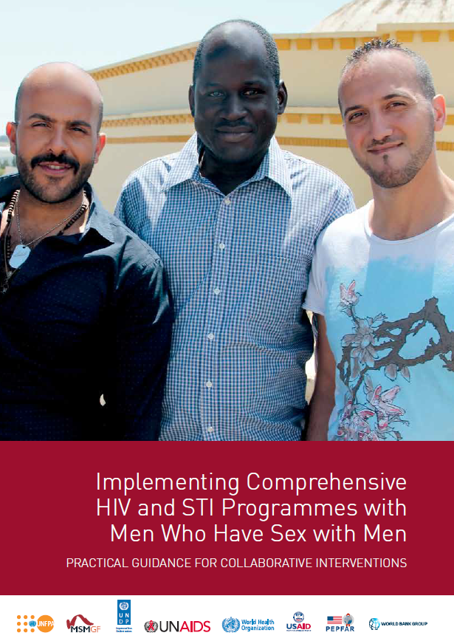
Introduction
This module draws its content largely from the Men who have sex with men HIV implementation tool (the “MSMIT”).
Published in 2015, the MSMIT provides practical guidance on effective HIV and STI programming with gay, bisexual and other men who have sex with men. It provides evidence for the need to decriminalise same-sex relations, involve gay, bisexual and other men who have sex with men in developing policy, and for the empowerment and self-determination of communities of gay, bisexual and other men who have sex with men as a fundamental part of the fight against HIV.
This module also draws upon the WHO Key Populations Consolidated Guidelines, 2022, which endorse and update the MSMIT’s approaches to health interventions and critical enablers.
MODULE 3 | INTRODUCTION

Slide 4
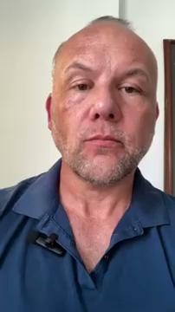
Video message from a gay community leader
MODULE 3 | INTRODUCTION

Slide 5
Module 3 Contents
Questions to frame this module
Some definitions
Vulnerability of men who have sex with men
Community organising for health and rights
Working with organisations of men who have sex with men
Legal and policy frameworks on same-sex sexual relations
The case for decriminalisation
UN frameworks and normative guidance on sexual orientation
Take-home messages
Module review questions
Further information and resources

Slide 6
Framing questions
1. Some men who have sex with men define themselves as heterosexual.
Agree
Disagree
Unsure
2. Discrimination against men who have sex with men is unpleasant for them, but it doesn’t have an impact on their risk of acquiring HIV.
Agree
Disagree
Unsure
MODULE 3 | QUESTIONS TO FRAME THIS MODULE

Slide 7
Framing questions
3. Men who have sex with men are more commonly found in Western countries than in developing countries.
Agree
Disagree
Unsure
4. UN Member States have committed to removing societal, legal and policy barriers that prevent men who have sex with men from accessing health services.
Agree
Disagree
Unsure
MODULE 3 | QUESTIONS TO FRAME THIS MODULE

Slide 8
Framing questions: Responses
Correct. A person’s sexual behaviour may not always coincide with the way they define their sexual orientation.
Incorrect. Discrimination makes it less likely that men who have sex with men are able to practise safer sex, or access information and prevention services for HIV.
Incorrect. Although data is not available in all countries, evidence suggests that the proportion of the male population who have sex with other men is similar around the world.
Correct. These commitments are part of the 2021 Political Declaration on HIV and AIDS.
MODULE 3 | QUESTIONS TO FRAME THIS MODULE

Slide 9
Module 3 Contents
Questions to frame this module
Some definitions
Vulnerability of men who have sex with men
Community organising for health and rights
Working with organisations of men who have sex with men
Legal and policy frameworks on same-sex sexual relations
The case for decriminalisation
UN frameworks and normative guidance on sexual orientation
Take-home messages
Module review questions
Further information and resources

Slide 10
Some definitions (1)
Men who have sex with men refers to all men who engage in sexual and/or romantic relations with other men, or who experience sexual attraction to other men. The words men and sex are interpreted differently in diverse cultures and societies and by the individuals involved. Therefore, “men who have sex with men” encompasses the large variety of settings and contexts in which male-to-male sex takes place, regardless of multiple motivations for engaging in sex, a spectrum of self-determined sexual orientation and gender identities, and various identifications with different communities or social groups.
In this module, “men who have sex with men” should be understood to mean the same as the phrase “gay, bisexual and other men who have sex with men”, which is used in other modules in the In-Reach Training.
Source: Consolidated guidelines on HIV, viral hepatitis and STI prevention, diagnosis, treatment and care for key populations (WHO, 2022)
MODULE 3 | SOME DEFINITIONS

Slide 11
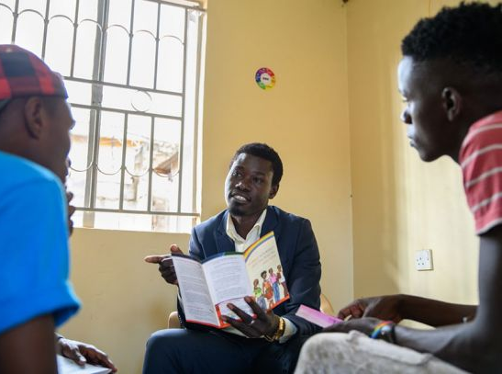
Some definitions (2)
Community refers to gay, bisexual and other men who have sex with men, rather than the broader geographic, social or cultural groupings of which they may be a part.
Gay: A person who has romantic, emotional and/or physical attraction predominantly or exclusively to persons of the same sex or gender.
Bisexual: A person who has romantic, emotional and/or physical attraction to persons of the same sex or gender as well as to persons of a different sex or gender.
Image: UNAIDS / Uganda, 2019
MODULE 3 | SOME DEFINITIONS

Slide 12
Module 3 Contents
Questions to frame this module
Some definitions
Vulnerability of men who have sex with men
Community organising for health and rights
Working with organisations of men who have sex with men
Legal and policy frameworks on same-sex sexual relations
The case for decriminalisation
UN frameworks and normative guidance on sexual orientation
Take-home messages
Module review questions
Further information and resources

Slide 13
HIV risk of men who have sex with men
In 2021, the risk of acquiring HIV was 28 times higher for men who have sex with men compared with the rest of the population.
They accounted for 64% of new HIV infections in Western and Central Europe and North America.
Men who have sex with men who live in countries that criminalise same-sex relations are more than twice as likely to be living with HIV.
28 times
Men who have sex with men have 28 times greater risk of acquiring HIV than men in the general population
Sources: Global AIDS Update 2022 (UNAIDS, 2022); HIV and Gay Men and Other Men who Have Sex with Men. Human Rights Fact Sheet Series No. 3 (UNAIDS, 2021)
MODULE 3 | VULNERABILITY OF MEN WHO HAVE SEX WITH MEN

Slide 14
What makes men who have sex
with men vulnerable?
A range of overlapping factors make men who have sex with men vulnerable to HIV, viral hepatitis and other sexually transmitted infections (STIs).
Persistent structural barriers reduce access to prevention, testing and treatment services:
Criminalisation of consensual sex between males
Stigma, discrimination and violence against men who have sex with men
Lack of access to pre-exposure prophylaxis (PrEP)
Violence and harassment by law-enforcement agents
Discrimination by health-care workers
For example, a study in Lesotho found that experiences of stigma in the health-care system were directly associated with depression, alcohol use and condomless sex among men who have sex with men.
Source: Da W, et al. Depressive Symptoms and alcohol use as mediators of HIV-related risk practices and stigma affecting men who have sex with men in Lesotho: A structural equation modelling approach. Annals of Epidemiology. 2016;26(8):551-556
MODULE 3 | VULNERABILITY OF MEN WHO HAVE SEX WITH MEN

Slide 15
How does vulnerability intersect
with other factors?
The vulnerability of men who have sex with men often intersects with other factors that lead to exclusion, stigma and ill health:
Migration
Humanitarian and crisis situations
Ethnic/racial minority status
Age
Substance use can also pose risks: for instance, some men who have sex with men also engage in chemsex, i.e. sexual activity while taking primarily stimulant drugs, typically involving multiple participants and over a prolonged time. This increases vulnerability to HIV when there is no access to, or use of, prevention, diagnosis and treatment programs and services.
MODULE 3 | VULNERABILITY OF MEN WHO HAVE SEX WITH MEN

Slide 16
Significant proportions of men who have sex with men
report experiences of stigma, discrimination and violence
Note:
AMIS = American Men’s Internet Survey (United States, 2015)
West Africa & Southern Africa: Face-to-face interviews conducted in 7 countries in 2013-2016.
Source: Stahlman S, et al. The prevalence of sexual behavior stigma affecting gay men and other men who have sex with men across sub-Saharan Africa and in the United States. JMIR Public Health and Surveillance. 2016;2(2):e35
MODULE 3 | VULNERABILITY OF MEN WHO HAVE SEX WITH MEN

Slide 17
Module 3 Contents
Questions to frame this module
Some definitions
Vulnerability of men who have sex with men
Community organising for health and rights
Working with organisations of men who have sex with men
Legal and policy frameworks on same-sex sexual relations
The case for decriminalisation
UN frameworks and normative guidance on sexual orientation
Take-home messages
Module review questions
Further information and resources

Slide 18
Violence against men who have sex with
men is an issue of health and human rights
Core principles for programmes addressing violence against men who have sex with men:
Addressing violence is a public health imperative
Men who have sex with men are entitled to the full protection of their human rights
One or both of the above principles can be emphasised when advocating for resources and policies, depending on local and national contexts.
Perpetrators of violence may include:
Police, military personnel and prison guards
Individuals seeking to punish men who have sex with men
Employers, health-care providers, bankers, landlords
Teachers, students and staff within schools
Intimate partners and family members
Extortion groups, militias or religious extremists
MODULE 3 | COMMUNITY ORGANISING FOR HEALTH & RIGHTS

Slide 19
Empowering and sustaining community
organising for health and rights
The foundational concept of the MSMIT is community empowerment, which is defined as:
supporting a process whereby men who have sex with men are at the centre of the response to HIV, including access to high-quality services by men who have sex with men, for men who have sex with men.
At country level, UN agencies can play a role to empower communities of men who have sex with men to ensure that programmes are comprehensive, accessible, acceptable, affordable and tailored to their specific needs and concerns.
MODULE 3 | COMMUNITY ORGANISING FOR HEALTH & RIGHTS

Slide 20
Module 3 Contents
Questions to frame this module
Some definitions
Vulnerability of men who have sex with men
Community organising for health and rights
Working with organisations of men who have sex with men
Legal and policy frameworks on same-sex sexual relations
The case for decriminalisation
UN frameworks and normative guidance on sexual orientation
Take-home messages
Module review questions
Further information and resources

Slide 21
How UN agencies can support community
empowerment of men who have sex with men
Community empowerment and mobilisation of men who have sex with men face many challenges, including social and legal barriers which impede the registration and growth organisations. Community systems strengthening is one of the approaches that UN organisations can use to support men who have sex with men to protect their health and human rights. Other activities include:
Analyse funding levels dedicated to men who have sex with men in HIV and sexual and reproductive health, or COVID-19 relief programmes. Such data can be useful for community-led organisations of men who have sex with men that wish to secure funding for their work on health and rights.
Support events to mark specific dates in the calendar year, such as the International Day Against Homophobia, Biphobia and Transphobia (IDAHOBIT, 17 May).
Support networking opportunities for men who have sex with men advocates, and their organisations by including them in UN-sponsored events such as World Human Rights Day.
At country level, UN agencies can play a role to empower communities of men who have sex with men to ensure that programmes are comprehensive, accessible, acceptable, affordable and tailored to their specific needs and concerns.
MODULE 3 | WORKING WITH ORGANISATIONS OF MEN WHO HAVE SEX WITH MEN

Slide 22
Working with organisations of men
who have sex with men
Meaningful engagement of men who have sex with men in policymaking or programming means that they can choose how to be engaged, how they are represented and by whom.
Examples of good practice:
Group activities of men who have sex with men should be organised in safe spaces, based on their interests.
Programmes should focus on needs collectively identified by men who have sex with men and should take on board solutions identified by them.
Men who have sex with men and their organisations should be empowered to deliver the comprehensive package of interventions in the health sector (see Module 1, Session 1.3).
Social protection is an important component of HIV programming for men who have sex with men.
Men who have sex with men should be involved as equal partners in the conception, delivery and monitoring of programmes. As such they should be paid as employees or community outreach workers.
MODULE 3 | WORKING WITH ORGANISATIONS OF MEN WHO HAVE SEX WITH MEN

Slide 23
Case study: Legal reform to support the
rights of men who have sex with men
In July 2022, the High Court of Antigua and Barbuda struck down laws criminalising sexual acts between consenting adult same-sex partners. Orden David, a gay man, had brought the case. He explained that stigmatisation made gay people scared to access services or pick up their medicines.
Partners working in the country’s HIV programme in Antigua and Barbuda know that law reform is not a magic bullet, but they consider it an important step towards ending the inequalities that drive HIV, injustice and lack of access to opportunities. The litigation was part of a five-country strategy coordinated by the Eastern Caribbean Alliance for Diversity and Equality (ECADE).
“The governments have sworn to protect and uphold the rights of all,” said ECADE’s Executive Director. “[Men who have sex with men] now have safety under the law.”
Source: The communities behind Antigua and Barbuda’s decriminalization win (UNAIDS, 2022)
MODULE 3 | WORKING WITH ORGANISATIONS OF MEN WHO HAVE SEX WITH MEN

Slide 24
Module 3 Contents
Questions to frame this module
Some definitions
Vulnerability of men who have sex with men
Community organising for health and rights
Working with organisations of men who have sex with men
Legal and policy frameworks on same-sex sexual relations
The case for decriminalisation
UN frameworks and normative guidance on sexual orientation
Take-home messages
Module review questions
Further information and resources

Slide 25
Legal and policy frameworks on
same-sex sexual relations
There are many types of laws and policies regarding sexual activities and sexuality, including in regard to marriage and same-sex relations.
Consensual same-sex acts between adults are illegal in around one-third of all countries.
One-fifth of countries have legal barriers to freedom of expression on sexual orientation and gender diversity issues.
One-quarter of countries have legal barriers to the registration or operation of civil society organisations working on sexual orientation and gender diversity issues.
Broad protection against discrimination based on sexual orientation is available in only one-third of countries.
MODULE 3 | LEGAL & POLICY FRAMEWORKS ON SAME-SEX SEXUAL RELATIONS

Slide 26
Approaches to criminalisation
In many cases, laws prohibiting same-sex sexual relations are ostensibly designed to “protect” society from moral decay or to preserve cultural or religious norms. For example:
“Sodomy” and “anti-buggery” laws (common in former colonies) prohibit certain sexual acts, such as anal sex, regardless of gender or sexual orientation.
Some laws prohibit a range of same-sex sexual activities and are very broad in scope.
Men who have sex with men may be arrested and prosecuted under a variety of other laws, such as “public indecency”, “debauchery”, “scandalous behaviour” etc.
In reality, these laws perpetuate stigma, violence and exclusion, and denial of human rights of LGBTI+ people.
Source: International Lesbian and Gay Association (ILGA)
MODULE 3 | LEGAL & POLICY FRAMEWORKS ON SAME-SEX SEXUAL RELATIONS

Slide 27
Frameworks for non-discrimination
Most countries have legal frameworks to promote and protect human rights and challenge discriminatory practices. Many have ratified one or more of the nine core international human rights treaties, or various regional treaties.
The Yogyakarta Principles on the application of International Human Rights Law in relation to Sexual Orientation and Gender Identity (2006), although not binding on states, provide recommendations on how international human rights statutes should be applied in specific situations relevant to sexual minorities.
The Yogyakarta Principles were revised and updated in 2017 (YP+10).
MODULE 3 | LEGAL & POLICY FRAMEWORKS ON SAME-SEX SEXUAL RELATIONS

Slide 28
Module 3 Contents
Questions to frame this module
Some definitions
Vulnerability of men who have sex with men
Community organising for health and rights
Working with organisations of men who have sex with men
Legal and policy frameworks on same-sex sexual relations
The case for decriminalisation
UN frameworks and normative guidance on sexual orientation
Take-home messages
Module review questions
Further information and resources

Slide 29

The case for decriminalisation
The criminalisation of same-sex sexual activity is a barrier to the HIV response.
In a study by the HIV Policy Lab, criminalisation of same-sex sex was associated with 11% lower knowledge of HIV status and 8% lower viral suppression among people living with HIV.
Non-discrimination protections were associated with 10% higher knowledge of HIV status and 11% higher viral suppression among people living with HIV.
Image: Flickr / See-ming Lee
Source: HIV Policy Lab
MODULE 3 | THE CASE FOR DECRIMINALISATION

Slide 30
The Global AIDS Strategy and
decriminalisation
The Global AIDS Strategy 2021-2026 has set the 10-10-10 targets to ensure that by 2025:
Less than 10% of countries have punitive legal and policy environments
Less than 10% of people living with HIV and key populations experience stigma and discrimination
Less than 10% of women, girls, people living with HIV and key populations (including men who have sex with men) experience gender inequality and violence
Sub-targets include that by 2025:
Less than 10% of countries criminalise same-sex sexual behaviour
Less than 10% of health workers and law-enforcement officers report negative attitudes towards men who have sex with men
MODULE 3 | THE CASE FOR DECRIMINALISATION

Slide 31
Legal reforms to protect men who
have sex with men
In 2012, the Global Commission on HIV and the Law recommended that countries reform their approach towards sexual diversity.
Rather than punishing consenting adults involved in same-sex activity, countries must offer them access to effective HIV and health services and commodities.
A variety of interventions are led by LGBT (lesbian, gay, bisexual and transgender) communities and advocates. These aim to destigmatise same-sex relations, reduce violence and reform laws which criminalise same-sex sexual activities as well as non-conforming gender identities.
“Being strong and moving towards sustainability begins by guaranteeing diversity, equality and economic development that promotes the inclusion of ALL.”
Amnesty International
Source: Inclusion of LGBTIQ+ people is essential to create a more just world (Amnesty International, 2021)
MODULE 3 | THE CASE FOR DECRIMINALISATION

Slide 32
Country examples of decriminalisation and
protection of men who have sex with men
The past decade has seen an increasing number of countries moving towards decriminalisation of same-sex sexual relations, or affording recognition or more protections to LGBT citizens.
Countries that have decriminalised consensual sexual relations between adults of the same sex include:
Belise: In 2016, the Supreme Court ruled that the country’s colonial-era sodomy law was unconstitutional. The Court revised the language of Section 53 of the Criminal Code and ordered the insertion of a clause to exclude consensual sexual acts between adults in private.
Trinidad and Tobago: in 2018, the High Court ruling in Jason Jones Vs AG of Trindad and Tobago established that buggery and serious indecency laws were unconstitutional.
Botswana: In 2019, the High Court ruled in favour of decriminalisation of homosexuality. The court rejected as unconstitutional laws imposing up to seven years’ imprisonment for same-sex relations.
In 2022, Antigua and Barbuda, Barbados and Saint Kitts and Nevis decriminalized same sex-relations.
In 2023, the Cook Islands adopted the Sexual Offences Amendment Bill, which decriminalized same sex-relations.
An example of evolution towards more protection of LGBT persons under the law:
Cuba: In 2019, constitutional reforms included an anti-discrimination clause that explicitly forbids discrimination based on sexual orientation.
MODULE 3 | THE CASE FOR DECRIMINALISATION

Slide 33
Module 3 Contents
Questions to frame this module
Some definitions
Vulnerability of men who have sex with men
Community organising for health and rights
Working with organisations of men who have sex with men
Legal and policy frameworks on same-sex sexual relations
The case for decriminalisation
UN frameworks and normative guidance on sexual orientation
Take-home messages
Module review questions
Further information and resources

Slide 34
Sexual orientation and UN frameworks (1)
UN Political Declaration on HIV and AIDS (2021): In this document, drafted at the High Level Meeting on HIV and AIDS in 2021, governments, “express deep concern about stigma, discrimination, violence and restrictive and discriminatory laws and practices that target people living with, at risk of and affected by HIV … and laws that restrict the movement or access to services for people living with, at risk of and affected by HIV, including key populations … and in this regard, deplore acts of violence and discrimination in all regions of the world against them”.
Global AIDS Strategy 2021-2026 (2021): The strategy includes a commitment to work towards the decriminalisation of same-sex sexual behaviour as part of the 10-10-10 targets to remove societal and legal barriers to accessing services.
MODULE 3 | UN FRAMEWORKS AND NORMATIVE GUIDANCE ON SEXUAL ORIENTATION

Slide 35
Sexual orientation and UN frameworks (2)
Consolidated Guidelines on HIV, Viral Hepatitis and STI Diagnosis, Prevention, Treatment and Care for Key Populations (2022): Published by the World Health Organisation, this is an updated version of the 2016 edition, and is designed to address HIV, viral hepatitis and STIs in key populations using a rights-based, integrated and person-centred approach. One of the recommendations is that “Countries should work toward decriminalisation of behaviours such as … same-sex activity … and toward the elimination of the unjust application of civil law and regulations against … men who have sex with men”.
HIV and the Law: Rights, Risk and Health (2012): Published by the Global Commission on HIV and the Law, the report recommends that: “Countries must reform their approach towards sexual diversity. Rather than punishing consenting adults involved in same-sex activity, countries must offer such people access to effective HiV and health services and commodities”.
MODULE 3 | UN FRAMEWORKS AND NORMATIVE GUIDANCE ON SEXUAL ORIENTATION

Slide 36
Module 3 Contents
Questions to frame this module
Some definitions
Vulnerability of men who have sex with men
Community organising for health and rights
Working with organisations of men who have sex with men
Legal and policy frameworks on same-sex sexual relations
The case for decriminalisation
UN frameworks and normative guidance on sexual orientation
Take-home messages
Module review questions
Further information and resources

Slide 37
Take-home messages
The vulnerability of gay, bisexual and other men who have sex with men to HIV, viral hepatitis and STIs is a combination of behavioural factors overlapping with social marginalisation, poor service access and punitive laws and policies.
Stigma limits coverage of effective HIV prevention and treatment interventions among gay, bisexual and other men who have sex with men.
Community empowerment of men who have sex with men is essential for the success of health and rights interventions. Organisations led by men who have sex with men should be empowered to deliver services to their peers.
UN agencies have an essential role to play in sustaining movements of men who have sex with men for protecting their health and rights. This role includes involving their community organisations in UN-led efforts to end violence and providing technical assistance for resource mobilisation and access to justice.
Normative guides provide evidence-based approaches to sustain LGBT and MSM movements and programmes. These include the MSMIT and the WHO Key Populations Consolidated Guidelines, 2022.
The Global AIDS Strategy 2021-2026 has set new 10-10-10 targets and commitments for 2025 to remove societal and legal barriers to accessing services, including for men who have sex with men.
MODULE 3 | TAKE-HOME MESSAGES

Slide 38
Module 3 Contents
Questions to frame this module
Some definitions
Vulnerability of men who have sex with men
Community organising for health and rights
Working with organisations of men who have sex with men
Legal and policy frameworks on same-sex sexual relations
The case for decriminalisation
UN frameworks and normative guidance on sexual orientation
Take-home messages
Module review questions
Further information and resources

Slide 39
Module 3 Contents
Questions to frame this module
Some definitions
Vulnerability of men who have sex with men
Community organising for health and rights
Working with organisations of men who have sex with men
Legal and policy frameworks on same-sex sexual relations
The case for decriminalisation
UN frameworks and normative guidance on sexual orientation
Take-home messages
Module review questions
Further information and resources

Slide 40
Further information and resources
Implementing Comprehensive HIV and STI Programmes with Men Who Have Sex with Men: Practical Approaches for Collaborative Interventions (UNFPA, 2015)
HIV and Gay Men and Other Men who have Sex with Men. Human Rights Fact Sheet Series #3 (UNAIDS, 2021)
IN DANGER: UNAIDS Global AIDS Update 2022 (UNAIDS, 2022)
Key Populations Atlas (UNAIDS)
HIV and the Law: Rights, Risk and Health (Global Commission on HIV and the Law, 2012)
State-sponsored Homophobia: Global Legislation Overview Update (ILGA, 2019)
The Yogyakarta Principles
Ending Violence and Discrimination against Lesbian, Gay, Bisexual, Transgender and Intersex People (United Nations, 2015)
How to make social protection inclusive of people living with HIV and key populations: a checklist (UNDP, 2022)
HIV and Gay Men and Other Men who have Sex with Men. Human Rights Factsheet Series #3 (UNAIDS, 2021)
MODULE 3 | FURTHER INFORMATION AND RESOURCES

