Slide 1


Module 4: People who inject drugs
In-Reach Online Training
Increasing support and partnerships with key populations at risk of HIV

Slide 2
Introduction
People who inject drugs are heavily impacted by HIV, viral hepatitis C (HCV) and tuberculosis (TB) and are often neglected in responses to the epidemics.
There are effective means to reduce the vulnerability of people who inject drugs, but legal and policy environments remain major barriers in most countries. Furthermore, there is often inadequate investment of financial, human and material resources to address the specific needs of people who inject drugs.
This module covers the elements of programmes and approaches that UN organisations can develop together with communities of people who use drugs to promote their health and human rights.
MODULE 4 | INTRODUCTION

Slide 3
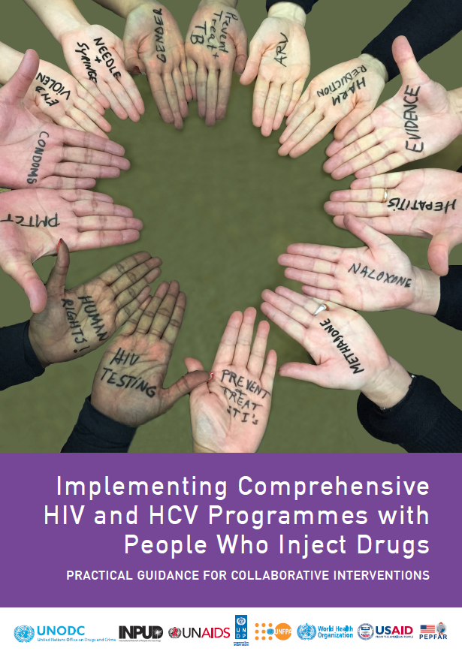
Introduction
This module draws its content largely from the people who Inject drugs implementation tool (the “IDUIT”).
Published in 2017, the IDUIT offers practical advice on effective programmes for and with people who inject drugs across the continuum of HIV and HCV prevention, diagnosis, treatment and care, aligned with UN guidance. It contains examples of good practice from around the world that may support efforts in planning programmes and services, and describes issues that should be considered and how to overcome challenges.
This module also draws upon the WHO Key Populations Consolidated Guidelines, 2022, which endorse and update the IDUIT’s approaches to health interventions and critical enablers.
MODULE 4 | INTRODUCTION

Slide 4

Video message from leader of an
organisation of people who use drugs
MODULE 4 | INTRODUCTION

Slide 5
Module 4 Contents
Questions to frame this module
Some definitions
Vulnerability of people who inject drugs
Harm reduction with people who inject drugs
Community organising for health and rights
Legal and policy frameworks on drug use and possession
The case for decriminalisation
UN frameworks and normative guidance on drugs
Take-home messages
Module review questions
Further information and resources

Slide 6
Framing questions
1. It is a bad idea for UN agencies to employ personnel who are known to use drugs.
Agree
Disagree
Unsure
2. UN agencies at country level should support organisations led by people who use drugs that wish to develop health and human rights programmes.
Agree
Disagree
Unsure
MODULE 4 | QUESTIONS TO FRAME THIS MODULE

Slide 7
Framing questions
3. Laws that criminalise drug use are a strong deterrent against addiction to drugs.
Agree
Disagree
Unsure
4. Compared with other key population groups, people who inject drugs are more vulnerable to viral hepatitis C.
Agree
Disagree
Unsure
MODULE 4 | QUESTIONS TO FRAME THIS MODULE

Slide 8
Framing questions: Responses
Not necessarily. In countries where recreational drug use is legal, this should not be a barrier to employment at a UN agency.
Correct. Programmes led by organisations of people who use drugs can be efficient and effective ways to reach other people who use drugs with services for harm reduction, HIV prevention and human rights.
Not necessarily. Criminalisation makes it harder for people who use drugs to do so safely, and to access treatment for drug use disorder (addiction).
Correct. Hepatitis C can be sexually transmitted, but it is more easily transmitted when drugs are injected using non-sterile needles or syringes.
MODULE 4 | QUESTIONS TO FRAME THIS MODULE

Slide 9
Module 4 Contents
Questions to frame this module
Some definitions
Vulnerability of people who inject drugs
Harm reduction with people who inject drugs
Community organising for health and rights
Legal and policy frameworks on drug use and possession
The case for decriminalisation
UN frameworks and normative guidance on drugs
Take-home messages
Module review questions
Further information and resources

Slide 10
Some definitions (1)
The high level of stigma surrounding drug use requires the careful use of person-centered language in speech or writing, e.g., “person who uses/injects drugs”, not “drug user” or “addict”. For more information see Words Matter! Language Statement & Reference Guide (INPUD & ANPUD, 2020).
People who inject drugs refers to people who inject psychoactive substances for non-medical purposes. The drugs include, but are not limited to opioids, amphetamine-type stimulants, cocaine and hypno-sedatives including new psychoactive substances. Injection may be through intravenous, intramuscular, subcutaneous or other injectable routes.
Drug use refers to the use of psychoactive drugs for nonmedical reasons, including drugs that are illegal, controlled, prescription or non-prescription (“over-the-counter”).
Substance abuse is harmful or hazardous use of psychoactive substances, including alcohol and illicit drugs.
Sources: Consolidated guidelines on HIV, viral hepatitis and STI prevention, diagnosis, treatment and care for key populations (WHO, 2022); IDUIT
MODULE 4 | SOME DEFINITIONS

Slide 11
Some definitions (1)
Stimulants are a group of plant-based or synthetic, including cocaine, amphetamine-type stimulants and new psychoactive substances, that increase alertness, heighten arousal and cause behavioural excitement.
Chemsex refers to engaging in sexual activity while taking primarily stimulant drugs, typically involving multiple participants and over a prolonged time.
Harm reduction refers to policies, programmes and practices that aim primarily to reduce the adverse health, social and economic consequences of the use of licit and illicit drugs, without necessarily stopping drug use.
Opioid agonist maintenance therapy OAMT (also known as opioid assisted maintenance therapy, or opioid substitution therapy or OST) is an effective, safe and cost-effective medical treatment for people who inject drugs who are dependent on opioids. OAMT is proven to reduce the frequency of injecting heroin or other opioids and the associated risks of overdose, infection and transmission of bloodborne viruses, as well as reducing criminal activity. It has been proven to be the most effective approach to preventing HIV among people who inject and are dependent on opioids. In addition, OAMT is effective for encouraging adherence to ART for people living with HIV and adherence to TB treatment.
Sources: World Drug Report 2019 (UNODC, 2019); Consolidated guidelines on HIV, viral hepatitis and STI prevention, diagnosis, treatment and care for key populations (WHO, 2022); IDUIT
MODULE 4 | SOME DEFINITIONS

Slide 12
Module 4 Contents
Questions to frame this module
Some definitions
Vulnerability of people who inject drugs
Harm reduction with people who inject drugs
Community organising for health and rights
Legal and policy frameworks on drug use and possession
The case for decriminalisation
UN frameworks and normative guidance on drugs
Take-home messages
Module review questions
Further information and resources

Slide 13
Vulnerability of people who inject drugs
In 2021, 10% of new HIV infections globally occurred among people who inject drugs.
Women account for 10-30% of people of inject drugs. Rates of intimate-partner and gender-based violence are up to five times higher among women who inject drugs, compared with women who do not inject drugs.
35 times
People who inject drugs have 35 times greater risk of acquiring HIV than adults who do not inject drugs
Sources: Global AIDS Update 2022 (UNAIDS, 2022); HIV and People who Use Drugs. Human Rights Fact Sheet Series No. 2 (UNAIDS, 2021)
MODULE 4 | VULNERABILITY OF PEOPLE WHO INJECT DRUGS

Slide 14
What makes people who inject
drugs vulnerable?
In most countries, drug use is considered immoral and is stigmatised, and drug possession or use are criminalised. As a result, people who inject drugs are and social services, and restrictions on access to education or employment. subject to punitive laws and policies, discrimination, violence, denial of health
People who inject drugs are vulnerable not only to HIV and HCV, but also to other bloodborne viruses such as hepatitis B, as well as to STIs and TB.
In many countries, people who inject drugs are subject to arrests, incarceration, forced treatment and harassment by law-enforcement agencies.
People who use drugs face additional barriers to accessing health services where ceasing drug use is a condition for eligibility.
Women who inject drugs may be more stigmatised than their male counterparts, and many sell sex to pay for both their and their partnerʼs drugs. Fear of losing custody of their children may make mothers who inject drugs less likely to access reproductive and other health services.
Source: Consolidated guidelines on HIV, viral hepatitis and STI prevention, diagnosis, treatment and care for key populations (WHO, 2022)
MODULE 4 | VULNERABILITY OF PEOPLE WHO INJECT DRUGS

Slide 15
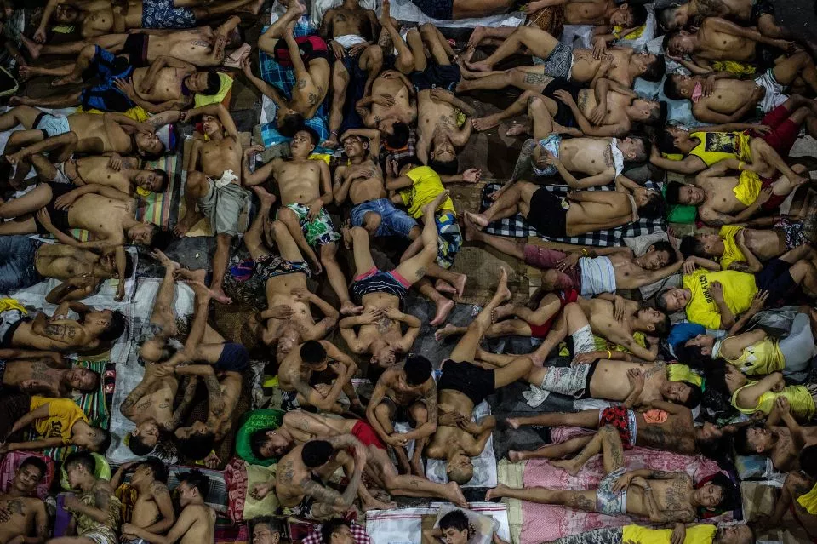
The “War on Drugs” and HIV
In many countries, drug policies have been shown not only to violate human rights, but to have significant negative public health consequences. Harsh drug enforcement can lead people who use drugs to “go underground”, away from critical health services.
This can fuel the transmission of HIV and HCV among people who use drugs and may discourage people with drug dependence from seeking effective treatment services.
Image: “License to Kill” (Human Rights Watch, 2017)
MODULE 4 | VULNERABILITY OF PEOPLE WHO INJECT DRUGS

Slide 16
Module 4 Contents
Questions to frame this module
Some definitions
Vulnerability of people who inject drugs
Harm reduction with people who inject drugs
Community organising for health and rights
Legal and policy frameworks on drug use and possession
The case for decriminalisation
UN frameworks and normative guidance on drugs
Take-home messages
Module review questions
Further information and resources

Slide 17
What is harm reduction?
Harm reduction refers to policies, programmes and practices that aim primarily to reduce the adverse health, social and economic consequences of the use of licit and illicit drugs.
WHO defines harm reduction as a comprehensive package of evidence-based interventions, based on public health and human rights, including needle and syringe programmes, opioid agonist maintenance therapy (OAMT) and naloxone for overdose management.
The harm reduction approach is based on a strong commitment to public health and human rights. Harm reduction helps protect people from preventable diseases and death from overdose and helps connect marginalised people with social and health services.
MODULE 4 | HARM REDUCTION WITH PEOPLE WHO INJECT DRUGS

Slide 18
Harm reduction is supported by the UN
All major UN agencies have endorsed a comprehensive package of harm reduction interventions
(see Module 1, Session 1.3).
Harm reduction is also endorsed by the 2021 Political Declaration on HIV and AIDS.
The 2022 WHO Key Populations Guidelines include the comprehensive harm reduction package, as well as interventions to address chemsex and HIV/TB coinfection, for people who inject drugs.
MODULE 4 | HARM REDUCTION WITH PEOPLE WHO INJECT DRUGS

Slide 19
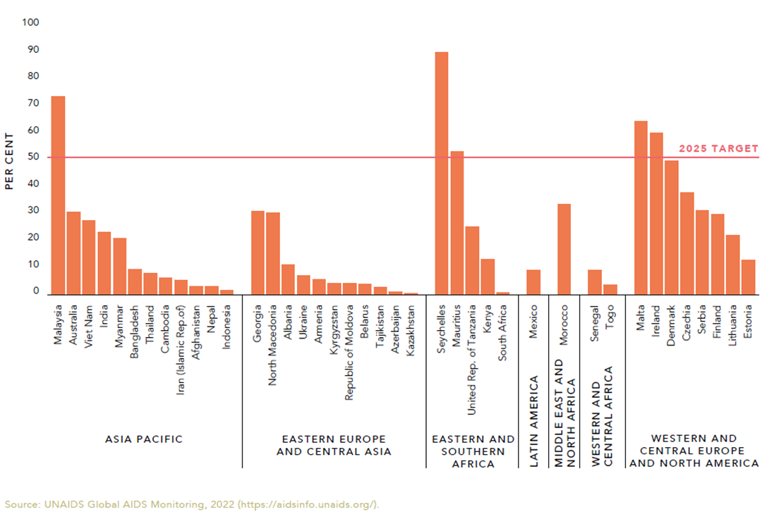
Coverage of opioid agonist maintenance
therapy is poor in nearly every country
Coverage of OAMT among people who inject drugs, countries with available data, 2017–2021.
The use of OAMT among people who inject drugs does not reach the 50% target in any overall region.
Source: Global AIDS Update 2022 (UNAIDS, 2022)
MODULE 4 | HARM REDUCTION WITH PEOPLE WHO INJECT DRUGS

Slide 20
Harm reduction is challenged by the
“War on Drugs”
In 2011, the Global Commission on Drug Policy published its first report on the state of drug policy globally. The report analysed responses to the production, trafficking and consumption of illicit drugs and noted that drug policies – especially criminalisation – have led to the social marginalisation of millions of citizens who do no harm to others.
The damaging impact of repressive measures against drug use have also impeded the HIV response.
For these reasons, the Commission concluded that the “War on Drugs” has failed.
The commission’s 2021 report, Time to End Prohibition, noted:
Despite the growing acceptance of harm reduction principles, funding and implementation on the ground still lag behind, especially in low- and middle-income countries. Far more resources are still invested in supply-side drug enforcement strategies than in life-saving harm reduction interventions.
MODULE 4 | HARM REDUCTION WITH PEOPLE WHO INJECT DRUGS

Slide 21
Module 4 Contents
Questions to frame this module
Some definitions
Vulnerability of people who inject drugs
Harm reduction with people who inject drugs
Community organising for health and rights
Legal and policy frameworks on drug use and possession
The case for decriminalisation
UN frameworks and normative guidance on drugs
Take-home messages
Module review questions
Further information and resources

Slide 22
Community organising for health
and rights
In the context of the In-Reach training, community refers to key populations, rather than the broader geographic, social or cultural groupings of which they may be a part. However, for people who inject drugs, the term should take into account the fact that people may move into or out of injecting drug use at various times in their life, whether by their own choice or because of circumstances beyond their control.
UN agencies have a role to play in sustaining community organising of people who inject drugs, for example by:
Building and strengthening partnerships with government, civil society, local allies and development partners
Providing technical assistance to networks of of people who use drugs to improve governance, fundraising or project management
Supporting the observance by people who use drugs of the Global Day of Action (on or around June 26)
Supporting local advocates in their efforts to decriminalise drug use and possession
Advocating for adequate resourcing of organisations led by people who use drugs
MODULE 4 | COMMUNITY ORGANISING FOR HEALTH AND RIGHTS

Slide 23
Community organising for health
and rights
Community empowerment describes a process whereby people who inject drugs take individual and collective ownership of activities, programmes and policies to achieve the most effective responses to HIV and HCV, and to address social and structural barriers to their health and their human rights.
This may mean that people who inject drugs:
Come together for mutual assistance
Form a collective identity with common goals and address their collective needs in a supportive environment
Identify their own priorities and the appropriate strategies to address these
advocate collectively for their rights as people who inject drugs and as human beings
Provide and facilitate access to HIV and HCV prevention, care and treatment, and support services
Participate meaningfully in all aspects of programme design, implementation, delivery, management, and monitoring and evaluation (M&E)
Build and strengthen partnerships with government, civil society, local allies and development partners.
MODULE 4 | COMMUNITY ORGANISING FOR HEALTH AND RIGHTS

Slide 24
Module 4 Contents
Questions to frame this module
Some definitions
Vulnerability of people who inject drugs
Harm reduction with people who inject drugs
Community organising for health and rights
Legal and policy frameworks on drug use and possession
The case for decriminalisation
UN frameworks and normative guidance on drugs
Take-home messages
Module review questions
Further information and resources

Slide 25
International legal and policy
frameworks
Most countries have laws and policies which regulate the use, possession, procurement, cultivation, manufacturing and sale of narcotic drugs or substances that are considered illicit.
The UN has three international drug control conventions, which are legally binding on member states:
Single Convention on Narcotic Drugs (1961)
Convention on Psychotropic substances (1971)
Convention against the illicit Traffic in narcotic Drugs and Psychotropic substances (1988).
Even though these conventions are based on a prohibitionist framework, they provide opportunities for governments to provide an alternative to conviction or punishment.
MODULE 4 | LEGAL AND POLICY FRAMEWORKS ON DRUG USE AND POSSESSION

Slide 26
Time to end prohibition
The 2021 report of the Global Commission on Drug Policy, Time to End Prohibition, states:
In drug policy, international law itself bears much of the responsibility for the world’s failure to address drug use in a rational and humane way. By unfairly deciding what is legal and what is not without sound scientific assessment, and by imposing a universal repressive model, international drug law stands in the way of much-needed reform. It is time to review the three international drug control conventions, in order to build a serious, modern and responsible drug control framework centered on human rights and based on results.
MODULE 4 | LEGAL AND POLICY FRAMEWORKS ON DRUG USE AND POSSESSION

Slide 27
National legal and policy frameworks
In 2018, the UN adopted the UN system common position on drug policy. This emphasises that drug use and dependency should not be treated as a criminal matter, but rather as a health issue to be addressed through rights-based measures including public health education, the provision of mental hygiene treatment, care and support, rehabilitation and transition/reintegration programmes.
The common position is committed to promote alternatives to punishment, including the decriminalisation of drug possession for personal use.
MODULE 4 | LEGAL AND POLICY FRAMEWORKS ON DRUG USE AND POSSESSION

Slide 28
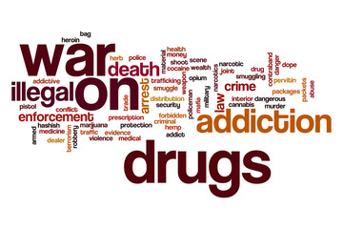
National legal frameworks on illicit drugs
There are a variety of laws and policies covering illicit drugs. Those which are used to prosecute people who use drugs directly are laws criminalising:
Drug use
Possession of drugs for personal use
Possession of drug equipment such as syringes and needles
Cultivation of drugs
Purchase and selling of drugs
Sharing and gifting of drugs
MODULE 4 | LEGAL AND POLICY FRAMEWORKS ON DRUG USE AND POSSESSION

Slide 29
Module 4 Contents
Questions to frame this module
Some definitions
Vulnerability of people who inject drugs
Harm reduction with people who inject drugs
Community organising for health and rights
Legal and policy frameworks on drug use and possession
The case for decriminalisation
UN frameworks and normative guidance on drugs
Take-home messages
Module review questions
Further information and resources

Slide 30
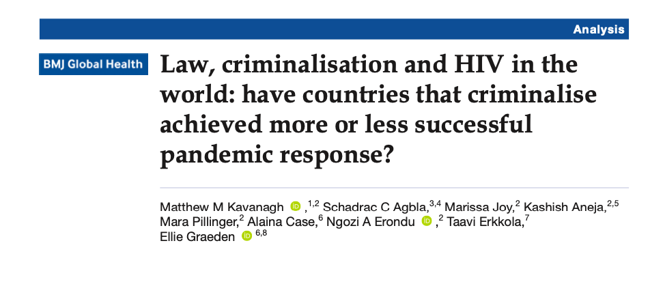
The case for decriminalisation
The criminalisation of drug use is a barrier to the HIV response.
In a study by the HIV Policy Lab, criminalisation of drug use was associated with 14% lower knowledge of HIV status and 15% lower viral suppression among people living with HIV.
Source: HIV Policy Lab
MODULE 4 | THE CASE FOR DECRIMINALISATION

Slide 31
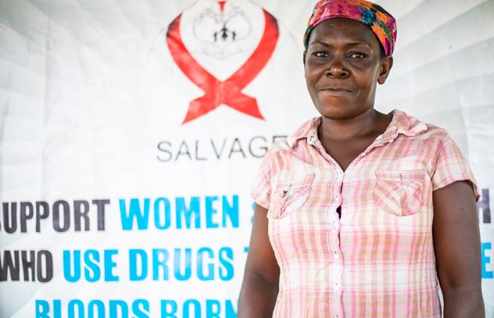
What does decriminalisation mean?
In the context of drug policy and, in particular, people who use drugs, decriminalisation refers to the removal of criminal penalties for drug use and related activities (such as the possession of substances for one’s own use, cultivation for personal use, and the possession of drug use materials).
The International Network of People Who Use Drugs (INPUD), the International Drug Policy Consortium (IDPC) and many drug user networks and advocates around the world, make the following distinction between decriminalisation and legalisation of drug use:
Decriminalisation: removal of sanctions under criminal law, with optional use of alternative sanctions.
Legalisation: complete removal of sanctions, making behaviour legal and applying no criminal or administrative penalty
Image: UNAIDS July 2020 / Doroth Hassan received support from SALVAGE, a sister organisation of the Tanzania Network for People who Use Drugs, Dar es Salaam
MODULE 4 | THE CASE FOR DECRIMINALISATION

Slide 32
Components of comprehensive drug decriminalisation
The gold standard of decriminalisation involves six key components:
The removal of all sanctions (whether criminal, civil or administrative) for drug use and related activities, and for all substances.
The promotion of voluntary access to evidence-based treatment, harm reduction and/or other relevant health and social services for people who use drugs.
The meaningful involvement of people who use drugs in each step of the development, implementation and evaluation of decriminalisation.
The expungement of, and reparations for, all previous convictions and criminal sanctions for the now-decriminalised acts.
Comprehensive training, sensitisation and awareness-raising among relevant public authorities to ensure effective implementation and adherence to the new decriminalisation policy
The redirection of resources from criminal justice and law enforcement responses towards health- and rights-based services and programmes.
Source: Decriminalisation of People Who Use Drugs: A Guide for Advocacy (International Drug Policy Consortium, 2022)
MODULE 4 | THE CASE FOR DECRIMINALISATION

Slide 33

Community-led efforts to improve legal and policy
environments on drug use and possession
Support. Don’t punish. is a global, grassroots campaign to build sustainable alternatives to the “war on drugs”. It supports harm reduction and drug policies that prioritise public health and human rights.
The campaign seeks to put harm reduction on the political agenda by strengthening the mobilisation capacity of communities targeted by the “war on drugs” and their allies, opening dialogue with policymakers and raising awareness among the media and the public.
MODULE 4 | THE CASE FOR DECRIMINALISATION

Slide 34
Improving legal and policy environments
on drug use and possession
A number of UN agencies have issued policy guidance in favour of decriminalising drug use, including UNAIDS, UNDP, WHO, OHCHR and UN Women, as well as the UN Special Rapporteur on the Right to Health.
UNAIDS data shows that countries that have implemented harm reduction and public health strategies early in the HIV epidemic have experienced consistently low rates of HIV transmission among people who inject drugs.
There is also evidence that countries that responded to increasing HIV prevalence among people who use drugs by introducing harm reduction programmes have been successful in containing and reversing the further spread of HIV.
The Global Commission on Drug Policy recommends that countries should stop criminalising people for drug use and possession and stop imposing “compulsory treatment” on people whose only offence is drug use or possession.
To ensure an effective, sustainable response to HIV that is consistent with human rights obligations, the Global Commission on HIV and the Law recommends that:
“Countries must reform their approach towards drug use. Rather than punishing people who use drugs who do no harm to others, they must offer them access to effective HIV and health services including harm reduction and voluntary, evidence-based treatment for drug dependence.”
MODULE 4 | THE CASE FOR DECRIMINALISATION

Slide 35
Portugal’s experience with
decriminalisation
In 2001 Portugal ceased to criminalise any drug use. People who use drugs remain subject to administrative charges that usually result in a referral to a regional Commission for the Dissuasion of Drug Addiction (CDT). CDT members are health, legal and social-work professionals who assess health risks and provide people who use drugs with access to a spectrum of services. CDTs suspend most cases referred to them, effectively leaving most “offenders” without penalty, and offer harm reduction interventions, various drug-treatment options and social integration and job placement programmes.
Ten years after decriminalisation, drug use (within the past 12 months) was lower in in the general population than in 2001. Use among 15-24-year-olds – the population most at risk of initiating drug use – fell throughout the decade. While there is some indication that drug use has risen since then (particularly among adults above 25 years), the proportion of the population who are “high-risk” opioid users is lower now than in 2001.
The combined effects of a supportive drug policy and significant investments in harm reduction in Portugal have drastically reduced the number of new HIV diagnoses due to drug injection – from 50% of all such diagnoses in the European Union in 2001, to less than 2% in 2019.
Source: Drug Decriminalization in Portugal: Setting the Record Straight (Transform Drug Policy Foundation, 2021)
MODULE 4 | THE CASE FOR DECRIMINALISATION

Slide 36
Country experiences with
decriminalisation
Numerous countries have decriminalised some aspects of drugs, and a growing number of countries are developing standards to decriminalise the use and possession of drugs.
Examples of decriminalisation:
Côte d’Ivoire: Following a legal environment assessment in 2021-2022, supported by UNDP, Côte d’Ivoire reformed its 1988 Drugs Act and introduced the “therapeutic injunction”. This is a new approach to the problems of drug use which stipulates that the user is not a delinquent but rather a person who should receive appropriate treatment, and alternatives to imprisonment. The penalty for imprisonment for drug use has also been reduced.
Colombia: Since 1994, the Constitutional Court of Colombia has gradually decriminalised the possession of narcotic drugs for personal use and, use of narcotic drugs, after ascertaining that the results of previous enforcement activities did not justify the limitations on individuals’ constitutional rights. In 2019, the Court cited the International Guidelines on Human Rights and Drug Policy, co-developed by UNDP.
Sources: Abjian.Net, Colombian Constitutional Court
MODULE 4 | THE CASE FOR DECRIMINALISATION

Slide 37
Module 4 Contents
Questions to frame this module
Some definitions
Vulnerability of people who inject drugs
Harm reduction with people who inject drugs
Community organising for health and rights
Legal and policy frameworks on drug use and possession
The case for decriminalisation
UN frameworks and normative guidance on drugs
Take-home messages
Module review questions
Further information and resources

Slide 38
UN frameworks and normative guidance
on drugs (1)
The Outcome Document of the 2016 United Nations General Assembly Special Session on the World Drug Problem (2016) lays out the UN’s joint commitment to effectively addressing and countering the world drug problem.
The United Nations Common Position on drug policy (2018) committed to promote alternatives to punishment, including the decriminalisation of drug possession for personal use.
The Ministerial declaration on strengthening our actions at the national, regional and international levels to accelerate the implementation of our joint commitments to address and counter the world drug problem (2019) includes a commitment “to promoting and protecting health, including access to treatment, safety and the well-being of all humanity”.
In 2022, to mark the International Day Against drug Abuse and Illicit Trafficking (June 26), 25 independent UN experts published a statement calling for an end to the “war on drugs” and the promotion of policies rooted in human rights.
The International Guidelines on Human Rights and Drug Policy (2021) provide a comprehensive set of international legal standards for placing human dignity and sustainable development at the centre of responses to illicit drug economies. The guidelines cover a diverse set of substantive issues ranging from development to criminal justice to public health.
MODULE 4 | UN FRAMEWORKS AND NORMATIVE GUIDANCE ON DRUGS

Slide 39
UN frameworks and normative guidance
on drugs (2)
UN Political Declaration on HIV and AIDS (2021): In this document, drafted at the High Level Meeting on HIV and AIDS in 2021, governments, “express deep concern about stigma, discrimination, violence and restrictive and discriminatory laws and practices that target people living with, at risk of and affected by HIV … and laws that restrict the movement or access to services for people living with, at risk of and affected by HIV, including key populations … and in this regard, deplore acts of violence and discrimination in all regions of the world against them”.
Global AIDS Strategy 2021-2026 (2021): The strategy includes a commitment to work towards the decriminalisation of drug use or possession for personal use, as part of the 10-10-10 targets to remove societal and legal barriers to accessing services.
Consolidated Guidelines on HIV, Viral Hepatitis and STI Diagnosis, Prevention, Treatment and Care for Key Populations (2022): Published by the World Health Organisation, this is an updated version of the 2016 edition, and is designed to address HIV, viral hepatitis and STIs in key populations using a rights-based, integrated and person-centred approach. One of the recommendations is that “Countries should work toward decriminalisation of drug use/injecting … and toward the elimination of the unjust application of civil law and regulations against people who use/inject drugs”.
MODULE 4 | UN FRAMEWORKS AND NORMATIVE GUIDANCE ON DRUGS

Slide 40
Module 4 Contents
Questions to frame this module
Some definitions
Vulnerability of people who inject drugs
Harm reduction with people who inject drugs
Community organising for health and rights
Legal and policy frameworks on drug use and possession
The case for decriminalisation
UN frameworks and normative guidance on drugs
Take-home messages
Module review questions
Further information and resources

Slide 41
Take-home messages
People who inject drugs have increased vulnerability to HIV and HCV compared with the rest of the population.
Criminalisation and the global “war on drugs” are major factors in the the vulnerability of people who inject drugs to HIV, HCV and TB.
Harm reduction approaches are recognised as effective in controlling transmission of HIV and HCV among people who inject drugs. These approaches are endorsed by member states as part of the 2021 Political Declaration on HIV and AIDS.
The Global AIDS Strategy 2021-2026 calls for the removal of punitive laws against drug users. As part of the 10-10-10 targets, by 2025, less than 10% of countries should criminalise drug use and the possession of small amounts of drugs.
MODULE 4 | TAKE-HOME MESSAGES

Slide 42
Module 4 Contents
Questions to frame this module
Some definitions
Vulnerability of people who inject drugs
Harm reduction with people who inject drugs
Community organising for health and rights
Legal and policy frameworks on drug use and possession
The case for decriminalisation
UN frameworks and normative guidance on drugs
Take-home messages
Module review questions
Further information and resources

Slide 43
Further information and resources (1)
Implementing comprehensive HIV and HCV programmes with people who inject drugs: practical guidance for collaborative interventions (UNODC, 2017)
HIV and People who Use Drugs. Human Rights Fact Sheet Series #2 (UNAIDS, 2021)
IN DANGER: UNAIDS Global AIDS Update 2022 (UNAIDS, 2022)
Key Populations Atlas (UNAIDS)
Time to End Prohibition: Report of the Global commission on Drug Policy (Global Commission on Drug Policy, 2021)
Drug decriminalisation across the world [interactive map] (TalkingDrugs.org)
Drug Decriminalisation [e]course (International Drug Policy Consortium, 2021)
International Guidelines on Human Rights and Drug Policy (UNDP, 2020)
World Drug Report 2022 (UNODC, 2022)
The Global State of Harm Reduction 2022 (Harm Reduction International, 2022)
MODULE 4 | FURTHER INFORMATION AND RESOURCES

Slide 44
Further information and resources (2)
Words Matter! Language Statement & Reference Guide (International Network of People who Use Drugs [INPUD] & Asian Network of People who Use Drugs [ANPUD], 2020)
The Vancouver Declaration: Why the world needs an international network of activists who use drugs (2006)
Drug Decriminalisation: Progress or Political Red Herring? (INPUD, 2021)
Surviving and Thriving: Lessons in Successful Advocacy from Drug User-Led Networks (INPUD, 2022)
MODULE 4 | FURTHER INFORMATION AND RESOURCES

