Slide 1


Module 5: Transgender and gender-diverse people
In-Reach Online Training
Increasing support and partnerships with key populations at risk of HIV

Slide 2
Introduction
While all transgender and gender-diverse people are potentially vulnerable to HIV infection, evidence shows that transgender women are significantly and disproportionately affected by HIV globally. Health and rights data for transgender women indicate high levels of stigma, discrimination and violence. Transgender people are also often excluded from many occupations.
Despite the evidence of these vulnerabilities, many countries still do not have disaggregated data on health issues affecting transgender women, or trans men who have sex with other men. In many countries, data on transgender people are not separated from data on men who have sex with men.
Due to the severity of human rights issues faced by transgender and gender-diverse people, addressing HIV and sexual health poses many challenges. This module covers the elements of programmes and approaches that UN organisations can develop together with transgender and gender-diverse people to promote their health and human rights.
MODULE 5 | INTRODUCTION

Slide 3
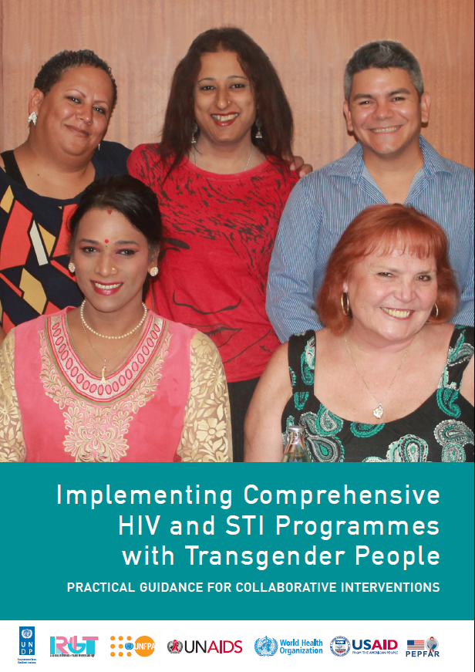
Introduction
This module draws its content largely from the Transgender people HIV implementation tool (the “TRANSIT”).
Published in 2016, the TRANSIT provides practical guidance on effective HIV and STI programming with transgender people, with a focus on trans women. It provides evidence for the need to decriminalise transgender identity, involve transgender and gender-diverse people in developing policy, and for the empowerment and self-determination of communities of transgender and gender-diverse people as a fundamental part of the fight against HIV.
This module also draws upon the WHO Key Populations Consolidated Guidelines, 2022, which endorse and update the TRANSIT’s approaches to health interventions and critical enablers.
MODULE 5 | INTRODUCTION

Slide 4

Video message from a transgender
community leader
MODULE 5 | INTRODUCTION

Slide 5
Module 5 Contents
Questions to frame this module
Some definitions
Vulnerability of trans and gender-diverse people
Community organising for health and rights
Gender-affirming and trans-competent health care
Legal and policy reform
UN frameworks and normative guidance on gender identity
Take-home messages
Module review questions
Further information and resources

Slide 6
Framing questions
1. Transgender people exist in every nationality, ethnicity and region around the world.
Agree
Disagree
Unsure
2. Where transgender people are not criminalised, they can better realise their human rights and can access services.
Agree
Disagree
Unsure
MODULE 5 | QUESTIONS TO FRAME THIS MODULE

Slide 7
Framing questions
3. Laws against same-sex sex are used to harass or prosecute transgender women who have sex with men.
Agree
Disagree
Unsure
4. Transgender people have the right to health care delivered by professionals who understand the physical and mental health needs of transgender people.
Agree
Disagree
Unsure
MODULE 5 | QUESTIONS TO FRAME THIS MODULE

Slide 8
Framing questions: Responses
Correct. Although data is not available in all countries, evidence suggests that there are transgender people in all populations. Trans people call themselves differently in various languages and cultures.
Not necessarily. Non-criminalisation of transgender identity helps ensure the rights of transgender people, but this must be supported by laws, advocacy and training to reduce discrimination in general society and among service providers.
Correct. If transgender women are “legally considered to be men”, their sexual relationships with men can make them subject to laws against same-sex sex.
Correct. Like all people, transgender people deserve to receive expert care for their physical and mental health, which means that providers should understand their particular health needs and be trained and equipped to serve them.
MODULE 5 | QUESTIONS TO FRAME THIS MODULE

Slide 9
Module 5 Contents
Questions to frame this module
Some definitions
Vulnerability of trans and gender-diverse people
Community organising for health and rights
Gender-affirming and trans-competent health care
Legal and policy reform
UN frameworks and normative guidance on gender identity
Take-home messages
Module review questions
Further information and resources

Slide 10
Some definitions (1)
Gender identity is a person’s internal, deeply felt sense of being male, female, an alternative gender or a combination of genders. A person’s gender identity may or may not correspond with their “sex assigned at birth”.
Transgender and gender-diverse is an umbrella term for those whose gender identity (their internal sense of their gender—see definition above) does not conform to the norms and expectations traditionally associated with the sex assigned to them at birth. The term includes people who are transsexual, transgender, or otherwise gender-nonconforming or gender-incongruent. Transgender people may self-identify as transgender, female, male, a trans woman or a trans man, transsexual or one of many other gender-nonconforming identities. They may express their genders in a variety of masculine, feminine and/or androgynous ways. This module of the In-Reach training mostly uses the shortened form of the word, trans.
Intersex describes a person born with sexual anatomy, reproductive organs or chromosome patterns that do not fit the typical definition of male or female, by contrast with a transgender person, who is often born with a male or female body.
Sources: TRANSIT (UNDP, 2015); Consolidated guidelines on HIV, viral hepatitis and STI prevention, diagnosis, treatment and care for key populations (WHO, 2022)
MODULE 5 | SOME DEFINITIONS

Slide 11
Some definitions (2)
Transition refers to the process trans people undergo to live authentically in their gender identity. This may involve changes to outward appearance, clothing, mannerisms or to the name someone uses in everyday interactions. These types of changes are sometimes called social transitions. Transitioning may also involve medical steps that help to align a person’s anatomy with their gender identity. These steps are sometimes called medical transition and can include feminising or masculinising hormone therapy, soft-tissue fillers or surgeries. However, transition is not defined by medical steps taken or not taken.
Trans-competent care refers to services that are provided in a sensitive, respectful and compassionate manner, in settings that are free of stigma and discrimination, by health-care workers who are technically competent and knowledgeable about gender identity, human rights and the particular situation and needs of the trans individual being served. Trans-competent care is person-centred - meeting all of a trans person’s needs, and an example of “differentiated service delivery”, ie being tailored for the particular needs of trans people.
Source: TRANSIT
MODULE 5 | SOME DEFINITIONS

Slide 12
Some definitions (3)
Transphobia is prejudice directed at people whose gender identity or gender expression does not conform to social norms and expectations. It is a reaction to the real or perceived difference between the biological sex attributed to a person at birth and their gender identity or expression. Transphobia is a socially created attitude, similar in nature to racism, sexism, xenophobia or religious intolerance. It contributes to the marginalisation of trans people and gender-nonconforming people and their resultant vulnerability to HIV.
MODULE 5 | SOME DEFINITIONS

Slide 13
Module 5 Contents
Questions to frame this module
Some definitions
Vulnerability of trans and gender-diverse people
Community organising for health and rights
Gender-affirming and trans-competent health care
Legal and policy reform
UN frameworks and normative guidance on gender identity
Take-home messages
Module review questions
Further information and resources

Slide 14
HIV risk of trans and gender-diverse
people
New HIV infections decreased among cisgender women between 2020 and 2019. This has not been the case for trans women.
In 2021, trans women were 14 times more likely to acquire HIV than women in the general population.
Global HIV prevalence among trans women over the course of the epidemic has been estimated as 19.9%.
14 times
Trans women have 14 times greater risk of acquiring HIV than adult women (15-49) in the general population
Sources: Global AIDS Update 2022 (UNAIDS, 2022); Stutterheim SE, et al. The worldwide burden of HIV in transgender individuals: An updated systematic review and meta-analysis. PLOS ONE. 2021;6(12):e0260063
MODULE 5 | VULNERABILITY OF TRANS AND GENDER-DIVERSE PEOPLE

Slide 15
What makes trans and gender-diverse people
vulnerable to HIV, STIs and viral hepatitis?
A range of overlapping factors make trans and gender-diverse people vulnerable to HIV, viral hepatitis and other sexually transmitted infections (STIs).
Discrimination and marginalisation impede trans women’s access to education and work opportunities, leading some to engage in sex work. This makes them vulnerable to HIV if they are unable to negotiate consistent condom use with partners, as well as to harassment and violence from law-enforcement officers, clients, managers and others.
Discrimination, marginalisation and violence increase the vulnerability of trans and gender-diverse people to substance use disorders, eating disorders, depression and suicide attempts. They are also barriers to accessing adequate health services, not only for HIV/STIs but also for gender-affirming care. As a result, some trans women inject hormones or silicon unsafely, increasing their vulnerability to HIV or viral hepatitis C infection if non-sterile needles and syringes are shared.
In six of the 13 countries that reported data to UNAIDS in recent years, less than half of trans women stated that they were able to access multiple HIV prevention services. Globally, on average, only about two-thirds of trans people know their HIV status.
Source for final paragraph: HIV and Transgender and Other Gender-Diverse People. Human Rights Fact Sheet Series No. 4 (UNAIDS, 2021)
MODULE 5 | VULNERABILITY OF TRANS AND GENDER-DIVERSE PEOPLE

Slide 16
Institutionalised discrimination
The criminalisation of trans and gender-diverse people is widespread, as is the application of other punitive and discriminatory laws, policies and practices in medical settings, education settings, workplaces, or in the community. This leads to a wide range of discriminatory practices by service providers including:
Harassment by law-enforcement officers
Harsh treatments before and during incarceration
Forced anal examinations of trans people who are arrested on homosexuality-related charges
Forced medical treatments, including sterilisation, gender reassignment interventions and so-called “conversion therapies” aiming to try to force a person to accept their gender assigned at birth
Refusal to provide health services
Source: Born Free and Equal: Sexual Orientation, Gender Identity and Sex Characteristics in International Human Rights Law (OHCHR, 2019)
MODULE 5 | VULNERABILITY OF TRANS AND GENDER-DIVERSE PEOPLE

Slide 17
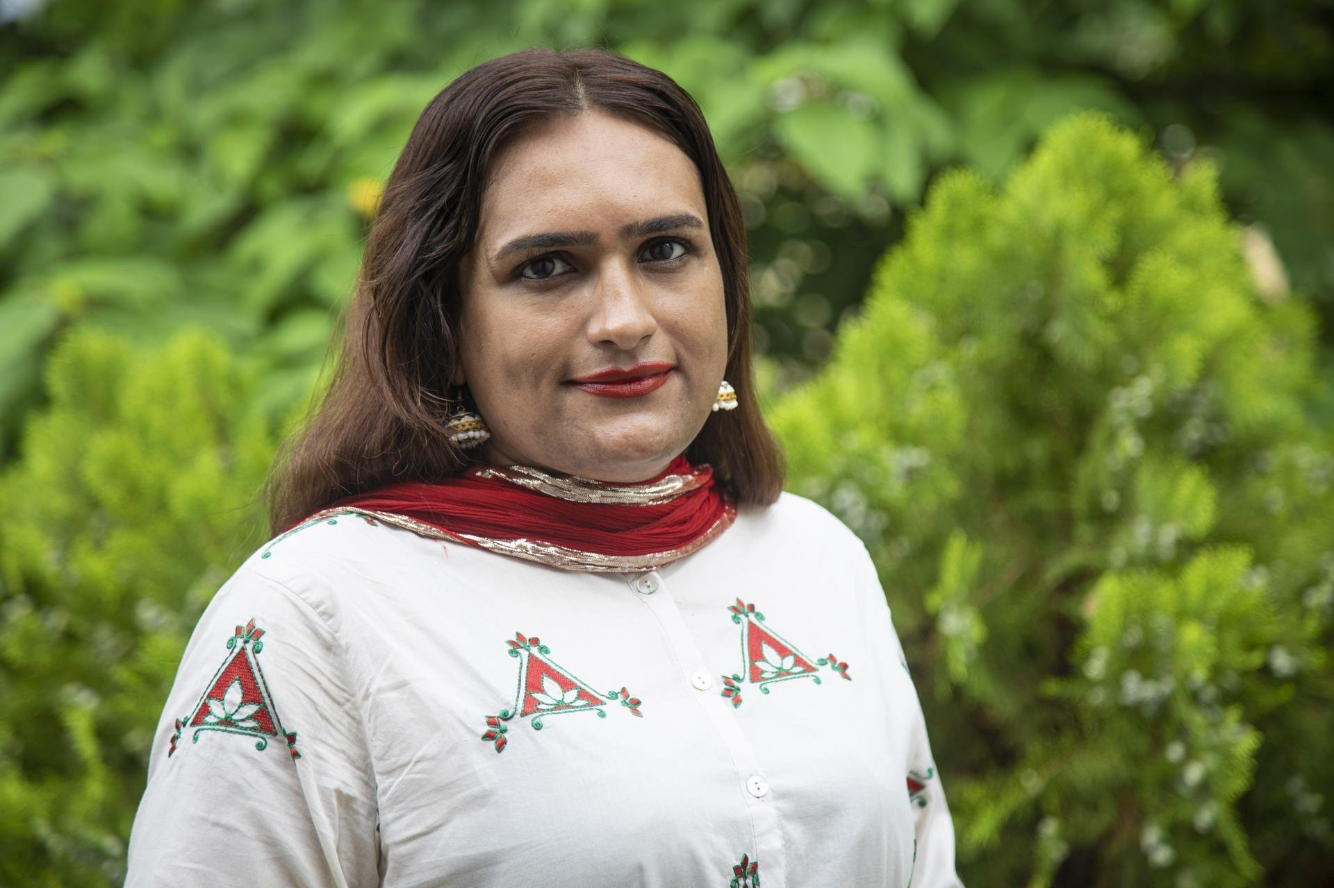
Violence against trans and
gender-diverse people
In a study in eight sub-Saharan African countries, 33% of the trans women surveyed said that they had been physically attacked at some point in their lives, 28% had been raped and 27% said that they were too afraid to use health-care services.
A study from Argentina found that trans women who had experienced police violence were twice as likely to avoid health-care services than trans women without such experience.
Image: UNDP Pakistan / Ms. Reem Sharif was the first transgender person to join the Rawalpindi Police Department where she worked for the protection of transgender persons and supporting the rehabilitation of 300 people affected by gender-based violence
Full story here.
Source: HIV and Transgender and Other Gender-Diverse People. Human Rights Fact Sheet Series No. 4 (UNAIDS, 2021)
MODULE 5 | VULNERABILITY OF TRANS AND GENDER-DIVERSE PEOPLE

Slide 18
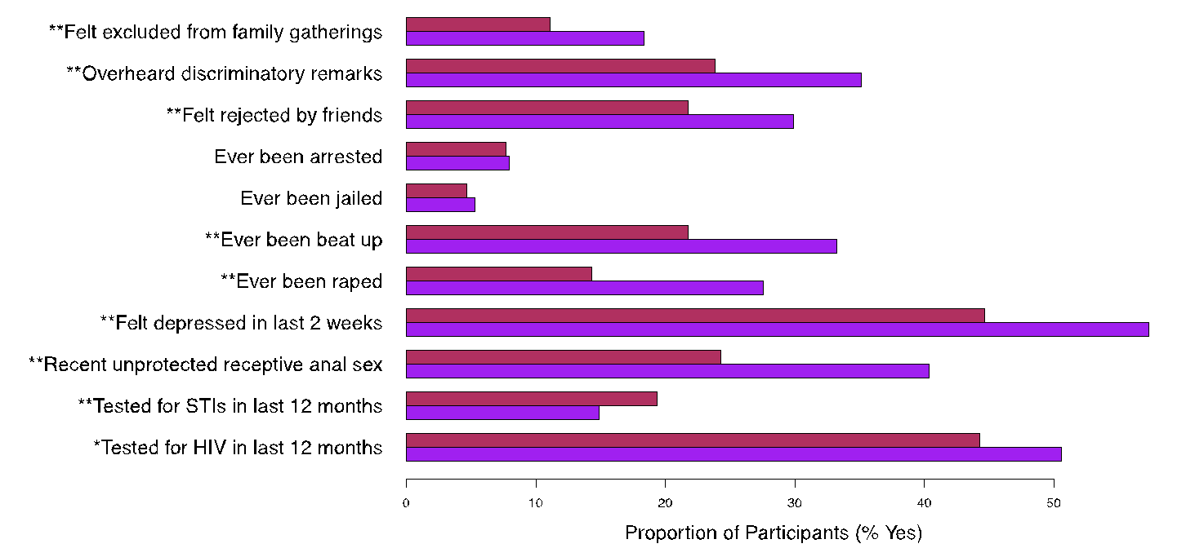

Trans and gender-diverse people are
especially vulnerable
In sub-Saharan Africa, a greater proportion of trans women than of men who have sex with men reported experiences of stigma, violence, depression and unprotected sex
Men who have sex with men
Transgender women
* p < 0.05
** p < 0.001
Source: Poteat T, et al. HIV prevalence and behavioral and psychosocial factors among transgender women and cisgender men who have sex with men in 8 African countries: A cross-sectional analysis. PLOS Medicine. 2017;14(11):e1002422
MODULE 5 | VULNERABILITY OF TRANS AND GENDER-DIVERSE PEOPLE

Slide 19
Module 5 Contents
Questions to frame this module
Some definitions
Vulnerability of trans and gender-diverse people
Community organising for health and rights
Gender-affirming and trans-competent health care
Legal and policy reform
UN frameworks and normative guidance on gender identity
Take-home messages
Module review questions
Further information and resources

Slide 20
Community organisation among trans
and gender-diverse people
Community organising of trans and gender-diverse people has often been linked their efforts with those of LGBT (lesbian, gay, bisexual and transgender) organisations, or organisations of men who have sex with men. However, in some regions and countries trans and gender-diverse people organise themselves separately, recognising that their needs and concerns may be different from those of (cisgender) men who have sex with men.
The TRANSIT provides step-by step approaches for trans and gender-diverse communities to set up and sustain strong organisations and networks in the areas of governance, peer outreach, community mobilisation, community-led programming and project management.
MODULE 5 | COMMUNITY ORGANISING FOR HEALTH AND RIGHTS

Slide 21
How UN agencies can support community
empowerment of trans and gender-diverse people (1)
Community mobilising led by trans and gender-diverse people faces many challenges, including social and legal barriers which impede the registration and growth of organisations.
Community systems strengthening is one of the approaches that UN organisations can use to sustain trans and gender-diverse people organising for health and human rights, including the following supportive actions:
Organise and sustain networks of trans-led organisations at national, regional and global levels
Conduct public sensitisation campaigns to dismantle myths and negative social norms about trans and gender diversity
Advocate alongside WHO with medical authorities for the de-pathologisation of diverse gender identity
Work with law-enforcement agencies to reduce violence against trans and gender-diverse people
Support training and sensitisation of health-care workers on trans and gender-diverse people’s medical needs and wider concerns
Advocate for the ban of “conversion” therapies and forced treatment
Advocate with governments for trans inclusion in national gender legislation, and HIV and sexual health strategies
Advocate for disaggregation of data on trans and gender-diverse people (especially disaggregation from data on men who have sex with men) in national data collections, and health and socioeconomic strategies
MODULE 5 | COMMUNITY ORGANISING FOR HEALTH AND RIGHTS

Slide 22
How UN agencies can support community
empowerment of trans and gender-diverse people (2)
Examples of trans and gender-diverse community efforts that the UN can support at country level:
Support the participation of trans and gender-diverse leaders in developing and implementing National HIV Strategic Plans
Foster dialogues between government counterparts and trans and gender-diverse activists to increase understanding and acceptance of trans people’s needs and priorities
Advocate with donors for resource allocation to trans people’s networks and organisations
Support local trans and gender-diverse community activities during the human rights calendar year, such as the International Day Against Homophobia, Biphobia and Transphobia (IDAHOBIT, 17 May 17), or the Transgender Day of Visibility (31 March)
Mobilise technical assistance for trans organisations through global networks to provide support on governance and organisational development
MODULE 5 | COMMUNITY ORGANISING FOR HEALTH AND RIGHTS

Slide 23
Legal reforms to reduce vulnerability
The criminalisation of same-sex sexual activity and sex work is a barrier to the HIV response among trans and gender-diverse people.
In a study by the HIV Policy Lab, criminalisation of same-sex sex was associated with 11% lower knowledge of HIV status and 8% lower viral suppression among people living with HIV.
Criminalisation of sex work was associated with 10% lower knowledge of HIV status and 6% lower viral suppression among sex workers who were living with HIV.
Non-discrimination and providing protections were associated with 10% higher knowledge of HIV status and 11% higher viral suppression among people living with HIV.
Source: HIV Policy Lab
MODULE 5 | COMMUNITY ORGANISING FOR HEALTH AND RIGHTS

Slide 24
Module 5 Contents
Questions to frame this module
Some definitions
Vulnerability of trans and gender-diverse people
Community organising for health and rights
Gender-affirming and trans-competent health care
Legal and policy reform
UN frameworks and normative guidance on gender identity
Take-home messages
Module review questions
Further information and resources

Slide 25
Key principles of gender-affirming care
WHO recommends a package of interventions for trans and gender-diverse people. In addition to essential interventions in the health sector to prevent and treat HIV (described in Module 1, Session 1.3), WHO recommends a number of interventions, including gender-affirming care to promote broader health needs of trans and gender diverse people.
Gender-affirming care can help trans and gender-diverse people to express themselves and be recognised as their self-identified gender. It includes the following approaches, for those trans people who wish to use them:
Hormonal treatment, which is proven to significantly improve the quality of life and well-being of trans people
Surgeries on the chest or sexual organs
“Fillers”, i.e. administration by subcutaneous injections of medical-grade silicone or other products to help the body conform with the gender the individual wishes to present as
Psychological support
It is important for providers of psychological support to act in accordance with the new classification of disease (ICD 11), which has removed gender identity-related health as a mental health condition.
In most low- and middle-income countries, gender-affirming care is not included in health packages. The use of illicit products or unregulated hormones and industrial-grade fillers is therefore common among trans and gender-diverse people. Adverse reactions and damaging side-effects associated with the use of unregulated products are commonly reported.
MODULE 5 | GENDER-AFFIRMING AND TRANS-COMPETENT HEALTH CARE

Slide 26
Case study 1: Supporting activism for access to
trans-competent health services at the community level
In June 2022, a community clinic in Guatemala serving trans people was officially approved as a health post by the Ministry of Public Health and Public Assistance, with a full-time doctor in position. With financial support from the Global Fund and Oxfam, the clinic offers comprehensive care, including HIV prevention (including PrEP) and diagnosis; prevention, diagnosis and treatment of STIs; psychosocial counselling; medical consultations including hormone therapy; a laboratory service and a pharmacy.
The clinic and its approach result in part from a comprehensive health strategy for trans people developed in 2016 with technical support from UNAIDS. It is also the result of years of activism by the trans community, including OTRANS Reinas de la Noche. This organisation contributes to the Centro de Documentación y Situación Trans de América Latina y el Caribe (CEDOSTALC), a community-based system for collecting information, monitoring and responding to human rights-related barriers faced by the trans population in 26 countries in Latin American and the Caribbean.
Guatemala’s UNAIDS Country Director notes that the HIV prevalence rate is 22.2% among the transgender population, compared with 0.2% for the general population, and that because of social exclusion, violence and the denial of rights, the life expectancy of trans women in Guatemala is only 35-40 years, compared with 74 for the general population.
Source: A beacon of hope in Guatemala (UNAIDS, 2022)
MODULE 5 | GENDER-AFFIRMING AND TRANS-COMPETENT HEALTH CARE

Slide 27
Case study 2: Reinforcing HIV prevention and
treatment in a trans community in Brazil
In 2021, UNAIDS launched the FRESH Project in partnership with Casa Florescer, a pioneering transgender welcoming centre in São Paulo, Brazil. The project uses contingency management, a process of positive reinforcement, to promote healthy behaviours. The project design draws on evidence that different kinds of incentives can improve health outcomes, including viral suppression of HIV.
FRESH began with a workshop for trans women focused on contingency management, self-care and combination HIV prevention. Ambassadors and influencers among the residents of Casa Florescer were identified to help promote the project goals.
A photography workshop was organised with a professional photographer who specialises in taking pictures of LGBTQ people and people living with HIV. Photos and life experiences from 24 transgender women who graduated from the project were shared at a special event commemorating the International Day Against Homophobia, Biphoia and Transphobia.
Source: Global AIDS Update 2022 (UNAIDS, 2022)
MODULE 5 | GENDER-AFFIRMING AND TRANS-COMPETENT HEALTH CARE

Slide 28
Module 5 Contents
Questions to frame this module
Some definitions
Vulnerability of trans and gender-diverse people
Community organising for health and rights
Gender-affirming and trans-competent health care
Legal and policy reform
UN frameworks and normative guidance on gender identity
Take-home messages
Module review questions
Further information and resources

Slide 29
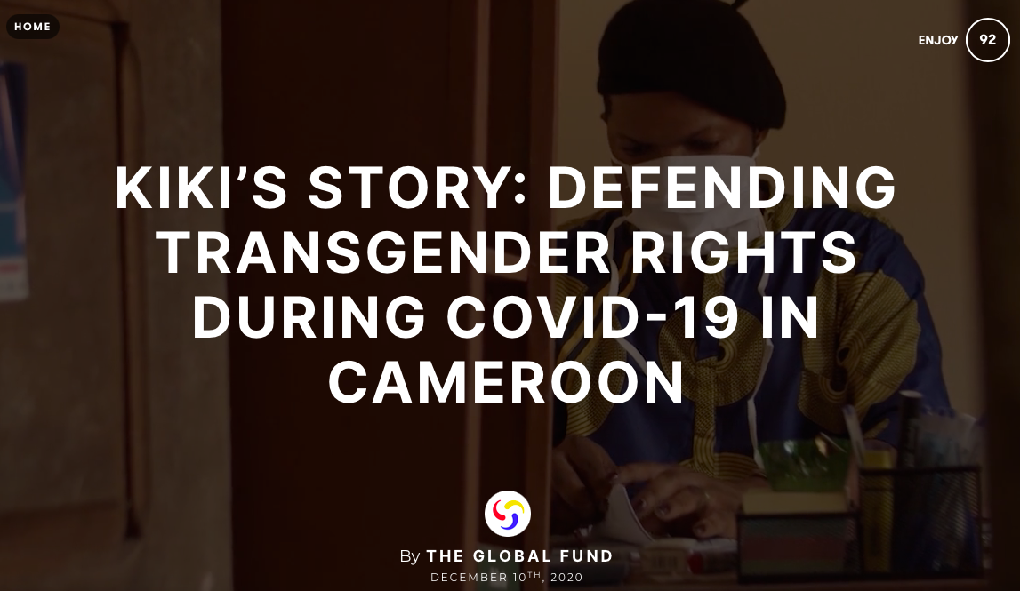
Approaches to criminalisation
Often, trans and gender-diverse people are criminalised under vaguely defined laws, or under laws against “cross dressing”, or “impersonation” or “imitation” of the opposite sex. Laws against “debauchery”, “vagrancy” or sex work are also used to target trans and gender-diverse people.
VIDEO: Kiki’s Story: Defending Transgender Rights During COVID-19 in Cameroon (The Global Fund, 2020)
Source: Born Free and Equal: Sexual Orientation, Gender Identity and Sex Characteristics in International Human Rights Law (OHCHR, 2019)
MODULE 5 | LEGAL AND POLICY REFORM

Slide 30
Ending criminalisation, stigma and
discrimination
The Global AIDS Strategy 2021-2026 has set the 10-10-10 targets to ensure that by 2025:
Less than 10% of countries have punitive legal and policy environments
Less than 10% of people living with HIV and key populations experience stigma and discrimination, including transgender people
Less than 10% of women, girls, people living with HIV and key populations experience gender inequality and violence
Sub-targets include that by 2025:
Less than 10% of countries criminalise same-sex sexual behaviour or sex work
Less than 10% of health workers and law-enforcement officers report negative attitudes towards trans people
MODULE 5 | LEGAL AND POLICY REFORM

Slide 31
Legal and policy reform on
gender identity
The past decade has seen several examples of countries working to promote an enabling environment and remove barriers to service access for trans and gender-diverse people. In many countries, trans and gender-diverse communities are advocating for recognition of their preferred gender identities.
In Europe, nine countries have progressed towards legal recognition of trans and gender-diverse people by adopting self-determination laws. These are Belgium, Denmark, Ireland, Iceland, Luxemburg, Malta, Norway, Portugal and Switzerland.
In Nepal, a third gender has been legally recognised, and can be selected in official records, such as the census and in passports.
MODULE 5 | LEGAL AND POLICY REFORM

Slide 32
Case study 1: legal and policy reform
on gender identity
In 2015, Malta passed the Gender Identity, Gender Expression and Sex Characteristics Act, which provides a self-determined, speedy and accessible diverse gender-recognition process. It envisages minors being able to exercise choice about their gender identity, while recognising parental participation and the minor’s best interests.
The law guarantees non-discrimination in the public and private sector and rejects the pathologising of gender identity by stipulating that people “shall not be required to provide proof of a surgical procedure for total or partial genital reassignment, hormonal therapies or any other psychiatric, psychological or medical treatment”. The law also calls for a working group on trans health care to research international best practices.
Following the law’s passage, the Maltese Ministry of Education, working with activists, devised a policy to accommodate trans, gender-nonconforming and intersex children within the educational system.
MODULE 5 | LEGAL AND POLICY REFORM

Slide 33
Case study 2: Supporting the safety
and rights of trans people
In 2018, the National Assembly of Pakistan enacted The Transgender Persons (Protection of Rights) Act 2018 providing legal recognition to trans people and prohibiting discrimination and harassment against them.
The law requires local governments to cater to the welfare of the community, for example by:
Establishing protection centres and safe houses for trans people
Establishing separate prison and detention cells for trans people
Instituting sensitisation and awareness training for public servants, in particular law enforcement officials and health-care workers
Organising vocational training programmes and encouraging trans people to start small business through incentives, loan schemes and grants.
MODULE 5 | LEGAL AND POLICY REFORM

Slide 34

Case study 3: Advocating for
legislative reform
As part of its aim to promote the human rights of trans women in the Dominican Republic, COTRAVETD (Comunidad de Trans y Travestis Trabajadoras Sexuales Dominicana) provides access to HIV prevention, support and treatment, and raises community and societal awareness about the stigma, discrimination and violence faced by trans people, including those living with HIV, and those involved in sex work.
COTRAVETD conducts advocacy work to promote legislative reform, including improving a draft Gender Identity Law. Its empowerment philosophy is based on the belief that even if the desired law fails to pass, the process of drafting and lobbying itself serves as a tool for movement-building and political visibility.
Source: COTRAVETD
MODULE 5 | LEGAL AND POLICY REFORM

Slide 35
Module 5 Contents
Questions to frame this module
Some definitions
Vulnerability of trans and gender-diverse people
Community organising for health and rights
Gender-affirming and trans-competent health care
Legal and policy reform
UN frameworks and normative guidance on gender identity
Take-home messages
Module review questions
Further information and resources

Slide 36
Gender identity and UN frameworks (1)
UN Political Declaration on HIV and AIDS (2021): In this document, drafted at the High Level Meeting on HIV and AIDS in 2021, governments, “express deep concern about stigma, discrimination, violence and restrictive and discriminatory laws and practices that target people living with, at risk of and affected by HIV … and laws that restrict the movement or access to services for people living with, at risk of and affected by HIV, including key populations … and in this regard, deplore acts of violence and discrimination in all regions of the world against them”.
Global AIDS Strategy 2021-2026 (2021): The strategy includes a commitment to work towards the end of stigma, discrimination and violence on the basis of gender identity as part of the 10-10-10 targets to remove societal and legal barriers to accessing services.
Consolidated Guidelines on HIV, Viral Hepatitis and STI Diagnosis, Prevention, Treatment and Care for Key Populations (2022): Published by the World Health Organisation, this is an updated version of the 2016 edition, and is designed to address HIV, viral hepatitis and STIs in key populations using a rights-based, integrated and person-centred approach. One of the recommendations is that “Countries should work toward decriminalisation of … non-conforming gender identities … and toward the elimination of the unjust application of civil law and regulations against … trans and gender-diverse people”.
MODULE 5 | UN FRAMEWORKS AND NORMATIVE GUIDANCE ON GENDER IDENTITY

Slide 37
Gender identity and UN frameworks (2)
Born Free And Equal: Sexual Orientation, Gender Identity and Sex Characteristics in International Human Rights Law. Second Edition (OHCHR, 2019)
Ending Violence and Discrimination Against Lesbian, Gay, Bisexual, Transgender and Intersex People (United Nations, 2015)
Discrimination and Violence against Individuals based on their Sexual Orientation and Gender Identity: Report of the Office of the United Nations Commissionner for Human Rights (2015)
HIV and the Law: Rights, Risk and Health (2012): Published by the Global Commission on HIV and the Law, the report recommends that: “Countries must reform their approach towards transgender people. Rather than punishing transgender people, countries must offer transgender people access to effective HiV and health services and commodities as well as repealing all laws that criminalise transgender identity or associated behaviours”.
MODULE 5 | UN FRAMEWORKS AND NORMATIVE GUIDANCE ON GENDER IDENTITY

Slide 38
Module 5 Contents
Questions to frame this module
Some definitions
Vulnerability of trans and gender-diverse people
Community organising for health and rights
Gender-affirming and trans-competent health care
Legal and policy reform
UN frameworks and normative guidance on gender identity
Take-home messages
Module review questions
Further information and resources

Slide 39
Take-home messages
The vulnerability of trans and gender-diverse people to HIV, viral hepatitis and STIs is a combination of behavioural factors overlapping with social marginalisation, and punitive laws and policies that limit their access to health care and other services.
Trans and gender-diverse people are particularly affected by stigmatisation and violence and are subject to prosecution under laws criminalising homosexuality and sex work.
Community empowerment of trans and gender-diverse people is essential for the success of health and rights interventions. Trans community organisations may prefer to organise and define their needs separately from communities of men who have sex with men.
UN agencies have an essential role to play in sustaining movements of trans and gender-diverse people for health and rights. This role includes involving their community organisations in UN-led efforts to end violence and providing technical assistance for resource mobilisation and access to justice.
Normative guides provide evidence-based approaches to sustain trans and gender-diverse movements and programmes. These include the TRANSIT and the WHO Key Populations Consolidated Guidelines, 2022.
The Global AIDS Strategy 2021-2026 has set new 10-10-10 targets and commitments for 2025 to remove societal and legal barriers to accessing services, including for trans and gender-diverse people.
MODULE 5 | TAKE-HOME MESSAGES

Slide 40
Module 5 Contents
Questions to frame this module
Some definitions
Vulnerability of trans and gender-diverse people
Community organising for health and rights
Gender-affirming and trans-competent health care
Legal and policy reform
UN frameworks and normative guidance on gender identity
Take-home messages
Module review questions
Further information and resources

Slide 41
Module 5 Contents
Questions to frame this module
Some definitions
Vulnerability of trans and gender-diverse people
Community organising for health and rights
Gender-affirming and trans-competent health care
Legal and policy reform
UN frameworks and normative guidance on gender identity
Take-home messages
Module review questions
Further information and resources

Slide 42
Further information and resources
Implementing Comprehensive HIV and STI Programmes with Transgender People: Practical Guidance for Collaborative Interventions (the TRANSIT) (UNDP, 2016)
HIV and Transgender and Other Gender-Diverse People. Human Rights Fact Sheet Series #4 (UNAIDS, 2021)
IN DANGER: UNAIDS Global AIDS Update 2022 (UNAIDS, 2022)
Key Populations Atlas (UNAIDS)
Best Practice Guide for Governments on the Engagement of Trans People in the Development of National Strategic Plans (NSPs) (GATE, 2021)
The World Professional Association for Transgender Health (WPATH) publishes Standards of Care for the Health of Transgender and Gender Diverse People.
The Center of Excellence for Transgender Health at the University of California San Francisco, USA has published the Guidelines for the Primary and Gender-Affirming Care of Transgender and Gender Nonbinary People (2016)
MODULE 5 | FURTHER INFORMATION AND RESOURCES

