Slide 1


Module 7: Adolescent and Young Key Populations
In-Reach Online Training
Increasing support and partnerships with key populations at risk of HIV

Slide 2
Introduction
Adolescents and young people (aged 10-24 years) from key populations face the same vulnerabilities to HIV, viral hepatitis and TB as older key populations, and many of the barriers to access to services – in other words, the vulnerabilities and barriers that are covered in the other modules in this training.
However, these factors may be exacerbated among adolescents and young people from key populations because of rapid physical and mental changes, combined with psychosocial, familial, social, educational and economic vulnerabilities due to their age and, often, their lack of legal and economic independence. There are also barriers to service providers working with young key populations, including consent and guardianship issues, and sometimes risk of prosecution for being viewed as supporting criminalised behaviour in young people.
This module covers the elements of programmes and approaches that UN organisations can develop together with organisations of young people to promote their health and human rights.
MODULE 7 | INTRODUCTION

Slide 3
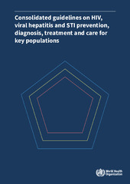

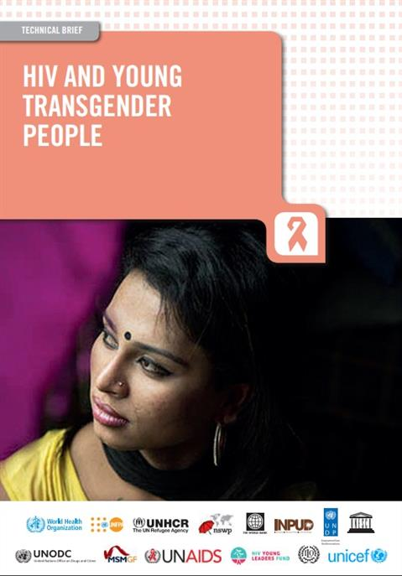
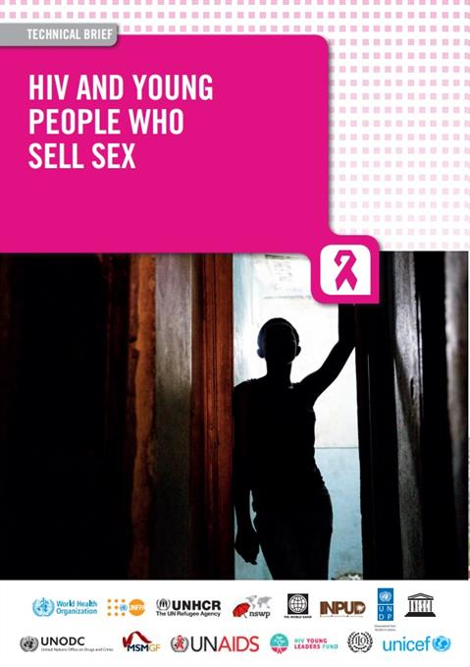
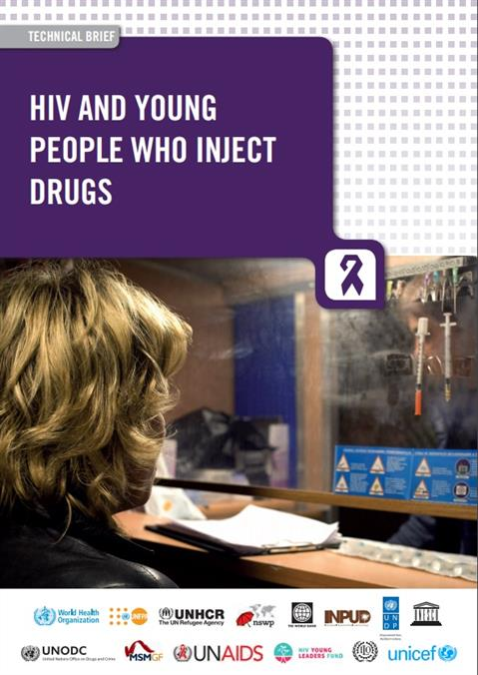
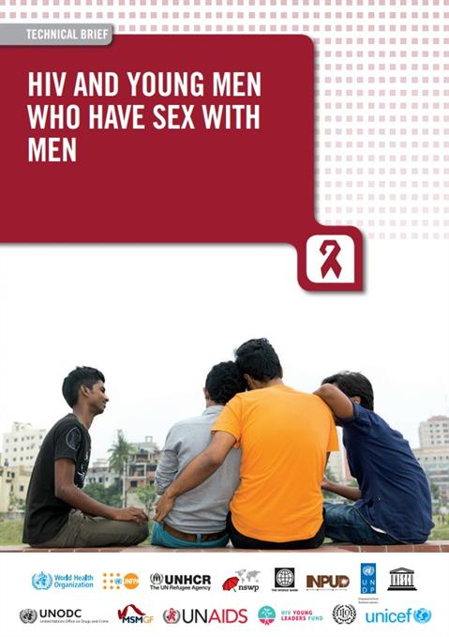
Introduction
This module draws its content from several global guidance documents and resources, including:
WHO Key Populations Consolidated Guidelines, 2022
UNICEF, UNFPA and UNDP ayKP Toolkit (2018)
WHO policy briefs on young key populations (2015)
MODULE 7 | INTRODUCTION

Slide 4
Module 7 Contents
Questions to frame this module
Some definitions
Vulnerability of adolescent and young key populations
Making services adolescent- and youth-friendly
Leadership of adolescent and young key populations
Youth-led and youth-focused interventions to remove barriers to services
UN frameworks and normative guidance on adolescent and young key populations
Take-home messages
Module review questions
Further information and resources

Slide 5
Framing questions
1. In some regions of the world, more than half of new HIV infections among young people occur among young key populations.
Agree
Disagree
Unsure
2. The Convention on the Rights of the Child does not apply to transgender children, nor to children who engage in same-sex behaviour, or use drugs.
Agree
Disagree
Unsure
MODULE 7 | QUESTIONS TO FRAME THIS MODULE

Slide 6
Framing questions
3. Young people from key populations should be consulted and involved when planning initiatives and services for them.
Agree
Disagree
Unsure
4. WHO guidance does not recommend interventions aiming to change people’s same-sex behaviour, gender identity, or drug use.
Agree
Disagree
Unsure
MODULE 7 | QUESTIONS TO FRAME THIS MODULE

Slide 7
Framing questions: responses
Correct. Outside sub-Saharan Africa, key populations account for more than half of new HIV infections among adolescents and young people.
Incorrect. The CRC applies to all children, regardless of their gender identity or their behaviours.
Correct. Like adult members of key populations, young people form key populations have important insights into their needs, and they can be involved in effective service delivery.
Correct. According to WHO guidance, evidence shows that interventions focused on these kinds of behaviour change are not effective in reducing the risk of HIV.
MODULE 7 | QUESTIONS TO FRAME THIS MODULE

Slide 8
Module 7 Contents
Questions to frame this module
Some definitions
Vulnerability of adolescent and young key populations
Making services adolescent- and youth-friendly
Leadership of adolescent and young key populations
Youth-led and youth-focused interventions to remove barriers to services
UN frameworks and normative guidance on adolescent and young key populations
Take-home messages
Module review questions
Further information and resources

Slide 9

Some definitions
The WHO Key Populations Consolidated Guidelines, 2022 define adolescents as those aged 10-19 years, and youth as those aged 15-24 years, both encompassed in the term young people, aged 10-24 years.
The Guidelines describe programming approaches for young key populations aged 10-24, including:
Young people in juvenile detention and prison
Young people (aged 18 or over) who sell sex
Young people (aged under 18) who are sexually exploited
Young men who have sex with men
Young people who inject drugs
Young transgender and gender-diverse people
Image: UNDP Dominican Republic
MODULE 7 | SOME DEFINITIONS

Slide 10
Module 7 Contents
Questions to frame this module
Some definitions
Vulnerability of adolescent and young key populations
Making services adolescent- and youth-friendly
Leadership of adolescent and young key populations
Youth-led and youth-focused interventions to remove barriers to services
UN frameworks and normative guidance on adolescent and young key populations
Take-home messages
Module review questions
Further information and resources

Slide 11
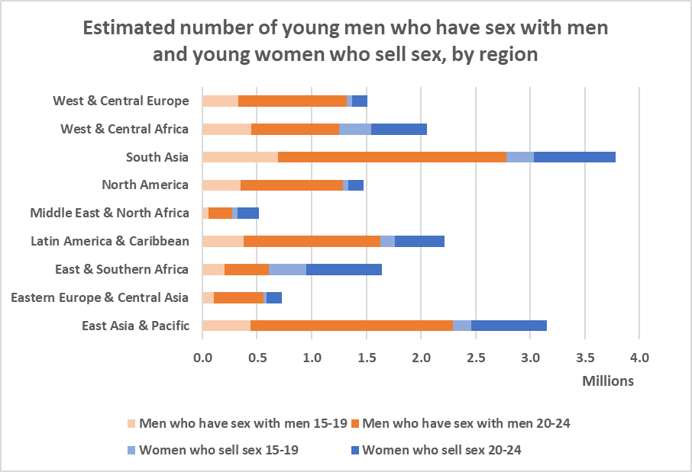
Globally, there are an estimated 17 million young gay, bisexual
and other men who have sex with men, and young females selling sex
Notes:
Regions are UNICEF regions.
The United Nations does not recognise “sex workers” under the age of 18 and considers girls under age 18 selling sex to be exploited youth.
Analogous population size estimates for young transgender people and young people who inject drugs are not currently available.
Source: Johnston LG, et al. Deriving and interpreting population size estimates for adolescent and young key populations at higher risk of HIV transmission: Men who have sex with men and females who sell sex. PLOS ONE. 2022;17(9):e0269780.
MODULE 7 | VULNERABILITY OF ADOLESCENT AND YOUNG KEY POPULATIONS

Slide 12
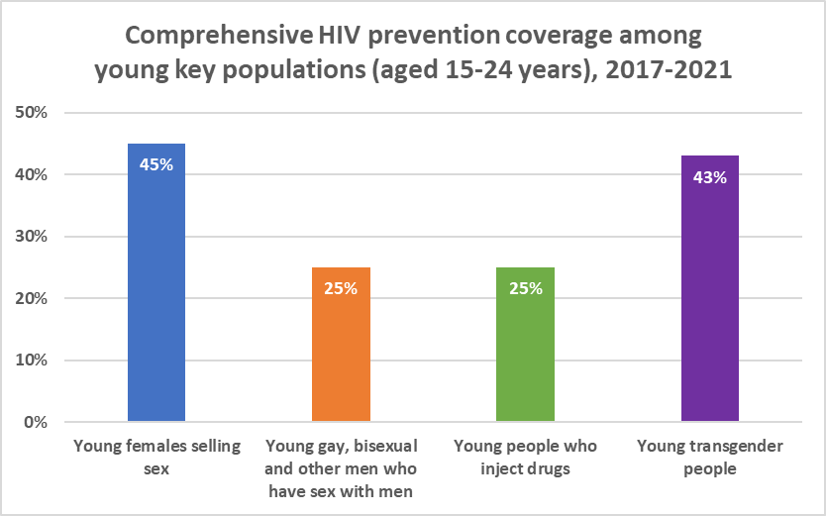
Young key populations have poor access to
comprehensive HIV prevention interventions
Notes:
Comprehensive prevention coverage is the percentage of people in a key population who report having received at least two of the following HIV prevention interventions in the past three months: (1) condoms and lubricants; (2) counselling on condom use and safe sex; (3) testing for STIs (for transgender people, females selling sex and gay, bisexual and other men who have sex with men), or received sterile needles or syringes (for people who inject drugs).
Calculations are based on nine reporting countries for females selling sex, eight reporting countries for gay, bisexual and other men who have sex with men, four reporting countries for transgender people, and three reporting countries for people who inject drugs.
Source: Global AIDS Update 2022 (UNAIDS, 2022)
MODULE 7 | VULNERABILITY OF ADOLESCENT AND YOUNG KEY POPULATIONS

Slide 13
Young key populations are at
particular risk of HIV
The global response to HIV, viral hepatitis and STIs has not successfully reached adolescent and young key populations.
In 2021, 27% of new HIV infections globally were among young people (aged 15-24).
Outside sub-Saharan Africa, adolescent and young key populations account for the majority of new HIV infections among adolescents and young people.
In Asia-Pacific, 26% of all new HIV infections occur among young people – and 99% of those are young people from key populations and their sex partners.
Rates of viral hepatitis C are high and rising among young people who inject drugs and young gay, bisexual and other men who have sex with men.
Sources: UNAIDS Global AIDS Monitoring, 2022 (https://aidsinfo.unaids.org/); Global AIDS Update 2022 (UNAIDS, 2022); Putting Young Key Populations First: HIV and Young People from Key Populations in the Asia and Pacific Region 2022 (UNAIDS, 2022); Consolidated guidelines on HIV, viral hepatitis and STI prevention, diagnosis, treatment and care for key populations (WHO, 2022)
MODULE 7 | VULNERABILITY OF ADOLESCENT AND YOUNG KEY POPULATIONS

Slide 14
Adolescence and young adulthood
Adolescence and young adulthood are periods when identities are forminged and new life explorations and experiences are made. Adolescents in particular are still developing into mature people. They experience rapid emotional, physical and social changes. These combine with structural factors in ways that affect the ability of adolescents and young people to make healthy choices for themselves. Power imbalances in relationships due to their age can make them especially vulnerable to HIV, viral hepatitis and other STIs.
These challenges are even more acute for adolescents and young people from key populations.
MODULE 7 | VULNERABILITY OF ADOLESCENT AND YOUNG KEY POPULATIONS

Slide 15
Access to information
Many adolescent and young key populations lack accurate, age-appropriate information on sexual and reproductive health, and have misconceptions about the risks of HIV, viral hepatitis and other sexually transmitted infections. Reasons for this include:
Lack of comprehensive sexuality education (CSE) in school and out-of-school, or poorly implemented CSE which does not address key populations’ needs and issues
Inaccurate or negative messaging on sexual and reproductive health from family, teachers and health-care providers
Sexual and reproductive health services designed for young people do not exist, or where they exist, they are not inclusive of key populations, or young people are unaware of them
Few young people from key populations receive adequate information and education centred on their sexual lives. Instead, they receive negative, critical, conflicting or confusing messages about gender, drug use, unintended pregnancy and STIs, including HIV.
WHO Key Populations Consolidated Guidelines, 2022
MODULE 7 | VULNERABILITY OF ADOLESCENT AND YOUNG KEY POPULATIONS

Slide 16
Health-care providers
Health-care providers often contribute to the barriers faced by adolescent and young key populations in accessing information and services for HIV and sexual and reproductive health. Because of inadequate knowledge, or because of their own prejudice, health-care providers may:
Be hostile to adolescent and young key populations, or deny them services outright
Pressure adolescent and young key populations to change their sexual orientation (including promoting “conversion therapies”), stop selling sex, or stop using drugs; this is likely to discourage them from returning to seek information and care
Misunderstand prevailing laws about consent for treatment by young people aged under 18; or believe incorrectly that the adolescent or young person is unable to consent to treatment
Legal reforms or workarounds can circumvent obstructive laws and practices, while training and closer monitoring can reduce stigma and discrimination at health facilities.
Global AIDS Update 2022
MODULE 7 | VULNERABILITY OF ADOLESCENT AND YOUNG KEY POPULATIONS

Slide 17
Legal, policy and social environments
Several factors prevent young key populations from accessing and taking up services:
Legal restrictions on providing sexual and reproductive health services (including HIV testing and treatment) to those under 18 without parental/guardian consent
Incoherence between age of consent requirements for sexual consent, medical testing and treatment, and marital union
Incoherence between traditional/customary, religious and civil law
Outright exclusion of young people under 18 from certain services, such as experimental treatments, and pre-exposure prophylaxis (PrEP) for HIV, in some contexts
Adolescents and young key populations are not consulted when services are designed and planned
MODULE 7 | VULNERABILITY OF ADOLESCENT AND YOUNG KEY POPULATIONS

Slide 18
Legal, policy and social environments
Evidence from sub-Saharan Africa shows that removing or relaxing laws that require parental consent prior to HIV testing improves the health-seeking behaviours of adolescents and young people.
Countries that have recently revised their laws or policies to make it easier for adolescents to access HIV testing and other HIV services include the Lao People’s Democratic Republic, Myanmar, Nepal, New Zealand, Papua New Guinea, the Philippines, Sri Lanka, Thailand and Viet Nam.
Source: Global AIDS Update 2022 (UNAIDS, 2022)
MODULE 7 | VULNERABILITY OF ADOLESCENT AND YOUNG KEY POPULATIONS

Slide 19
Module 7 Contents
Questions to frame this module
Some definitions
Vulnerability of adolescent and young key populations
Making services adolescent- and youth-friendly
Leadership of adolescent and young key populations
Youth-led and youth-focused interventions to remove barriers to services
UN frameworks and normative guidance on adolescent and young key populations
Take-home messages
Module review questions
Further information and resources

Slide 20
Youth-friendly services
Services must be designed and delivered to consider the differing needs and rights of young people according to their age, gender identity, sexual orientation, specific behaviours, the complexities of their social and legal environment and the epidemic setting, while simultaneously respecting the Convention on the Rights of the Child.
WHO Key Populations Consolidated Guidelines, 2022
WHO provides guidance on this in Making health services adolescent friendly: Developing national quality standards for adolescent friendly health services (2012).
MODULE 7 | MAKING SERVICES ADOLESCENT- AND YOUTH-FRIENDLY

Slide 21
Key characteristics of effective services
for adolescent and young key populations
Quality services are friendly, tailored, affordable, confidential, safe and easy to access, at convenient times
Comprehensive, youth-centred services are integrated and decentralised where relevant
Developmentally appropriate information and education are provided
Healthcare providers, peers, educators, people working in welfare, social and justice services are trained and competent to provide quality services for young people
Supportive and make use of peer based and peer-led initiatives (with appropriate remuneration of young people)
Source: Consolidated guidelines on HIV, viral hepatitis and STI prevention, diagnosis, treatment and care for key populations (WHO, 2022)
MODULE 7 | MAKING SERVICES ADOLESCENT- AND YOUTH-FRIENDLY

Slide 22
Module 7 Contents
Questions to frame this module
Some definitions
Vulnerability of adolescent and young key populations
Making services adolescent- and youth-friendly
Leadership of adolescent and young key populations
Youth-led and youth-focused interventions to remove barriers to services
UN frameworks and normative guidance on adolescent and young key populations
Take-home messages
Module review questions
Further information and resources

Slide 23
Young people are calling for action
Across regions and in many countries, youth organisations are advocating for greater involvement in policy and service delivery in HIV, sexual and reproductive health and rights.
At the International AIDS Conference in July 2022, the Youth Force Declaration was presented by Montreal Youth Force 2022, a global coalition of youth-led organisations inclusive of key populations. The Declaration calls for greater involvement of young people in the global HIV response.
At the 2nd Asia-Pacific Youth Forum in October 2022, youth advocates from 14 countries issued a set of nine recommendations for a comprehensive approach to young key populations and HIV. They advocated for more youth leadership, equitable access to quality and youth-friendly healthcare services, stronger strategies to tackle stigma and discrimination and increased access to funding for youth-led and key population programming.
In conjunction with youth-led groups, UN staff can lead advocacy efforts to ensure that a focus on enabling environments for youth is articulated in national plans on HIV and sexual and reproductive health and rights.
MODULE 7 | LEADERSHIP OF ADOLESCENT AND YOUNG KEY POPULATIONS

Slide 24
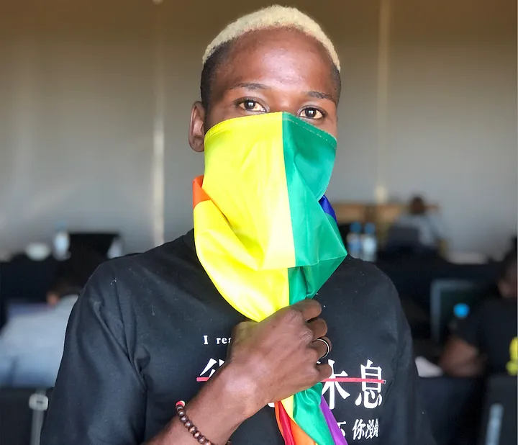
The Global AIDS Strategy
The Global AIDS Strategy 2021-2026 calls for young people to be “fully empowered and resourced to set new a direction for the HIV response and unlock the progress needed to end inequalities and end AIDS”
(Result Area 7)
Among the Strategy’s priority actions are several that call for greater involvement and leadership of young people:
Scaling up the meaningful engagement and leadership of young people in all HIV-related processes and decision-making spaces
Accelerating investment in youth leadership, capacity-building and skills development
Fostering partnerships between youth-led organisations and other stakeholders
Redesigning HIV services to meet the needs of adolescents and young people
Image: Wanzyanji Mulwanda/UNDP - A participant at a UNDP’ Linking Policy to Programming project media training workshop, where young key populations expressed aspirations to make their voices heard and change the narrative on being LGBTI in Africa. Full story here.
MODULE 7 | LEADERSHIP OF ADOLESCENT AND YOUNG KEY POPULATIONS

Slide 25
Module 7 Contents
Questions to frame this module
Some definitions
Vulnerability of adolescent and young key populations
Making services adolescent- and youth-friendly
Leadership of adolescent and young key populations
Youth-led and youth-focused interventions to remove barriers to services
UN frameworks and normative guidance on adolescent and young key populations
Take-home messages
Module review questions
Further information and resources

Slide 26

Case study: Peer education
Myanmar Youth Stars is a national network that draws together 1,200 young people from key populations in Myanmar. Active in 18 towns, it offers a variety of HIV services, including condom distribution and referrals for HIV testing and treatment.
In 2019, it ran a 6-month peer education programme for young people from key populations, with the support of UNFPA Myanmar. The programme focused on providing comprehensive sexuality education to young people from key populations to improve their knowledge about sexual and reproductive health and rights and HIV. Myanmar Youth Stars trained 646 youth to share sexual health information with their peers and improved their peer counselling skills.
HIV interventions for young key populations are likely to perform better if they include peer support and are designed and run by community-led organisations that include adolescents and young people.
Global AIDS Update 2022
MODULE 7 | YOUTH-LED AND -FOCUSED INTERVENTIONS TO REMOVE BARRIERS TO SERVICES

Slide 27
E-health as a channel for outreach
and services
E-health services can be particularly convenient and relevant to young key populations. HIV programmes can use the Internet, social media and dating platforms to share information and link young key populations to relevant services. Examples include:
Philippines: The LoveYourSelf project operates an online, app-based condom distribution service called SafeSpacesPH, which allows young people to access condoms without embarrassment or stigma.
Thailand: The TestMeNow system allows young people to easily book an HIV test online and then take that test at a community-based or private sector clinic.
MODULE 7 | YOUTH-LED AND -FOCUSED INTERVENTIONS TO REMOVE BARRIERS TO SERVICES

Slide 28
Case study: Advocacy for legal changes
to protect young people’s rights
Peru’s criminal code prohibited sex between adolescents and prevented young people from accessing essential sexual and reproductive health services. This changed in 2013, when the country’s Constitutional Tribunal amended the law that had criminalised sex between consenting adolescents. Advocacy for the change was supported by UNAIDS and UNFPA in response to petitions which mobilised more than 10,000 Peruvians. The change in the law increased access ofto Peruvians between the ages of 14 and 18 to sexual and reproductive health services, and information about sexually transmitted infections, including HIV.
Source: Changes in Peru’s penal code will enable more young people to access HIV services (UNAIDS, 2013)
MODULE 7 | YOUTH-LED AND -FOCUSED INTERVENTIONS TO REMOVE BARRIERS TO SERVICES

Slide 29
Case study: Harm reduction for young
women who use drugs
Dristi Nepal is a non-governmental organisation providing harm reduction services. It opened a drop-in centre in 2018 and added an outreach needle-syringe programme and other harm reduction services, serving more than 700 young women who use drugs. It also provides HIV services.
Most of the women assisted by Dristi Nepal are homeless, poor and vulnerable to sexual and other forms of violence. Dristi Nepal started offering legal referral and support services and provided shelter for survivors of violence, but the COVID-19 pandemic made it impossible to continue.
MODULE 7 | YOUTH-LED AND -FOCUSED INTERVENTIONS TO REMOVE BARRIERS TO SERVICES

Slide 30
Advocacy for young people who
use drugs
In many countries, initiation into drug use happens at a young age. Despite this, young people find it difficult to find information, sterile injecting equipment, drug dependence treatment, and HIV testing, counselling and treatment. Parental consent requirements for HIV testing, and access to drug dependence treatment, make young people vulnerable to HIV.
WHO provides some considerations for advocacy at country level:
Examine existing consent policies in the country, and age-related role of parents and guardians for HIV and STI testing and treatment.
Include programming specific to the needs and rights of young people who use drugs in national health plans and policies. Ensure linkages with relevant plans and policies in areas such as child protection and to protect their right to education.
Provide support for youth-led organisations, including those working on harm reduction.
MODULE 7 | YOUTH-LED AND -FOCUSED INTERVENTIONS TO REMOVE BARRIERS TO SERVICES

Slide 31
Module 7 Contents
Questions to frame this module
Some definitions
Vulnerability of adolescent and young key populations
Making services adolescent- and youth-friendly
Leadership of adolescent and young key populations
Youth-led and youth-focused interventions to remove barriers to services
UN frameworks and normative guidance on adolescent and young key populations
Take-home messages
Module review questions
Further information and resources

Slide 32
The Convention on the Rights of the Child
The Convention on the Rights of the Child (CRC, 1990) obliges the state to protect the rights of all young people under 18 years of age. Its four guiding principles are non-discrimination; the best interests of the child; the right to life, survival and development; and respect for the young personʼs views.
The right to health: “States Parties recognise the right of the child to the enjoyment of the highest attainable standard of health and to facilities for the treatment of illness and rehabilitation of health. States Parties shall strive to ensure that no child is deprived of his or her right of access to such health care services” (Article 24/1).
Best interests of the child: “In all actions concerning children… the best interests of the child shall be a primary consideration” (Article 3/1).
Evolving capacities of the child: The CRC recognises the responsibilities, rights and duties of parents/guardians to direct and guide the exercise by the child of the rights recognised by the CRC “in a manner consistent with the evolving capacities of the child” (Article 5).
Under the CRC, children have a clear right to access effective HIV, STI and viral hepatitis prevention, diagnosis, treatment, care and support services.
MODULE 7 | UN FRAMEWORKS AND NORMATIVE GUIDANCE

Slide 33
UNICEF Guidelines on Adolescent
Participation and Civic Engagement
ENGAGED AND HEARD! Guidelines on Adolescent Participation and Civic Engagement (UNICEF, 2020) offers information on the “why”, “what” and “how-to” of participation and civic engagement to realise adolescents’ right to be heard in matters affecting them. Strategies include:
Advocate for laws, policies, practices and budgets that institutionalise adolescent participation and civic engagement
Enhance positive social norms and attitudes that support adolescent participation and civic engagement
Build the awareness, skills and capacities of adults to promote and support adolescent participation and civic engagement
Build the awareness, skills and capacities of adolescents (especially the most marginalised) to participate and civically engage
Create and sustain platforms for adolescent participation and civic engagement.
MODULE 7 | UN FRAMEWORKS AND NORMATIVE GUIDANCE

Slide 34
The Global Consensus Statement on Meaningful
Adolescent & Youth Engagement (MAYE)
The Global Consensus Statement on MAYE (2020) defines meaningful engagement and affirms five principles of participation of adolescents and youth in programmes for them.
Meaningful adolescent and youth engagement is an inclusive, intentional, mutually respectful partnership between adolescents, youth, and adults whereby power is shared, respective contributions are valued, and young people’s ideas, perspectives, skills, and strengths are integrated into the design and delivery of programs, strategies, policies, funding mechanisms, and organisations that affect their lives and their communities, countries, and the world.
Principles of participation
Rights-based
Transparent and informative
Voluntary and free from coercion
Respectful of young people’s views, backgrounds, and identities
Safe
MODULE 7 | UN FRAMEWORKS AND NORMATIVE GUIDANCE

Slide 35
The Global AIDS Strategy
The Strategy’s 10-10-10 targets call for action to ensure that by 2025:
Less than 10% of countries have punitive legal and policy environments
Less than 10% of people living with HIV and key populations experience stigma and discrimination
Less than 10% of women, girls, people living with HIV and key populations experience gender inequality and violence.
These targets apply equally and importantly to adolescent and young key populations.
MODULE 7 | UN FRAMEWORKS AND NORMATIVE GUIDANCE

Slide 36
Module 7 Contents
Questions to frame this module
Some definitions
Vulnerability of adolescent and young key populations
Making services adolescent- and youth-friendly
Leadership of adolescent and young key populations
Youth-led and youth-focused interventions to remove barriers to services
UN frameworks and normative guidance on adolescent and young key populations
Take-home messages
Module review questions
Further information and resources

Slide 37
Take-home messages
Adolescent and young key populations are particularly vulnerable to HIV, viral hepatitis and other STIs because of their age and because of structural factors that create barriers to their access to services – both as young people and as members of key populations.
Adolescent and young key populations, including those aged under 18, have the same rights to receive effective HIV, viral hepatitis and STI prevention and life-saving care and support as all young people, and all people generally.
The Convention on the Rights of the Child obliges the state to protect the rights of all young people under the age of 18. The Global AIDS Strategy and other UN guidance prioritise services and societal enablers for adolescent and young key populations.
Adolescent-led and youth-led organisations – including organisations of young key populations – should be capacitated and supported to develop and implement HIV and sexual and reproductive health and rights programmes for their peers.
UN organisations should encourage countries to examine their age of consent policies and to consider revising them to reduce age-related barriers to access and uptake services and interventions that are critical to the health and well-being of young key populations.
MODULE 7 | TAKE-HOME MESSAGES

Slide 38
Module 7 Contents
Questions to frame this module
Some definitions
Vulnerability of adolescent and young key populations
Making services adolescent- and youth-friendly
Leadership of adolescent and young key populations
Youth-led and youth-focused interventions to remove barriers to services
UN frameworks and normative guidance on adolescent and young key populations
Take-home messages
Module review questions
Further information and resources

Slide 39
Module 7 Contents
Questions to frame this module
Some definitions
Vulnerability of adolescent and young key populations
Making services adolescent- and youth-friendly
Leadership of adolescent and young key populations
Youth-led and youth-focused interventions to remove barriers to services
UN frameworks and normative guidance on adolescent and young key populations
Take-home messages
Module review questions
Further information and resources

Slide 40
Further information and resources (1)
IN DANGER: UNAIDS Global AIDS Update 2022 (UNAIDS, 2022)
Key Populations Atlas (UNAIDS)
Consolidated Guidelines on HIV, Viral Hepatitis and STI Diagnosis, Prevention, Treatment and Care for Key Populations (WHO, 2022)
AyKP toolkit (UNFPA, UNDP, UNICEF, 2022)
HIV and Young People who Sell Sex: Technical Brief (WHO, 2015)
HIV and Young Men who Have Sex with Men: Technical Brief (WHO, 2015)
HIV and Young People who Inject Drugs: Technical Brief (WHO, 2015)
HIV and Young Transgender People: Technical Brief (WHO, 2015)
MODULE 7 | FURTHER INFORMATION AND RESOURCES

Slide 41
Further information and resources (2)
Global Consensus Statement: Meaningful Adolescent and Youth Engagement (2020)
Youth Declaration (Montreal Youth Force, 2022)
Putting Young Key Populations First: HIV and Young People from Key Populations in the Asia and Pacific Region 2022 (UNAIDS, 2022)
We Matter, Value Us: A Guideline for Organisations on the Meaningful and Ethical Engagement of Young People Living with HIV in the HIV Response (Y+ - Global Network of Young People Living with HIV, 2022)
Positive Learning: How the Education Sector can Meet the Needs of Learners Living with HIV (UNESCO, 2021)
MODULE 7 | FURTHER INFORMATION AND RESOURCES

