Slide 1



National HIV Prevention Summit 2024
Accra, Ghana
13th June 2024

Slide 2
Stakeholders break out into groups of 10 people each to prioritize HIV prevention agenda for the country.
(i) Discuss and prioritize the HIV prevention agenda provided in the attached mapping template (prioritization criteria have been provided on the next page).
(ii) Include additional HIV prevention activities discussed by the group.
- 2 groups to report their top 3 challenges with prioritization that came out of the brainstorm
- 2groups to report on opportunities and positive feedback from the brainstorm.
- 2 groups to report on recommendations and way forward.
- 1 table to report on looking forward & sustainability.

Slide 3
HIV Prevention Prioritization Criteria
Impact on HIV prevention | The potential of the activity to reduce HIV transmission rates.
Target population needs | The extent to which the activity addresses the needs of high-risk or vulnerable populations
Feasibility | The practicality and ease of implementing the activity.
Cost-effectiveness | The cost-effectiveness of the activity

Slide 4
HIV Prevention Prioritization Criteria
Alignment with national strategic goals | The degree to which the activity aligns with the national strategic goals for HIV prevention
Community support and involvement | The level of community support and involvement in the activity
Innovations | The inclusion of innovative and potentially more effective methods for HIV prevention
Sustainability | The potential for the activity to have a long-term impact and sustainability beyond the initial funding period

Slide 5
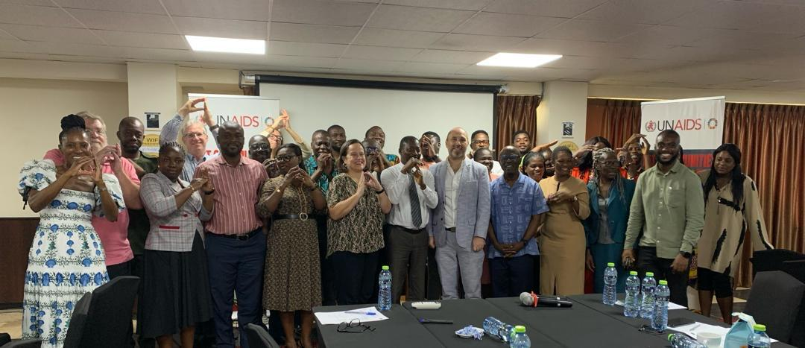
Prioritized HIV Prevention Agenda Mapping Exercise

Slide 6
Pillar 1: Key Populations
Activity (Rate 1-5) | Description | Target Group/Geographic Coverage | Implementation Timeframe (2024 – 2025) | Resources Available/ Resources Needed
 |  |  |  | Resources Available? Yes ☐ No ☐ Resources Needed:
 |  |  |  | Resources Available? Yes ☐ No ☐ Resources Needed:
 |  |  |  | Resources Available? Yes ☐ No ☐ Resources Needed:

Slide 7
Pillar 2: Adolescent Girls and Young Women
Activity (Rate 1-5) | Description | Target Group/Geographic Coverage | Implementation Timeframe (2024 – 2025) | Resources Available/ Resources Needed
 |  |  |  | Resources Available? Yes ☐ No ☐ Resources Needed:
 |  |  |  | Resources Available? Yes ☐ No ☐ Resources Needed:
 |  |  |  | Resources Available? Yes ☐ No ☐ Resources Needed:

Slide 8
Pillar 3: Adolescent Boys and Men
Activity (Rate 1-5) | Description | Target Group/Geographic Coverage | Implementation Timeframe (2024 – 2025) | Resources Available/ Resources Needed
 |  |  |  | Resources Available? Yes ☐ No ☐ Resources Needed:
 |  |  |  | Resources Available? Yes ☐ No ☐ Resources Needed:
 |  |  |  | Resources Available? Yes ☐ No ☐ Resources Needed:

Slide 9
Pillar 4: Condom Programming
Activity (Rate 1-5) | Description | Target Group/Geographic Coverage | Implementation Timeframe (2024 – 2025) | Resources Available/ Resources Needed
 |  |  |  | Resources Available? Yes ☐ No ☐ Resources Needed:
 |  |  |  | Resources Available? Yes ☐ No ☐ Resources Needed:
 |  |  |  | Resources Available? Yes ☐ No ☐ Resources Needed:

Slide 10
Pillar 5: ARV-Based Prevention
Activity (Rate 1-5) | Description | Target Group/Geographic Coverage | Implementation Timeframe (2024 – 2025) | Resources Available/ Resources Needed
 |  |  |  | Resources Available? Yes ☐ No ☐ Resources Needed:
 |  |  |  | Resources Available? Yes ☐ No ☐ Resources Needed:
 |  |  |  | Resources Available? Yes ☐ No ☐ Resources Needed:

