Slide 1

Core issues in HIV prevention among Key Populations
Dave Burrows
Tuesday, 25 September 2018
Geneva, Switzerland

Slide 2
Overview
Why key populations?
Recommended service packages
Global Fund study on service packages
Core issues

Slide 3
Stef Baral’s final slide: Plenary, AIDS 2018
HIV is not Zika
The risks for HIV are not evenly distributed in any population anywhere in the world
Move away from the term “general population”
Understanding who and why people are at risk for and living with HIV can support improved individual services and larger scale program implementation

Slide 4
Key Populations
Gay and other men who have sex with men
Sex workers: female, male and transgender
People who inject drugs
Transgendered people
Prisoners

Slide 5
Miles to GO: UNAIDS Update 2018
40% of new HIV infections globally in 2017 among key populations and their sexual partners
Risk of HIV acquisition among
gay men and other men who have sex with men 28 times higher than among heterosexual men.
people who inject drugs 22 times higher than for people who do not inject drugs,
female sex workers 13 times higher than adult women aged 15–49 years,
and 13 times higher for transgender women than adults aged 15–49 years

Slide 6
Key Population Service Packages
WHO (2016) Consolidated guidelines on HIV prevention, diagnosis, treatment and care for key populations
SWIT (2013) Implementing Comprehensive HIV/STI Programmes with Sex Workers developed by WHO in collaboration with international partners
UNODC (2013) HIV prevention, treatment and care in prisons and other closed settings developed with international partners
MSMIT (2015) Implementing Comprehensive HIV and STI Programmes with Men Who Have Sex with Men developed by UNFPA in collaboration with international partners
TRANSIT (2016) Implementing Comprehensive HIV and STI Programmes with Transgender People developed by UNDP in collaboration with international partners
IDUIT (2017) Implementing Comprehensive HIV and HCV Programs with People Who Inject Drugs developed with the support of UNODC

Slide 7
Essential Health Sector Interventions
Comprehensive condom and lubricant programming
Harm reduction interventions for substance use, in particular needle and syringe programs and opioid substitution therapy
Behavioral interventions
HIV testing and counseling
HIV treatment and care
Prevention and management of co-infections and other comorbidities, including viral hepatitis, TB, and mental health conditions
Sexual and reproductive health interventions

Slide 8
Essential Strategies for an Enabling Environment
Supportive legislation, policy, and financial commitment, including decriminalization of behaviors of KP
Addressing stigma and discrimination
Community empowerment
Addressing violence against people from key populations

Slide 9
UNAIDS Guidance
UNAIDS (2015) Fast-tracking Combination Prevention
UNAIDS (2017) HIV Prevention 2020 Road Map

Slide 10
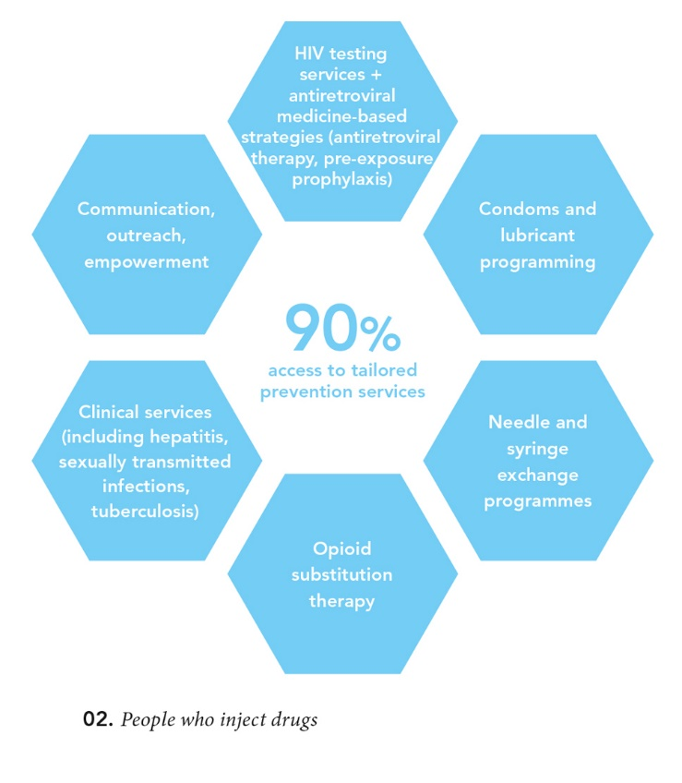
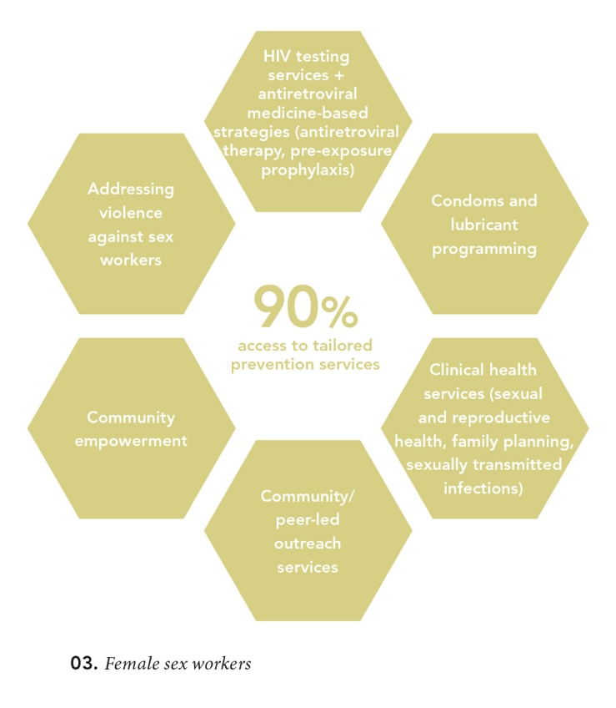
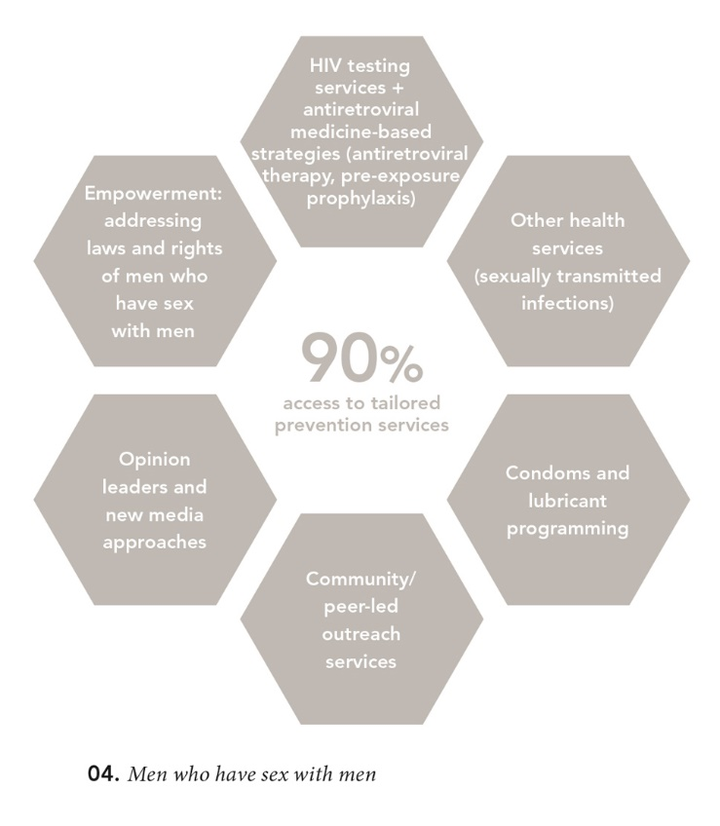
Combination Prevention Interventions

Slide 11
Global Fund study on KP Service Packages
Review the design, implementation and monitoring of the delivery of intervention service packages for key populations in the continuum of prevention, testing, care and treatment since 2013.
Desk reviews carried out of KP Service packages for 5 KP in 65 countries
In-country visits for more detailed reviews of 2-3 KP service packages in 32 countries
Country, six regional and global reports

Slide 12
KP packages Assessed In-Country
MSM |  | FSW | PWID | TG | Prisoners
Afghanistan Indonesia Nepal Pakistan Philippines Belarus Georgia Kosovo Moldova Ukraine Angola Kenya Madagascar Malawi | South Africa DR Guatemala Guyana Haiti Peru Morocco Sudan Benin Cameroon Mali Sierra Leone Togo Tunisia | Indonesia PNG Armenia Kyrgyzstan Uzbekistan Angola Kenya Madagascar Malawi South Africa Guyana Haiti Morocco Sudan Benin Cameroon Mali Sierra Leone Togo | Afghanistan Nepal Pakistan Armenia Belarus Georgia Kosovo Kyrgyzstan Moldova Ukraine Uzbekistan Kenya Morocco Sierra Leone | Indonesia Nepal PNG Philippines DR Guatemala Peru | None

Slide 13
Global Fund study on KP Service Packages
This approach has been substantially successful
More countries have identified key populations for programming within their National Strategic Plans
More countries are implementing specific interventions to KP for HIV prevention, testing, treatment, and care and to address human rights barriers and co-morbidities
Few of the implemented activities lie outside the list designated by WHO and other agencies as evidence-based HIV-related interventions
More countries know more about KP including population sizes, characteristics of KP, how to reach and provide prevention products to KP
With more funding from international donors (and some increase in domestic funding), more countries are reaching more KP with appropriate services and can measure the reach and coverage of these interventions

Slide 14
Global Fund study on KP Service Packages
Looked separately at issues related to:
Design: whether KP packages in NSP or supported by Global Fund grants are appropriate to epidemiological contexts, in line with international standards and guidelines (WHO 2016).
Implementation: whether KP packages are reaching intended target groups, including, coverage, quality and whether these programs are available, accessible and utilized by KP.
Monitoring: whether the framework, monitoring tools and mechanism set up by implementation partners are appropriate to local contexts, and are used effectively to regularly report on programmatic coverage.

Slide 15
Elements included in national designs - SW

Slide 16
Design Analysis
Individuals from and organizations run by key populations need to be fully involved in designing service packages
Lack of or inadequate definitions of coverage for most interventions
Some key populations are not recognized in national documents; some are recognized but no package is designed
Lack of lubricant to accompany condom programming across populations (some exceptions in MSM packages)
Inadequate inclusion of needle-syringe programs and opioid substitution treatment for PWID and prisoners

Slide 17
Design Analysis
New elements have not included in the majority of countries: PrEP and overdose prevention
Community empowerment is rarely mentioned in design documents
Activities to reduce the most prominent human rights barriers need to be included in designs
HTC and ART particularly important to reach 90-90-90 targets – but not all countries specify these interventions for key populations
Other complementary services, addressing comorbidities and related health needs, need more careful consideration during design phases

Slide 18
Implementation across KP
Implementation matched design in broad terms, for most populations for most countries
Range and quality of services delivered differs considerably from country to country
In most countries, services are concentrated (along with populations) in the urban centers of the jurisdictions with the highest prevalence
Leads to some under-servicing (and sometimes no dedicated servicing) of KP in rural areas or in lower-prevalence provinces

Slide 19
Implementation Analysis: Key Points
Condom programming is in place but there are many problems with appropriate quality, consistency of supply and availability of appropriate lubricant
Increased levels of HIV testing but concerning results in linkage to treatment and care
Ambitious testing targets leave little time and resources for a broad health engagement with KP
Social media outreach to KP is increasingly becoming an essential element of services, but requires standard setting and guidance
There is still a resistance to testing among certain sub-populations (especially MSM)

Slide 20
Monitoring Analysis: Key Points
Key data gaps remain
Accuracy of programmatic coverage data continues to be a concern
Coverage of a defined package of services is difficult and rarely recorded well
Data collection and data entry are highly inefficient in most countries
Security of data remains a major concern
Data analysis is generally only carried out at the PR level or not at all
SW data disaggregation remains rare.
Prisoner data remains very poor

Slide 21
Limits of a Standardized Package: 3 Trends
A reduction of growth in HIV spending globally, particularly from international donors
While efforts are under way to increase domestic funding of HIV programs, there has been very limited success to date in encouraging governments to increase (or even to begin) funding KP programs
A substantial number of countries are either in transition or will transition from international donor funding for HIV during the next decade
A narrowing of focus of outreach and peer education
Not universal but it can be observed in many countries that outreach workers and/ or peer educators are mostly delivery systems for health products (condoms, lubricant, injecting equipment, IEC materials), data collectors and HIV test promoters

Slide 22
Limits of a Standardized Package: 3 Trends
Standard service package my be too restrictive and may hamper creativity and local problem-solving in more mature responses
Mature responses have started at least 15 years ago, may also be home to generalized epidemics
Kenya, South Africa, Indonesia, the Philippines (MSM programs) and Ukraine are examples of mature responses
Would potentially benefit from a differentiated approach

Slide 23
Core issues
Design of service packages for all KP in the country, in collaboration with KP organizations/ networks: in particular, more work needed for PWID, TG and prisoners
Differentiation of service delivery to meet KP needs (within a standardized framework of national design)
Reach/ coverage and service quality often at odds
Specific issues related to SW: female, male, TG. Who works with whom?
Specific issues on MSM and HIV testing: linked to grave fears about being/ being known to be HIV-positive
Monitoring coverage of “package of defined services” requires significant discussion and consensus at national level

Slide 24
Thank you!

