Slide 1
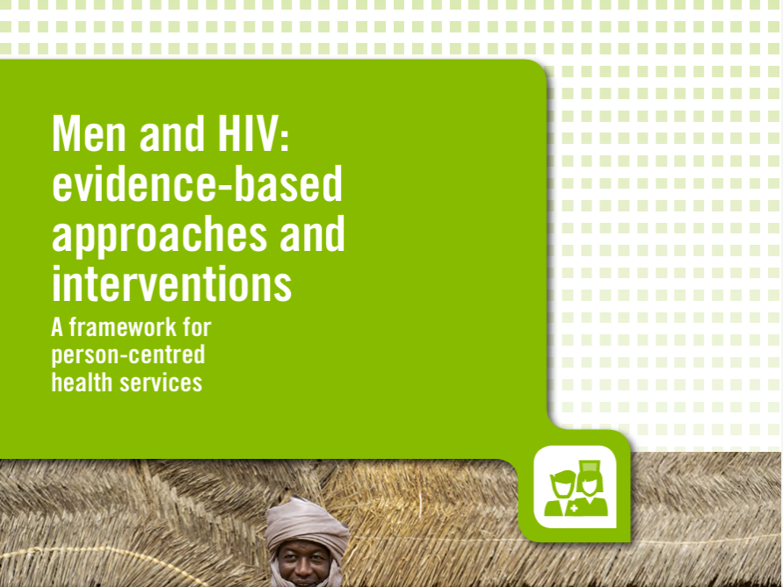
Men and Boys
HIV prevention with men & boys in settings with high HIV (including what’s next for VMMC)
Virtual Session on Overview of prevention tools and guidance for the GC8
Presented by Lycias Zembe: zembel@unaids.org
Global HIV Prevention Coalition, UNAIDS, Geneva
27 April 2026

Slide 2

Why VMMC still matters in high-incidence settings
VMMC remains a high-impact “prevention insurance” intervention for men and boys—especially where incidence is high and systems are fragile.
Proven efficacy: ~60% reduction in female-to-male HIV transmission; one-time, permanent partial protection.
Scale + impact: 41+ million men and boys reached (15 priority countries) through 2024; >250,000 infections averted; potential 1.5 million by 2030 if sustained.
Epidemic reality: Even with progress (regional ~81% viral suppression), eastern & southern Africa still sees ~450,000 new infections/year.
High-incidence targeting is key: ~23% of the population live in areas with incidence >0.35% where VMMC remains highly cost-effective.
Notes:
VMMC is not a legacy programme—it’s a durable, cost-effective prevention tool for men and boys in high-incidence settings. It offers one-time, permanent protection and acts like prevention insurance when treatment systems get disrupted. After 38 million circumcisions, we’ve already averted about 250,000 infections, and the upside remains large—up to 1.5 million by 2030 if sustained. Incidence is not uniform, so the ‘next’ VMMC is about precision: focus on districts where incidence is still high and where VMMC delivers the strongest value.

Slide 3
The question is not “does VMMC work?”— it’s “how do we sustain it after financing shocks?
Post-2025 cuts disrupted 13/15 countries => workforce, kits, QA, M&E.
Next phase => differentiated approach => sustain/optimize, stabilize/transition, rebuild integration-first, maintain gains.
Safety & QA are non‑negotiable.
Notes:
The financing and operational context changed dramatically in 2025. Rapid operational assessments described severe disruption across 13 of 15 priority countries, with immediate impacts: trained workforce losses, commodity and kit stockouts, weakened quality assurance, and non-functional monitoring systems. That reality forces a differentiated strategy rather than a one-size-fits-all plan. The brief lays out practical country archetypes: countries that can sustain and optimize; countries that must stabilize and transition; countries where services have collapsed and rebuilding must be integration-first; and places with high coverage where the goal is to maintain gains efficiently. Across every pathway, safety is non-negotiable—minimum clinical standards, infection prevention, supervision, and adverse event monitoring must be protected, even if volumes are reduced.

Slide 4
What’s next for VMMC: an integrated men-and-boys prevention platform (5 moves)
Make VMMC sustainable by embedding it into routine systems, targeting smarter, and expanding value for men and boys.
Integrate into primary care + task shifting: Use trained nurses/clinical officers with standardized training and supervision to reduce cost and protect continuity.
Precision targeting: Prioritize highest-incidence districts and priority age cohorts under constrained resources; reallocate from very low-incidence areas.
Position VMMC as a “men’s health gateway”: Combine with HIV testing, linkage to ART, STI services, condoms, and referrals (plus male-friendly hours and environments).
Domestic + innovative financing: Co-financing pathways; integrate into insurance/benefit packages; explore earmarked levies/sin taxes; performance-linked financing.
Combination prevention, not competition: VMMC complements PrEP/long-acting options (e.g., lenacapavir) by providing durable baseline protection while PrEP targets highest-risk men.
Notes:
Here’s the forward strategy in five moves. First, integrate VMMC into routine primary care and use task shifting with standardized training and supervision—evidence from settings like Zimbabwe and Lesotho supports quality with appropriate oversight. Second, prioritize the highest-incidence districts and priority age cohorts to maximize impact per dollar. Third, reposition VMMC as a gateway to men’s and boys’ health: HIV testing with linkage, STI services, condoms, and referrals—delivered in male-friendly environments and hours. Fourth, anchor sustainability with domestic and innovative financing—co-financing pathways, insurance benefit packages, earmarked levies or results-based financing, and structured transition plans. Fifth, bring in private sector participation via social franchising and PPP models to expand access and efficiency while preserving national QA and reporting. Finally, frame VMMC as complementary to PrEP and long-acting prevention—VMMC provides prevention insurance when systems are stressed.

Slide 5
Key VMMC & Men's Health Resources
Selected WHO, UNAIDS & AVAC Publications · 2020–2025
#
Title
Organization
Year
Focus Area / Description
1
Men and HIV: Evidence-Based Approaches — A Framework for Person-Centred Health Services
WHO, UNAIDS
2023
Consolidated framework for the HIV cascade for men; three person-centred care pillars: Easy Access, Quality Services, and Supportive Services.
Practical Approaches and Case-Based Models for Reaching Men and Boys with Integrated HIV Services
Implementation brief with real-world case examples and scale-up guidance for evidence-based HIV strategies targeting men and boys in sub-Saharan Africa.
2
WHO, UNAIDS
2025
Assessing and Enhancing Sustainable VMMC Services: A Landscape Report of VMMC Priority Countries
Sustainability self-assessment of 15 VMMC priority countries across six WHO health system building blocks; identifies strengths, gaps, and strategic directions for East & Southern Africa.
3
WHO, UNAIDS
2023
Call to Action for Voluntary Medical Male Circumcision: The Job Is Not Done Yet
AVAC / UNAIDS / WHO
Joint advocacy brief urging accelerated VMMC funding (≥$250M/year), governance, differentiated service delivery, and innovation to reach 90% coverage by 2030.
4
2024
Preventing HIV Through Safe Voluntary Medical Male Circumcision for Adolescent Boys and Men in Generalized HIV Epidemics
Core WHO guidelines and operational recommendations for safe VMMC delivery; foundational document for the 15 VMMC priority country programmes and 2030 prevention targets.
5
WHO
2020
Policy Brief: Improving Men's Uptake of HIV Testing and Linkage to Services
Five WHO-recommended approaches for improving men's HIV testing uptake: facility-based, community-based, HIV self-testing, index testing, and social network-based strategies.
6
WHO
2021
Sources: WHO Global HIV, Hepatitis & STIs Programmes · UNAIDS · AVAC
For technical and programmatic audiences | Updated 2025

Slide 6
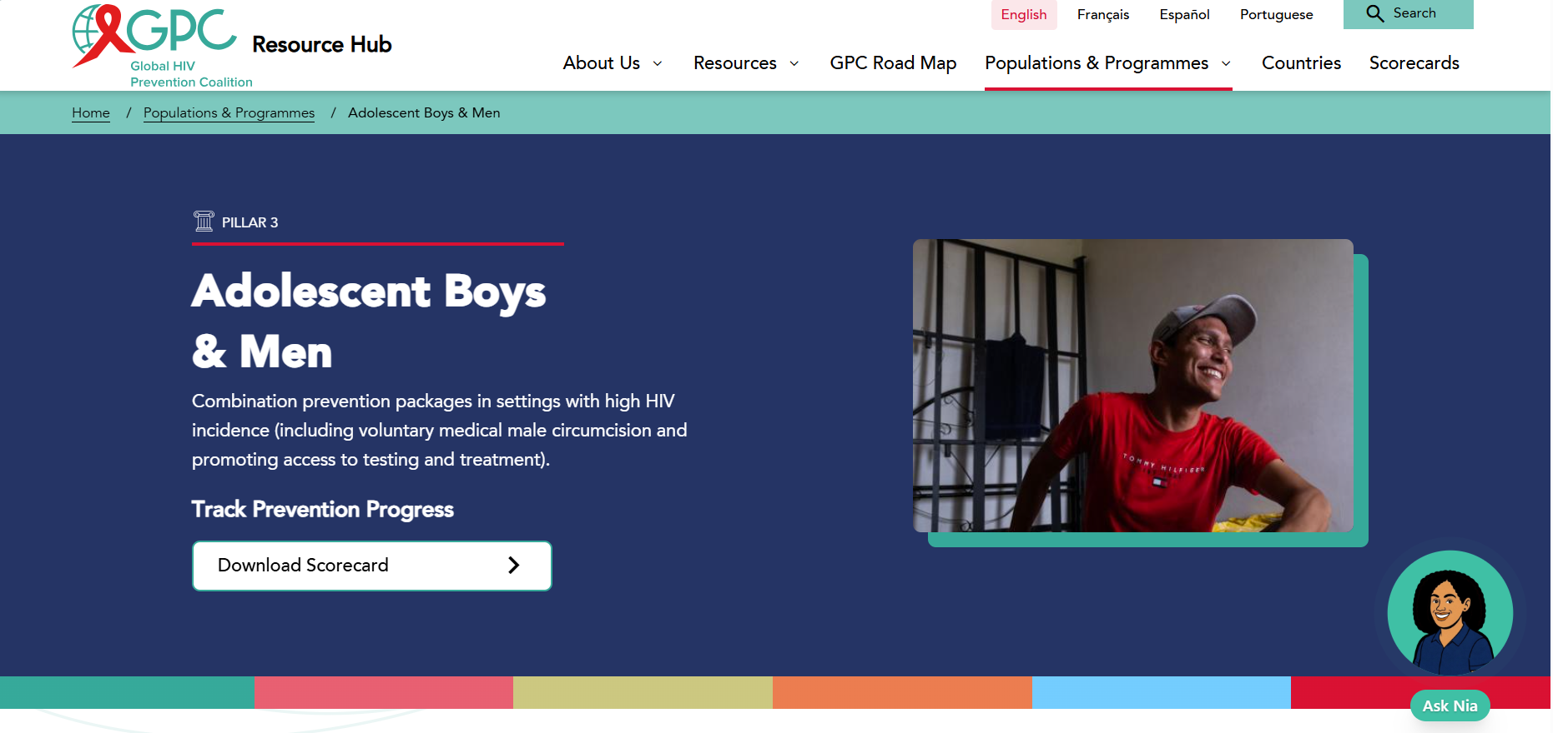
Notes:
Here’s the forward strategy in five moves. First, integrate VMMC into routine primary care and use task shifting with standardized training and supervision—evidence from settings like Zimbabwe and Lesotho supports quality with appropriate oversight. Second, prioritize the highest-incidence districts and priority age cohorts to maximize impact per dollar. Third, reposition VMMC as a gateway to men’s and boys’ health: HIV testing with linkage, STI services, condoms, and referrals—delivered in male-friendly environments and hours. Fourth, anchor sustainability with domestic and innovative financing—co-financing pathways, insurance benefit packages, earmarked levies or results-based financing, and structured transition plans. Fifth, bring in private sector participation via social franchising and PPP models to expand access and efficiency while preserving national QA and reporting. Finally, frame VMMC as complementary to PrEP and long-acting prevention—VMMC provides prevention insurance when systems are stressed.

