Slide 1
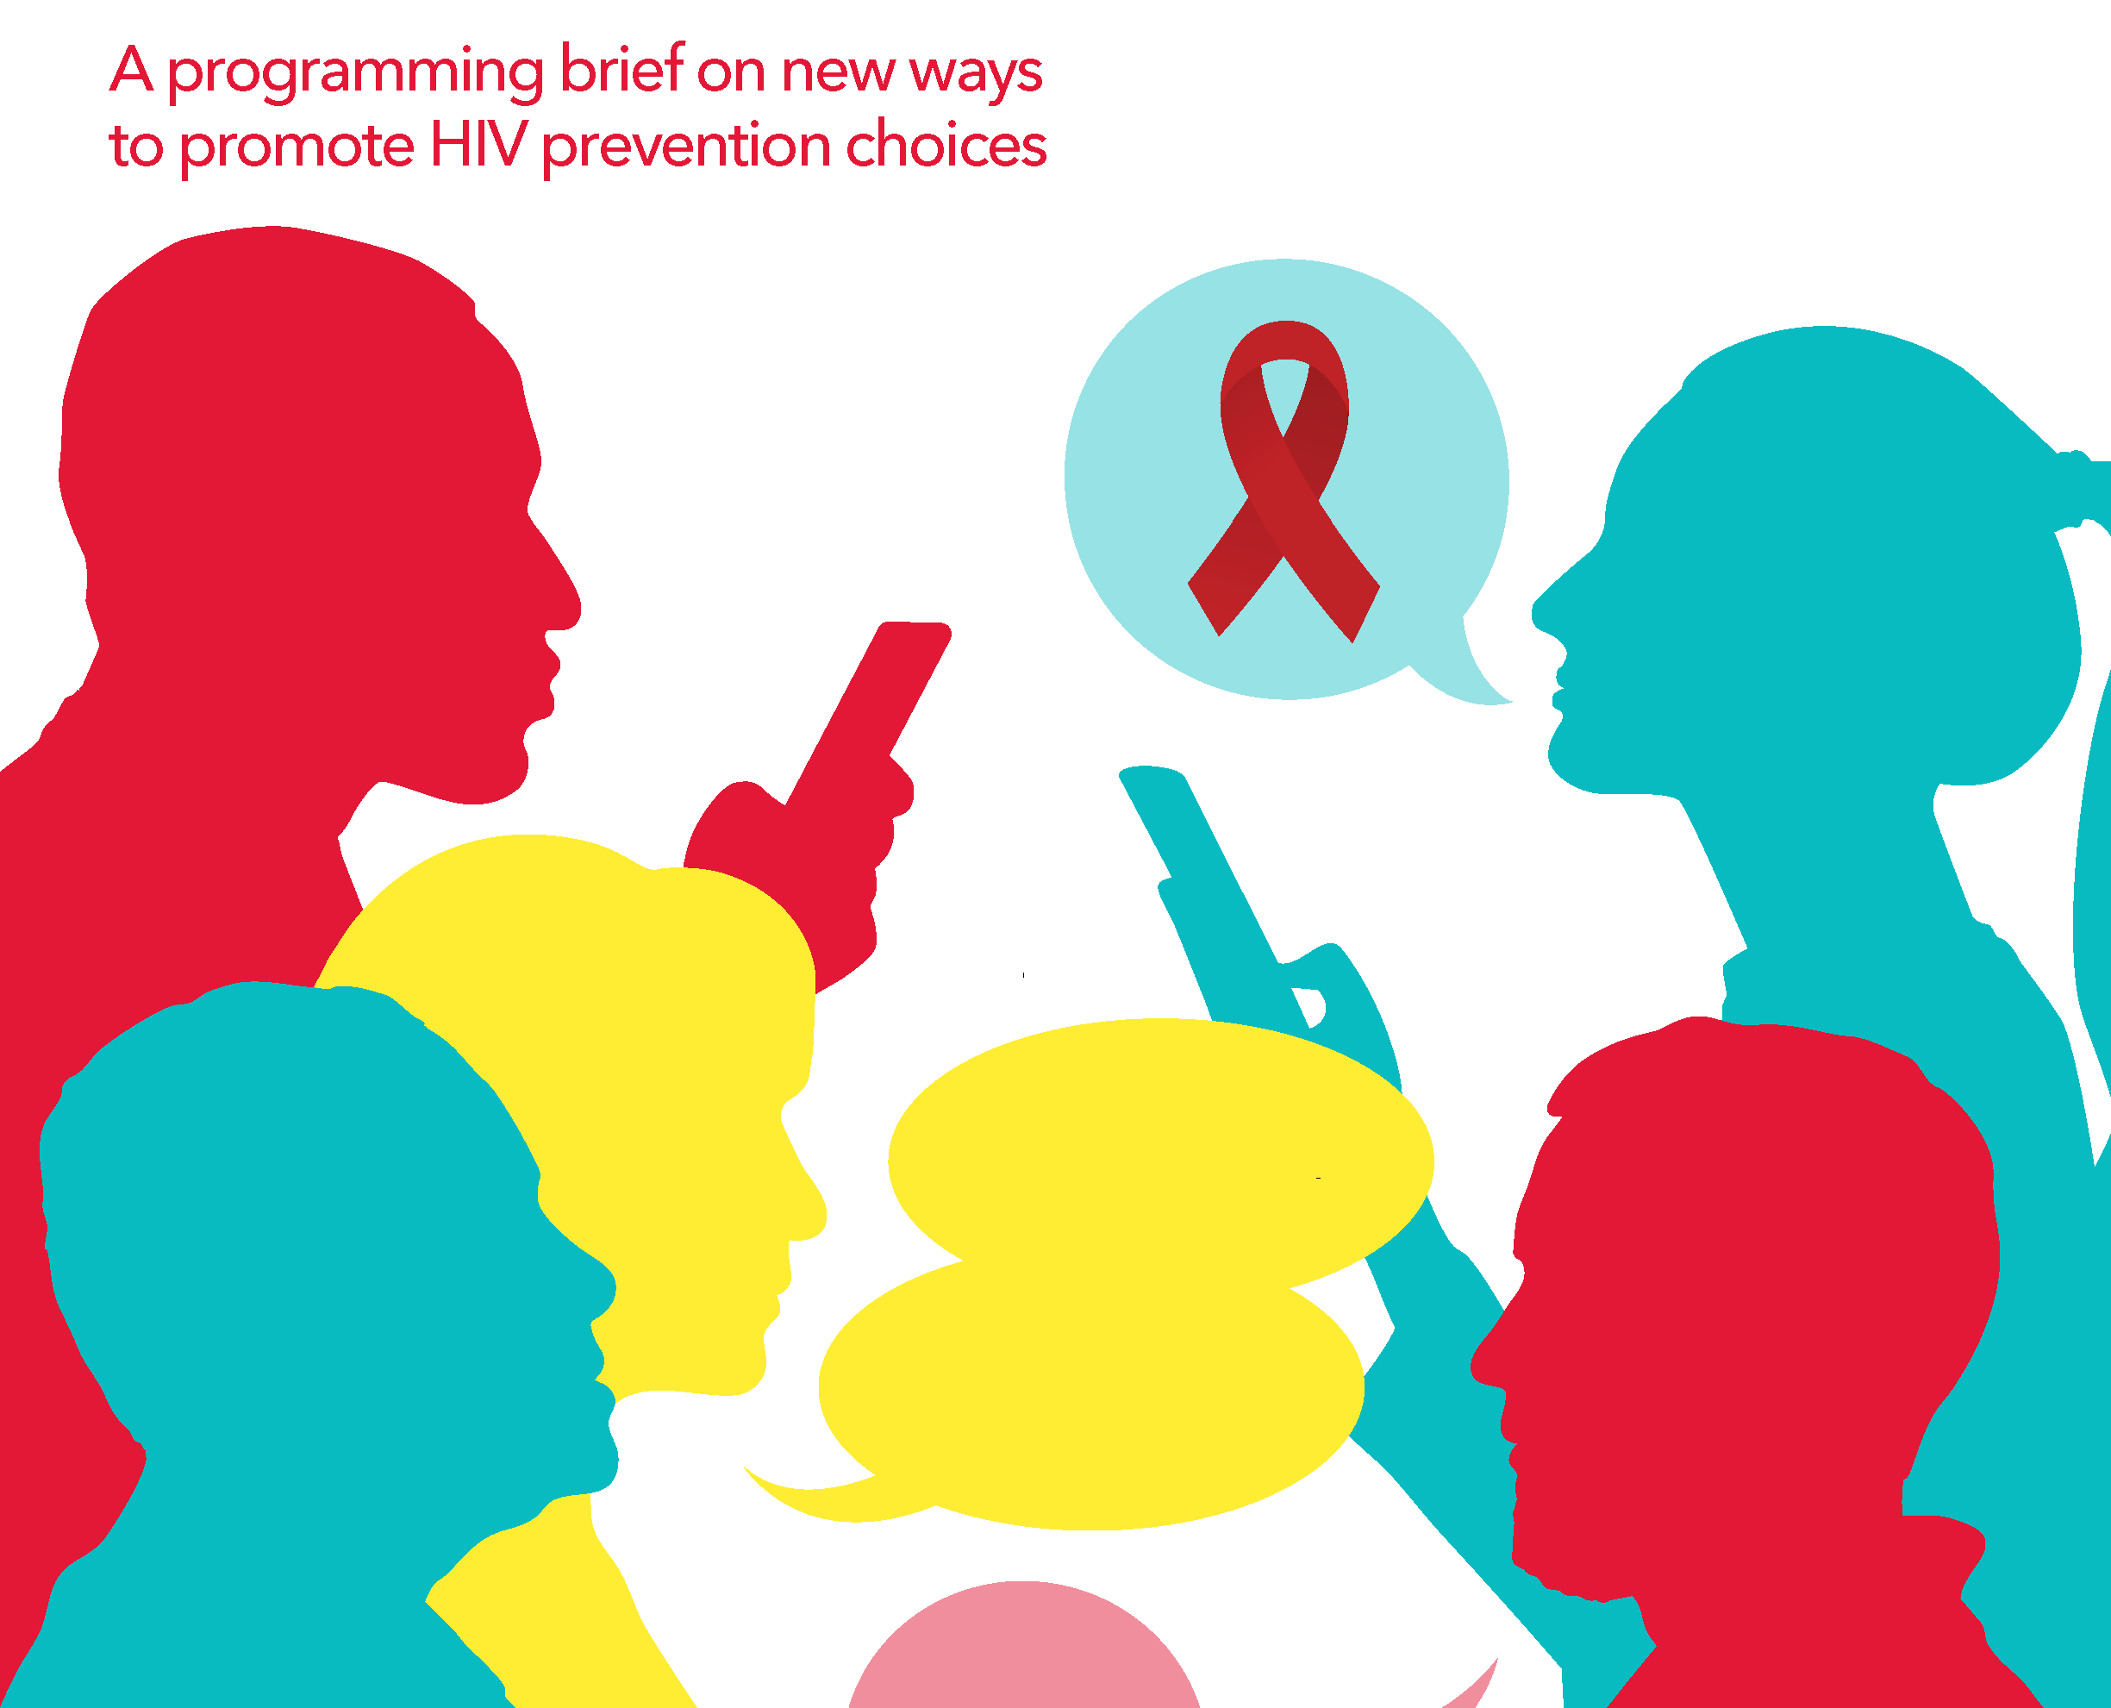

People-centred HIV prevention communication: Consolidated approaches for the demand generation and behavioural aspects of HIV prevention
Gloria B. Byaruhanga
Technical Officer, HIV prevention
GPC Communications lead
April 2026
Developed by The Global HIV Prevention Coalition with special contributions from UNAIDS, The Global Fund, UNFPA, Gates Foundation, The South-to-South HIV Prevention Learning Network (SSLN), AVAC, The Behavior Change Accelerator Initiative
Notes:
People-centred HIV prevention communication
How do we reach people where they are and get them to understand, access, and sustainably use HIV prevention options?
Optimized mix of prevention multisectoral communications to address behavioral aspects of prevention.
Influencing decision making of people in need of prevention in their lived realities and preferences – supporting choices that people on a prevention journey have to make.
A shift from top-down design of prevention programmes to co-creation with the people in need of prevention.
Right environment for equitable access of prevention options by users - strengthened community leadership

Slide 2
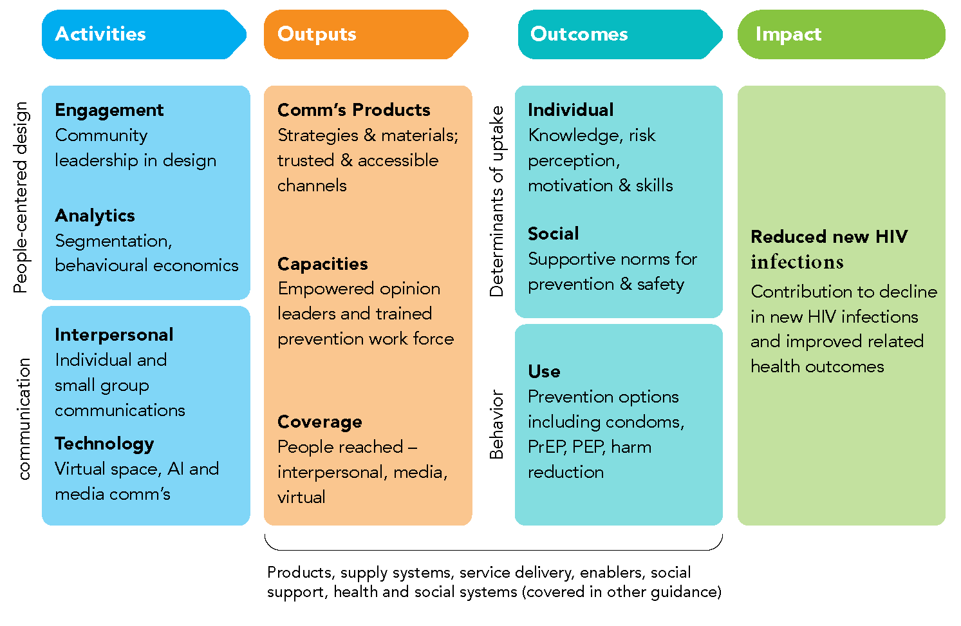
The “theory of change” for people-centred design and communication
Targeted information sharing to empower choice – demand generation
Sustained uptake of prevention options and sustained behaviour change
90% reduction of new HIV infections by 2030
Phase 1: Empathize (deep understanding of the user)
Phase 2: Define (synthesize insights and frame the problem)
Phase 3: Develop ideas (brainstorm creative solutions)
Phase 4: Prototype (build tangible representations)
Phase 5: Test (gather feedback and iterate)
Phase 6: Scale (implement and monitor)

Slide 3
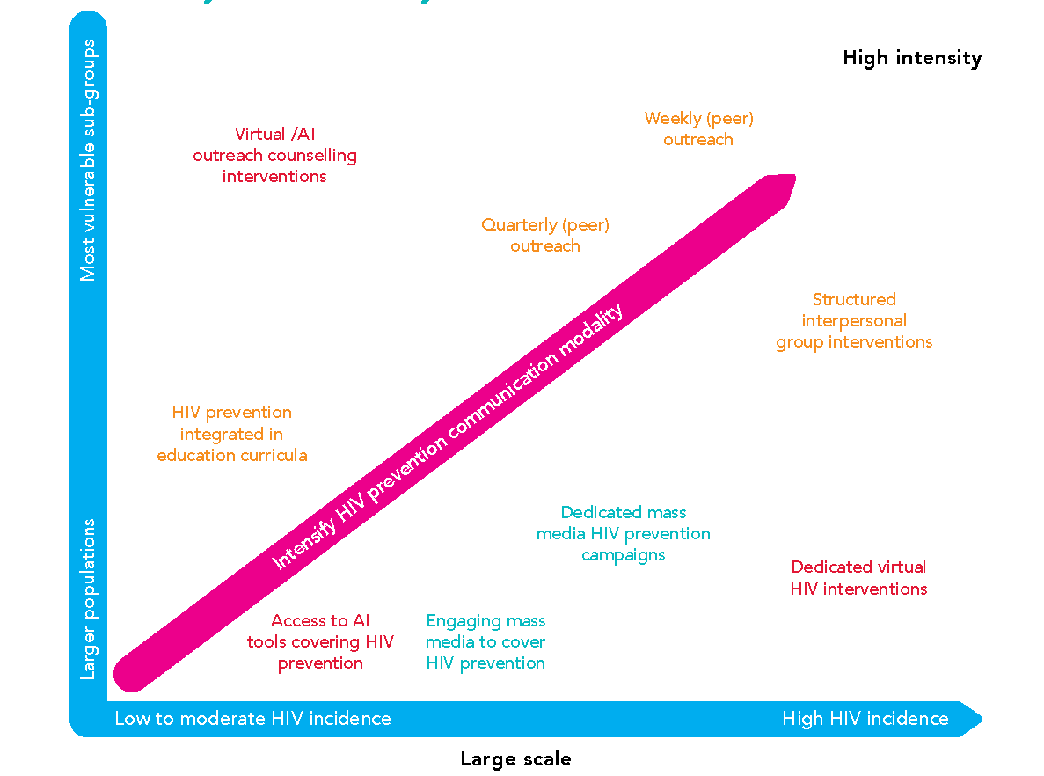
Prioritizing HIV prevention communication approaches by scale and intensity
Right communication modalities for the right populations in need of prevention
Scale and Intensity of prevention communications are dependent on risk and incidence settings
Tailored – adaptable prevention communication interventions
Notes:
Behavior change Interventions are one of the largest investment areas of the Global Fund, although not always well-prioritized.
With limited resources, we need to prioritize high-intensity programmes. Contextualization is important, noting that it might not be advisable to do high intensity communications for people at moderate risk.
Prioritization, though, does not necessarily entail choosing one approach over the other – it’s about selecting the most suitable modalities for a given population and topic. This slide depicts the logic of prioritization for prevention communication.

Slide 4
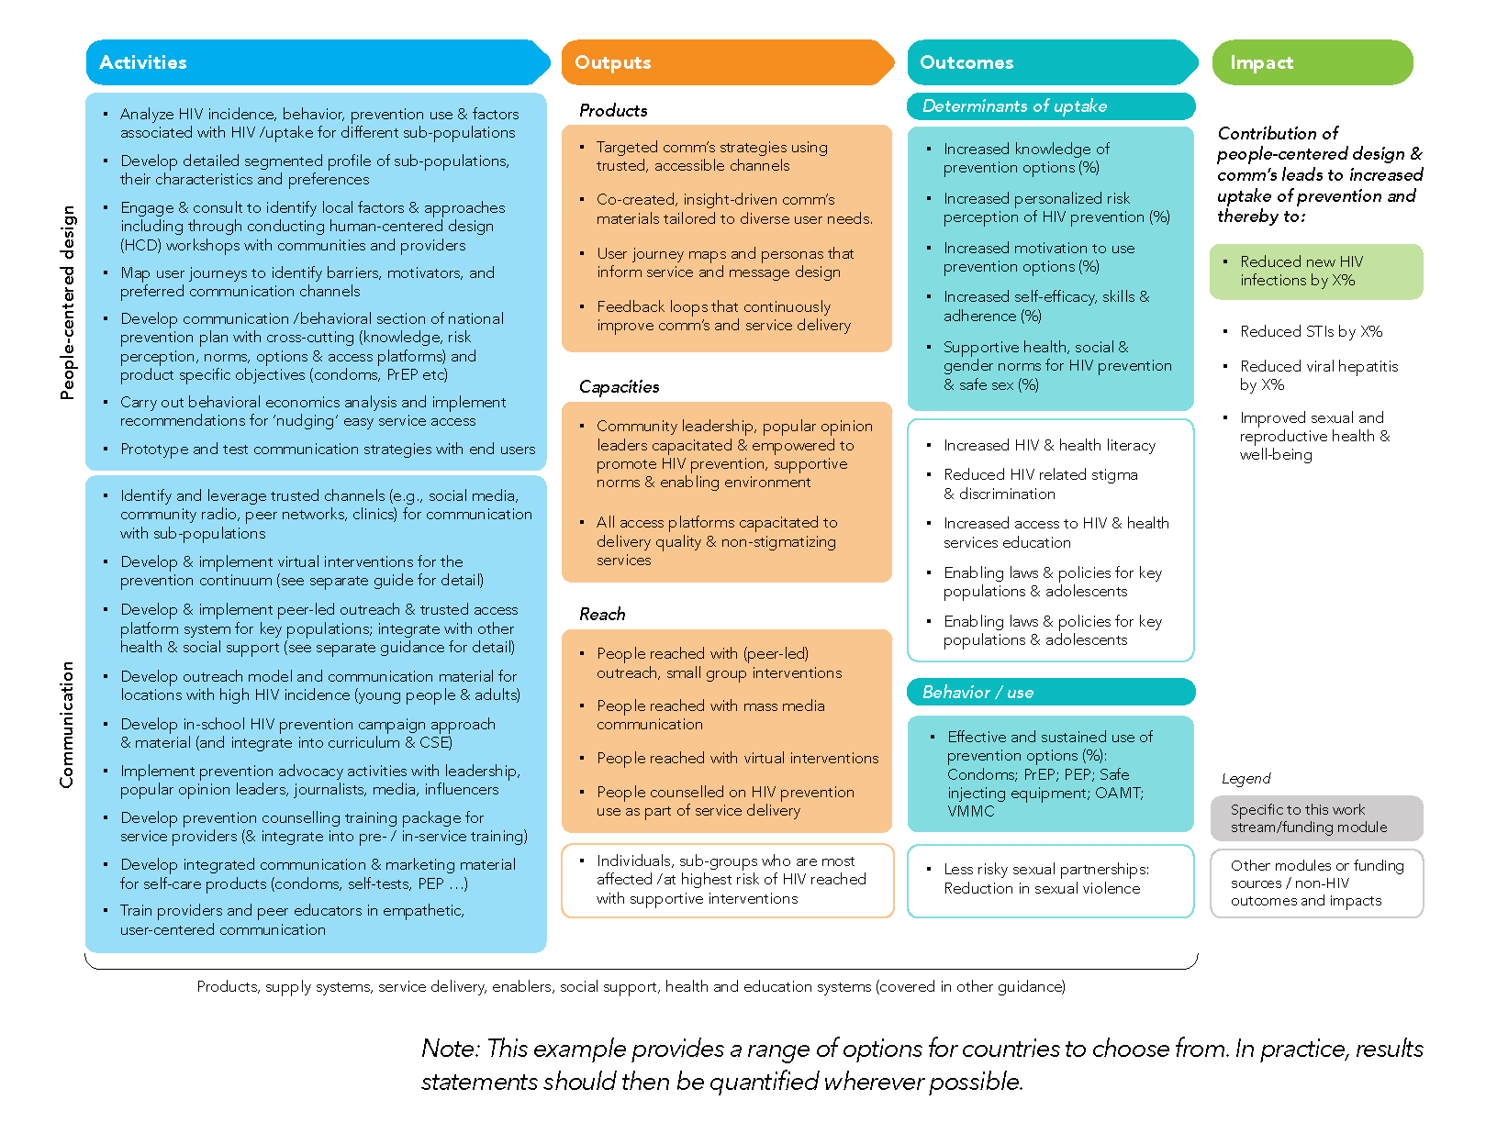
Relevance to GC8
A logical framework for people-centred design and communication programmes and funding proposals for HIV prevention
A cross-cutting communication strategy developed
HIV prevention communication programmes can be integrated into other platforms – less fragmentation.
Self-care models, access and sustained use of HIV prevention options are highly dependent on understanding of risk perception of HIV and choice tool kits.
Key tools included in the brief to support prevention programme leads such as: A programme manager check list for step-by-step planning and budgeting.
Notes:
Available tools in the document – checklist

