Slide 1

HIV Prevention 2030.
A Global Access Framework for Country-Led Responses
Dissemination webinar, 31 March 2026

Slide 2


Without sustained and accelerated primary prevention, 2030 targets will be out of reach and gains lost
The world’s HIV response at a tipping point
New HIV infections: Trends and projections for three scenarios, global
Source: UNAIDS estimates and projections from Avenir Health, October 2025.
For more information please see: https://www.unaids.org/sites/default/files/2025-04/JC3144_Estimates_Funding_cuts_impact_En.pdf

Slide 3
Progress made in the Africa region through a combination of treatment and primary prevention
but
- large gaps remain to reach targets
- progress is unequal between countries and,
- threatened by declining investment
2030 Target: 90% reduction compared to 2010

Slide 4
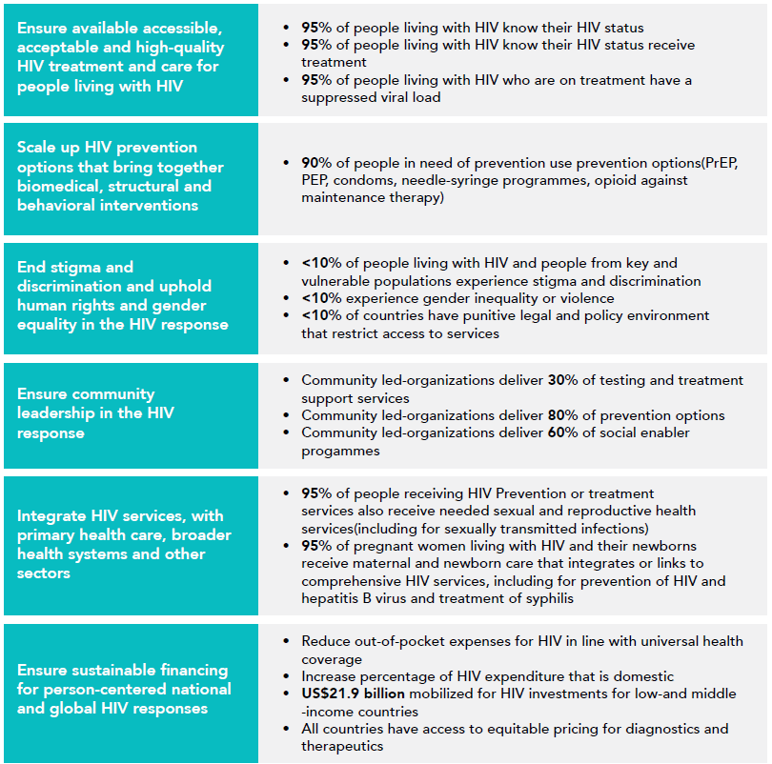
Global AIDS Strategy
2026-2031
2030 Global AIDS Targets

Slide 5
Bold Vision
By 2030, every person at risk of HIV will have access to a prevention option that suits their needs.

Slide 6
Reality of a Funding Crisis and Fragmented Prevention Systems
We will not achieve our bold vision for 2030 in a constrained environment without significant transformation.
Countries now need to reshape their responses towards country-led, sustainable, well-prioritized, efficient prevention programs.
-> optimally use available resources

Slide 7
Zooming in on 2030 programmatic primary prevention targets within GAS
Denominators
Outputs
Outcomes
Impact
People in need of HIV prevention
Young people and adults
(in areas with elevated HIV)
Key populations
(sex workers, gay men and other men who have sex with men, transgender people, people who inject drugs, people in prisons and other closed settings)
People living with HIV
95% of people in need of prevention reached with HIV prevention
90%* of people in need of prevention use effective prevention options
Translated into:
95% of people reached with person-centred prevention programs*
95% of country distribution need met for condoms, PrEP, PEP, needles, syringes, OAMT
90% of adolescents and young people receive CSE
80% of people-centred HIV prevention programmes for key populations delivered by community-led organizations
Achieved through trusted health, community, virtual and other sector platforms for women & girls, men & boys in settings with high HIV and five key populations
Translated into thematic targets:
80% condom use with non-regular partners
Up to 80% use of ARV-based prevention – PEP/PrEP including long-acting products in line with epidemiology** and people’s choices
Population-specific targets:
90% of boys & men accessed VMMC in 15 priority countries
95% of people who inject drugs use safe injecting equipment, 50% of people who inject opioids on OST
95% condom use at paid sex among sex workers and their clients
New HIV infections reduced by 90% in 2030 compared to 2010
Improved health, community, education & social support systems, legal environments
80% HIV prevention options delivered by community-led organizations
HIV treatment as prevention:
90% of all people living with HIV have suppressed viral loads
* People-centred programs in line with programmatic guidance include services, access to prevention options, actions to address structural barriers and tailored prevention communications addressing behavior and norms
** For PrEP targets, indicative HIV incidence thresholds by sub-populations will be updated and simplified, while maintaining the principle of a differentiated approach.
Primary HIV prevention targets
Other critical HIV, health & development targets

Slide 8
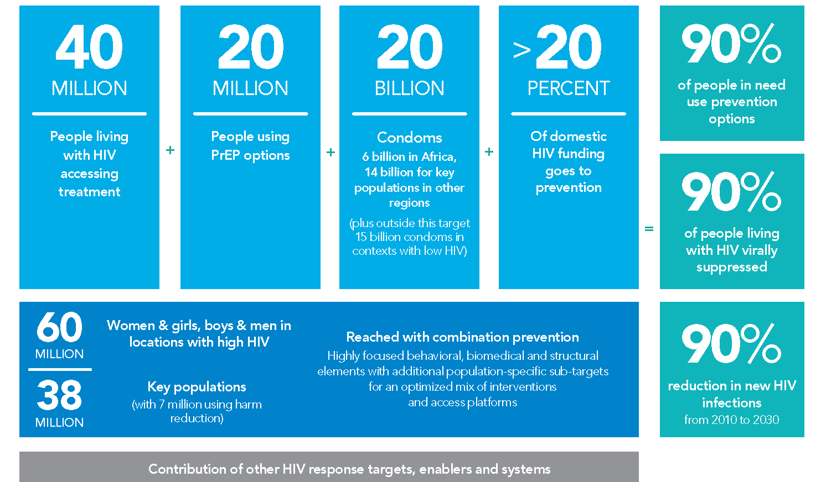



Alternative presentation – DO NOT CITE
40+20 by 30: Top line numeric milestones for reducing new HIV infections

Slide 9
Alternative presentation – DO NOT CITE
The key innovation will be country-owned needs estimates & milestones based on granular data: Illustrative country example
1.1 MILLION | + | 350 THOUSAND |  | + | 85 MILLION |  | + | >20PERCENT | = | 90% of people in need use prevention options
People living with HIV accessing treatment |  | People using PrEP options |  |  | Condoms |  |  | of domestic HIV funding goes to prevention |  | 90% of people living with HIV virally suppressed
And this could be translated into district targets as well |  | 1.3 MILLION | Women & girls, boys & men in locations with high HIV |  |  | Reached with combination prevention Highly focused behavioral, biomedical and structural elements with additional population-specific sub-targets for an optimized mix of interventions and access platforms |  |  |  | 90% reduction in new HIV infections from 2010 to 2030
 |  | 80 THOUSAND | Key populations (with 9 500 using harm reduction) |  |  |  |  |  |  | 90% reduction in new HIV infections from 2010 to 2030
Contribution of other HIV response targets, enablers and systems

Slide 10
Illustrative country target table based on granular needs estimate
 | 2024 (baseline) | 2026 | 2027 | 2028 | 2029 | 2030
Condoms | 52 million | 56 | 64 | 72 | 80 | 85 million
PrEP | 70 000 | 100 000 | 220 000 | 270 000 | 350 000 | 350 000
PEP | TBC | TBC | TBC | TBC | TBC | TBC
VMMC | 120 000 | 120 000 | 120 000 | 120 000 | 120 000 | 120 000
Women & girls in locations with elevated HIV incidence (>0.2%) | 350 000 | 350 000 | 550 000 | 750 000 | 900 000 | 900 000
Men and boys in locations with elevated HIV incidence (>0.2%) | 200 000 | 200 000 | 300 000 | 350 000 | 400 000 | 400 000
Sex Workers reached | 23 000 | 25 000 | 35 000 | 40 000 | 45 000 | 45 000
MSM reached | 20 000 | 24 000 | 32 000 | 40 000 | 50 000 | 60 000
TG people reached | 1000 | 1500 | 2000 | 3000 | 3500 | 4000
PWID reached with needles & syringes | 4000 | 6000 | 8000 | 9500 | 9500 | 9500
PWID receiving OAMT | 500 | 1000 | 2000 | 3000 | 4000 | 4800
Prisoners reached | 1000 | 2000 | 3000 | 5000 | 6000 | 6000

Slide 11
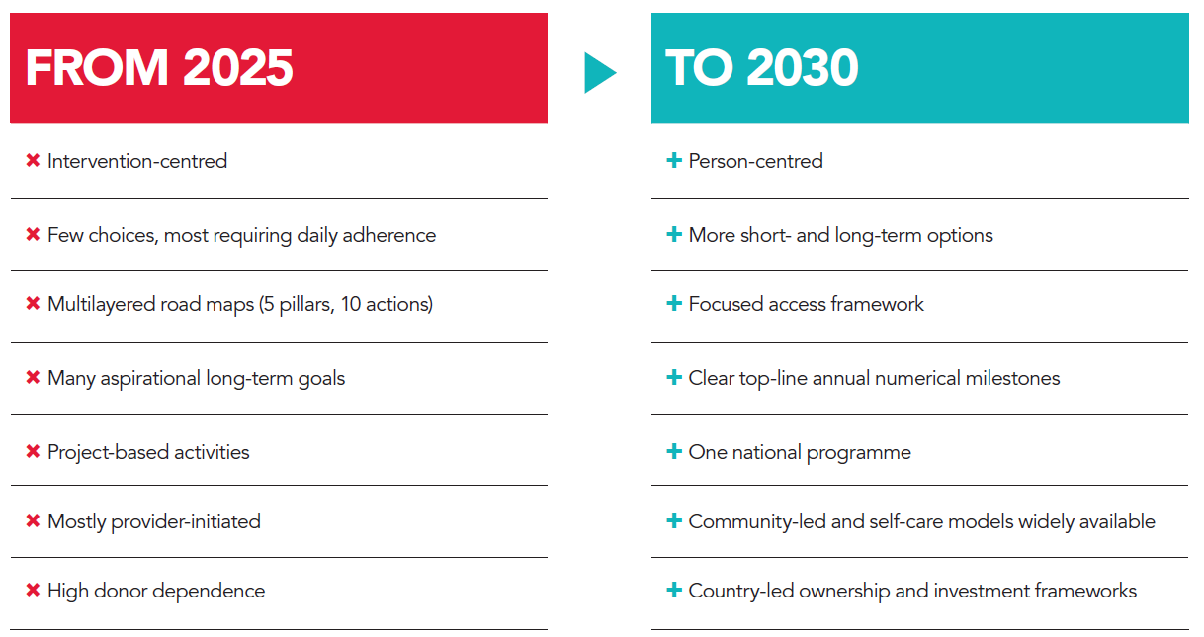
Strategic shifts in the new framing of prevention

Slide 12
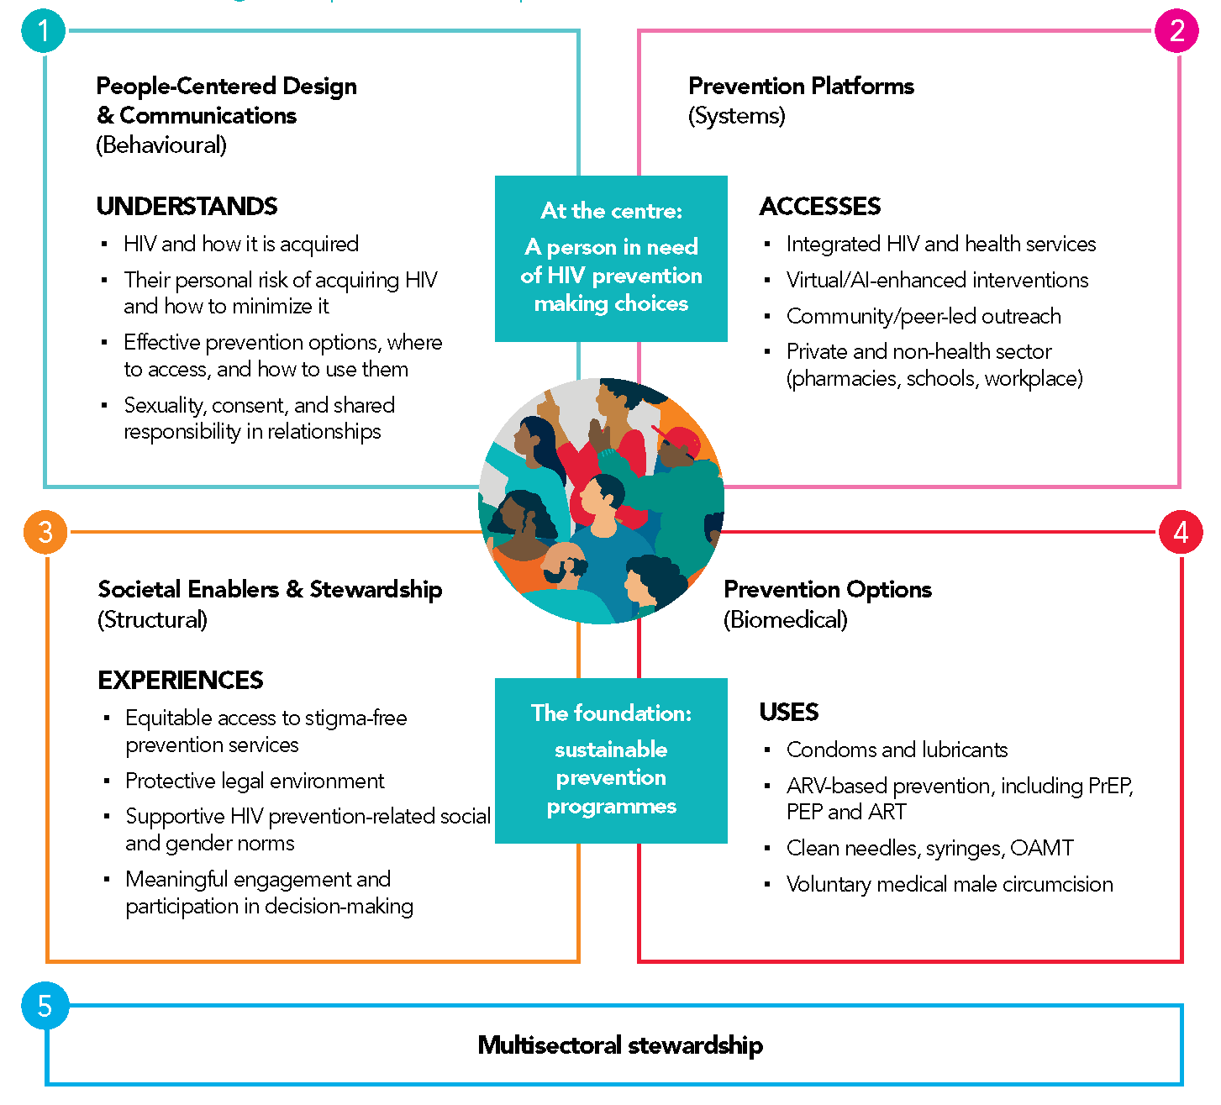
A person- centred prevention framework
But not everything for everyone
Carefully chosen biomedical, behavioral,
structural elements

Slide 13
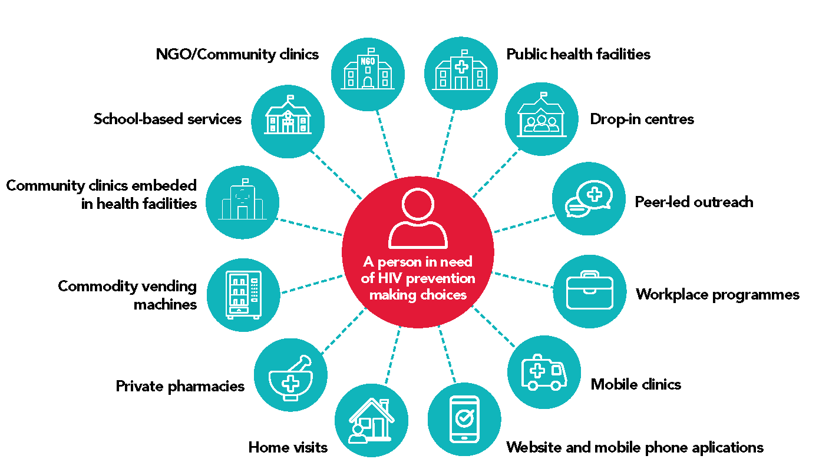
Scaled trusted access platforms
NEW
Systematically plan country access platforms for different prevention options and populations
Design with a view to enable self-care
 | Access points
By intervention | Health facilities | Community -led and other outreach | Pharmacies | Key / higher risk locations | Virtual space | Private sector outlets | Other government sectors | Dispensers
Communications
Condoms
Oral PrEP
PEP
Needles & syringes
By population
Women & Girls
Men & boys
Gay men & other MSM
Sex workers
Transgender people
People who inject drugs

Slide 14
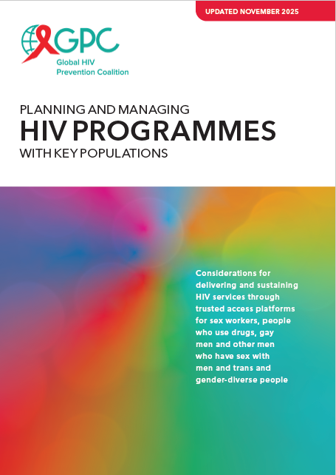
Dedicated
KP clinic sites
Example: Prioritizing access platforms for key populations
Mobile clinics
Drop-in centres
Other key venue presence:
Vending machines, bars, kiosks, events
Add …
Clinics
Other health facility-based modalities: Peer navigation,
KP rooms or days, sexual health clinics
Outreach
Service delivery approaches
Online
Additional online services (e-pharmacy, counselling)
Peer-led outreach in physical settings (differentiated based on need)
Peer-led outreach in virtual spaces
Updated detailed
planning guide available
KP-competent health facilities
KP-competent pharmacies
Fewer resources More resources
Lower HIV incidence Higher HIV incidence
Actions to address human-rights & gender related barriers and create an enabling policy environment
Community engagement, leadership and accountability
Enablers
Enablers are a foundation that entail some actions that do not require extensive resources and others that do.
The specific needs should be considered based on the country’s legal and policy environment and resource availability .

Slide 15
Multi-sector stewardship of HIV prevention: Key functions of national coordinating / lead agencies
Leadership & coordination
Establish political leadership and responsibility for stewardship of the multi-sectoral HIV prevention response
Analysis
Analyse the HIV epidemic & prevention response, determine the gaps and needs
Strategy
Define an evidence-based strategy, set targets and multisectoral action areas for programmes, and address policy & legal barriers
Resources
Define resource needs & gaps and mobilize resources
Communications
Popularize the urgency of HIV prevention and coordinate communications
System design
Define a sustainable national prevention delivery system, identify strategic actors and their roles (across all partners and funding streams)
Implementation
Drive and facilitate effective management of implementation at scale
Monitoring
Monitor & evaluate and use learnings for problem-solving
Accountability
Establish and monitor joint accountability

Slide 16
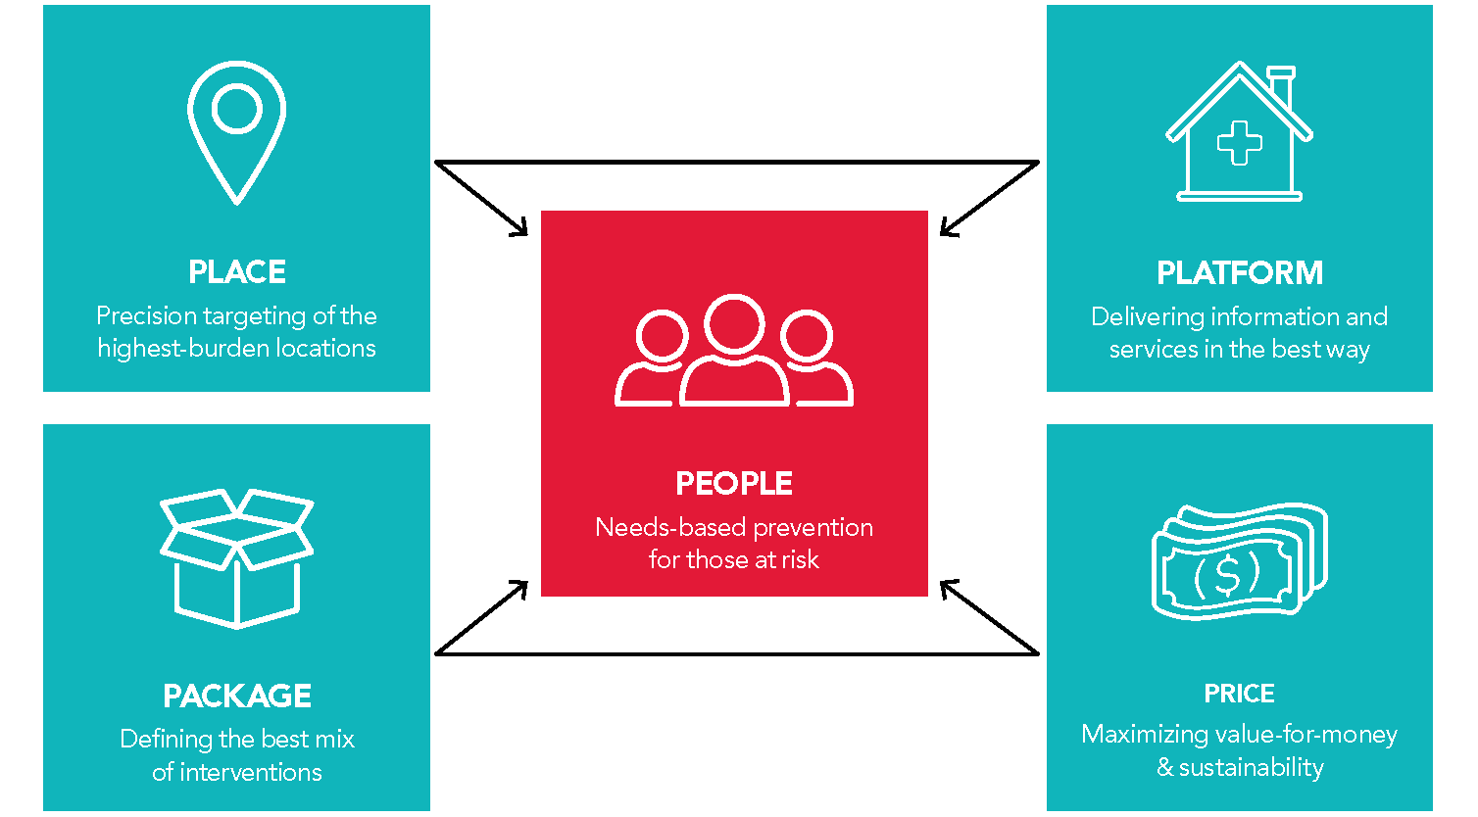
Scalable and sustainable prevention to 2030 and beyond. 5 Ps of prioritization
The right people, right places, packages, best platforms, prices
Focus on key and priority populations who need prevention most

Slide 17
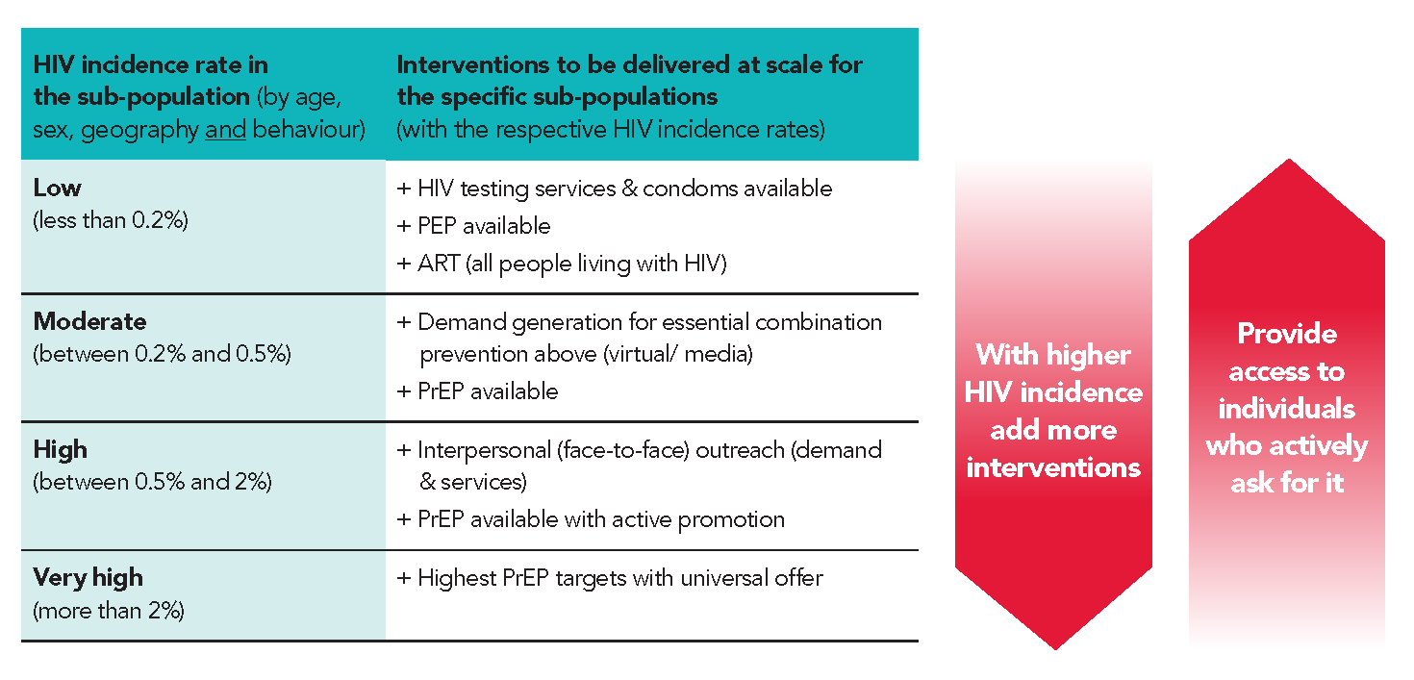
Rationale for prevention targets – and how they relate to HIV incidence

Slide 18
A new financing context
FIGURE 10. Adjusted Resource Needs Estimates for HIV Prevention, 2025 vs 2030 (^{[i]})
A 45% reduction in cost for meeting 2030 prevention targets in low-and middle-income countries compared to the resource needs estimate for 2025
Reductions in commodity prices
Improved focus of programs and targets
The bulk of resource need for prevention is now in middle- income countries
Among the Top 10 LMICs for prevention resource need
  9 of 10 are middle- income countries
  8 of 10 are outside sub-Saharan Africa
Total Need: US$ 29.3 billion
Total Need:
US$ 21.9 billion
^{[i]}. UNAIDS (2021). Global AIDS Strategy 2021-2026 — End Inequalities. End AIDS. Page 103. Online at https://www.unaids.org/sites/default/files/media_asset/global-AIDS-strategy-2021-2026_en.pdf & UNAIDS (2025). AIDS, crisis and the power to transform: UNAIDS Global AIDS Update 2025. Geneva: Joint United Nations Programme on HIV/AIDS; 2025. Licence: CC BY-NC-SA 3.0 IGO. Page 112-113. Online at https://www.unaids.org/en/resources/documents/2025/2025-global-aids-update

Slide 19
2030 PrEP targets in LMICs by income level
90% of this is South Africa ~50% of this is Mozambique

Slide 20
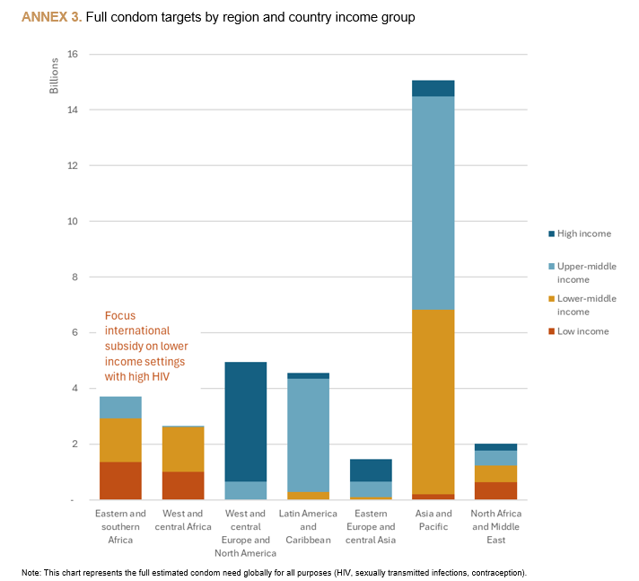
2030 Condom targets
Need for differentiated total market/ program approach
Large role for markets in high-income and (upper) middle- income countries
Key role for international financing in lower- income countries with high HIV

Slide 21
From needs estimates to delivery and financing (illustrative country table)
Prevention options | Target (illustrative) | Program /market segment (share in % of products and populations to be reached) |  |  | Funding source for free & subsidized (share in % of cost)
 |  | Free (public) | Subsidized (social marketing) | Sold (private /out of pocket) | Government | Donors
Condoms | 85 million | 50% | 30% | 20% | 50% | 30%
PrEP (Daily Oral) | 120 000 | 80% | 10% | 10% | 30% | 60%
PrEP (Long-acting) | 230 000 | 100% | - | - | 10% | 90%
PEP | TBC | 60% | 20% | 20% | 50% | 20%
VMMC | 120 000 | 90% | - | 10% | 50% | 50%
Needles & syringes | 2.5 million | 80% | - | 20% | 40% | 20%
OAMT | 4 800 | 100% | - | - | 80% | 20%
People-centred programs and access platforms | Target (illustrative) | Facility | Outreach | Virtual | Government | Donors
Women & girls in locations with elevated HIV incidence (>0.2%) | 900 000 | 40% | 10% | 50% | 80% | 20%
Men and boys in locations with elevated HIV incidence (>0.2%) | 400 000 | 10% | 10% | 80% | 80% | 20%
Sex Workers reached | 45 000 | 40% | 40% | 20% | 50% | 50%
MSM reached | 60 000 | 20% | 10% | 70% | 50% | 50%
TG people reached | 4 000 | 20% | 30% | 50% | 50% | 50%
PWID reached | 10 000 | 40% | 40% | 20% | 50% | 50%
Prisoners | 8 000 | 80% | - | 20% | 90% | 10%

Slide 22
Key milestones of a roll-out plan for 2030
 |  | Due Date
 | Needs Estimates: Revise prevention denominators for those in need of targeted services | April 2026
 | Method Mix Tables: Set annual numeric access targets per population and intervention | April 2026
 | M&E Tools: Update tools to track overall HIV prevention use (i.e., any method at last sex) | June 2026
 | Access Platforms: Map prevention use by population and product across delivery models | June 2026
 | Total Market Approach: Analyse viability of increased self-care and social enterprise | August 2026
 | Resource Needs: Estimate domestic and external funding required to meet access targets | September 2026
 | Planning: Develop National “Prevention 2030” Action Plan | December 2026
 | Monitoring: Update Prevention 2030 country scorecards | Annually
 | Resource Tracking: Assess prevention spending; focus on domestic and KP expenditure | Annually
 | Management: TBC | TBC

Slide 23
Call to action: A new era of prevention
New set of targets
New approach to prevention needs estimates
Will enable
  more granular & more systematic analysis of need across populations and prevention options
  annual tracking of progress at all levels
  prioritization and alignment
A new era, a new framework
  Country-led, streamlined, sustainable models & costs
  Revised state-of-the-art country prevention plans are needed to chart the way to 2030
2026 – we can make it the year of a renewed prevention push!

Slide 24
Thank you, Merci, Obrigado

