Slide 1
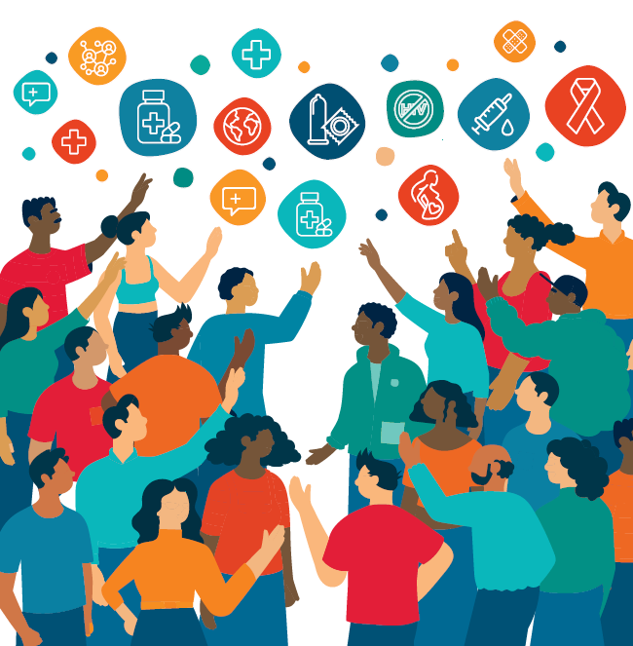

HIV Prevention 2030
A Global Access Framework for Country-Led Responses
October 2026

Slide 2


Without sustained and accelerated primary prevention and treatment, 2030 targets will be missed and the epidemic extended beyond 2030
The world’s HIV response is at a tipping point
New HIV infections: Trends and projections for three scenarios, global
With effective prevention and treatment, the number of people acquiring HIV can be dramatically reduced by 2030
Source: UNAIDS estimates and projections from Avenir Health, October 2025.
For more information please see: https://www.unaids.org/sites/default/files/2025-04/JC3144_Estimates_Funding_cuts_impact_En.pdf

Slide 3
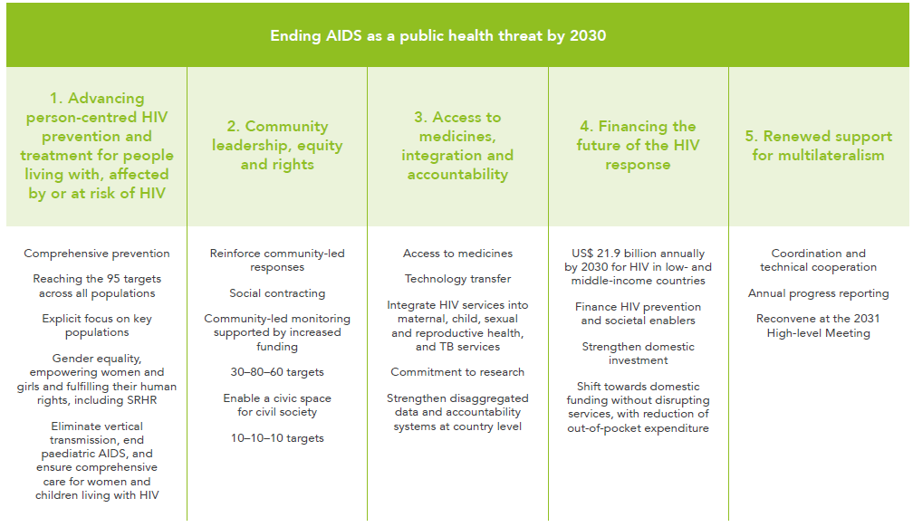
2026 Political Declaration on ending AIDS by 2030
An ambitious framework agreed by member states
Notes:
In June 2026, 149 Member States adopted the new Political Declaration on HIV/AIDS, aligned with the UNAIDS Global AIDS Strategy 2026–2031 and all the 2030 targets.
The new commitments made by Member States as part of the 2026 Political Declaration fall under five pillars, which recognize that ending AIDS as a public health threat requires more than biomedical tools.
The five pillars call for advancing per-centred HIV prevention, treatment and people living with, affected by or at risk of HIV (pillar 1), community leadership (pillar 2), access to medicines, integration and accountability (pillar 3), financing the future of the HIV response (pillar 4) and renewed support for multilateralism (pillar 5)

Slide 4
Zooming in on 2030 programmatic primary prevention targets within GAS
Denominators
Outputs
Outcomes
Impact
People in need of HIV prevention
Young people and adults
(in areas with elevated HIV)
Key populations
(sex workers, gay men and other men who have sex with men, transgender people, people who inject drugs, people in prisons and other closed settings)
People living with HIV
95% of people in need of prevention reached with HIV prevention
90%* of people in need of prevention use effective prevention options
Translated into:
95% of people reached with person-centred prevention programs*
Country distribution need met for condoms, PrEP, PEP, needles, syringes, OAMT
90% of adolescents and young people receive CSE
80% of people-centred HIV prevention programmes for key populations delivered by community-led organizations
Achieved through trusted health, community, virtual and other sector platforms for women & girls, men & boys in settings with high HIV and five key populations
Translated into thematic targets:
80% condom use with non-regular partners
Up to 80% use of ARV-based prevention – PEP/PrEP including long-acting products in line with epidemiology** and people’s choices
Population-specific targets:
90% of boys & men accessed VMMC in 15 priority countries
95% of people who inject drugs use safe injecting equipment, 50% of people who inject opioids on OST
95% condom use at paid sex among sex workers and their clients
New HIV infections reduced by 90% in 2030 compared to 2010
Improved health, community, education & social support systems, legal environments
HIV treatment as prevention:
90% of all people living with HIV have suppressed viral loads
* People-centred programs in line with programmatic guidance include services, access to prevention options, actions to address structural barriers and tailored prevention communications addressing behavior and norms
** For PrEP targets, indicative HIV incidence thresholds by sub-populations will be updated and simplified, while maintaining the principle of a differentiated approach.
Primary HIV prevention targets
Other critical HIV, health & development targets

Slide 5
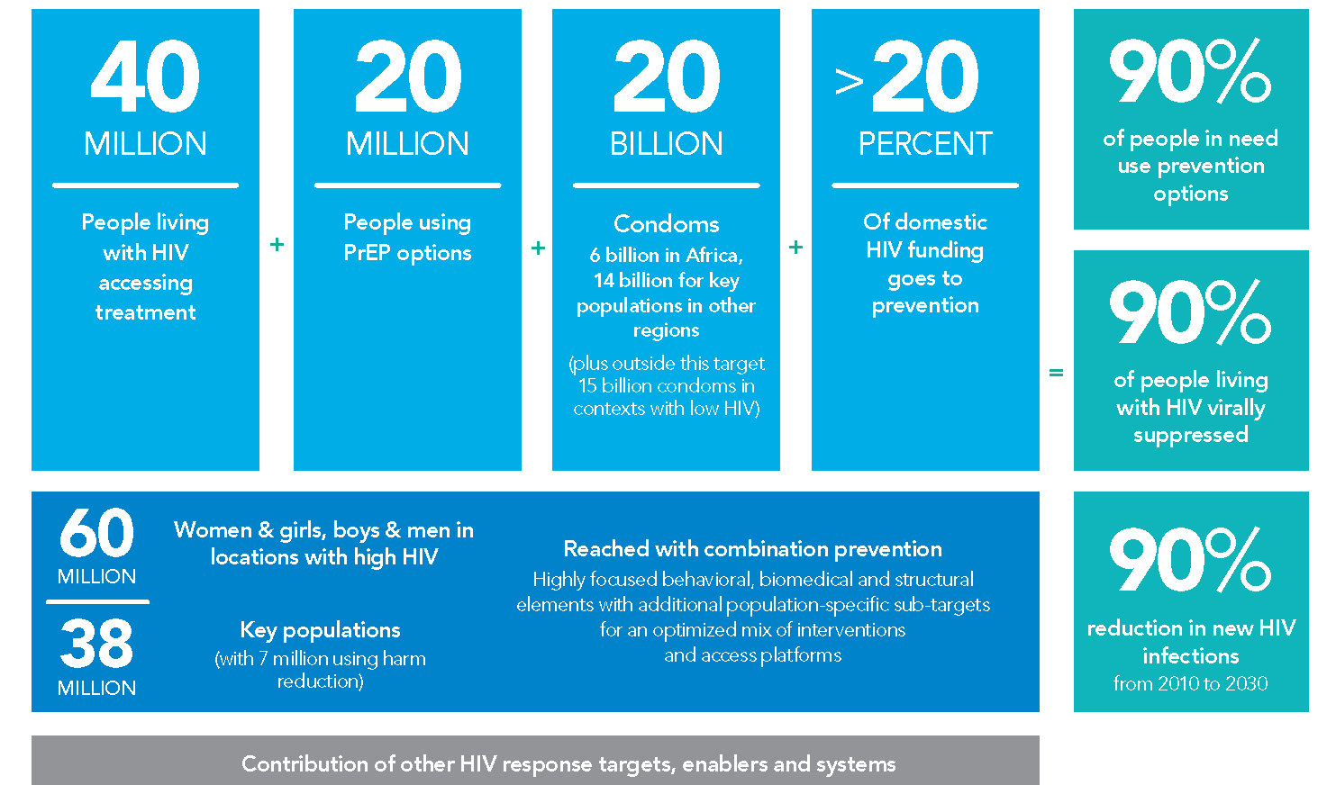



40+20 by 30: Top line numeric milestones for reducing new HIV infections

Slide 6
The key innovation will be country-owned needs estimates & milestones based on granular data: Illustrative country example
1.1 MILLION | + | 350 THOUSAND |  | + | 85 MILLION |  | + | >20PERCENT | = | 90% of people in need use prevention options
People living with HIV accessing treatment |  | People using PrEP options |  |  | Condoms |  |  | of domestic HIV funding goes to prevention |  | 90% of people living with HIV virally suppressed
And this could be translated into district targets as well |  | 1.3 MILLION | Women & girls, boys & men in locations with high HIV |  |  | Reached with combination prevention Highly focused behavioral, biomedical and structural elements with additional population-specific sub-targets for an optimized mix of interventions and access platforms |  |  |  | 90% reduction in new HIV infections from 2010 to 2030
 |  | 80 THOUSAND | Key populations (with 9 500 using harm reduction) |  |  |  |  |  |  | 90% reduction in new HIV infections from 2010 to 2030
Contribution of other HIV response targets, enablers and systems

Slide 7
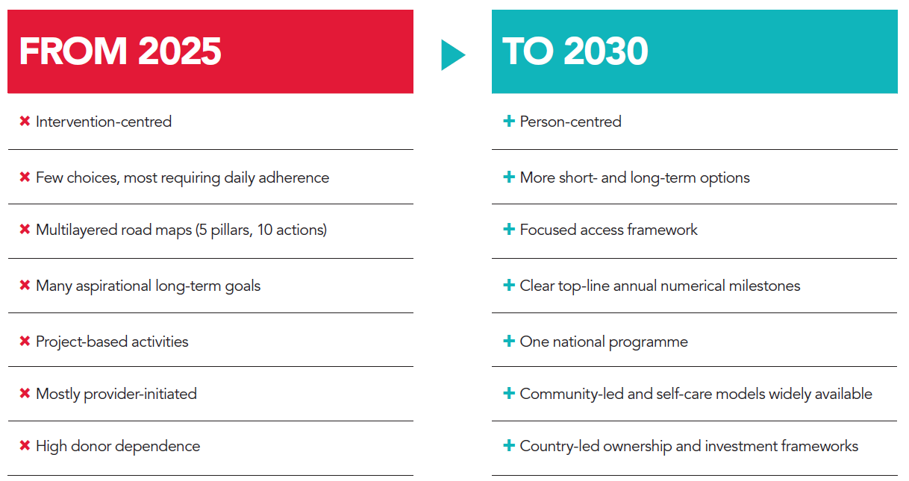
Strategic shifts in the new framing of prevention

Slide 8
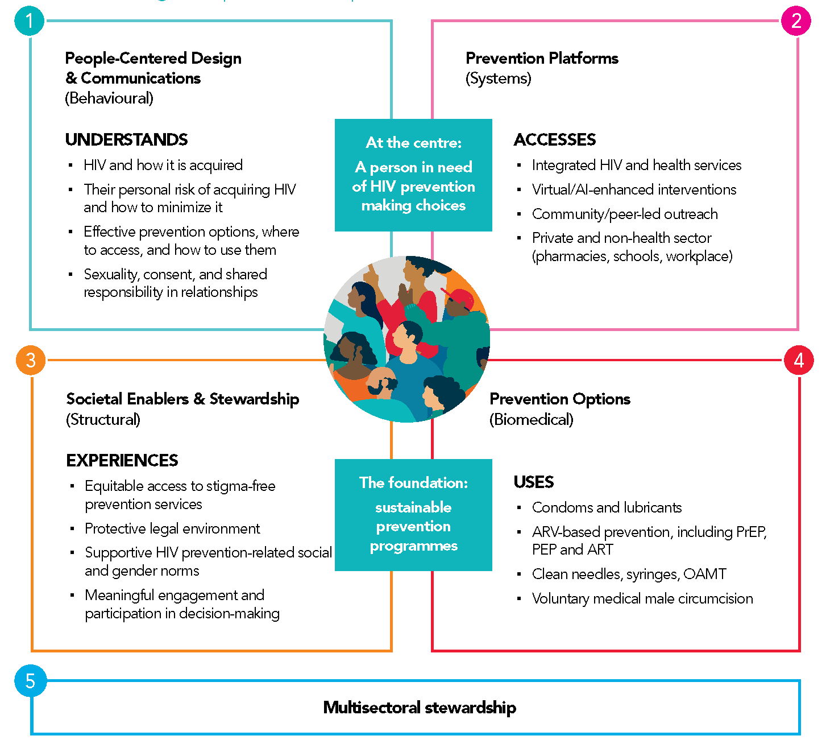
A person- centred prevention framework
But not everything for everyone
Carefully chosen biomedical, behavioral,
structural elements

Slide 9
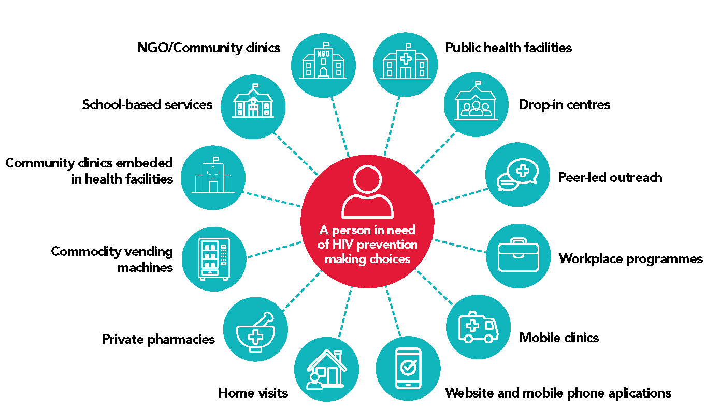
Scaled trusted access platforms
NEW
Systematically plan country access platforms for different prevention options and populations
Design with a view to enable self-care
 | Access points
By intervention | Health facilities | Community -led and other outreach | Pharmacies | Key / higher risk locations | Virtual space | Private sector outlets | Other government sectors | Dispensers
Communications
Condoms
Oral PrEP
PEP
Needles & syringes
By population
Women & Girls
Men & boys
Gay men & other MSM
Sex workers
Transgender people
People who inject drugs

Slide 10
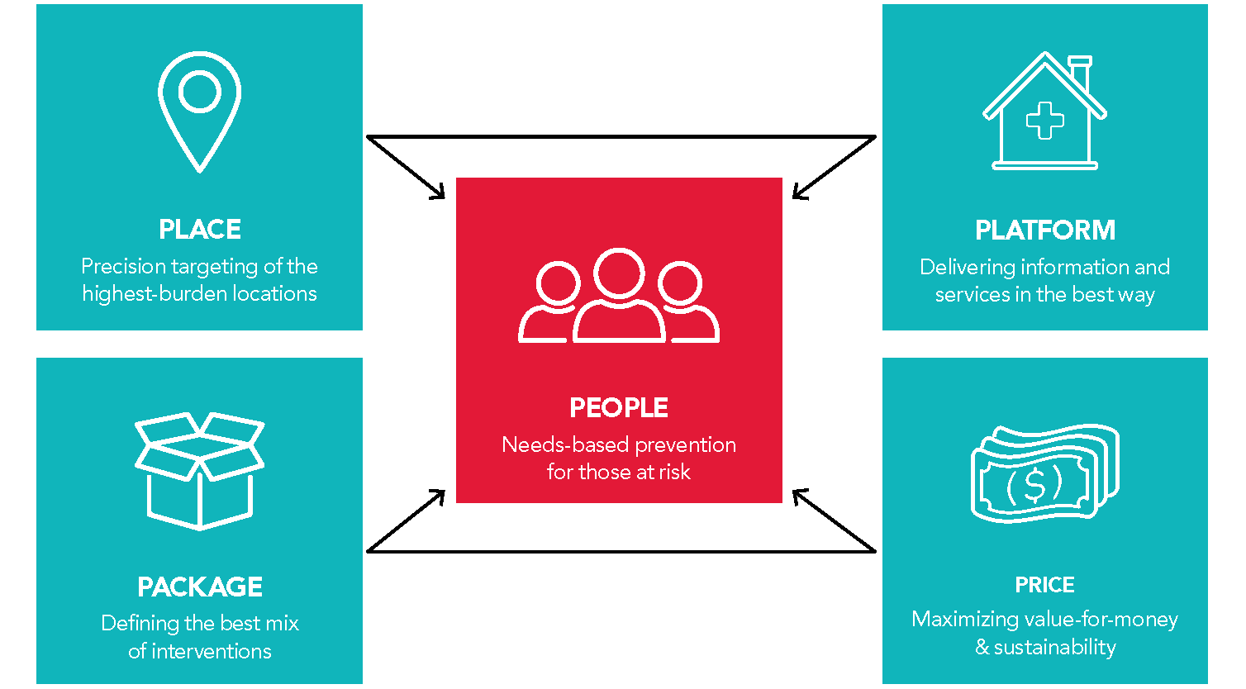
Scalable and sustainable prevention to 2030 and beyond. 5 Ps of prioritization
The right people, right places, packages, best platforms, prices
Focus on key and priority populations who need prevention most

Slide 11
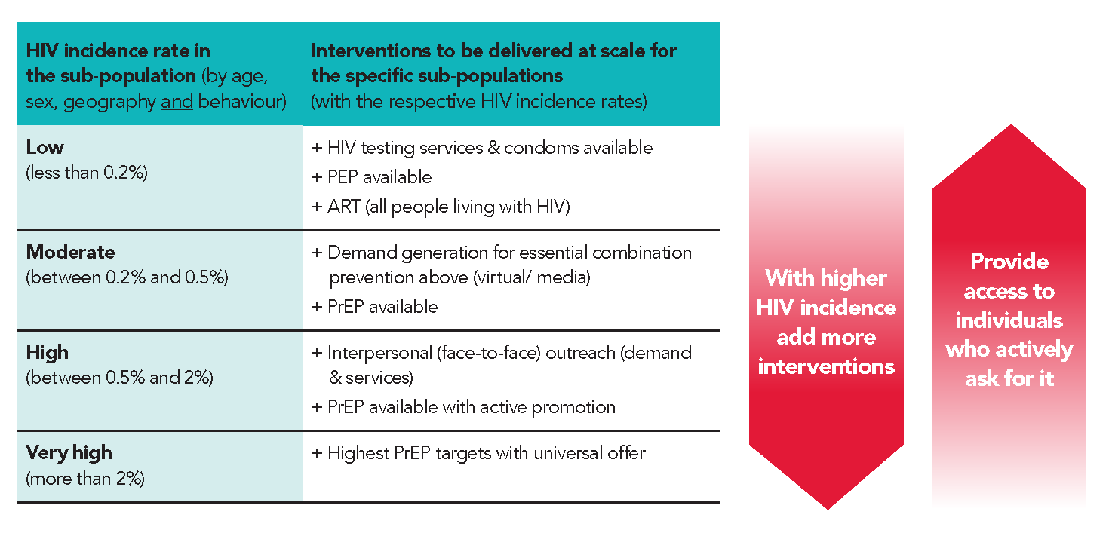
Rationale for prevention targets – and how they relate to HIV incidence

Slide 12
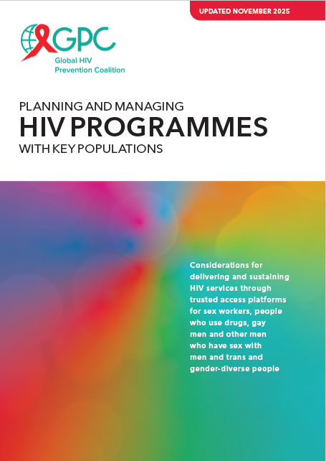
Dedicated
KP clinic sites
Example: Prioritizing access platforms for key populations
Mobile clinics
Drop-in centres
Other key venue presence:
Vending machines, bars, kiosks, events
Add …
Clinics
Other health facility-based modalities: Peer navigation,
KP rooms or days, sexual health clinics
Outreach
Service delivery approaches
Online
Additional online services (e-pharmacy, counselling)
Peer-led outreach in physical settings (differentiated based on need)
Peer-led outreach in virtual spaces
Updated detailed
planning guide available
KP-competent health facilities
KP-competent pharmacies
Fewer resources More resources
Lower HIV incidence Higher HIV incidence
Actions to address human-rights & gender related barriers and create an enabling policy environment
Community engagement, leadership and accountability
Enablers
Enablers are a foundation that entail some actions that do not require extensive resources and others that do.
The specific needs should be considered based on the country’s legal and policy environment and resource availability .

Slide 13
From needs estimates to delivery and financing (illustrative country table)
Prevention options | Target (illustrative) | Program /market segment (share in % of products and populations to be reached) |  |  | Funding source for free & subsidized (share in % of cost)
 |  | Free (public) | Subsidized (social marketing) | Sold (private /out of pocket) | Government | Donors
Condoms | 85 million | 50% | 30% | 20% | 50% | 30%
PrEP (Daily Oral) | 120 000 | 80% | 10% | 10% | 30% | 60%
PrEP (Long-acting) | 230 000 | 100% | - | - | 10% | 90%
PEP | TBC | 60% | 20% | 20% | 50% | 20%
VMMC | 120 000 | 90% | - | 10% | 50% | 50%
Needles & syringes | 2.5 million | 80% | - | 20% | 40% | 20%
OAMT | 4 800 | 100% | - | - | 80% | 20%
People-centred programs and access platforms | Target (illustrative) | Facility | Outreach | Virtual | Government | Donors
Women & girls in locations with elevated HIV incidence (>0.2%) | 900 000 | 40% | 10% | 50% | 80% | 20%
Men and boys in locations with elevated HIV incidence (>0.2%) | 400 000 | 10% | 10% | 80% | 80% | 20%
Sex Workers reached | 45 000 | 40% | 40% | 20% | 50% | 50%
MSM reached | 60 000 | 20% | 10% | 70% | 50% | 50%
TG people reached | 4 000 | 20% | 30% | 50% | 50% | 50%
PWID reached | 10 000 | 40% | 40% | 20% | 50% | 50%
Prisoners | 8 000 | 80% | - | 20% | 90% | 10%

Slide 14

Multi-sector stewardship of HIV prevention: Key functions of national coordinating / lead agencies
Leadership & coordination
Establish political leadership and responsibility for stewardship of the multi-sectoral HIV prevention response
Analysis
Analyse the HIV epidemic & prevention response, determine the gaps and needs
Strategy
Define an evidence-based strategy, set targets and multisectoral action areas for programmes, and address policy & legal barriers
Resources
Define resource needs & gaps and mobilize resources
Communications
Popularize the urgency of HIV prevention and coordinate communications
System design
Define a sustainable national prevention delivery system, identify strategic actors and their roles (across all partners and funding streams)
Implementation
Drive and facilitate effective management of implementation at scale
Monitoring
Monitor & evaluate and use learnings for problem-solving
Accountability
Establish and monitor joint accountability

Slide 15
Key milestones of a roll-out plan for 2030
(illustrative timelines)
 |  | Due Date
 | Needs Estimates: Revise prevention denominators for those in need of targeted services | April 2026
 | Method Mix Tables: Set annual numeric access targets per population and intervention | November 2026
 | M&E Tools: Update tools to track overall HIV prevention use (i.e., any method at last sex) | December 2026
 | Access Platforms: Map prevention use by population and product across delivery models | November 2026
 | Total Market Approach: Analyse viability of increased self-care and social enterprise | March 2027
 | Resource Needs: Estimate domestic and external funding required to meet access targets | December 2026
 | Planning: Develop National “Prevention 2030” Action Plan | December 2026
 | Monitoring: Update Prevention 2030 country scorecards | Annually
 | Resource Tracking: Assess prevention spending; focus on domestic and KP expenditure | Annually
 | Management: TBC | TBC

Slide 16
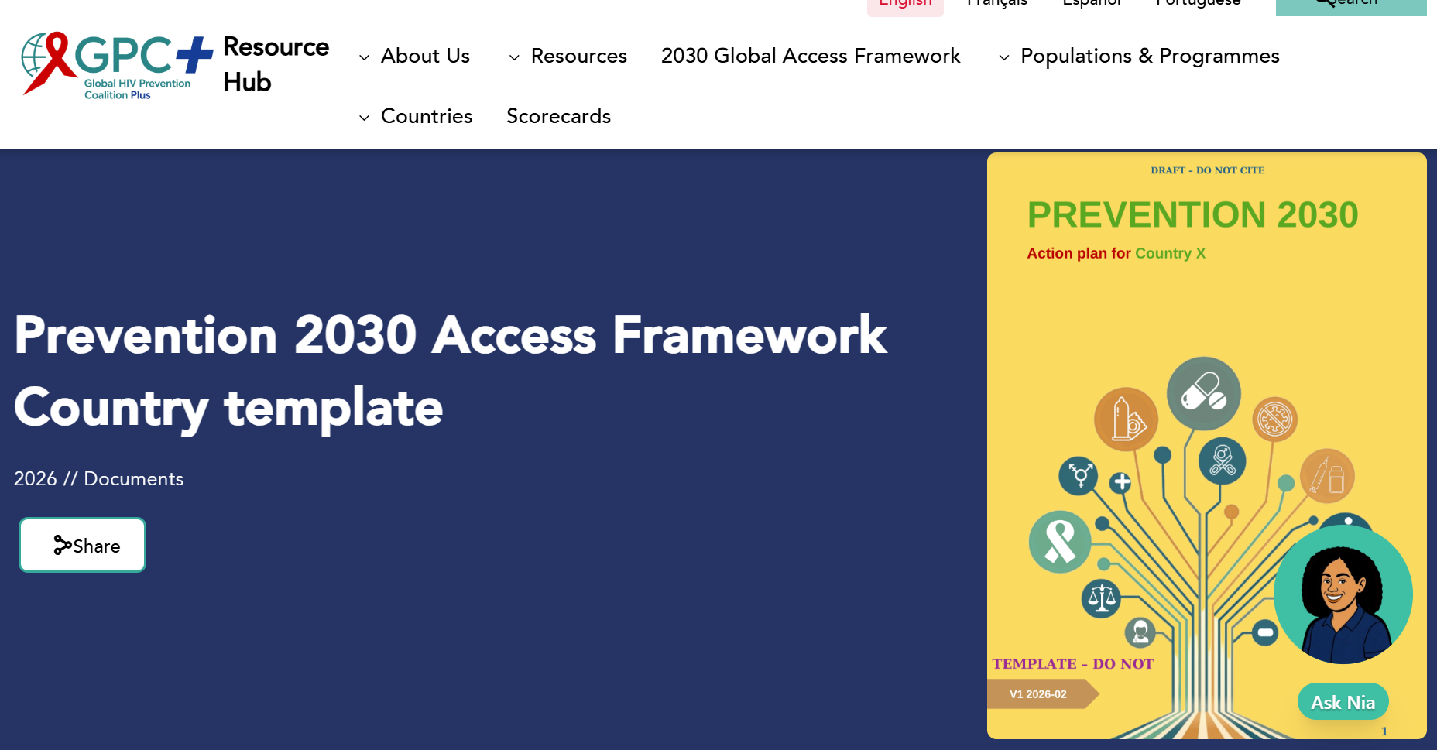
https://hivpreventioncoalition.unaids.org/en/resources/prevention-2030-access-framework-country-template

Slide 17
Thank you, Merci, Obrigado

Slide 18
Discussion – simply raise your hand to be unmuted
Feel free
to comment and reflect on all presentations
explain responses that you made in Mentimeter
share reflections on national prevention plans and operationalizing global targets
Discuss
what type of 2030 prevention plan will be useful in your country context to make progress toward 2030 targets
how resource constraints influence your planning for 2030
what are practical experiences in 2030 prevention planning that you would like to share
what support from partners and lessons from other countries will be most useful to you

