Slide 1
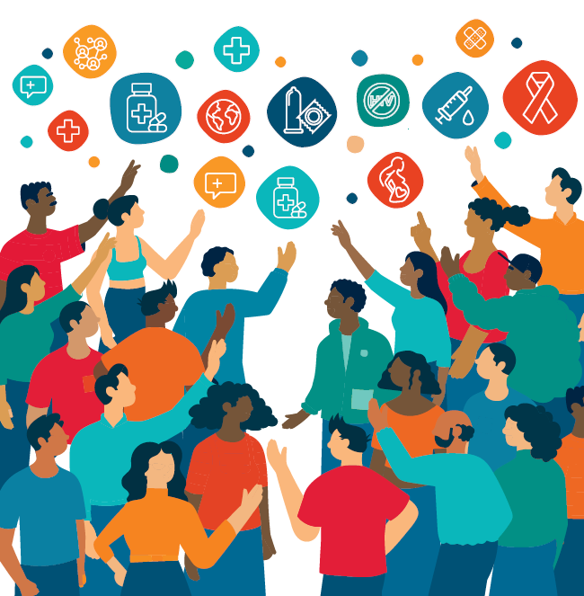
HIV Prevention 2030.
A prioritized approach to prevention in line with a Global Access Framework for Country-Led Responses

Slide 2
Bold Vision
By 2030, every person at risk of HIV will have access to a prevention option that suits their needs.

Slide 3
Reality of a Funding Crisis and Fragmented Prevention Systems
We will not achieve our bold vision for 2030 in a constrained environment without significant transformation.
Countries now need to reshape their responses towards country-led, sustainable, well-prioritized, efficient prevention programs.
-> optimally use available resources

Slide 4


Zooming in on 2030 programmatic primary prevention targets within GAS
Denominators
Outputs
Outcomes
Impact
People in need of HIV prevention
Young people and adults
(in areas with elevated HIV)
Key populations
(sex workers, gay men and other men who have sex with men, transgender people, people who inject drugs, people in prisons and other closed settings)
People living with HIV
95% of people in need of prevention reached with HIV prevention
90%* of people in need of prevention use effective prevention options
Translated into:
95% of people reached with person-centred prevention programs*
Country distribution need met for condoms, PrEP, PEP, needles, syringes, OAMT
90% of adolescents and young people receive CSE
80% of people-centred HIV prevention programmes for key populations delivered by community-led organizations
Achieved through trusted health, community, virtual and other sector platforms for women & girls, men & boys in settings with high HIV and five key populations
Translated into thematic targets:
80% condom use with non-regular partners
Up to 80% use of ARV-based prevention – PEP/PrEP including long-acting products in line with epidemiology** and people’s choices
Population-specific targets:
90% of boys & men accessed VMMC in 15 priority countries
95% of people who inject drugs use safe injecting equipment, 50% of people who inject opioids on OST
95% condom use at paid sex among sex workers and their clients
New HIV infections reduced by 90% in 2030 compared to 2010
Improved health, community, education & social support systems, legal environments
80% HIV prevention options delivered by community-led organizations
HIV treatment as prevention:
90% of all people living with HIV have suppressed viral loads
* People-centred programs in line with programmatic guidance include services, access to prevention options, actions to address structural barriers and tailored prevention communications addressing behavior and norms
** For PrEP targets, indicative HIV incidence thresholds by sub-populations will be updated and simplified, while maintaining the principle of a differentiated approach.
Primary HIV prevention targets
Other critical HIV, health & development targets

Slide 5



Alternative presentation – DO NOT CITE
The key innovation will be country-owned needs estimates & milestones based on granular data: Illustrative country example
1.1 MILLION | + | 350 THOUSAND |  | + | 85 MILLION |  | + | >20PERCENT | = | 90% of people in need use prevention options
People living with HIV accessing treatment |  | People using PrEP options |  |  | Condoms |  |  | of domestic HIV funding goes to prevention |  | 90% of people living with HIV virally suppressed
And this could be translated into district targets as well |  | 1.3 MILLION | Women & girls, boys & men in locations with high HIV |  |  | Reached with combination prevention Highly focused behavioral, biomedical and structural elements with additional population-specific sub-targets for an optimized mix of interventions and access platforms |  |  |  | 90% reduction in new HIV infections from 2010 to 2030
 |  | 80 THOUSAND | Key populations (with 9 500 using harm reduction) |  |  |  |  |  |  | 90% reduction in new HIV infections from 2010 to 2030
Contribution of other HIV response targets, enablers and systems

Slide 6
Many interventions, many populations, many platforms:
What to sustain? What mix? What focus?
Behaviour change communication, blood safefy, cash transfers, community mobilization, comprehensive sexuality education, community-led prevention services, condom social marketing/market development, couples’ HIV prevention, address criminalization and legal change, education (keeping girls in school), early infant circumcision, economic empowerment of young women, HIV prevention in humanitarian settings, income generation for HIV prevention, integrated gender-based violence & HIV prevention, injectable PrEP, intergenerational sex campaigns, life-skills education, male & female condom distribution, mass media programmes, micro-finance for HIV prevention, multiple concurrent partnership campaigns, multi-purpose youth centres, needle & syringe distribution, new media prevention programmes, opioid substitution, overdose prevention, oral pre-exposure prophylaxis, parenting programmes, post-exposure prophylaxis, post-violence care, prevention with positives, prevention among men having sex with men, prevention among mobile populations, prevention among sex workers, prevention with people living with disabilities, prevention for people who inject drugs, prevention among transgender people, prevention with people in prisons, prevention for truck drivers, primary prevention among pregnant women, safe spaces, social asset building, treatment as prevention, STI diagnosis & management, U=U campaigns, vaccine development, vaginal ring, voluntary counselling and testing, voluntary medical male circumcision, work-place based prevention, youth friendly health services, … … …

Slide 7
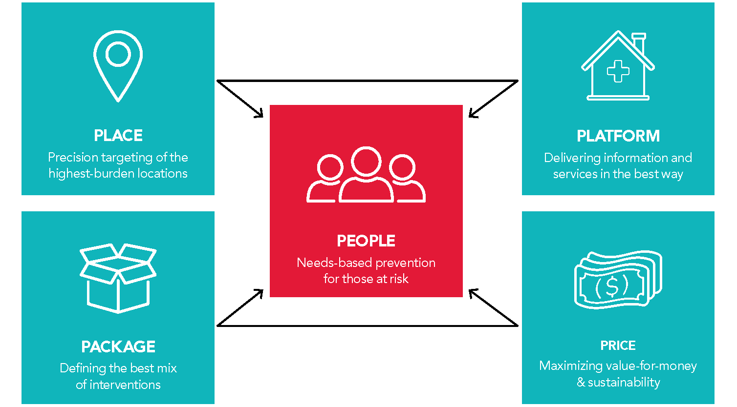
Scalable and sustainable prevention to 2030 and beyond. 5 Ps of prioritization
The right people, right places, packages, best platforms, prices
Focus on key and priority populations who need prevention most

Slide 8
Prioritized, efficient, effective & sustainable
For the right people
In the right places
With the right packages
Using the right platforms
At the right price
The right combination and balance

Slide 9


Defining Who Needs Prevention
Adopt a simple and practical approach that enables countries apply the new risk thresholds and arrive at clearly defined denominators for prevention programs within 12 months, in line with the Global AIDS Strategy.
DETERMINE TOTAL POPULATION SIZE ESTIMATE
Countries should have up-to-date, nationally validated key population size estimates generated from empirical methods and sound statistical concepts.
Where PSEs are outdated or do not exist, global or regional averages may be used to benchmark. For MSM, this should be at least 1% of the total adult male population (WHO & UNAIDS, 2020).
In resource constrained settings, low-cost methodologies that generate reliable PSEs need to be developed and used.
Where possible, multiple sources should be triangulated for greater certainty.
Plausible PSEs should be mandatory in the development of all national strategic plans, prevention roadmaps as well as funding requests/country operational plans for major donors.
CALCULATE A PREVENTION DENOMINATOR
For key populations:
  Men who have sex with men with a non-regular partner
  All transgender women (with non-regular partner)
  All sex workers
  All people who inject drugs
  All prisoners
  For other young people and adults:
Use sub-national HIV incidence estimates disaggregated by age, sex, location and risk. The denominator for regular community outreach should be populations with high HIV incidence (globally defined as more than 1 per 100 person years).
In parts of sub-Saharan Africa this level is also reached among people with non-regular partner(s), people who have transactional sex or another sexually transmitted infection.

Slide 10
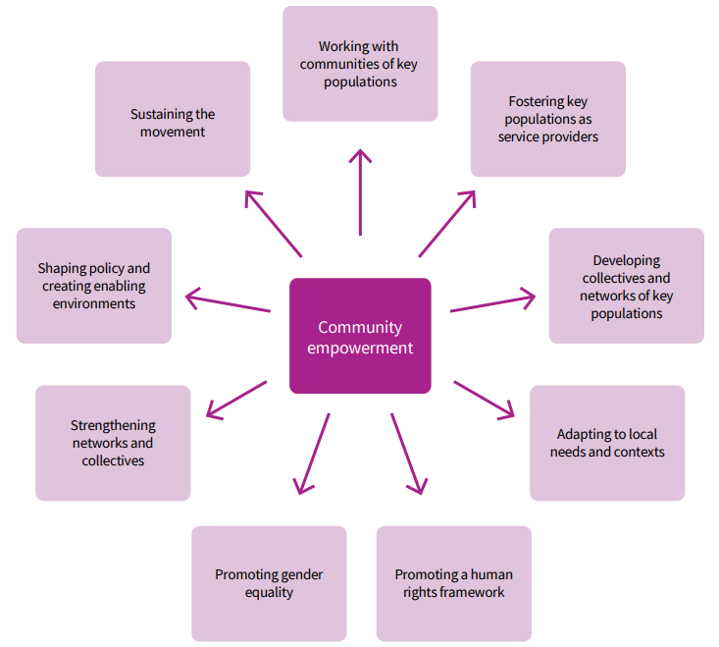
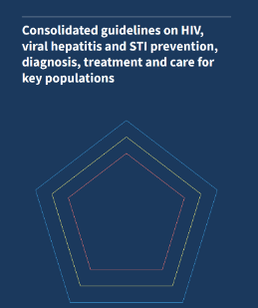
Understand communities
and put communities in the driving seat
  Co-create with communities
  Life-style choices
  Local design

Slide 12
Prioritized, efficient, effective & sustainable
For the right people
In the right places
With the right packages
Using the right platforms
At the right price
The right combination and balance

Slide 13
Location-population dynamics
Globally
  Key populations and their partners at highest risk
  Prevention programs needed wherever key populations are: Urban settings, other key locations, virtual platforms
For heterosexual transmission in Africa:
  Location the primary factory: Where you live determines probability of acquiring HIV (> 1000 fold differences in HIV incidence by location on the continent)
  Intensity of programmes needs to follow geography
  Some countries with large variation in HIV incidence by location within the country (eg Kenya, Tanzania, Nigeria)
  Some countries with relatively lower variation of HIV incidence by location within the country (e.g. Botswana, Eswatini, Lesotho)

Slide 14
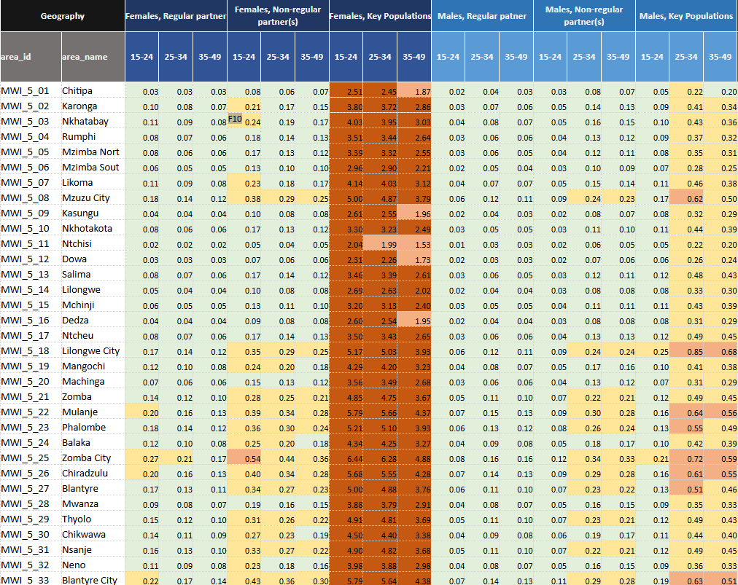
Analyze HIV incidence patterns:
Major differences in HIV incidence by:
Location
Individual level of risk
Sex
Age
Figure: Excerpt from a national summary of district estimates for an eastern African country
DO NOT CITE
Source: Tool for estimating the population size of people at risk of acquiring HIV in settings with high HIV incidence. Geneva, 2023.
Sub-national HIV Estimates in Priority Populations Tool | GPC

Slide 15
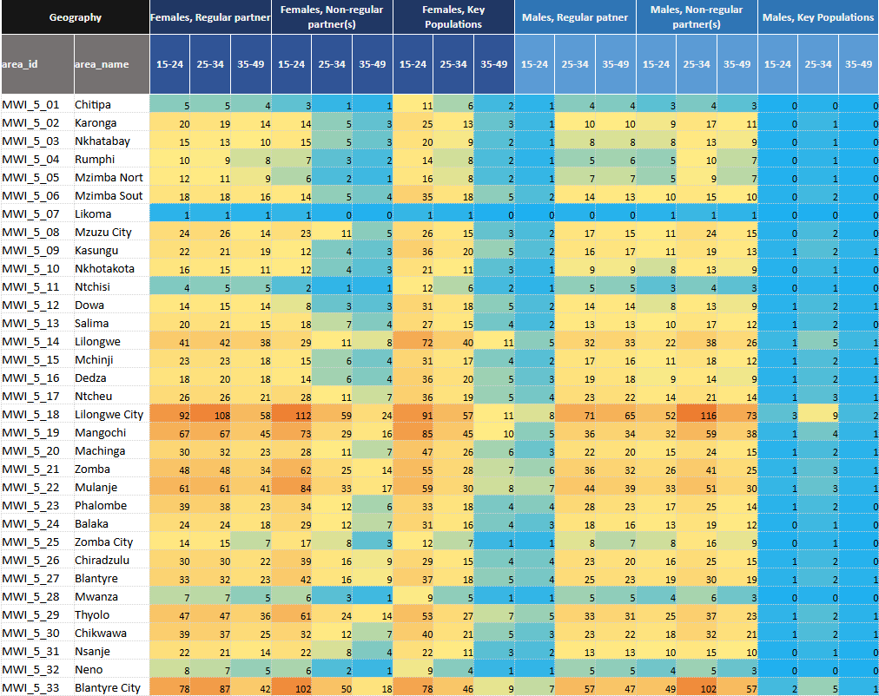
Analyze VOLUME OF NEW HIV INFECTIONS
Figure: Excerpt from a national summary of district estimates for an eastern African country
DO NOT CITE
Source: Tool for estimating the population size of people at risk of acquiring HIV in settings with high HIV incidence. Geneva, 2023.

Slide 16
Prioritized, efficient, effective & sustainable
For the right people
In the right places
With the right packages
Using the right platforms
At the right price
The right combination and balance

Slide 17
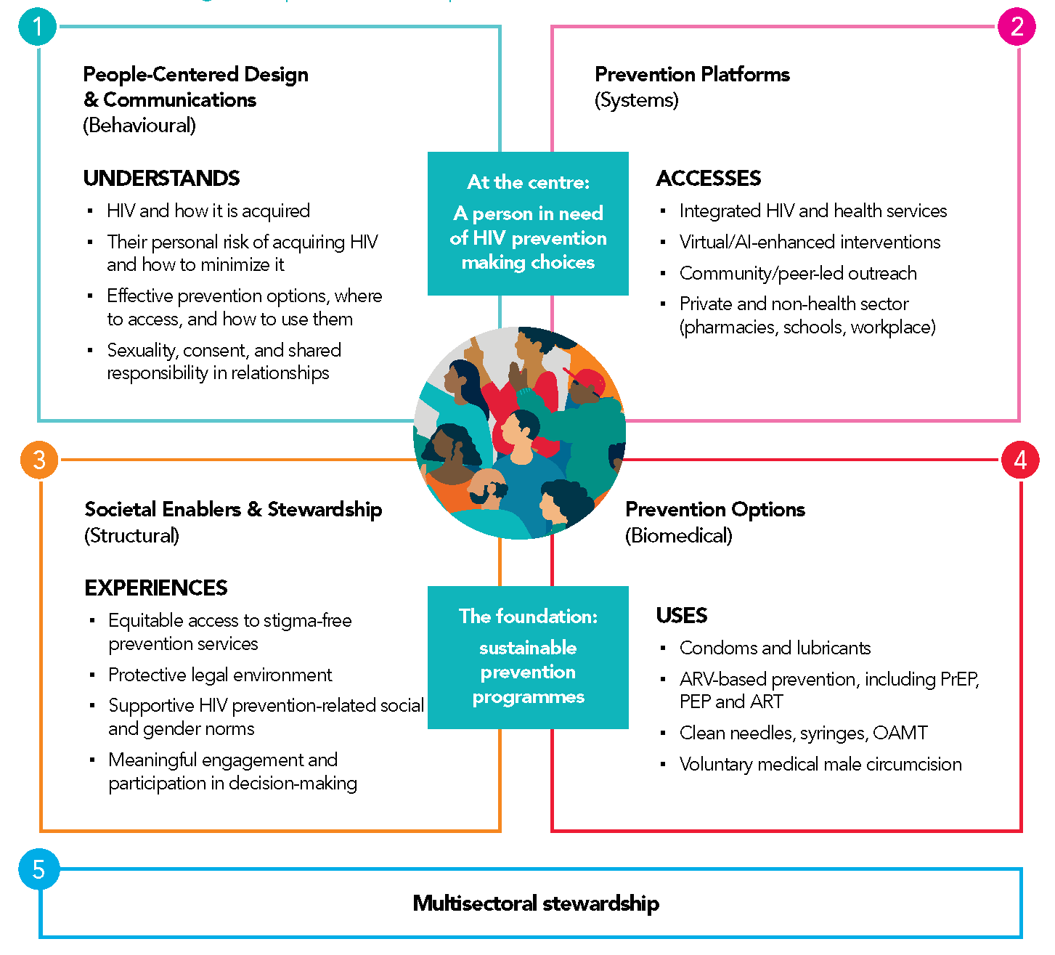
A person- centred prevention framework
But not everything for everyone
Carefully chosen biomedical, behavioral,
structural elements

Slide 18
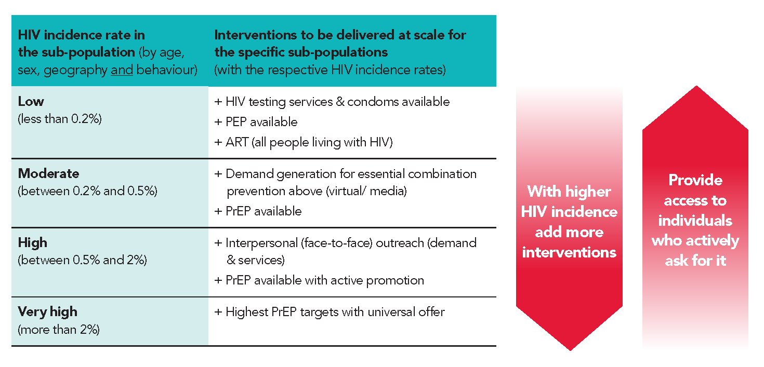
Rationale for prevention targets – and how they relate to HIV incidence

Slide 19
Illustrative country target table based on granular needs estimate
 | 2024 (baseline) | 2026 | 2027 | 2028 | 2029 | 2030
Condoms | 52 million | 56 | 64 | 72 | 80 | 85 million
PrEP | 70 000 | 100 000 | 220 000 | 270 000 | 350 000 | 350 000
PEP | TBC | TBC | TBC | TBC | TBC | TBC
VMMC | 120 000 | 120 000 | 120 000 | 120 000 | 120 000 | 120 000
Women & girls in locations with elevated HIV incidence (>0.2%) | 350 000 | 350 000 | 550 000 | 750 000 | 900 000 | 900 000
Men and boys in locations with elevated HIV incidence (>0.2%) | 200 000 | 200 000 | 300 000 | 350 000 | 400 000 | 400 000
Sex Workers reached | 23 000 | 25 000 | 35 000 | 40 000 | 45 000 | 45 000
MSM reached | 20 000 | 24 000 | 32 000 | 40 000 | 50 000 | 60 000
TG people reached | 1000 | 1500 | 2000 | 3000 | 3500 | 4000
PWID reached with needles & syringes | 4000 | 6000 | 8000 | 9500 | 9500 | 9500
PWID receiving OAMT | 500 | 1000 | 2000 | 3000 | 4000 | 4800
Prisoners reached | 1000 | 2000 | 3000 | 5000 | 6000 | 6000

Slide 20
Prioritized, efficient, effective & sustainable
For the right people
In the right places
With the right packages
Using the right platforms
At the right price
The right combination and balance

Slide 21
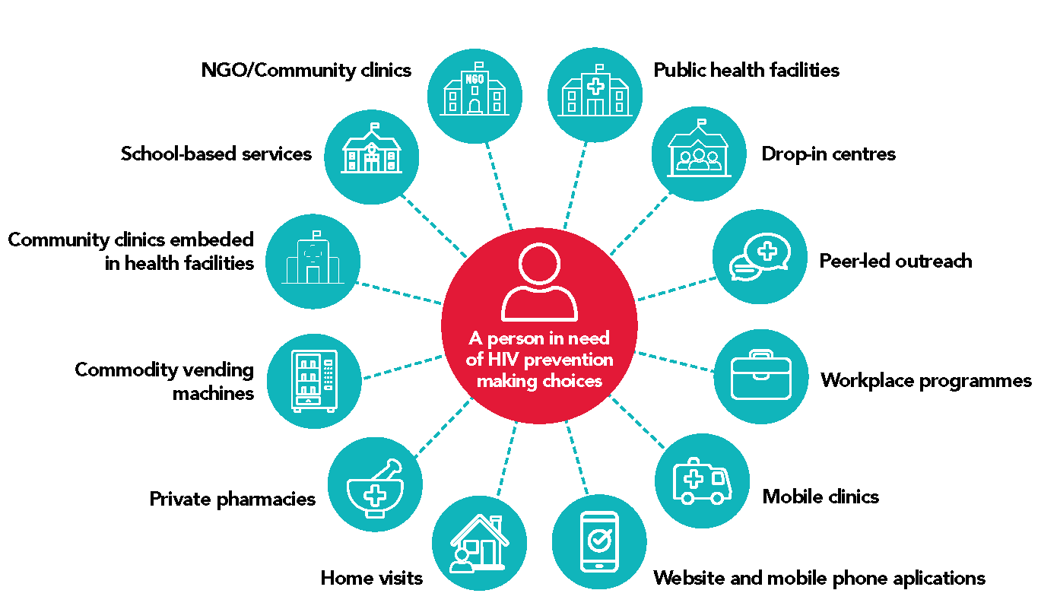
Scaled trusted access platforms
NEW
Systematically plan country access platforms for different prevention options and populations
Design with a view to enable self-care
 | Access points
By intervention | Health facilities | Community -led and other outreach | Pharmacies | Key / higher risk locations | Virtual space | Private sector outlets | Other government sectors | Dispensers
Communications
Condoms
Oral PrEP
PEP
Needles & syringes
By population
Women & Girls
Men & boys
Gay men & other MSM
Sex workers
Transgender people
People who inject drugs

Slide 22
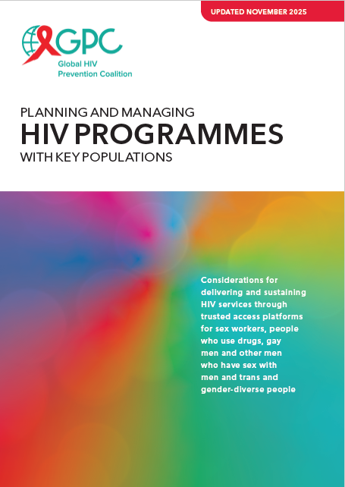
Dedicated
KP clinic sites
Example: Prioritizing access platforms for key populations
Mobile clinics
Drop-in centres
Other key venue presence:
Vending machines, bars, kiosks, events
Add …
Clinics
Other health facility-based modalities: Peer navigation,
KP rooms or days, sexual health clinics
Outreach
Service delivery approaches
Online
Additional online services (e-pharmacy, counselling)
Peer-led outreach in physical settings (differentiated based on need)
Peer-led outreach in virtual spaces
Updated detailed
planning guide available
KP-competent health facilities
KP-competent pharmacies
Fewer resources More resources
Lower HIV incidence Higher HIV incidence
Actions to address human-rights & gender related barriers and create an enabling policy environment
Community engagement, leadership and accountability
Enablers
Enablers are a foundation that entail some actions that do not require extensive resources and others that do.
The specific needs should be considered based on the country’s legal and policy environment and resource availability .

Slide 23
The ‘right’ platform is local: Finding and engaging people using local data
Example:
Using local data to
reach young women
in a district with high HIV incidence

Slide 24
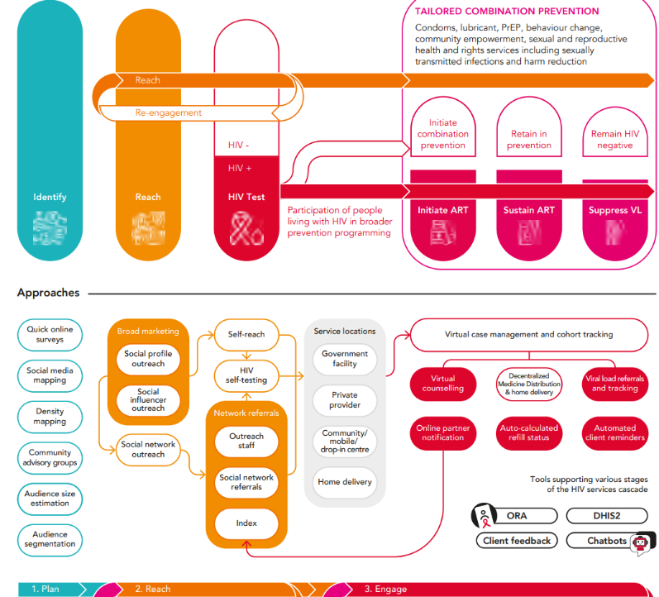
Virtual HIV interventions:
Consider the range of options and prioritize in line with country realities

Slide 25
Prioritized, efficient, effective & sustainable
For the right people
In the right places
With the right packages
Using the right platforms
At the right price
The right combination and balance

Slide 26
Cost-efficiency for prevention
What are typical areas for large savings through implementation efficiencies
Reduce fragmentation of delivery: Reduce multiplicity of overlapping cadres & projects
Human resources: Move to sustainable and standardized country scales for health and non-health delivery
Prevention commodities: Use high volume international procurement platforms

Slide 27
From needs estimates to delivery and financing (illustrative country table)
Prevention options | Target (illustrative) | Program /market segment (share in % of products and populations to be reached) |  |  | Funding source for free & subsidized (share in % of cost)
 |  | Free (public) | Subsidized (social marketing) | Sold (private /out of pocket) | Government | Donors
Condoms | 85 million | 50% | 30% | 20% | 50% | 30%
PrEP (Daily Oral) | 120 000 | 80% | 10% | 10% | 30% | 60%
PrEP (Long-acting) | 230 000 | 100% | - | - | 10% | 90%
PEP | TBC | 60% | 20% | 20% | 50% | 20%
VMMC | 120 000 | 90% | - | 10% | 50% | 50%
Needles & syringes | 2.5 million | 80% | - | 20% | 40% | 20%
OAMT | 4 800 | 100% | - | - | 80% | 20%
People-centred programs and access platforms | Target (illustrative) | Facility | Outreach | Virtual | Government | Donors
Women & girls in locations with elevated HIV incidence (>0.2%) | 900 000 | 40% | 10% | 50% | 80% | 20%
Men and boys in locations with elevated HIV incidence (>0.2%) | 400 000 | 10% | 10% | 80% | 80% | 20%
Sex Workers reached | 45 000 | 40% | 40% | 20% | 50% | 50%
MSM reached | 60 000 | 20% | 10% | 70% | 50% | 50%
TG people reached | 4 000 | 20% | 30% | 50% | 50% | 50%
PWID reached | 10 000 | 40% | 40% | 20% | 50% | 50%
Prisoners | 8 000 | 80% | - | 20% | 90% | 10%

Slide 28

Prioritization is unavoidable in any HIV prevention response
Beyond cost-effectiveness: For full value for money considerations: Important to consider equity, non-HIV benefits and other factors
BUT – avoiding prioritization is not possible in any public health response
The attempt to avoid explicit prioritization is likely to lead to implicit prioritization, which typically more inequity and lower impact
Various modelling tools available to support allocative efficiency analyses (GOALS, AEM, Optima …)

Slide 29
Thank you, Merci, Obrigado

