Slide 1


Prevention guidance and tools to support GC8: an overview
Heather-Marie Schmidt
Advisor, HIV Prevention Programme Implementation
schmidth@unaids.org
27 April 2026

Slide 2
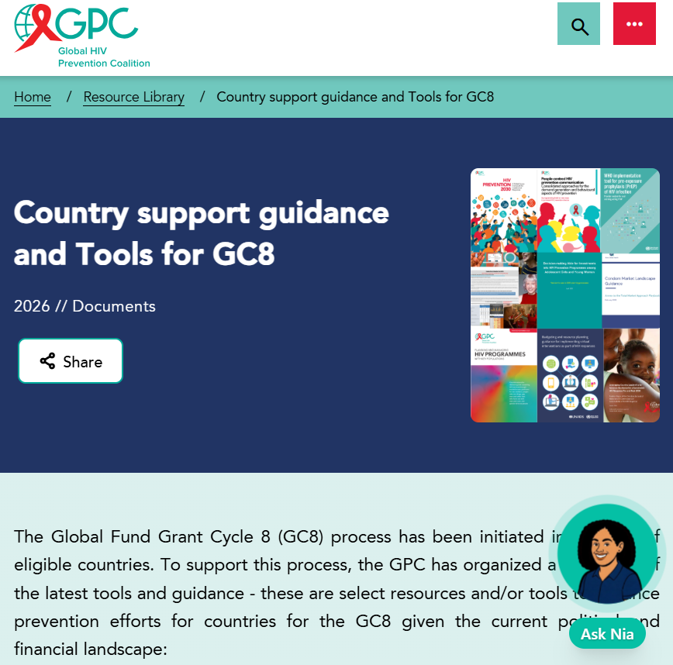
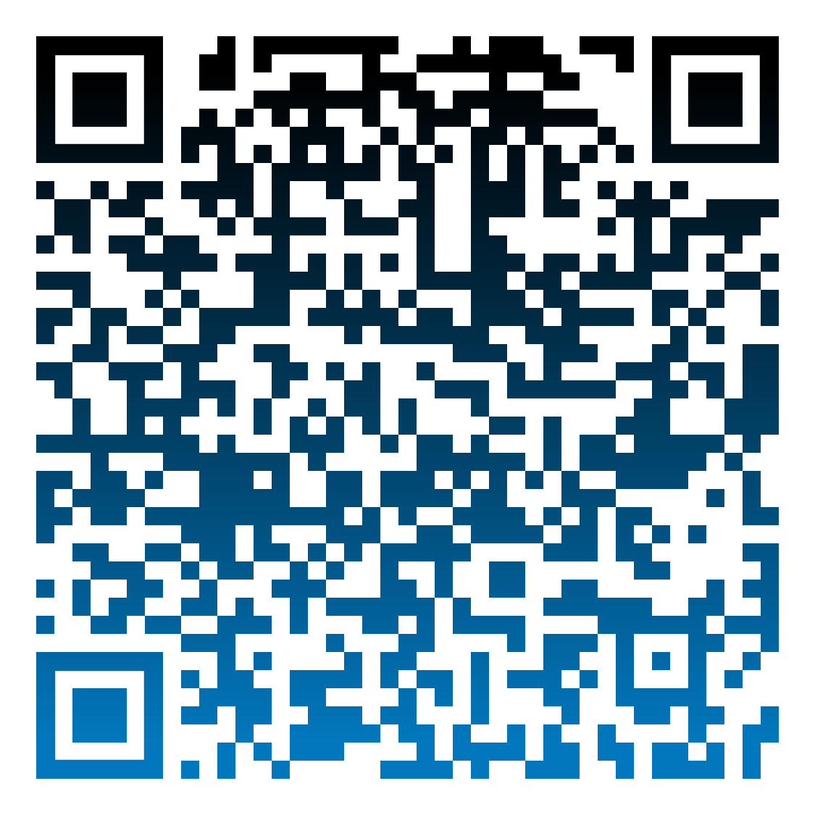
GPC resource hub compiles guidance and a range of tools useful for GC8

Slide 3
Overview of prevention guidance and tools relevant to GC8: Navigating what to use for what purpose
Thematic area | Guidance | Planning and management tools | Analytical tools
Country target setting, prevention plans and systems | HIV Prevention 2030. A Global Access Framework for Country-Led Responses Multi-sectoral stewardship of HIV prevention (coming soon) | Supporting Prioritization in the Context of HIV Funding Cuts | GPC Template for 2030 country prevention access plans (coming soon) | Prevention Needs Estimates Tools - The collection Country and Global HIV Prevention Scorecards Sub-national HIV Estimates in Priority Populations Tool (SHIPP Tool) Five HIV prevention self-assessment tools (PSATs) Checklist for prevention in GC8 proposals (coming soon)
People-centred prevention communication and demand generation | People-centred HIV prevention communication: Consolidated approaches for the demand generation and behavioural aspects of HIV prevention Virtual interventions in response to HIV, sexually transmitted infections and viral hepatitis: policy brief | Budgeting and resource planning guidance for implementing virtual interventions as part of HIV responses
Key populations | Consolidated guidelines on HIV, viral hepatitis and STI for key populations | Planning and Managing HIV programmes with key populations
Women & girls | HIV prevention among adolescent girls and young women - Guidance | Decision-making aid for investments into HIV prevention programmes among adolescent girls and young women
Men & boys | Men and HIV: evidence-based approaches and interventions. A framework for person-centred health services | Brief on sustainability of voluntary medical male circumcision programmes (coming soon)
Condom programming | Developing effective condom programmes: technical brief | Total Market Approach Playbook for Sustainable Condom Access Toolkit to Design Social Media Campaigns that Promote Condom Use | Condom Needs Estimation Tool
ARV-based prevention | Guidelines on lenacapavir for HIV prevention and testing strategies for long-acting injectable PrEP WHO implementation tools for pre-exposure prophylaxis (PrEP): Provider Module (update coming soon) Guidelines for HIV post-exposure prophylaxis | Tools to support Lenacapavir introduction Lenacapavir introduction blueprint (coming soon) | PrEP-it - needs estimation tool

Slide 4

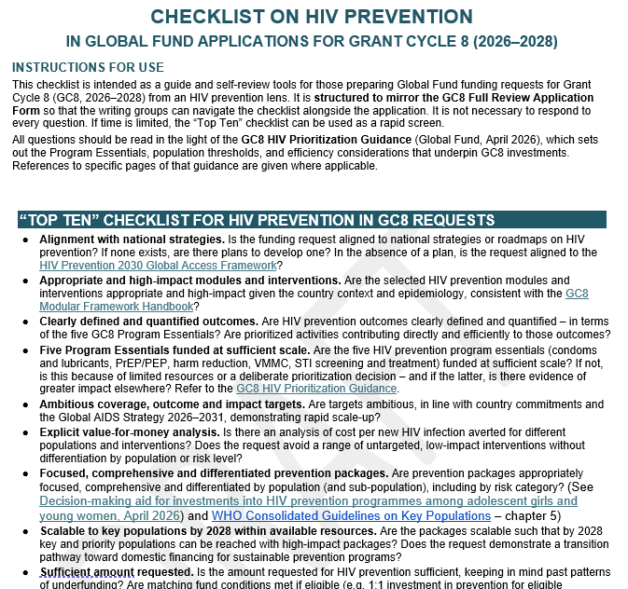

Checklist on HIV Prevention in Global Fund Applications for GC8
Coming soon

Slide 5
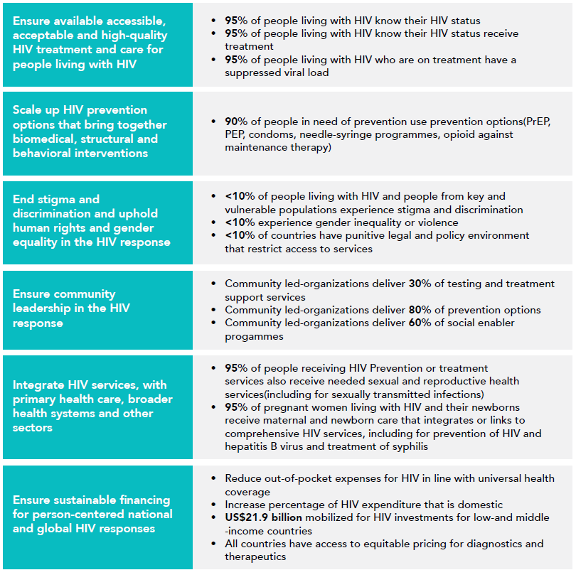

Global AIDS Strategy
2026-2031
2030 Global AIDS Targets

Slide 6
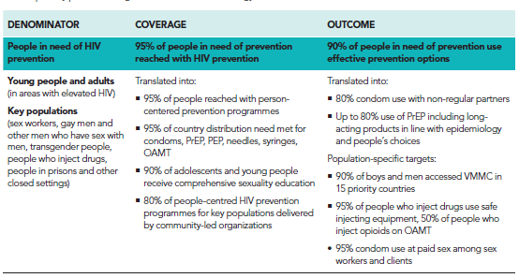
Global AIDS Strategy 2026-2031: 2030 primary prevention targets

Slide 7

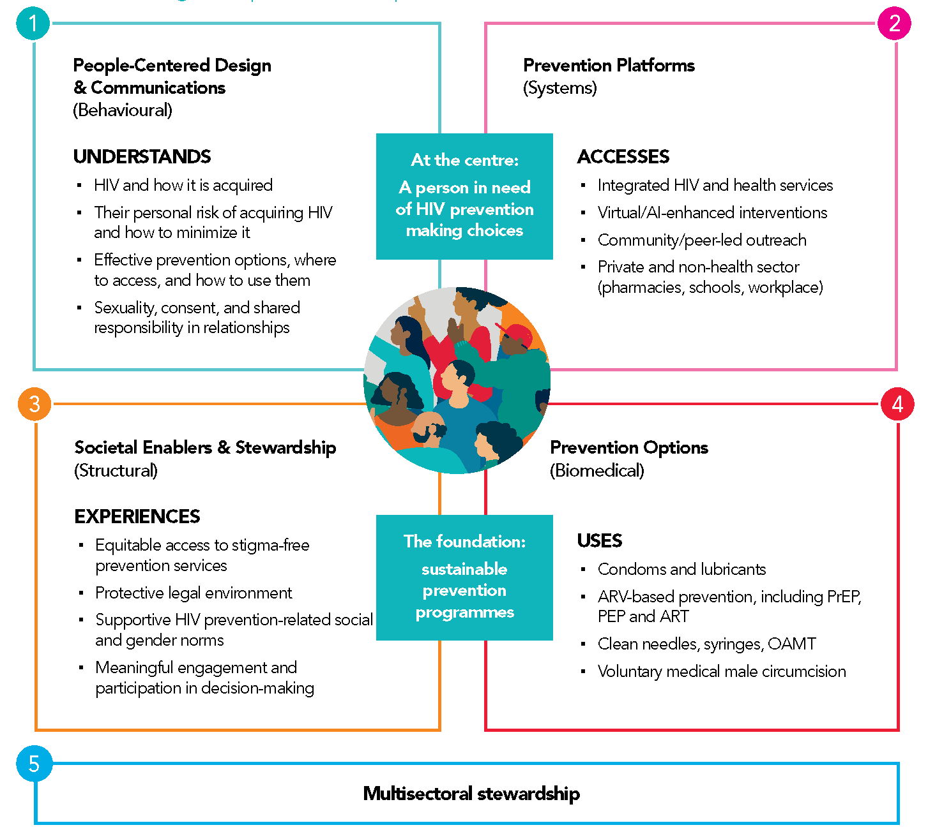
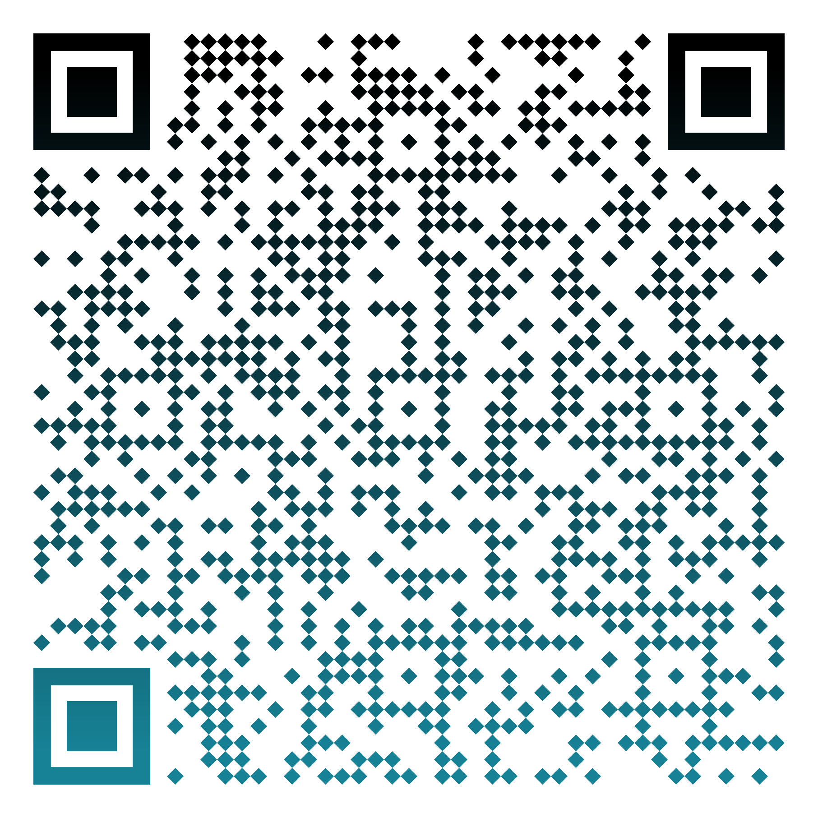
Achieving a bold vision for HIV prevention in GC8
New Guidance
The Global Access Framework makes strategic shifts in the framing, leverages the GAS 2026-2031 targets and provides a new approach to prevention needs estimates with direct relevance to GC8
  As a framework, it puts people at the centre supported by sustainable and evidence-based prevention programming incorporating carefully chosen (and prioritised) biomedical, behavioural and structural elements, and underpinned by multisectoral stewardship
Includes tools / guidance to enable:
  more granular & more systematic analysis of need across populations and prevention options
  annual tracking of progress at all levels
  prioritization and alignment

Slide 8
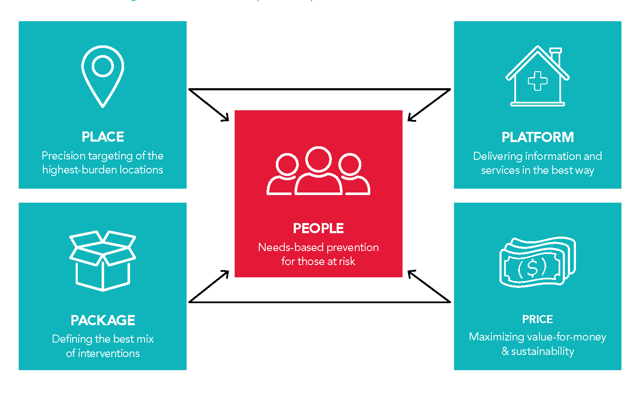
Scalable and sustainable prevention to 2030 and beyond.
5 Ps of prioritization: people, places, packages, best platforms, prices

Slide 9
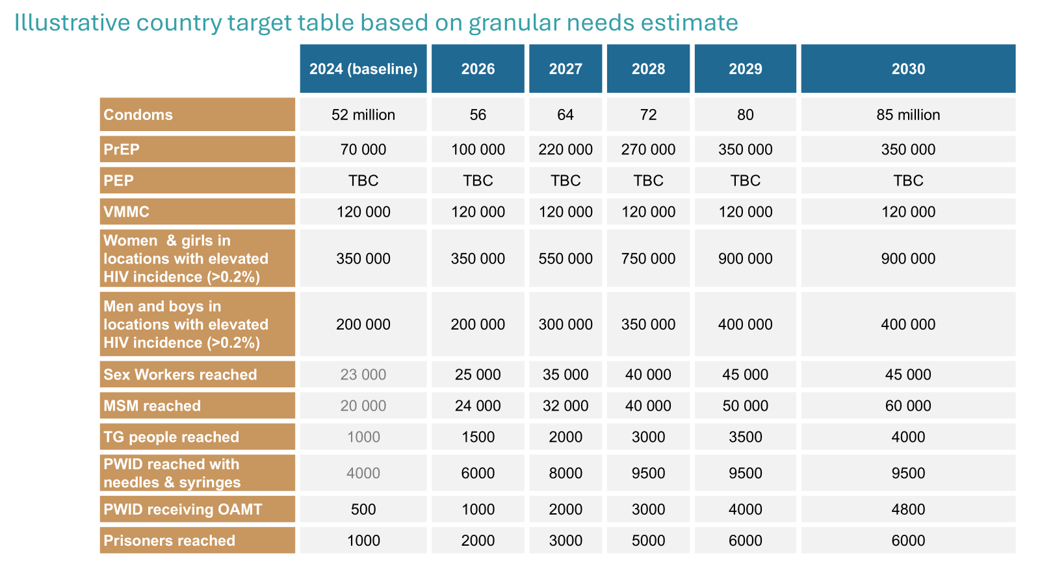
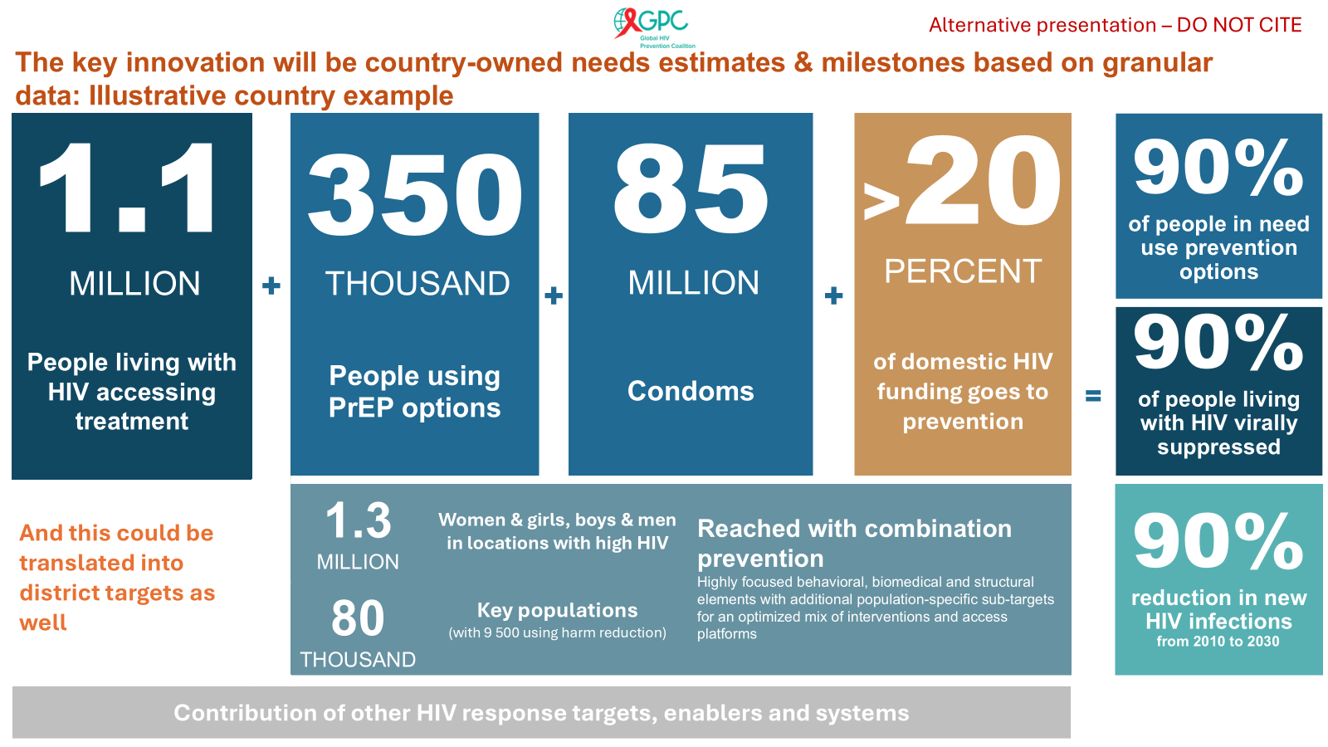
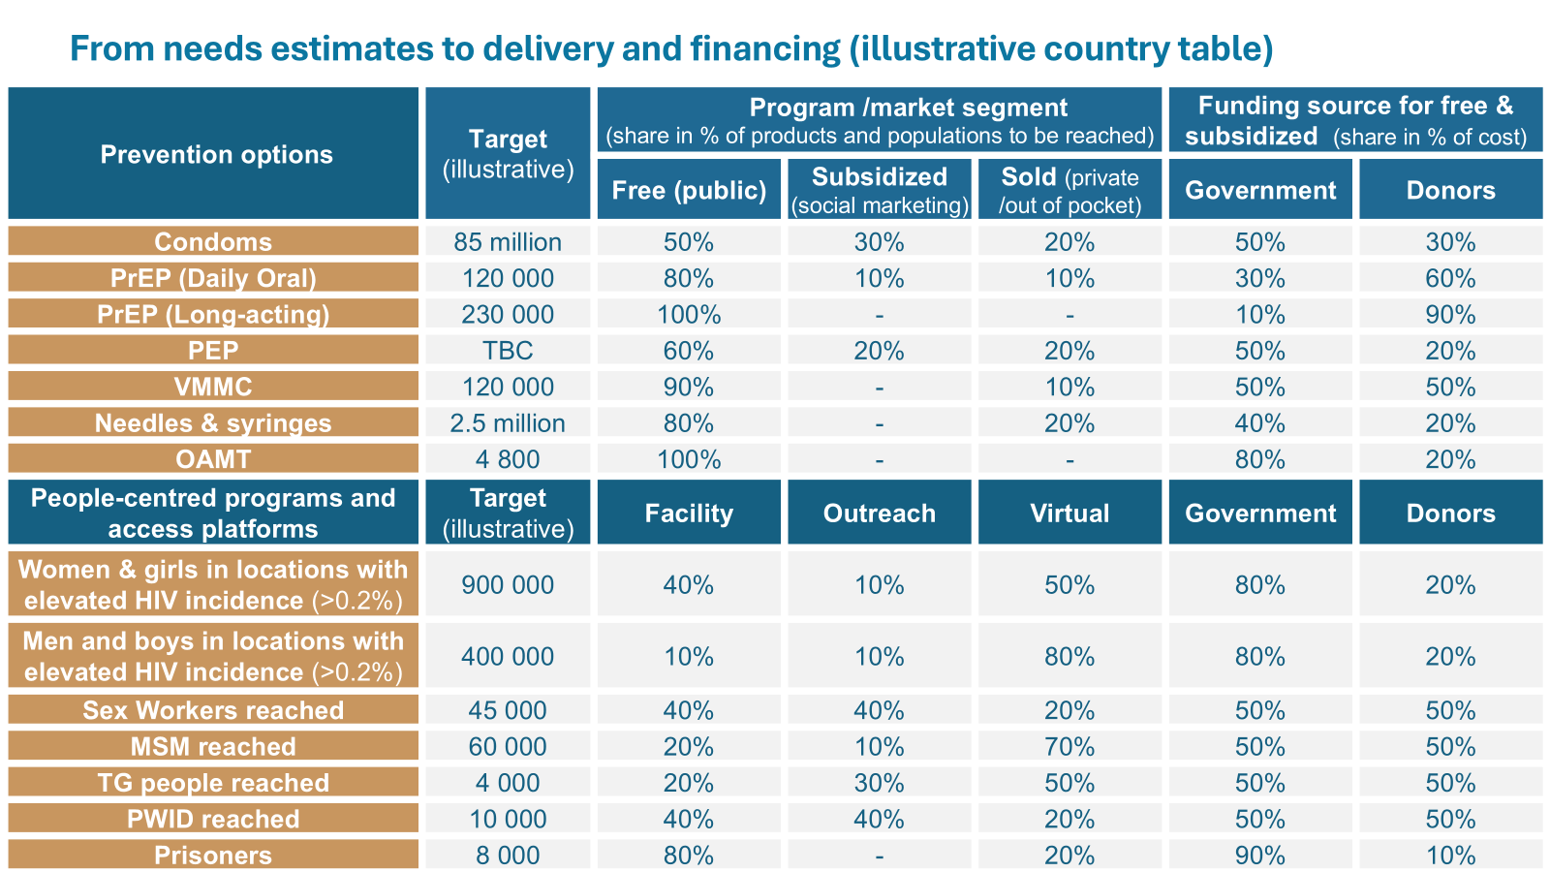
Taking prioritisation forward: needs estimates, targets and milestones – illustrative tables for countries

