Slide 1
The Sub-national HIV Estimates in Priority Populations (SHIPP) tool: approach and methods
Katie Risher, PhD MHS
Assistant Professor, Penn State University
Honorary Research Fellow, Imperial College London

Slide 2
Background
Many HIV prevention programmes aim to reduce new infections
Infeasible to target all individuals at risk of HIV
  For example, an estimated 20 million young women aged 15-24 live in districts with high HIV incidence, more if you include 10-14 and 25-29 year olds
  About 1/3 of locations with high HIV incidence in young women are covered by programmes
  Infeasible to reach all young women in high HIV incidence locations with comprehensive programme packages based on current resourcing
In different geographic settings, with different background incidence, behaviours have different level of risk

Slide 3
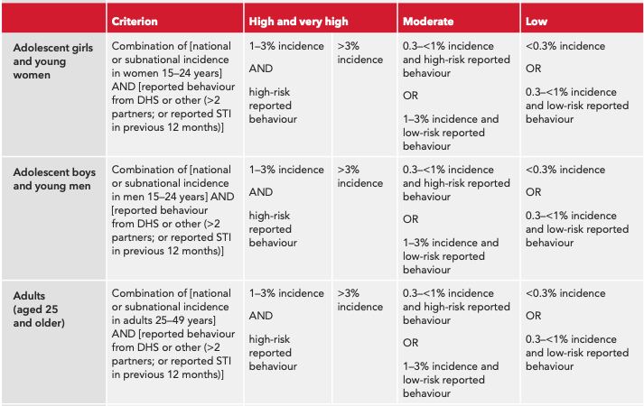
Threshold for the prioritization of HIV prevention methods

Slide 4
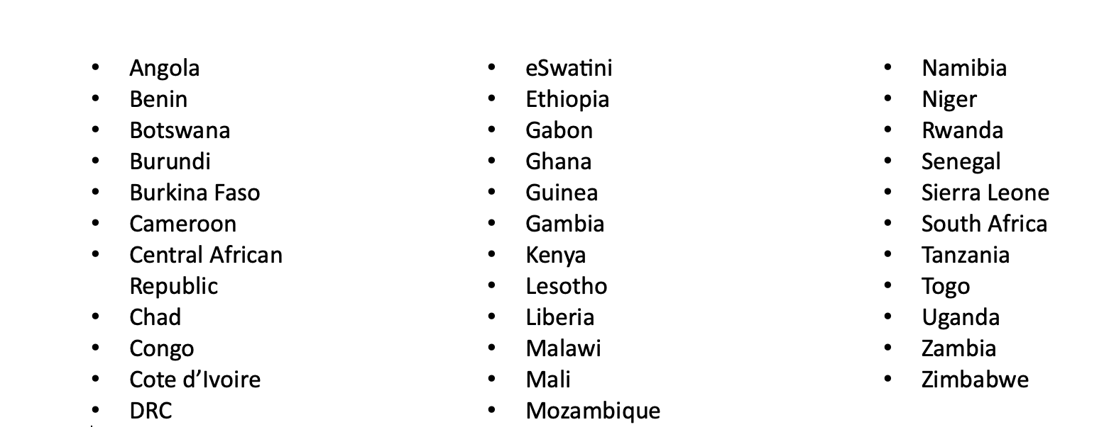
SHIPP Tool Objective
Estimate the “denominator” – number of men and women at higher risk of acquiring HIV who need intensified HIV prevention programmes
Using survey and Naomi model outputs to estimate the size of sub-populations of men and women aged 15-49 at higher risk of HIV, stratified by level of risk and age, at district level in 34 countries

Slide 5
SHIPP tool outputs
Disaggregated by age (5-year age groups, 15-49), sexual behaviour, and sub-national location (district):
Behavioural proportions (% of age group in each behaviour category)
HIV-negative population size
Estimated new HIV infections
HIV incidence rates

Slide 6
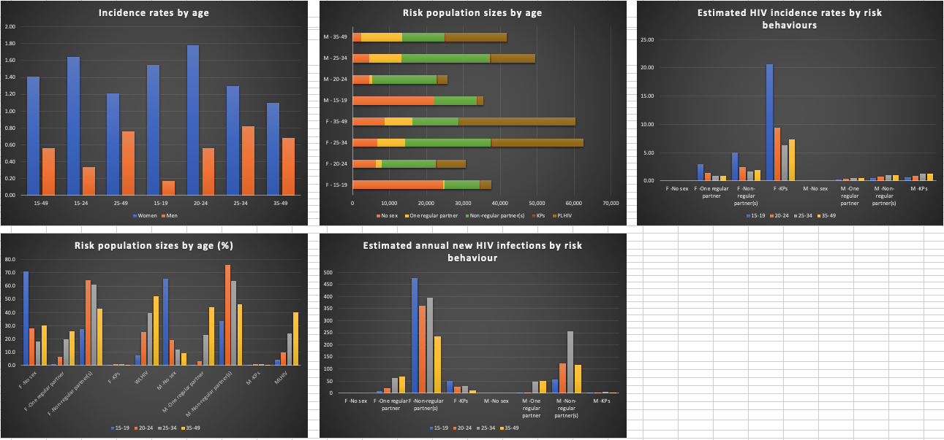
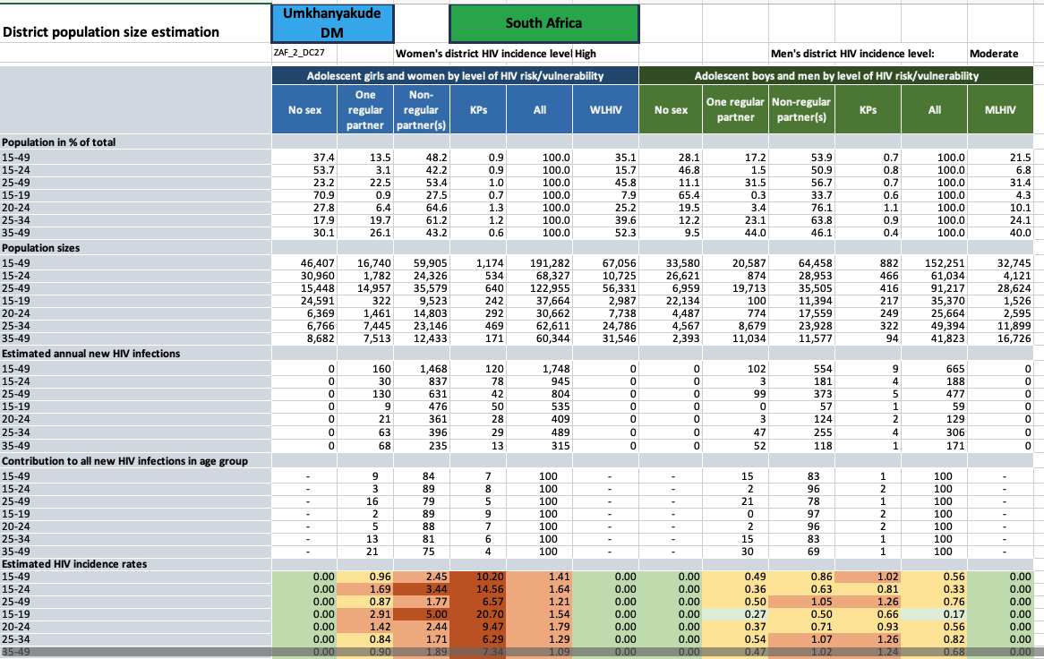
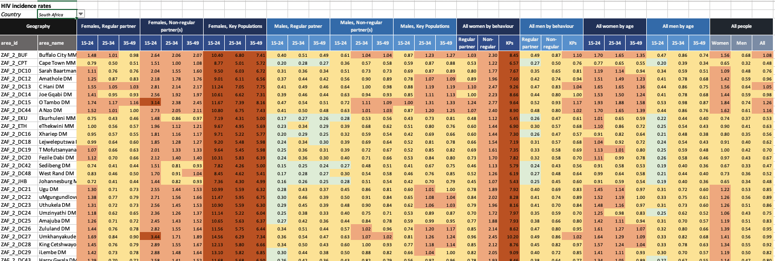

Slide 7
How does the SHIPP tool build on the Naomi model?
The Naomi model estimates are disaggregated by (3D):
  Age
  Sex
  Sub-national location (district)
The SHIPP tool adds sexual behaviour to these levels of disaggregation (4D)
  Maintains Naomi estimates for age, sex and district

Slide 8
What is the added value of the SHIPP tool?
Combines behavioural risk groups with HIV incidence at a small area
This can help plan resources and strategies for population-specific programming

Slide 9
Data/inputs

Slide 10
Data/inputs
DHS survey data – behavioural risk
Naomi model – HIV incidence, prevalence, population
Key Population size estimates and HIV prevalence

Slide 11
Data/inputs
Survey data – behavioural risk
Naomi model – HIV incidence, prevalence, population
Key Population size estimates and HIV prevalence

Slide 12

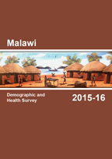



Demographic & Health Surveys (DHS)
Primary source for behavioural data
Household survey - two-stage stratified cluster design
Module on sexual behaviour
Cluster geo-coordinates (random displacement)

Slide 13


Population-based HIV Impact Assessments (PHIAs) & Botswana AIDS Impact Surveys
Additional source for behavioural data
Household survey - two-stage stratified cluster design
Module on sexual behaviour
Cluster geo-coordinates (random displacement)

Slide 14
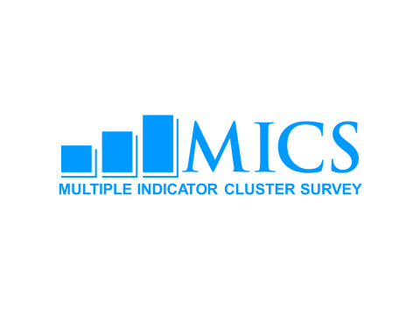
Multiple Indicator Cluster Surveys (MICS)
Source for behavioural data
Household survey - two-stage stratified cluster design
Module on sexual behaviour
NO cluster geo-coordinates, only admin-1 (province) level geographic disaggregation
Only used as supplement if a country doesn’t have a recent DHS/PHIA
  CAR

Slide 15
Behaviour category definitions
Category | HIV related risk
No sex | Not sexually active
One regular | Sexually active, one cohabiting partner
Non-regular | Non-regular sexual partner(s)
KPs | Women: women who sell sex | Men: MSM and PWID
Use geospatial data from DHS to fit spatially smoothed district-level model to top three (no, low and high) behaviour categories
Notes:
Use geospatial data from DHS & PHIA to fit spatially smoothed district-level model to the top three of these categories. Model has a term for 5-year age group, a spatial effect, and a spatial interaction term by 5-year age group - spatial effect can be different for different age groups.

Slide 16
Questions used to derive behavioural proportions (no sex/one regular/non-regular)
No sex: respondent reports no sex in the past 12 months
One regular partner: respondent reports sex with one cohabiting partner in the past 12 months (derived from question on number of partners and partner history describing type of partner for up to three most recent partners - marital or cohabiting partners)
Non-regular partner(s): respondent reports sex with one or more non-regular partners or multiple partners (derived from question on number of partners and partner history describing type of partner for up to three most recent partners - any partner that is neither marital nor cohabiting is considered non-regular)
Notes:
If inconsistent responses, respondents are mapped to the “highest risk” of these behaviours

Slide 17
Data/inputs
DHS survey data – behavioural risk
Naomi model – HIV incidence, prevalence, population
Key Population size estimates and HIV prevalence

Slide 18
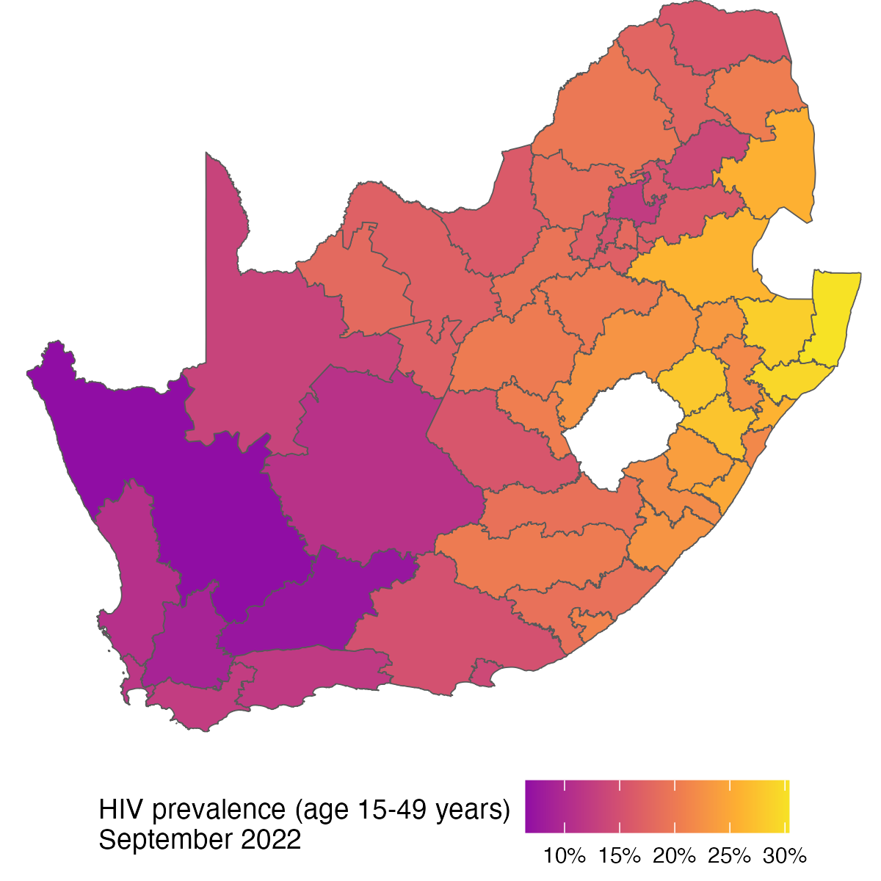
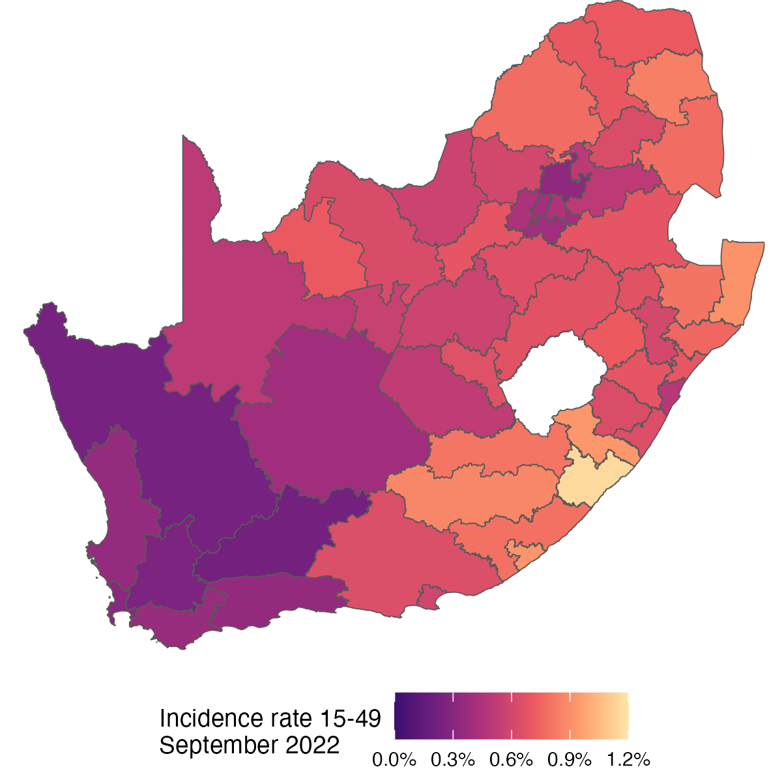
Naomi model – source for district-level HIV prevalence, incidence, and population
Jeff Eaton TWG Presentation 22 March 2023

Slide 19

Naomi model
Small-area estimation model for estimating at district level by sex and five-year age group :
  HIV prevalence and PLHIV
  ART coverage
  new HIV infections and HIV incidence
Combines multiple data sources in a Bayesian statistical model
District-level data incorporated include:
  Census or other district-level population estimates
  National household surveys, including DHS, PHIAs, BAIS, HSRC, more
  Number accessing ART through public sector provision with some additional sources
  Public sector ANC HIV prevalence and ART coverage
https://naomi-spectrum.unaids.org

Slide 20
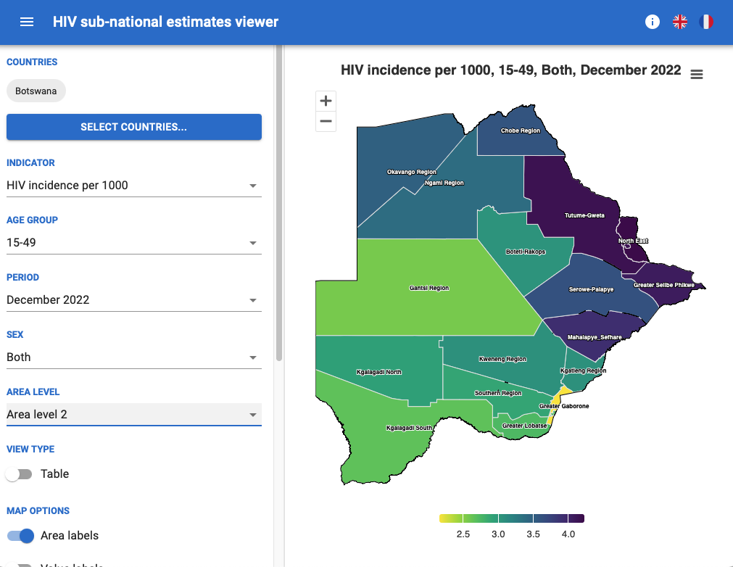
Accessing Naomi estimates
District estimates disseminated via:
https://naomi-spectrum.unaids.org
Detailed description of methods
  Eaton et al. J Int AIDS Soc. 2021;24 Suppl 5(Suppl 5):e25788.

Slide 21
Naomi Estimates → SHIPP Tool
District-level, 5-year age group
  Population
  HIV incidence
  HIV prevalence
  New infections
  PLHIV
  Eaton et al. J Int AIDS Soc. 2021;24 Suppl 5(Suppl 5):e25788.

Slide 22
Data/inputs
DHS survey data – behavioural risk
Naomi model – HIV incidence, prevalence, population
Key Population size estimates and HIV prevalence

Slide 23
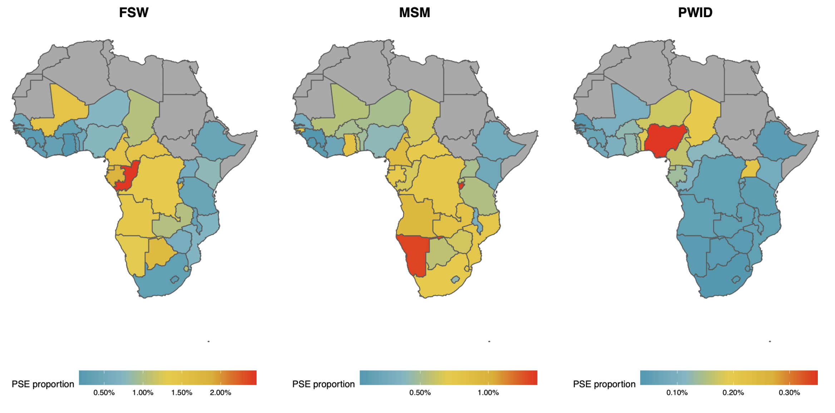
Key Population Size Estimates
Stevens et al. Key population size, HIV prevalence, and ART coverage in sub-Saharan Africa: systematic collation and synthesis of survey data. medRxiv 2022. https://doi.org/10.1101/2022.07.27.22278071
Oli Stevens UNAIDS Reference Group 22 May 2022

Slide 24
Key Population Estimates Data sources
UNAIDS Global AIDS Monitoring & Key Population Atlas
CDC surveillance database
GFATM surveillance database
Additional peer-reviewed and grey literature sources
  Global.HIV
  Degenhardt PWID systematic review
PSEs are matched to a geography by name and corresponding population
Oli Stevens UNAIDS Reference Group 22 May 2022

Slide 25
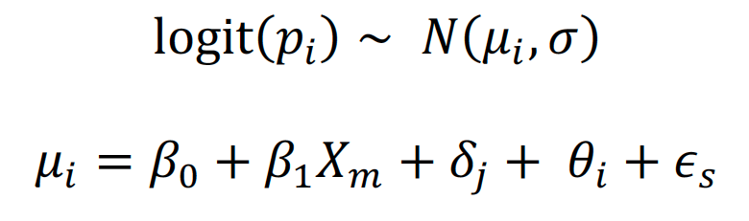
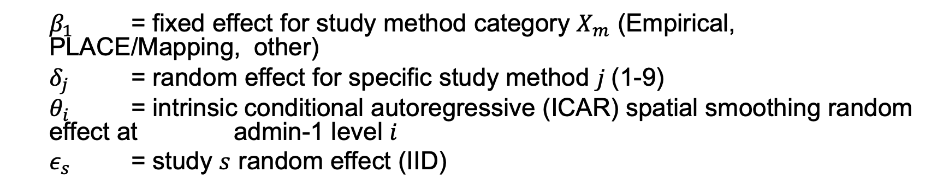
Population size model – urban proportions
Population proportions in each KP are spatially correlated between admin-1 neighbours
FSW, MSM, PWID
  $β_{1}$ = fixed effect for study method category $X_{m}$ (Empirical, PLACE/Mapping, other)
  $δ_{j}$ = random effect for specific study method $j$(1-9)
  $θ_{i}$ = intrinsic conditional autoregressive (ICAR) spatial smoothing random effect at admin-1 level $i$
  $ε_{s}$ = study $s$ random effect (IID)
Oli Stevens UNAIDS Reference Group 22 May 2022
Notes:
Study method = e.g. Capture recapture methods, Unique object multipliers

Slide 26
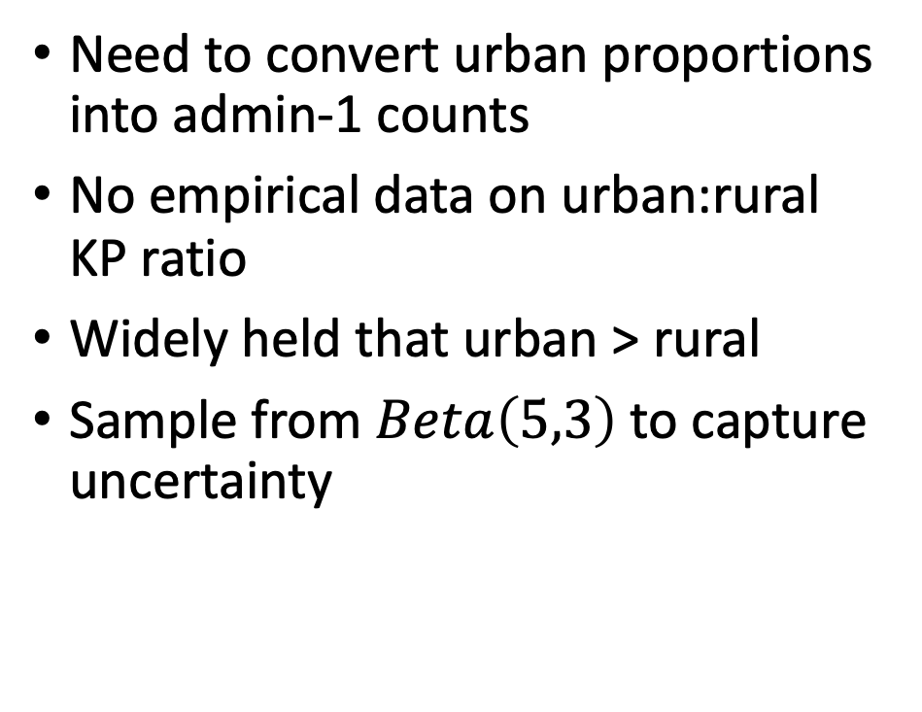
Population size model
Need to convert urban proportions into admin-1 counts
No empirical data on urban:rural KP ratio
Widely held that urban > rural
Sample from $Beta\left(5,3\right)$ to capture uncertainty
Oli Stevens UNAIDS Reference Group 22 May 2022

Slide 27
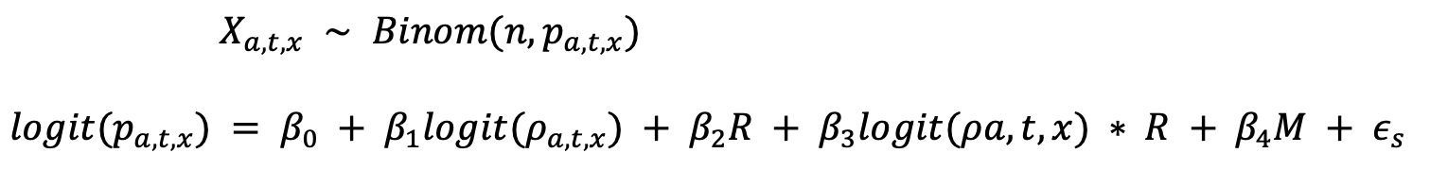
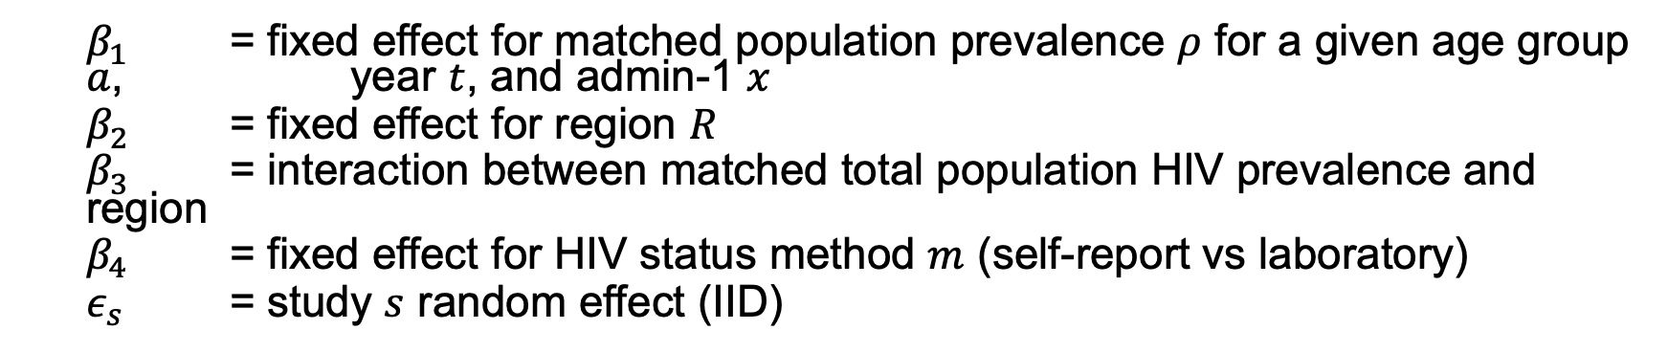
HIV prevalence model
Age-location-year matched total population prevalence can predict KP prevalence
FSW, PWID, MSM
  $β_{1}$ = fixed effect for matched population prevalence $ρ$ for a given age group $a$, year $t$, and admin-1 $x$
  $β_{2}$ = fixed effect for region $R$
  $β_{3}$ = interaction between matched total population HIV prevalence and region
  $β_{4}$ = fixed effect for HIV status method $m$ (self-report vs laboratory)
  $ε_{s}$ = study $s$ random effect (IID)
Oli Stevens UNAIDS Reference Group 22 May 2022

Slide 28
Key Population Estimates → SHIPP Tool
KP admin-1 level size estimates – FSW, MSM, PWID
KP admin-1 level HIV prevalence estimates – FSW, MSM, PWID
Stevens et al. Key population size, HIV prevalence, and ART coverage in sub-Saharan Africa: systematic collation and synthesis of survey data. medRxiv 2022. https://doi.org/10.1101/2022.07.27.22278071

Slide 29
Model Development

Slide 30
Model Development
Sexual behavior proportions – “general” and “key” populations
Population sizes by behaviour
HIV prevalence by behaviour
HIV incidence rates by behaviour
Number of new infections by behaviour

Slide 31
Model Development
Sexual behavior proportions – “general” and “key” populations
Population sizes by behaviour
HIV prevalence by behaviour
HIV incidence rates by behaviour
Number of new infections by behaviour

Slide 32
Behaviour category definitions
Category | HIV related risk
No sex | Not sexually active
One regular | Sexually active, one cohabiting partner
Non-regular | Non-regular sexual partner(s)
KPs | Women: women who sell sex | Men: MSM and PWID
Use geospatial data from DHS to fit spatially smoothed district-level model to top three (no, low and high) behaviour categories
Notes:
Use geospatial data from DHS & PHIA to fit spatially smoothed district-level model to the top three of these categories. Model has a term for 5-year age group, a spatial effect, and a spatial interaction term by 5-year age group - spatial effect can be different for different age groups.

Slide 33
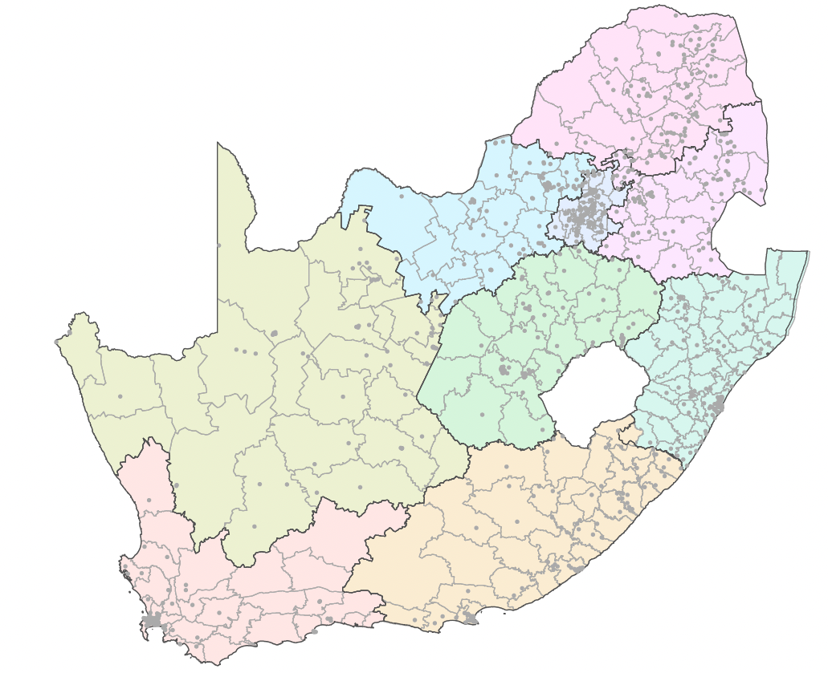
Source for behavioural proportions (no sex/one regular/non-regular)
Demographic & Health Surveys, PHIAs, BAIS
Survey cluster locations are mapped to districts
Notes:
Mapped to sub-districts here – results then aggregated in model to district

Slide 34
Spatio-temporal model for behavioural prevalence (no sex/one regular/non-regular)
Fit multinomial model with three behaviour outcomes (no sex, one regular and non-regular partner(s)) from survey data
Spatially smoothed district-level models
Model has a term for age (5-year age groups, 20-24 is reference), spatial effect for 20-24 year olds, a spatial interaction term for 5-year age groups, and survey year (temporal effect)
  This means that the spatial effect can be different for the different age groups
Men and women’s behavioural data fitted separately
All countries fitted in a single model

Slide 35
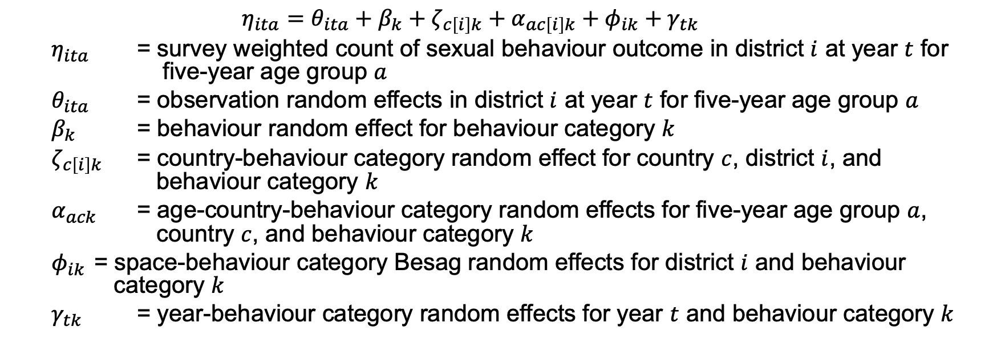
Spatio-temporal model for behavioural proportions (no sex/one regular/non-regular)
Spatially smoothed district estimates
  $$η_{ita}=θ_{ita}+β_{k}+ζ_{c\left[i\right]k}+α_{ac\left[i\right]k}+φ_{ik}+γ_{tk}$$
  $η_{ita}$ = survey weighted count of sexual behaviour outcome in district $i$ at year $t$ for five-year age group $a$
  $θ_{ita}$ = observation random effects in district $i$ at year $t$ for five-year age group $a$
  $β_{k}$ = behaviour random effect for behaviour category $k$
  $ζ_{c\left[i\right]k}$ = country-behaviour category random effect for country $c$, district $i$, and behaviour category $k$
  $α_{ack}$ = age-country-behaviour category random effects for five-year age group $a$, country $c$, and behaviour category $k$
  $φ_{ik}$ = space-behaviour category Besag random effects for district $i$ and behaviour category $k$
  $γ_{tk}$ = year-behaviour category random effects for year $t$ and behaviour category $k$
Notes:
All random effects assumed to be distributed IID except for space-behaviour
All random effect precision parameters τ ∈ {τβ, τζ , τα, τϕ, τγ} were given independent penalised complexity (PC) priors

Slide 36

Spatio-temporal model for behavioural proportions (no sex/one regular/non-regular)
Fit using INLA package in R
Multinomial models fit for three behavioural indicators, $y_{itak}$ (no sex, one cohabiting, non-regular partner(s)) using multinomial-Poisson transformation

Slide 37
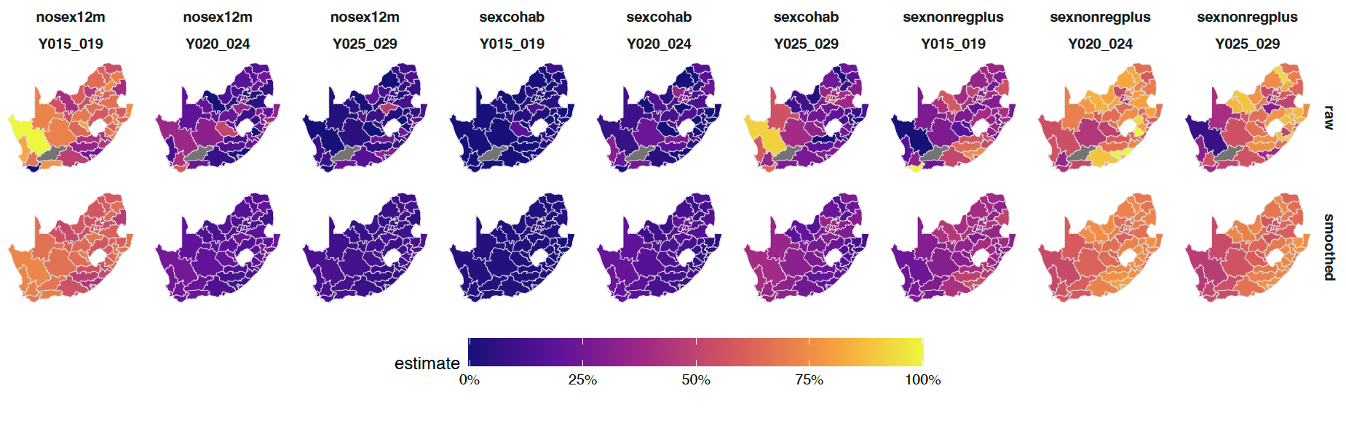
Small area estimation model smooths sparse data
Sex with one cohabiting partner in past 12 months
Sex with non-regular partner(s) in past 12 months
No sex in past 12 months
Notes:
AGYW

Slide 38
Behaviour category definitions
Category | HIV related risk
No sex | Not sexually active
One regular | Sexually active, one cohabiting partner
Non-regular | Non-regular sexual partner(s)
KPs | Women: women who sell sex | Men: MSM and PWID
Use geospatial data from DHS to fit spatially smoothed district-level model to top three (no, low and high) behaviour categories
Notes:
Use geospatial data from DHS & PHIA to fit spatially smoothed district-level model to the top three of these categories. Model has a term for 5-year age group, a spatial effect, and a spatial interaction term by 5-year age group - spatial effect can be different for different age groups.

Slide 39
Source for behavioural proportions
Admin-1 estimates for KPs come from Stevens et al¹ population size estimates of FSW, MSM, PWID
Age disaggregation of KPs by 5-year age group based on the Thembisa model² and published data, in combination with age at first sex distributions^{3,4}
¹ Stevens et al. medRxiv. 2022. doi: 10.1101/2022.07.27.22278071 ² Johnson & Dorrington. Thembisa version 4.6.
³ Johnston et al. PLoS One. 2022. ⁴ Nguyen & Eaton. BMC Public Health. 2022

Slide 40
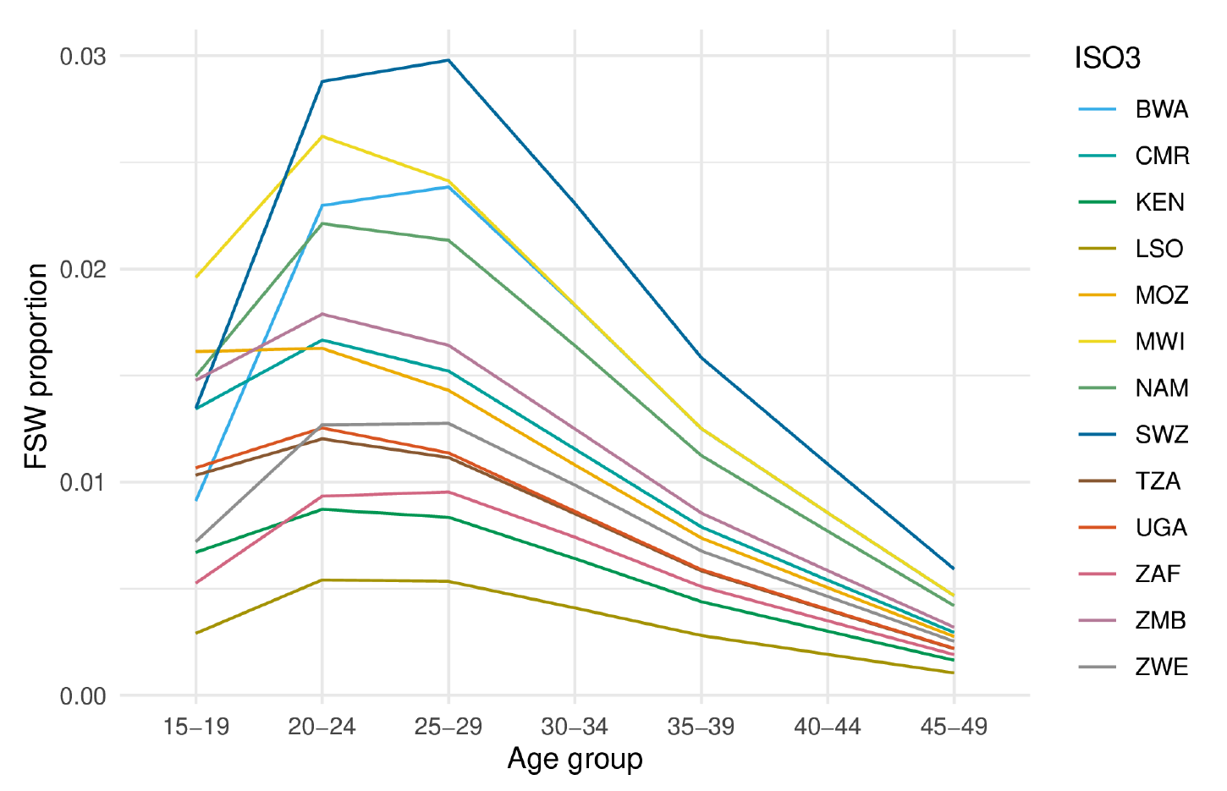
Age disaggregation
Overall KP population sizes are disaggregated by 5-year age group
For age distribution of MSM and women who sell sex, we assume a combination of:
  Age at first sex¹
  Thembisa age distribution² (Gamma distribution)
    Mean age of MSM 25, SD 7
    Mean age of FSW 29, SD 9
For age distribution of PWID, literature estimate of age distribution³
    Mean age of PWID 29.4, SD 7
¹ Nguyen & Eaton. BMC Public Health. 2022. ² Johnson & Dorrington. Thembisa version 4.6.
³ Hines et al. Lancet Global Health. 2020.

Slide 41
KP estimates
PWID – assume 1:10 male to female ratio
Men – Present MSM and PWID combined due to high degree of uncertainty
Women – KPs are women who sell sex only
Notes:
Average proportion PWID male in studies in SSA 90.3% in 17 studies

Slide 42
Model Development
Sexual behavior proportions – “general” and “key” populations
Population sizes by behaviour
HIV prevalence by behaviour
HIV incidence rates by behaviour
Number of new infections by behaviour

Slide 43
Population sizes by behavior
Population size estimates use Naomi Sep 2022 estimates for district-level population and PLHIV by five-year age group
Naomi district-level population estimates by sex and age group are drawn from district population projections produced by national statistical offices, household censuses, or global population data products such as the Gridded Population of the World or the WorldPop projects
Population sizes by behaviour are derived by multiplying the estimated proportions by risk behaviour from the multinomial model and KP proportions (described in step 1) with the population size from Naomi, in each of the age groups
“Population sizes by behaviour” are the district-level proportion in each risk group minus the estimate of the PLHIV in this risk group (step 3)

Slide 44
Model Development
Sexual behavior proportions – “general” and “key” populations
Population sizes by behaviour
HIV prevalence by behaviour
HIV incidence rates by behaviour
Number of new infections by behaviour

Slide 45
HIV prevalence by behaviour
Prevalence ratios by behaviour group are used to distribute PLHIV between behavioural risk groups
  Household survey data is used to estimate HIV prevalence in the no sex, one regular and non-regular partner(s) groups to calculate log odds-ratios for each behavioural category
  HIV prevalence ratio for KPs is based on the ratio of KP HIV prevalence¹ to HIV prevalence among all women (FSW) or men (MSM and PWID)
HIV prevalence by behaviour is not explicitly presented – it is used to subtract off population sizes to present population susceptible to HIV (HIV-negative)
¹ Stevens et al. medRxiv 2022. https://doi.org/10.1101/2022.07.27.22278071
Notes:
We have not currently spatially modelled the survey HIV prevalence by risk behaviour due to small sample size – conducted at a national level

Slide 46
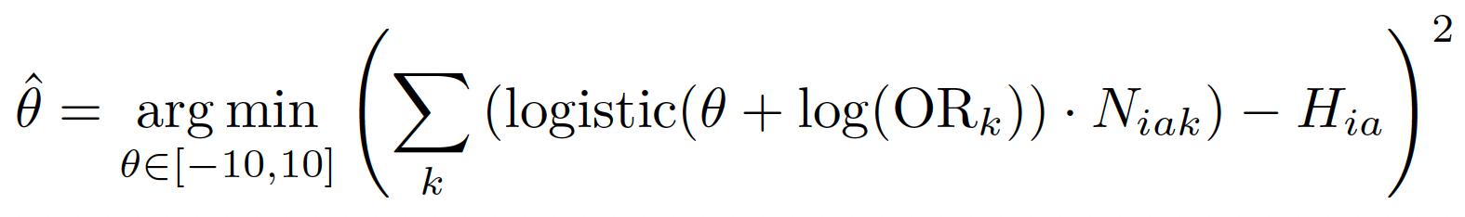
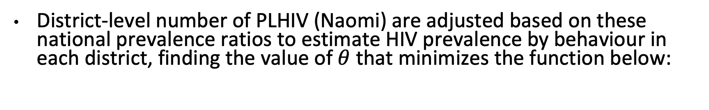
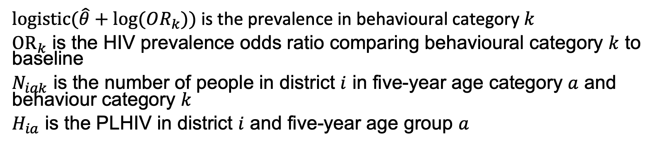
Distribution of PLHIV by behaviour
District-level number of PLHIV (Naomi) are adjusted based on these national prevalence ratios to estimate HIV prevalence by behaviour in each district, finding the value of $θ$ that minimizes the function below:
$logistic(\hat{θ}+log⁡(OR_{k}))$ is the prevalence in behavioural category $k$
$OR_{k}$ is the HIV prevalence odds ratio comparing behavioural category $k$ to baseline
$N_{iak}$ is the number of people in district $i$ in five-year age category $a$ and behaviour category $k$
$H_{ia}$ is the PLHIV in district $i$ and five-year age group $a$
Notes:
Logistic = inverse logit exp(x)/(1+exp(x))

Slide 47
Model Development
Sexual behavior proportions – “general” and “key” populations
Population sizes by behaviour
HIV prevalence by behaviour
HIV incidence rates by behaviour
Number of new infections by behaviour

Slide 48
HIV incidence rates by behaviour
Maintaining Naomi incidence rate and number of new infections for the district and five-year age group, we use literature estimates of incidence rate ratios by behavioural category to get estimates of HIV incidence rates by behaviour

Slide 49
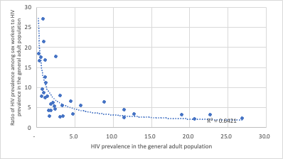
HIV relative risk by behaviour - for incidence rates - women
Category | HIV risk ratios |  | Comments
No sex | 0
One regular partner | 1 |  | Reference category
Non-regular partner(s) | 1.72 (15-24), 2.1 (25-49) |  | ALPHA Network pooled analysis (Slaymaker et al CROI 2020), systematic review (Jia et al JIAS 2022), Ssempijja et al JAIDS 2022
KPs | HIV incidence category | HIV risk ratio | Ratio of HIV incidence among women in key populations vs single cohabiting partner women derived based on HIV incidence category in district
 | Very high | 3
 | High | 4
 | Moderate | 7
 | Low | 11
 | Very Low | 17

Slide 50
HIV relative risk by behaviour - for incidence rates - men
Category | HIV risk ratios | Comments
No sex | 0
One regular partner | 1 | Reference category
Non-regular partner(s) | 1.89 (15-24), 2.1 (25-49) | ALPHA Network pooled analysis (Slaymaker et al CROI 2020), Hoffman et al JAIDS 2022, Ssempijja et al JAIDS 2022
KPs | 2.5-250: MSM 2.5-55: PWID | Admin 1 KP prevalence estimates relative to general population prevalence (Stevens et al medRxiv 2022); Systematic review & meta-regression (Stannah et al medRxiv 2022)

Slide 51
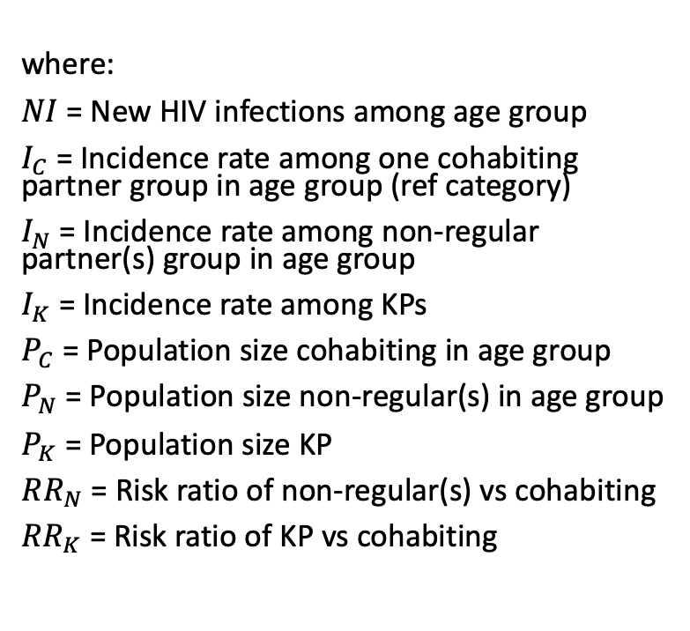
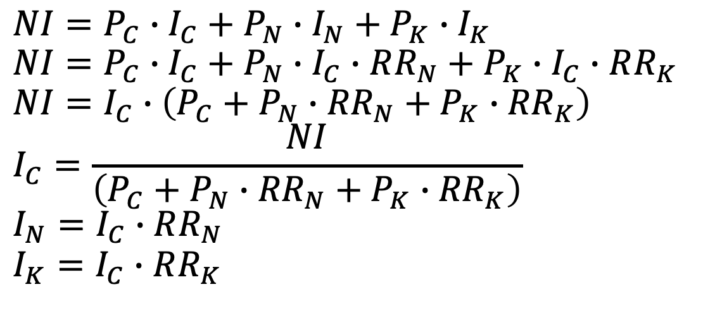
Estimated HIV incidence rates by behaviour
District-level number of new infections (Naomi) are adjusted based on these relative risks to estimate HIV incidence rates by behaviour, derived below
where:
$NI$ = New HIV infections among age group
$I_{C}$ = Incidence rate among one cohabiting partner group in age group (ref category)
$I_{N}$ = Incidence rate among non-regular partner(s) group in age group
$I_{K}$ = Incidence rate among KPs
$P_{C}$ = Population size cohabiting in age group
$P_{N}$ = Population size non-regular(s) in age group
$P_{K}$ = Population size KP
$RR_{N}$ = Risk ratio of non-regular(s) vs cohabiting
${RR}_{K}$ = Risk ratio of KP vs cohabiting
$$NI=P_{C}∙I_{C}+P_{N}∙I_{N}+P_{K}∙I_{K}$$
$$NI=P_{C}∙I_{C}+P_{N}∙I_{C}∙RR_{N}+P_{K}∙I_{C}∙RR_{K}$$
$$NI=I_{C}∙\left(P_{C}+P_{N}∙{RR}_{N}+P_{K}∙{RR}_{K}\right)$$
$$I_{C}=\frac{NI}{\left(P_{C}+P_{N}∙{RR}_{N}+P_{K}∙{RR}_{K}\right)}$$
$$I_{N}=I_{C}∙RR_{N}$$
$$I_{K}=I_{C}∙RR_{K}$$

Slide 52
Model Development
Sexual behavior proportions – “general” and “key” populations
Population sizes by behaviour
HIV prevalence by behaviour
HIV incidence rates by behaviour
Number of new infections by behaviour

Slide 53
Estimated new infections
Number of new infections by risk group is derived by multiplying these estimated incidence rates by risk behaviour times the population sizes of HIV-negative individuals by risk behaviour, in each of the 5-year age groups

Slide 54
SHIPP Tool

Slide 55
Limitations to approach
Risk behaviour population size estimates at a district level have a high degree of uncertainty, which is not captured in the current version of the tool
Uncertainty in:
  KP sizes and their age and geographical disaggregation
  Small area estimates based on survey data
  Behavioural reports in surveys
  Incidence rate ratios by behaviour
  Naomi estimates
PSEs should be considered indicative rather than exact

Slide 56
Acknowledgements
Imperial College London
Jeffrey Eaton
Adam Howes
Oli Stevens
UNAIDS
Clemens Benedikt
Ana Diaz
Souad Orhan
London School of Hygiene & Tropical Medicine
Isolde Birdthistle
Funding: Global Fund

Slide 57
Thank you!
Questions?
For more details:
Howes et al. Spatio-temporal estimates of HIV risk group proportions for adolescent girls and young women across 13 priority countries in sub- Saharan Africa. PLoS Global Public Health. 2023;3(4):e0001731.
krisher@pennstatehealth.psu.edu

Slide 58
Frequently Asked Questions about the SHIPP tool (1)
Populations included/excluded
Q: Which key population groups are included in the SHIPP Tool estimates?
For females, the SHIPP Tool includes women who sell sex (whether they do or do not identify as sex workers). Note this is not women who report transactional sex.
For males: the SHIPP Tool includes men who have sex with men and men who inject drugs.
Q: Which key populations are not included in the SHIPP Tool, and why?
Transgender women – due to lack of reliable data and small population size, particularly for spatially disaggregated estimates at 5-year age categories.
Women who inject drugs – due to small population size. Based on the literature review of roughly 17 peer-reviewed studies, about 94% of the populations sampled were males. Therefore, in the SHIPP Tool we assume a 1:10 female to male ratio.
Men in prisons.
Q: Why are estimates for 10-14 year olds not included? Aren’t they a priority group for HIV prevention among adolescents, especially girls?
Estimates for 10-14 year-olds have not been included in the SHIPP Tool due to the sparsity of sexual behaviour data for this age group. The main demographic and health surveys used in the Tool do not ask detailed sexual behaviour questions to children under age 15.
However, the SHIPP Tool identifies areas in which HIV risk is high or very high among 15-19 year old girls; it would be advantageous to prioritise such areas with comprehensive prevention programmes for 10-14 year olds before their risk of HIV escalates and to reduce new infections among the next cohort of 15-19 year olds. (Note that the Naomi model estimates HIV prevalence for those under 15 years, based on data from sources such as routine testing, PMTCT and ART programmes).
Q: Why are some countries not included in the SHIPP Tool?
The SHIPP Tool includes countries that have validated the Naomi model and have at least one household survey within the past 15 years.

Slide 59
Frequently Asked Questions about the SHIPP tool (2)
Data Sources
Q: Do model estimates match the Modes of Transmission Model?
At present, no.
Q: Do model estimates match the Key Population ‘workbook’ population sizes?
Work is underway to be able to scale national KP population size estimates to the workbook, it is anticipated that during the estimates process, if a KP workbook is available, it will be used to scale national KP population sizes within the tool.
Q: What is the Naomi Model?
Naomi is a Bayesian small-area estimation model, which estimates the number of people living with HIV (PLHIV), antiretroviral treatment (ART) coverage and unmet need, and new HIV infections by district, or equivalent subnational administrative level. The model presents the data stratified by subnational administrative units, sex, and five-year age groups.
For more information on the Naomi model, please see the article Naomi: a new modelling tool for estimating HIV epidemic indicators at the district level in sub-Saharan Africa by Eaton JW et al. Journal of the International AIDS Society 2021, 24(S5):e25788.
The development of the data viewer for Naomi is led by UNAIDS, Avenir Health, Imperial College London and the UNAIDS Reference Group on Estimates, Models and Projections.
You can find the data viewer here: https://naomi-spectrum.unaids.org/
Q: Should the estimate of new infections by district be similar to what we observe in Naomi?
Yes, they should match exactly to what we observe in Naomi. Additionally, Naomi provides the following inputs to the SHIPP Tool: total population, HIV incidence, HIV prevalence, new infections and the number of people living with HIV (disaggregated by age, sex and district). The overall estimates by age, sex and district are identical to the Naomi model results.
The addition the SHIPP tool makes is to integrate sexual behavioural data in order to further disaggregate HIV estimates by behavioural categories. This helps to identify priority sub-populations for differentiated HIV prevention (e.g., to plan the most intensive prevention for the highest risk groups).

Slide 60
Frequently Asked Questions about the SHIPP tool (3)
Why does the SHIPP Tool pool data from Naomi and not other models like Spectrum or Thembisa?
The main reason that we are pulling data from the Naomi model is to have district-level estimates. The lowest level of geographical information for Thembisa (South Africa-specific) is provincial and for Spectrum (all countries) is national.
Because the Naomi model is calibrated to the Thembisa model (in the case of South Africa) and to Spectrum (in the case of other countries), the estimate
in the SHIPP Tool are also aligned with Thembisa and Spectrum.
Q: What is the data source for the population size estimates and HIV prevalence for Key Populations?
The estimates come from the work of a team lead by Oli Stevens at Imperial College London and UNAIDS. They have synthesised available data on population sizes, HIV prevalence and ART coverage for KPs in sub-Saharan Africa to develop a small area estimation model to output KP estimates at an Admin-1 level (i.e., province, state, district or municipality, depending on the country; see next question).
Available data used to build the model includes: The UNAIDS Global AIDS Monitoring & Key Population Atlas, the CDC Surveillance Database, the GFATM Surveillance Database, Peer-reviewed sources such as the Global.HIV and a systematic review by Degenhardt et al on people who inject drugs (PWID) systematic review.
Based on the year and geography that the data were collected in, population size estimates are matched to a geography by name and corresponding population in order to obtain a baseline of general population size to compare to.
Currently the model provides estimates for 3 KPs: FSW, MSM, and PWID.
To estimate the population size, the Stevens et al model incorporates: an overall fixed effect for the study method category (i.e., empirical, PLACE, mapping, other); a random effect for the specific study method; an intrinsic conditional autoregressive (ICAR) spatial smoothing random effect at Admin-1 level and a study random effect (IID). Stevens et al’s population size model specifically estimates urban proportions. When there is no information for a particular area, data is borrowed from neighbouring areas, that is, they are spatially correlated between admin-1 neighbours.
There is limited empirical data on the urban to rural KP ratio but it is widely held that the urban proportion of KPs is greater in urban areas. The assumption in Oli’s model is that the KP size in rural areas is about 60% of what it is in urban areas.
To estimate HIV prevalence, the Stevens et al model incorporates the following terms: a fixed effect to matched population prevalence for a given population group, year and admin-1; fixed effect for Region (e.g., west and central Africa vs, east and southern Africa); interaction between matched population HIV prevalence and region (to allow for the relationship between general population prevalence and KP prevalence to vary based on which region you are in); fixed effect for HIV status method (self-report vs laboratory) and a study random effect.
Q: What does Admin-1 level mean?
Admin-1 level refers to the first level of spatial disaggregation in a country. It varies from country to country and can be: province, state, district or municipality.

Slide 61
Frequently Asked Questions about the SHIPP tool (4)
Q: What is the data source for Key Population HIV incidence data?
For FSW, the SHIPP Tool utilizes a systematic review of age and sex-matched HIV incidence estimates among FSW relative to the general population in Jones & Anderson et al medRxiv (https://www.medrxiv.org/content/10.1101/2023.10.17.23297108v2.full.pdf).
For MSM and PWID, the SHIPP Tool utilizes the relative prevalence of HIV at an Admin-1 level in the Stevens et al modeling working described above to approximate relative incidence. These estimates are substantially lower for MSM than the relative incidence estimates calculated in a systematic review by Stannah et al medRxiv (https://www.medrxiv.org/content/10.1101/2022.11.14.22282329v1). UNAIDS analyses have found an inconsistency between empirical incidence and prevalence estimates among MSM, with empirical incidence estimates resulting in drastically higher HIV prevalence than is found in surveys of MSM. The hypotheses are that either empirical incidence estimates are increased due to the populations recruited in longitudinal incidence studies being substantially higher risk than most MSM, due to very young MSM experiencing a very short extremely high HIV risk period in their lives, or a further explanation. As a result, the SHIPP tool uses the prevalence ratio to approximate incidence rate ratio instead of empirical incidence estimates.
Q: How are HIV incidence rates by behaviour derived?
The Model maintains the overall Naomi incidence rates and number of new infections in a given district and 5-year age group but pulls in literature estimates of incidence rate ratios by each of the behavioural categories to get estimates of HIV incidence rates by behaviours.
The Model makes the assumption that the incidence rate ratios are the same across populations.

Slide 62
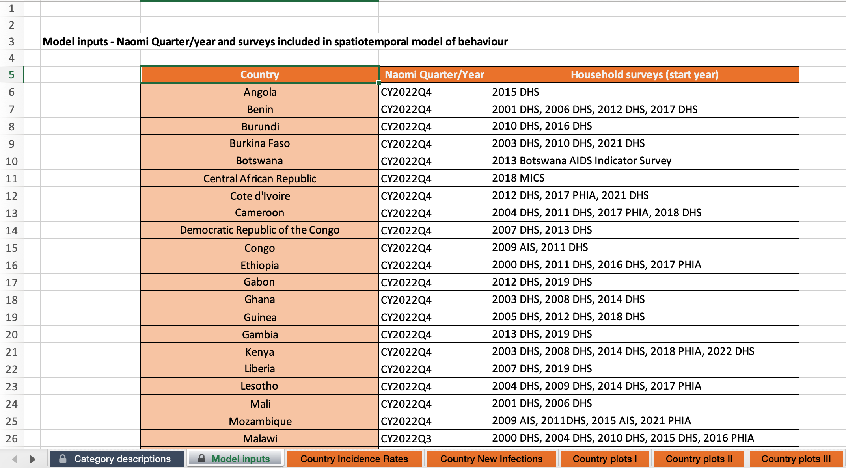
Frequently Asked Questions about the SHIPP tool (5)
Q: Where to find what behavioural survey data by country informs the model?
  In the ‘Model Input’ tab of the SHIPP Tool

Slide 63
Frequently Asked Questions about the SHIPP tool (6)
Q: Which behavioural surveys are included in the SHIPP Tool?
Demographic Health Surveys (DHS), Population-based HIV Impact Assessment Surveys (PHIAs), the Botswana HIV/AIDS Impact Surveys, and Multiple Indicator Cluster Surveys (MICS).
Q: Why are multiple surveys listed in the table?
This is a spatio-temporal model of sexual behaviour over time in a country. We find that there is relatively little change over time in sexual behaviour reporting, but we include multiple surveys to improve estimation. The year of each survey included is listed on the table in the ‘Model Inputs’ tab mentioned above.
Q: How reliable are the sexual behaviour data? How confidently can we interpret the estimates in each age group?
The behavioural survey data may be subject to selection bias (if some groups are systematically excluded from participation) and to reporting bias (e.g., if there is under- or over-reporting of sexual behaviours, and these differ systematically by age, sex or geographic area).
The SHIPP Tool does not account for these biases. If data are available to quantify the extent of reporting biases by age, we may be able to adjust for this in future iterations of the Tool.

Slide 64
Frequently Asked Questions about the SHIPP tool (7)
Q: Why aren’t other known behavioural risk factors included in the model, like condom use or condomless sex? e.g., if somebody with multiple sex partners uses a condom, the HIV risk estimate should be lower.
Currently, we are not using any questions on inconsistent condom use or transactional sex from behavioural surveys. While this would add an additional feature, this represents an additional layer of complexity that ultimately would be too great for the quality of the data available.
There continue to be challenges with collecting reliable data on condom use (including problems with measurement definitions and social desirability bias). Also, consistent condom use is rare among those cohabiting, or in a relationship with a regular partner.
Q: How are missing data from behavioural surveys handled?
Although the rates of missing data from the survey questions used is very low, the SHIPP Tool is currently ignoring any missing data and doing a complete case analysis.
The analysis accounts for sampling weights, which accounts for survey non-response but does not account for non-response from within individual indicators. This is a limitation of the SHIPP Tool.
Q: Why aren’t social and structural determinants of HIV risk included in the SHIPP estimates, e.g., educational level, orphan status, socio-economic status, experience of violence?
The SHIPP Tool fits data for all countries in a single model, and the risk associated with social and structural determinants varies by context (it is not universal).
Going forward, it may be possible to fit separate models for countries with strong data on the HIV risks associated with important social and structural factors.

Slide 65
Frequently Asked Questions about the SHIPP tool (8)
Tool Updates & Contacts
Q: How often will the tool be updated?
Tool updates will be incorporated into the annual HIV estimates process that starts every fall, and be finalized as a country’s Naomi estimates are finalized in the early months of the year (Jan-April)
New survey data will be pulled in advance of the estimates process around December of each year
Q: How current are the estimates produced by the Tool?
The HIV incidence rates are drawn from the Naomi model, which is updated annually (see previous question)
The behavioural data are drawn from the most recent surveys available, and more than one survey if possible (for spatio-temporal modelling). The data suggest that there is little change over time in the proportions of the general population reporting the sexual behaviours used in this Tool.
Q: Who should I direct questions about the tool to?
For technical support requests and related questions, please contact
  as a first entry point for all technical support, estimates@unaids.org
  for general questions and support, the technical focal point in the Global Prevention Coalition Secretariat: benediktc@unaids.org
  for any questions related to the NAOMI model estimates: wanyekii@unaids.org
  for any questions on the spreadsheet: krisher@pennstatehealth.psu.edu

Slide 66
Limitations to approach
Risk behaviour population size estimates at a district level have a high degree of uncertainty, which is not captured in the current version of the tool
Uncertainty in:
  KP population sizes and their age and geographical disaggregation
  Small area estimates based on survey data
  Behavioural reports in surveys
  Incidence rate ratios by behaviour
  Naomi estimates
Estimates should be considered indicative rather than exact

Slide 67
Thank you
For more details:
Howes et al. Spatio-temporal estimates of HIV risk group proportions for adolescent girls and young women across 13 priority countries in sub-Saharan Africa. PLoS Global Public Health. 2023;3(4):e0001731. doi: 10.1371/journal.pgph.0001731.
krisher@pennstathealth.psu.edu

