Slide 1
SSLN: Opportunities and mechanisms for technical and financial support to the HIV Leadership Forum
Kerry Mangold | SSLN Programme Director
09 November 2023

Slide 2
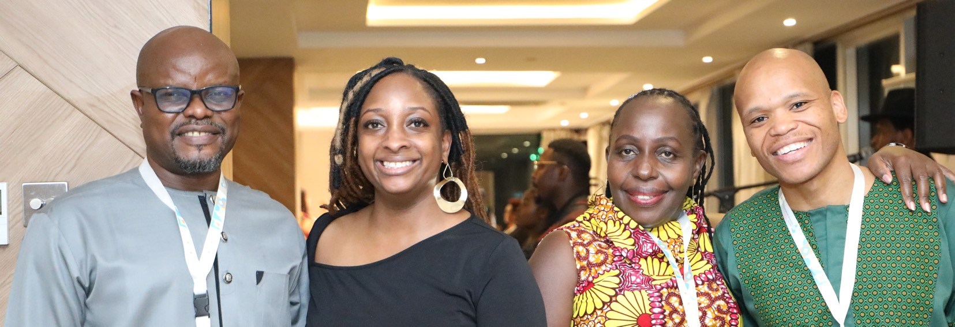
Presentation overview
What is the SSLN?
What has been achieved through the SSLN?
What support can the SSLN offer to the HIV Leadership Forum?

Slide 3
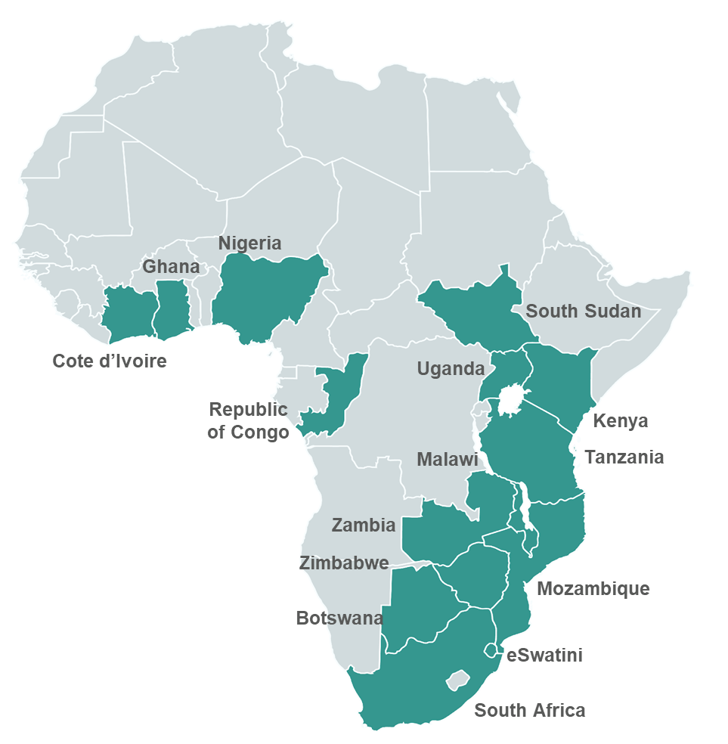
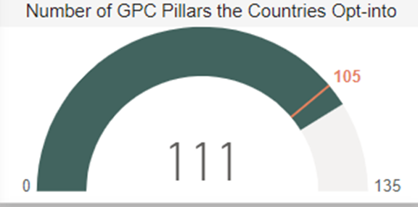
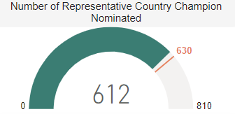
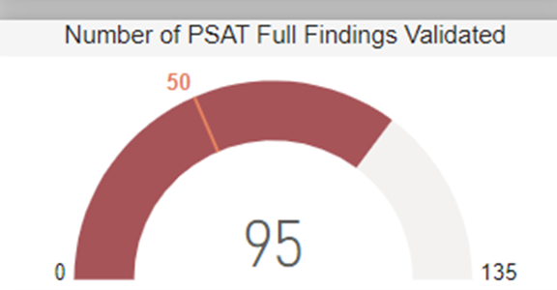
The SSLN is an HIV prevention learning network that is established in 15 countries across sub-Saharan Africa
Global NAC Directors Forum calling for a south-south learning platform
SSLN Phase I: Proof of Concept
2 pillars
10 countries
SSLN Phase II: Scale up
5 pillars
15 countries
2019
2020
2021
2022
2023
2024
2025
Our Mission is to be a trusted learning platform that connects and supports south-south collaboration and dialogue through facilitated self-reflection, shared learnings and application of good practices and tools to catalyse social capital, leverage resources and optimise country actions towards achieving the global agenda.

Slide 4
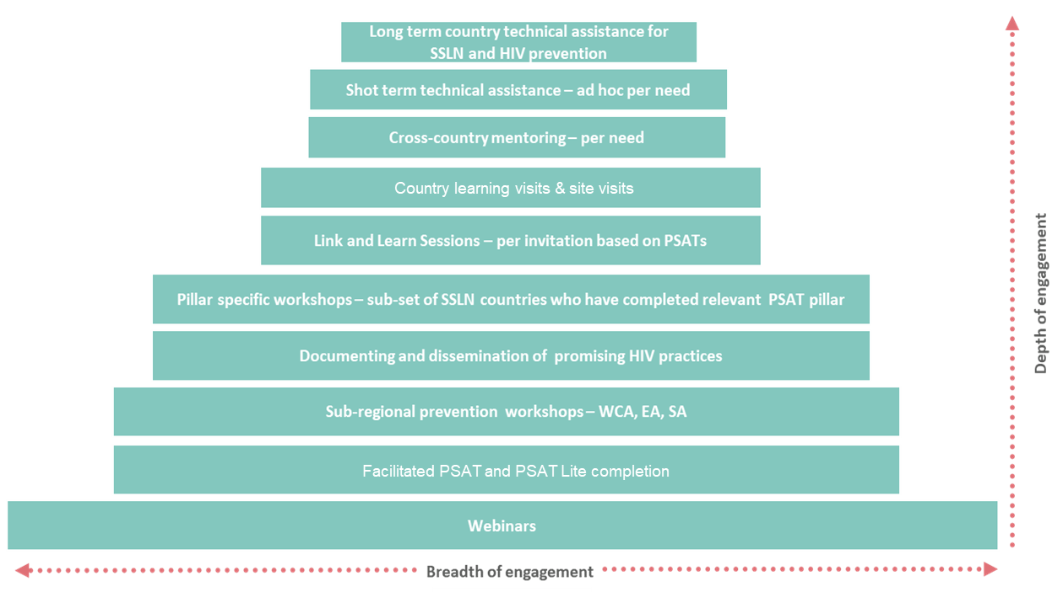
The SSLN provides deliberate and varied opportunities and channels for country-driven learning, informed through country self-assessments
“The approach of the learning network is collaborative and supportive, not directive or prescriptive. Countries lead and own the learning network, with the SSLN implementing team in a facilitative and supportive role, providing a range of learning opportunities that foster interaction, active participation, and joint learning.” external evaluation
In total 245 learning activities have thus far been completed by the 15 countries in the SSLN [per the pyramid to the left].
The external evaluation found all learning activities to be effective, albeit each with its own unique learning objective.

Slide 5
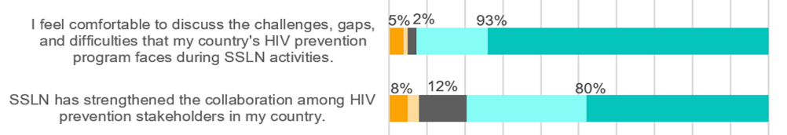
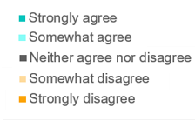

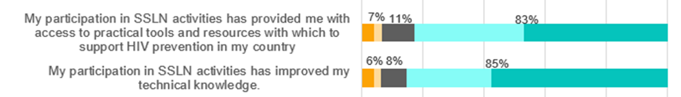
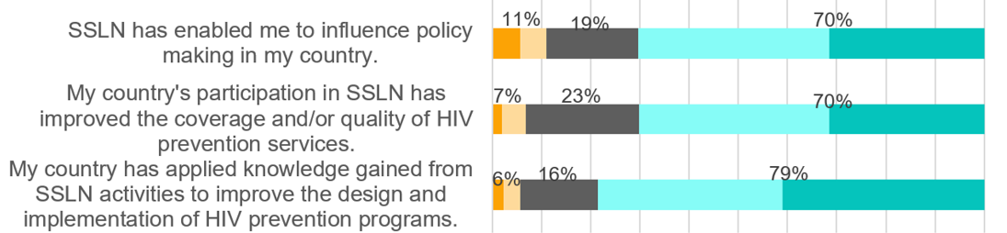
Nominated SSLN Country Champions have realized immediate value belonging to the SSLN and are also now seeing the applied and unlocked value
n = 296

Slide 6
Importantly, the SSLN has been recognized as being instrumental in informing prevention funding proposals and advocating for prevention
Prevention funding proposals: At least 6 countries reported explicitly using the PSAT and learnings from the SSLN to feed into their Global Fund GC7 proposals for the prevention modules
Prevention advocacy: According to the mid-term evaluation report “The existence of SSLN appears to be pushing the issue of HIV prevention further in some countries. Champions report that SSLN is helping advocate for more resources for HIV prevention programs and opening the conversation with higher-level leaders and donors”.
More than a quarter of Champions reported reaching out bilaterally to their peers. This networking is sustainable beyond even the SSLN. If HIV prevention leaders are linked and learning on one another in a way that didn’t happen before, then this could be the thing that carries forward and that we can apply and expand into other places too.
“This Learning Network is a game-changer in HIV prevention in our region, where we can safely learn from one another in a relatable and critical way. We are building each other up and building an army of HIV prevention experts and leaders in Africa for Africa” Uganda Champion, East Africa Sub-Regional Meeting

Slide 7


The SSLN is a Network for all HIV prevention stakeholders, but intensively available to support its 15 GPC member countries with optimizing their HIV prevention responses through facilitated peer learning
1
Information portal and dissemination channel for promising practices, new guidelines, country outputs on HIV prevention
2
Virtual platform for connecting with peers through webinars, mailers, social media channels and the SSLN website.
3
Orientation on UNAIDS programme self assessment tools to identify gaps and priorities and support countries to develop HIV prevention learning agendas, action plans and TA plans
4
Facilitate the implementation of country HIV prevention learning agendas – directly or through partnerships.
5
Deliberately strengthen HIV prevention social capital and network in sub-Saharan Africa by creating a safe space for diverse voices.
6
Document and profile country promising practices for the purpose of sharing and replication across countries.

Slide 8




Thank you
https://www.hivinterchange.com/
https://www.youtube.com/@hivinterchange
@SSLN_HIV
@southsouthlearningnetwork
Kerry Mangold | SSLN Programme Director
kerrym@genesis-analytics.com

