Slide 1
Building a strong foundation for a scaled and effective HIV response with key populations
Trusted Access Platform
Parinita Bhattacharjee
South-South Learning Network
23rd September 2021

Slide 2
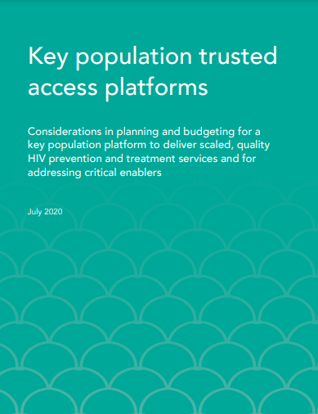
What is it?
‘Platform’ = foundation on which effective Key Population programmes are built
Also a way of working with key population communities to establish trust and improve access to those services
Programmes may be implemented by Key Population led organisations or other civil society organization in partnership or with support from government - but derive their effectiveness mainly from active key population engagement and participation
TAP at local level are building blocks for national programmes at scale
The focus of this document is on the principles of building a solid foundation for key population service provision, one that enjoys high levels of trust and participation with and by key populations in community and clinic settings
https://hivpreventioncoalition.unaids.org/wp-content/uploads/2020/04/Budget-Considerations-for-KP-Trusted-Access-Platforms-April-2-2020-Final-V-1.1a-no-TCs-1.pdf
Available in English and French

Slide 3




KEY POPULATION PROGRAMME Implementation Tools EXIST
SWIT
MSMIT
TRANSIT
IDUIT
These tools contain practical advice on implementing HIV and sexually transmitted infection (STI) programmes with key populations

Slide 4
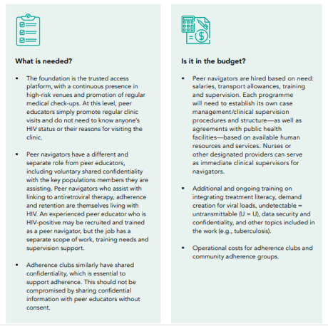
Planning and budgeting considerations for KP trusted access platforms
Annex A Consolidated Table of Budget Considerations (budgeting for online platforms)
Annex B Examples of different stages in implementing a trusted service platform
Annex C Outreach and Case Management Team Composition and Roles
Annex D Summary of WHO Recommendations Concerning Key Populations
Part 1: Intervention design for impact
Engaging community with continuous high-risk venue presence
Safe spaces
Structural interventions
Strengthening outreach (including microplanning)
Prevention basics (condom/lubricant, needle/syringe programming)
Optimising clinical services (regular medical checkups)
Boosting prevention and treatment cascades
Chapters
Part 2: Management for scale and coverage
        Focusing efforts where needed (scale and targeting)
        Knowing your communities
        Monitoring performance (for trusted access platforms)
        Community qualitative monitoring
        Monitoring select outcomes
        Capacity building

Slide 5
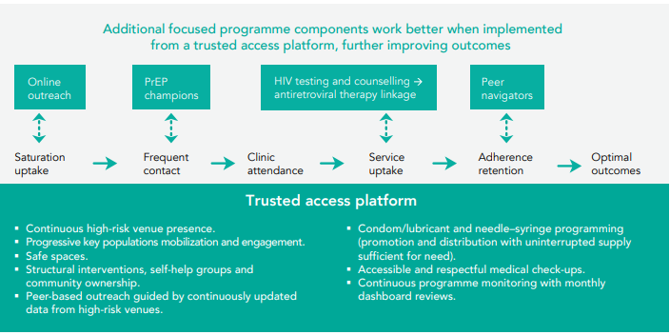
Trusted Access Platform as a foundation for multiple interventions

Slide 6
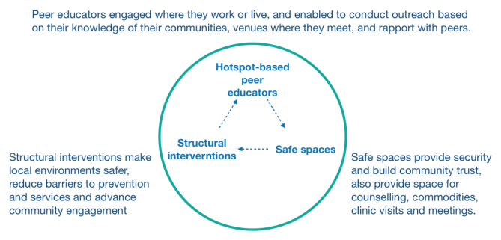
Part 1: Intervention design for impact
Engaging community with high risk venue presence
Structural Interventions
Safe spaces
Peers who live or work at identified high-risk venues are well placed to do effective outreach
Safe spaces and structural interventions are critical enablers
  One of the best way to build trust early one is creating safe spaces that are welcoming, secure, and provide opportunities for rest, networking, meetings, services. Safe spaces like drop-in centres provide simple amenities that attract key populations and facilitate community cohesion and networking
  Addressing structural issues builds trust, removes or mitigates barriers to prevention and service access, and improves conditions. A range of structural conditions, including violence, venues, and other vulnerabilities, have been effectively addressed by key population communities with programme support

Slide 7
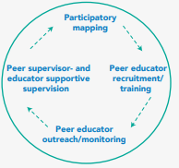
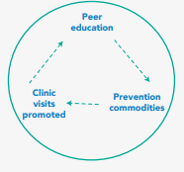
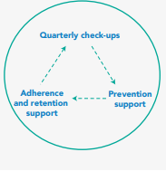
Part 1: Intervention design for impact
Strengthening outreach (including microplanning)
Prevention services and products
Optimising Clinical Services
Peer education based in venues is a starting point for microplanning, which empowers key populations to lead outreach. Sufficient number of peer educators and peer supervisors for the intended key population is critical
Together with education on prevention and treatment, condom/lubricant and needle–syringe promotion and distribution are main components of community outreach
Wide mix of service delivery models can be chosen based on the preference of the community.
  Peer educators create demand for preventive and curative services and mobilize key populations to visit the programme clinic on a quarterly basis for routine check-ups
  Promoting check-ups rather than specific services safeguards medical confidentiality and builds community trust

Slide 8
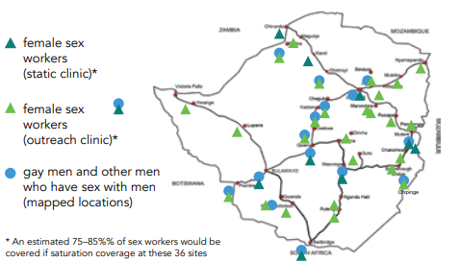
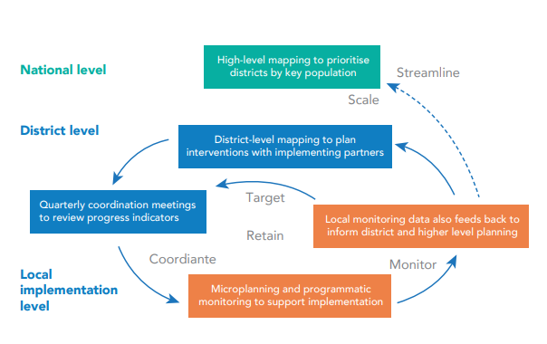
Part 2: Management for scale & coverage
Mapping and Population Size Estimation - Focusing efforts where needed
Coordination and management mechanism
Identifying locations and estimating population sizes is first step in launching key populations programming, and it is a critical opportunity for engaging communities.
Engagement of key populations in mapping and estimation provides needed information, sparks community interest and helps the programme identify members of key populations
Coordination of the response and programme at the national and sub national level is critical

Slide 9
Part 2: Management for scale & coverage
Monitor priority platform indicators (PPIs)
  Have all KP been reached at least once by PE?
  Are KP being reached regularly?
  Have all KP visited the clinic at least once?
  Are KP using clinic services regularly?
Specific service indicators
  Prevention commodities, promotion/distribution
  STI screening/treatment uptake, quarterly checkup
  HIV testing uptake, retesting q 3-6 mos
  PrEP uptake, quarterly checkups, retention
  ART linkage, quarterly checkups, retention
Community qualitative monitoring
  Community feedback on availability, accessibility and acceptability of services, provider attitudes, structural barriers, etc.
  Methods include peer-mediated feedback, community feedback meetings, community-guided qualitative research
Monitor outcomes and impact
  Use of condoms, lubricants, needles, syringes, etc.
  New STI infections, new HIV infections
  ART linkage, adherence, retention, suppressed VL

Slide 10
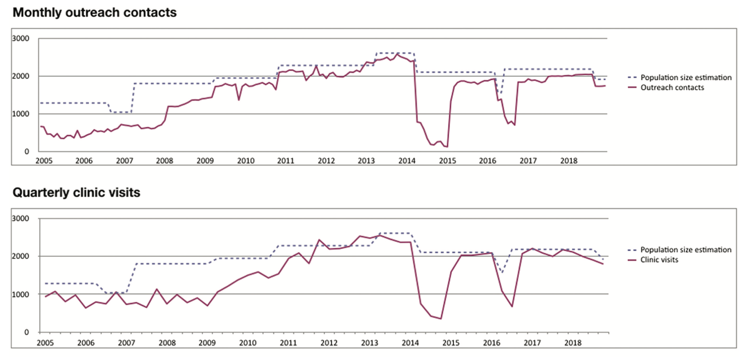
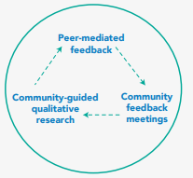
Part 2: Management for scale & coverage
Monitoring Performance
Community led Monitoring
It is important to know whether programmes are moving towards key outcome objectives
Early investment in community meetings and qualitative monitoring through peer networks associated with an action plan for resolution builds trust and participation in the programme and improves the quality of services
Robust, routine programming monitoring system with core indicators standardized across key population programmes help in assessing progress and gaps
Population based surveys could help in measuring outcomes and impact

Slide 11
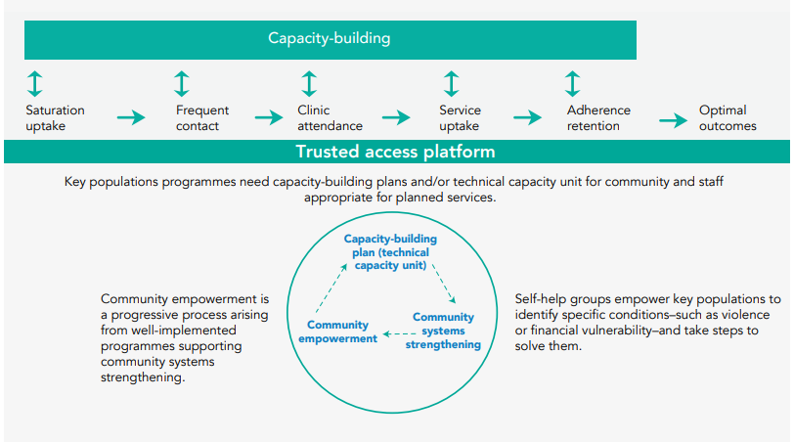
Part 2: Management for scale & coverage
Community empowerment is a progressive process arising from well implemented key population programmes that can be facilitated by a range of community systems strengthening activities
Articulated and planned progression pathway for key populations to assume increasing responsibilities in the planning, implementation and review of programmes critical
Community systems strengthening at the local level is essential

