Slide 1



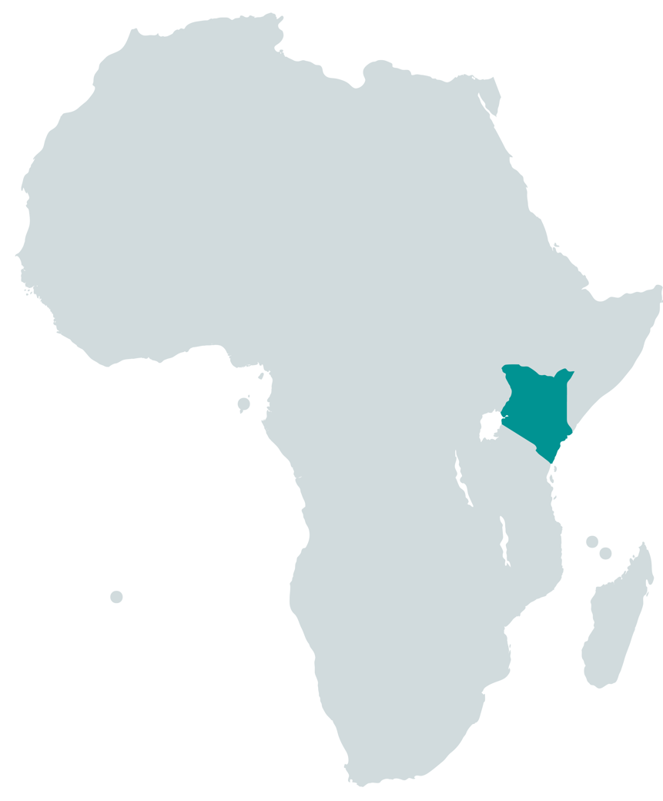
Managing a kp programme at scale
Case study
Kenya Key Populations
(KP) Programme
Mary Mugambi
HIV Prevention lead
Key population programme manager
Nascop, kenya
Notes:
Thank you Richard. My name is Parinita and I work with University of Manitoba. I am going to share how the Kenya KP Programme is managing a programme at scale keeping some of the key elements of TAP in mind. The Kenya KP programme is led by NASCOP and NACC and University of Manitoba provides technical support to the programme through a establishment of a Technical Support Unit embedded within NASCOP

Slide 2
Context
High HIV prevalence among KP in Kenya
Population size estimates of KPs high
FSW: 206,609
MSM: 50,569
PWID: 19,691
Transgender People: 4,305
A national KP programme emerged in 2009 with MoH (NASCOP and NACC) taking the lead
Currently there are KP programmes in 36/47 counties in Kenya with funding support from MoH, PEPFAR, GF and other donors
There are more than 100 implementing partners reaching 181,246 FSW (88%); 39,933 MSM (79%), 18,302 PWID (93%) and 800 Transgender people (19%)
Notes:
A little bit about the context of the KP programme in Kenya for those who may not be aware. HIV prevalence among KP is high in Kenya, 29% among FSW, 19% among MSM and 18% among PWID while the general population prevalence is at 4.7%. A population size estimates conducted in 2018 also shows that the population size of key populations is high. Key populations were prioritized in the National Strategic Plan in 2009 with MoH taking the lead. In Kenya NASCAP and NACC lead the national KP programme. Currently we have programmes in 36 out of 47 counties in Kenya with 100 implementing partners reaching more than 80% of the estimated population. Our implementing partners are civil society organization and KP led organisations sub contracted by the civil society PR of the donors. We are just starting our programme with transgender people with the populations estimation of 2018 showing that the country has over 4000 transgender people. We also have a prison programme funded by largely PEPFAR but as a national programme we still need to bring it under the KP programming.

Slide 3

Policy environment for the programme
Sex work, same sex relationship and drug possession and use is criminalized
However, KPs (FSW, MSM, PWID, Transgender people) are prioritized in the National Strategic Plan since 2009
National guidelines for HIV and STI programming with KPs was developed in 2014 – guided by SWIT
National policy for prevention of HIV among KPs developed in 2016
National guidelines for HIV and STI programming with young KP developed in 2018
National guidelines for HIV and STI programming with Transgender people developed in 2020
Notes:
Sex work, same sex relationships, drug possession and use is still criminalized. Kenya also has age at consent related laws which make it challenging to provide services to young KPs. However, we have created opportunities to programme with KPs by including them as priority population in our NSP and developing several national guidelines providing guidance and standards to work with the populations. All these guidelines borrow heavily from global guidance like the SWIT, MSMIT and under WHO and UNAIDS guidelines.

Slide 4
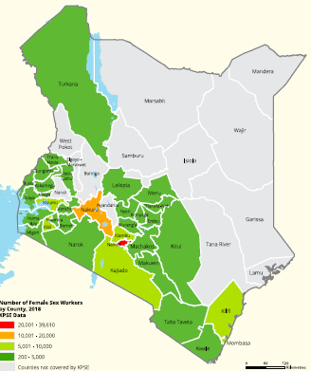
Planning for scale
Mapping and population size estimation is a key first step.
Geographical mapping approach in priority towns (2012)
Participatory programmatic mapping approach in 34 counties (2018)
Map and estimate virtual MSM
Size estimates were derived in counties without programmes using mathematical modelling
Mapping and estimation exercise helped in identifying “where” and “how many”
Helped in setting targets and guiding scale up
Implementation level: participatory mapping identifies intervention locations/venues and KPs who operate in those locations/venues
Notes:
After the NSP included KP as the priority population, the country developed their plans to scale up KP programme and the first step was conducting population size estimates in 2012. We used a geographic mapping approach as we were going to towns and cities where there were no programmes. Subsequently after 5 years of implementation, when we reached a scale, the KP programme decided to conduct another exercise to validate the estimates in counties where there are programmes, conduct size estimation in the counties where there are no programmes, include virtual sites (as traditionally we had included physical sites and venues), include estimation of young KPs and Transgender people. In counties where there were programmes (34 counties), we used programmatic mapping approach and the mapping was led by peer educators and outreach workers. We like the geographic mapping approach as this approach tells us where are the KPs and how many KPs. In some other methods we do get the estimates but do not know where they are. Based on our experience, we should do mapping and validation every 5 years and use programmatic mapping approach where there are programmes as the KP community can lead those process and the process is also rapid and cost effective. Mapping helped the national programme to set targets for scaling up – provided an understanding of . At the implementation partner level the mapping and estimation exercise helps them understand where the venues are and who are there in the venues to initiation interventions.

Slide 5
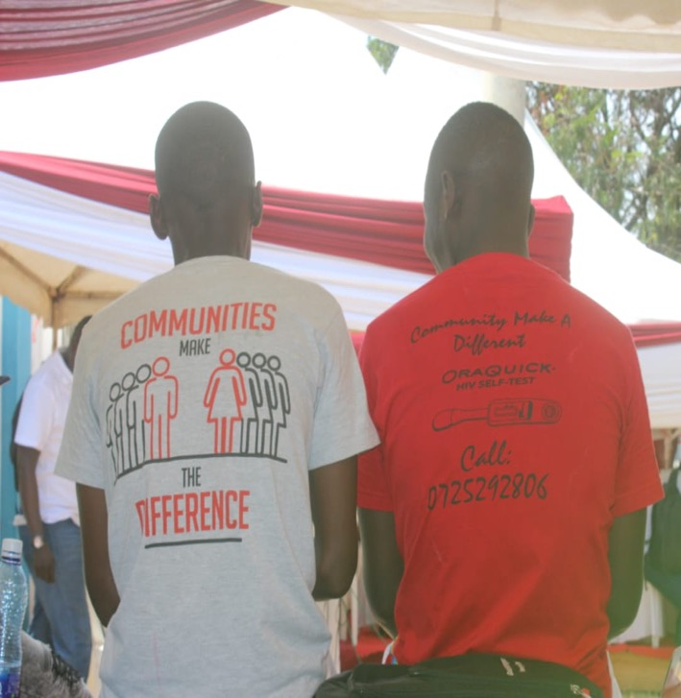
Strengthening outreach
Community outreach is prioritized with peer educators and outreach workers as backbone
Peer educators (who are KPs) are selected from the mapped venues – in many cases by the KP community in the venue/location
Peer educator : KP ratio is specified in the national guidelines –
FSW 1 PE : 60-80 FSW
MSM 1 PE : 30-40 MSM
PWID 1 PE : 30-40 PWID
Trans people 1 PE : 30 Trans people
Supervisory cadre of outreach workers is critical –
ORW 1 ORW : 5 PE
Outreach workers who are also KP interact with their peer educators on a regular basis to review performance and support planning and monitoring
Peer educators are encouraged to perform well and progress to become outreach worker (peer progression)
Notes:
Community outreach is our backbone and we need to invest in this structure. Our community outreach structure includes peer educators and outreach workers. The peer educators and outreach workers in Kenya are KPs. Peer educators are normally active KPs and are selected from the venues where they operate. In the national guidelines, based on our evidence we have defined the ration for Peer educator vs KP. You can see the ration in the slide. This ratio is important for Peer educators to maintain optimal contact with their cohort and provide services. The peer ratio is also important for budgeting the outreach activities (In GF it falls under BCC intervention). Besides the peer educators, we also have a outreach worker cadre which is a supervisory cadre and supports and mentors peer educators. Peer educators are volunteers but outreach workers work longer hours and in some implementing partner they are full time staff. The national programme recommends 1 ORW for every 5 PE. Many a times Peer educators who work very well get promoted to ORW and they are given training on mentoring and supervision skills. When we develop the GF proposal or discuss with PEPFAR, we insist that this outreach structure is adequately budgeted as per the peer ratio and there are also resources for review meetings for the outreach teams.

Slide 6
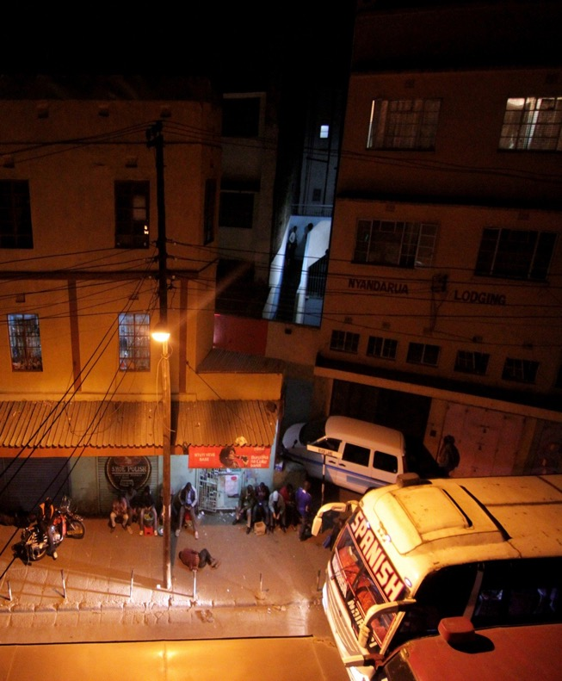
Engaging community with continuous high-risk venue presence
Outreach team is trained on peer education skills, planning at venue level for each KP member of their cohort using simple participatory tools
As peer educators work in the venue/ location, they are expected to be present in the venue on most days
Virtual sites are emerging as ‘venues’ specially for MSM and hence virtual outreach is needed to make contact and provide services
Outreach services include provision of:
Information and education
Condom and lube
Needles and syringes
Referral to clinics (static and outreach)
Outreach team play a critical role in mobilizing KP to access clinical services and follow up
Outreach team also provide support to KPs when they experience violence
Notes:
One of the critical aspect of outreach is to ensure that there is a continuous venue presence. Peer educators are selected from the venues itself (sometimes by the KPs in the venue) and the Peer educator is expected to be in the venue almost all days or during the peak days as they work in those venues. The definition of venues is changing specially with COVID as we are seeing lot of activity in the virtual sites including apps, facebook, whatsapp groups and we are now including virtual sites also as venues and have planned outreach in those sites. Similar to venues, the implementing partners select KPs who operate in these virtual sites as peer educators. Outreach services provided by the peer educators and outreach workers include provision of information about HIV, STI and other services, condoms and lubricants, new needles and syringes, referral to the clinics and follow up. Peer educators and outreach workers also provide violence support at the venues, when KPs experience violence. Hence the programme need to budget for the prevention commodities but also for the outreach team to travel to the venues to provide information and commodities. With outreach through virtual sites becoming essential, there is need to also budget for data, tablets, registration costs etc to access virtual sites. In Kenya, instate of emergence of the virtual platforms, venue based outreach still remain a critical part of outreach as it provides face to face interaction and provision of commodities directly. This interaction also builds a sense of community and solidarity among KPs,

Slide 7
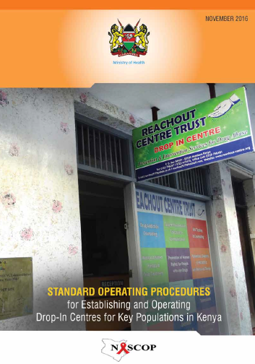
Safe spaces
Safe spaces or Drop in Centre (DIC) are part of the guidelines
SOP developed on “how to establish” a safe space
Difference between clinics and DIC
DICs are meant for relaxing, socializing and normally designed by KPs
KP led organisations have better understanding of DICs
Notes:
The national programme recommends establishment of safe spaces or drop in centres/ safe spaces. We have SOPs for setting up safe spaces as we found the clinic reception was considered as a safe space by many partners. However now most of our partners have a separate physical space most of the time along side a clinic where the KPs can relax, socialize with other community members. These spaces are most of the time designed by the key populations and the space is used by the implementing partners to organize community empowerment activities including training and sensitization on rights. We have found that KP led organisations tend to have better DICs. But this is one space that needs to be considered and budgeted for when planning a clinic or a office for the intervention

Slide 8


Structural interventions
Focus has been on violence prevention and response
Awareness of rights among KPs
Crisis response system
Sensitization and training with law enforcement
Dialogue and advocacy with court user committee
Effort has been made in reducing stigma and discrimination in the health sector
KP led organisations have initiated economic empowerment activities
Collectivization and strengthening capacities of KP led organizations
Notes:
Structural interventions are critical and the Kenya programme largely focuses on Violence prevention and response though the implementing organization and KP led organizations have also initiated economic empowerment activities and community empowerment activities through collectivization. Violence prevention and response is provided at the community platforms through peer educators and outreach workers (some organisations also have a cadre of paralegals while others train the peer educators and outreach workers as para legals) where the outreach team provides information and awareness of rights, provide support in case of crisis or violence. At the clinics, screening of violence takes place and support is provided. In addition, the national programme in partnership with the implementing partners also conduct sensitization of the law enforcement and sensitization of health workers to reduce stigma and discrimination. These interventions are most of the time lost and not budgeted for. In the context of GF, this fits beautifully under the Human Rights Module but sometimes KPs are missed and budget is not separately allocated for setting up violence prevention teams, training, development and distribution of information materials of post violence support

Slide 9
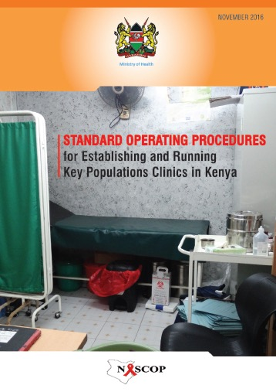
Optimising Clinical Services
SOP for providing clinical services
Different models of clinics
Static/ standalone
Outreach clinics
Integrated clinics
Comprehensive services : HIV testing, STI, PReP, SRH, condoms and lube, ART, special services
Emphasis on quarterly check up irrespective of HIV status
Focus is on improving health seeking behavior
Strong linkage between community and facility teams
Notes:
The national programme has developed SOP to standardize operation of clinics. The partners offer different models of clinical services, including static clinics, outreach clinics and integrated clinic within a public health facility. The clinics provide comprehensive services. With recent experience of Covid 19, there is also stress in providing mental health services. The national programme also focuses on building a health seeking behavior among key populations by promoting quarterly health checkups irrespective of HIV status. These check ups can be done at the static clinic or the outreach clinics. These check ups provide time for risk reduction counselling, screening for depression and alcohol use, violence etc. Programmes need to budget for clinical teams, equipments, treatment. The budget should also include costs of outreach clinics as we see more KPs in the outreach clinics which are organized in the venues than in the static clinics. For clinical services to work effectively the clinical team have to work with the outreach team as the outreach team does all the demand generation

Slide 10
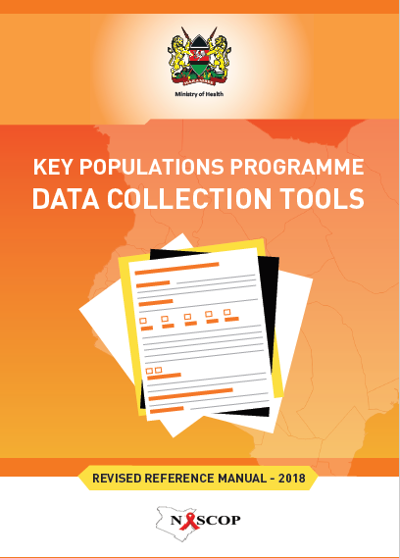
Monitoring performance
Standard national tools (data collection and reporting) irrespective of donor
Simple data collection tools for peer educators. At IP level, these tools can be used for monitoring progress and reporting.
IPs (400+ units) report monthly (DHIS) and quarterly to the national programme
Analysis of the data and presentation in
Quarterly donor meetings
Quarterly national KP TWG
Quarterly county KP TWG
Monthly meetings at IP level
Annual behavioural surveys using PBS method (rapid, scalable, feasible and cost effective)
Development of cascades for gaps analysis and planning
Notes:
The national programme has developed standard set of indicators, data collection tools and reporting formats and all implementing partners report using these tools, irrespective of the donors. The national programme has reviewed the global targets and indicators to finalise the national indicators. Data collections tools are available for all cadre of staff including peer educators. We have tried to keep the tools simple and few for the peer educators. These tools are used to review progress and performance of different staff. Like the peer educator calendar is used by peer educators and outreach workers to review how many Kps were reached in the cohort with what services, the gaps and where the PE should pay attention. The national programme has a KP module in the DHIS and all implementing partners report on a monthly basis. We are also trying to move towards EMR. As we collect data we also analyse and disseminate data at all levels. At the implementing partner level, they analyse their data and use it for improving programme. At the county level and the national level, the data is analysed during our Technical Working groups to define programme priorities. Kenya also conducts annual behavioural survey to monitor the programme outcomes. These are population based surveys and the method of Polling Booth Surveys, makes the surveys rapid, feasible and cost effective. Again it is essential to budget of these activities as this helps in monitoring the programme and identifying priorities for improvement. In GF proposals and budgets we should also explore inclusion of these activities under the RSSH module rather than burdening the KP module. Wanted to share this as a thought.

Slide 11
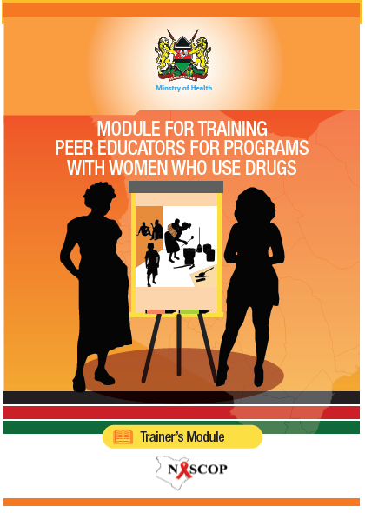
Capacity building
Critical aspect of a KP programme
Specific cadre wise training
Outreach team (peer educators, outreach workers, advocacy workers, paralegals)
Clinical team (clinician, counsellors, nurse
Programme management (Prevention officers, managers)
Joint training with stakeholders
Police
Health care workers
TOTs are conducted by the national programme
Capacity building plan is developed quarterly and certification
Notes:
The KP programme is dependent on the team implementing the programme and hence investment in capacity building is critical. Capacity building is not one time activity and hence we need to plan for refresher trainings too. In Kenya we do cadre wise training but also do joint training when it comes to training of police or health care workers. We use standardized curriculum and an approach. The responsibility of developing a team of trainers is with the national programme and the implementation level and county training is done by the implementing partners and county. Trainings need to be adequately budgeted for though with covid 19, we are adapting to virtual trainings too.

Slide 12
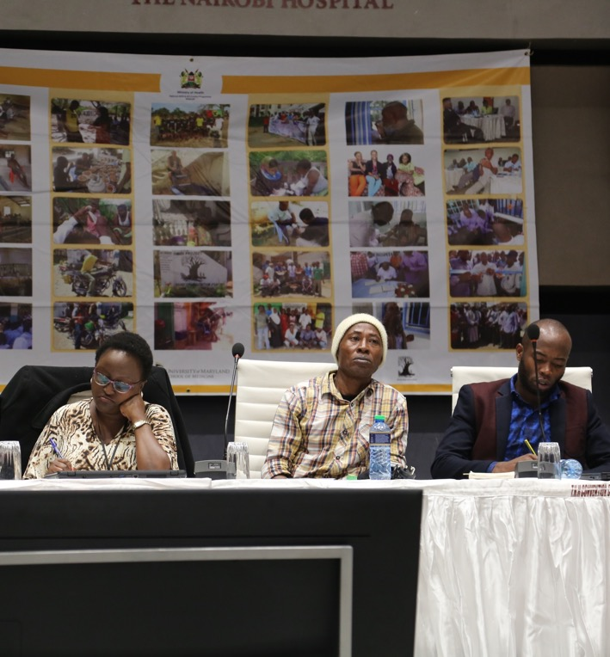
Managing scale
Established Coordination mechanism at national and county level
TWG, sub committees
Meet on a quarterly basis
Allocation of counties to specific donors to avoid duplication
Quarterly donor meetings to review progress using data and joint solutioning to address gaps
Annual Peer Convention to receive community feedback
Annual stakeholders meeting to address critical programme gaps and plan innovations
Technical Support Unit embedded within national KP programme
Notes:
We need strong coordination mechanisms to manage scale at national and county level and hence Kenya has established Technical working groups for KPs which meet on a quarterly basis. This is a technical and sharing forum where all stakeholders are present including KP led organisations. Kenya also has quarterly forums with donors to ensure that resources are optimally used to reach the estimated population. These forums are great for also ensure we do not have duplication of efforts. We also organize annual peer educators convention where we invite peer educators from all partner organization to share their experiences and feedback. This is one of our community monitoring approach. We also have a Technical Support Unit embedded with the national programme that supports in develop technical strategies to manage scale

