Slide 1










2026
South to South Learning Network
Selected practical SSLN guidance tools & products to support countries with their GC8 application and proposal
27 April 2026
Kerry Mangold
SSLN Programme Director
kerrym@genesis-analytics.com

Slide 2

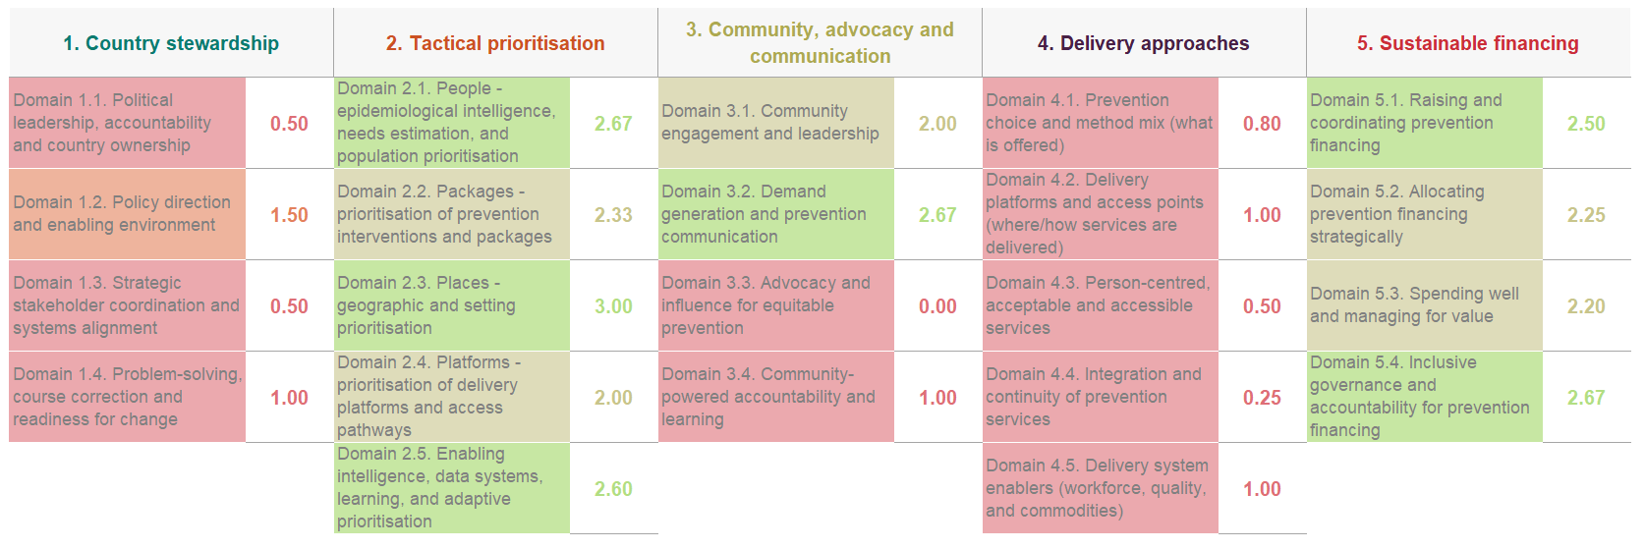
Pan Prevention Self-Assessment Tool (PSAT)
& PSAT lite
Pan-PSAT findings provide a comprehensive, stakeholder-validated overview of prevention system strengths and gaps across governance, prioritisation, service delivery, community systems, and financing - generating the evidence base needed to identify and justify priority prevention investments in GC8 applications
Building on UNAIDS' pillar-specific PSATs, this structured, country-led self- assessment is accessible in multiple languages
Organised across 5 prevention streams, each evaluating core HIV prevention systems functions — not individual programmes
High level process for completing the PSAT
1. SCORE
Assess each element (0-3) based on current functioning
2. DIAGNOSE
Identify barrier / root cause, population & geography impacted
3. ACT
Define priority actions that address root causes
Designed to support integration, sustainability, and new prevention technologies
6. SUPPORT
Define up to 3 priority TA needs (capacity-focused)
5. LEARN
Define up to 3 priority learning needs (decision-linked)
4. REVIEW
Use summary scores to identify priority system gaps

Slide 3






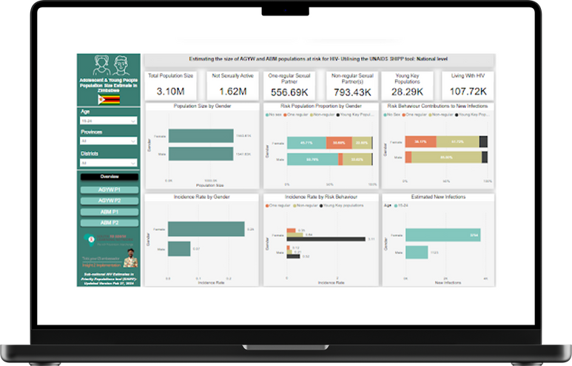


Tools focusing on data-driven gap analysis & targeted service design
Together, these tools provide the data, frameworks, and implementation guidance needed to identify gaps, prioritise resources, and design targeted prevention services for key and underserved populations - ensuring GC8 strategies are high-impact and evidence-driven
Dashboard
Interactive Guide
Implementation Guide
Evidence Synthesis Report
How to implement HIV programmes for YWSS
Peer-Led Approaches to HIV Prevention for KPs:
Strategies & Investment Opportunities
i2i sub-national estimates in priority populations (SHIPP) dashboard
HIV Prevention Cascade
An analytical framework that can be used to assess gaps in HIV prevention programming with KPs
Helps programmes identify gaps in service uptake, measure coverage and continuity, and prioritise resources to reduce new HIV infections at the population level.
Informs data-driven planning, prioritisation, and programme optimisation
A practical, programmatic guide that supports the design and delivery of tailored HIV prevention interventions for young women who sell sex (YWSS)
Focuses on addressing structural, behavioural, and biomedical risks
Provides guidance on outreach, service delivery models, and community engagement
Utilises UNAIDS sub-national estimates to provide disaggregated HIV incidence and population size data by age, sex, location, and behavioural risk at district level
Supports data-driven prioritisation of prevention resources across key populations - directly informing targeted intervention design and resource allocation in GC8 proposals
A consolidated review of global evidence on peer-led approaches in KP programming.
Summarises what works, for whom, and under what conditions
Provides recommendations for strengthening peer-led models and implementation
Highlights effectiveness of peer outreach in reaching KPs

Slide 4


SOP template for injectable Lenacapvir (LEN)
as PrEP
Supports countries with the operational foundation needed to plan and cost LEN introduction within GC8 prevention proposals
An adaptable SOP template aligned with WHO guidance on injectable LEN as PrEP, designed for national policymakers and TWGs
Offers suggested language, prompts, and clearly marked sections where national decisions are needed
Policymakers and technical working groups are expected to use the tool to align SOPs with national policies, regulatory requirements, and WHO guidance
Supports consistent, evidence-informed rollout of LEN as PrEP at national level

Slide 5






Find all our resources on the SSLN website under the resources section
@southsouthlearning network
https://hivinterchange.com
@southsouthlearning network
@south-south learning network

