Slide 1
HIV Prevention Needs Estimates and Cost-Effectiveness Analysis with the Goals Model
John Stover, May 11, 2026
Prioritization for HIV Prevention using the 5 Ps: A Practical Session to Support GC8 Processes

Slide 2
Prevention Needs Estimates
New tool added to Spectrum to estimate the need for four key primary prevention interventions
Condoms
VMMC
Key populations
PrEP
By default, the tool country reports to GAM for current use and UNAIDS global targets for 2030 targets – but these can be changed by the user
Purpose is to provide quick assessment of potential needs
Does not include impact or cost

Slide 3
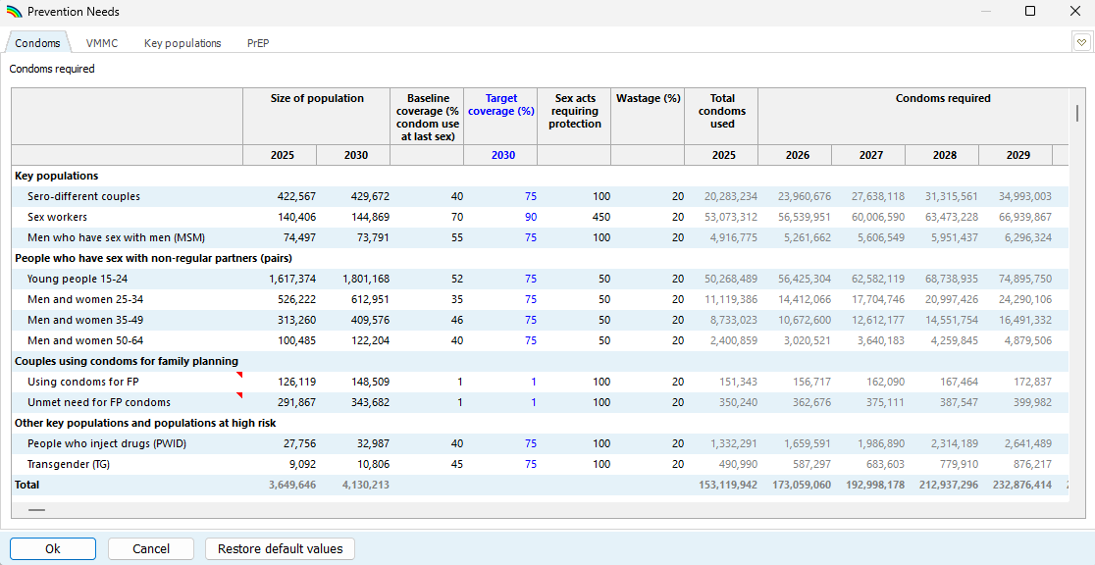
Prevention Needs Estimates

Slide 4
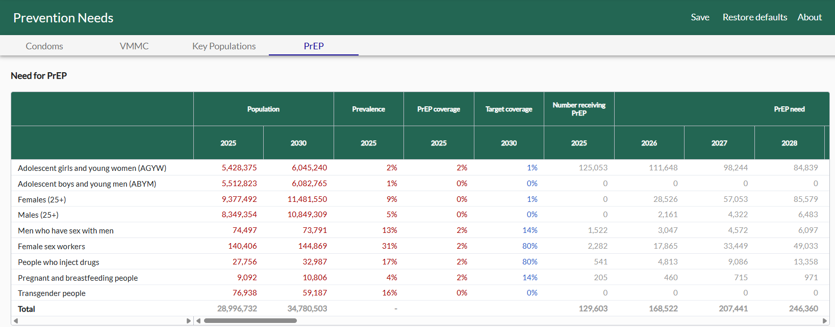
Prevention Needs Estimates

Slide 5
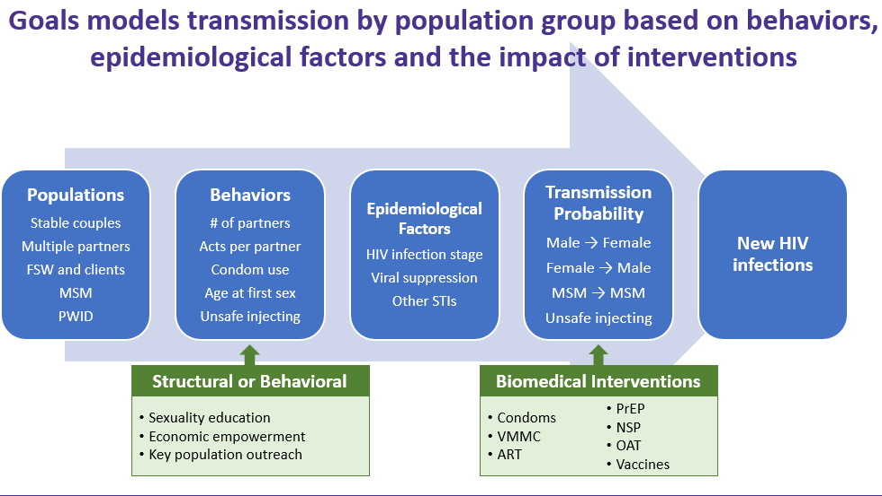
Goals Model
Goals is a mathematical model that simulates the HIV epidemic
New infections are estimated by population group based on behaviors, intervention coverage and epidemiological factors
It can estimate the cost and impact of a full range of prevention and treatment interventions

Slide 6
Models help ensure consistency between intervention coverage, impact and cost
Interventions
Population Groups
Condoms/lube
PrEP / PEP
Needle/syringe programs
Opioid substitution
STI screening and treatment
PMTCT
HIV testing
Treatment
Comprehensive sexuality education
Economic empowerment
Programs to address stigma & discrimination, gender-based violence, legal reform
Support functions: administration, research, etc.
Female sex workers
Men who have sex with men
Transgender people
People who inject drugs
Prisoners
Adolescent girls and young women
Adolescent boys and young men
Adults 25+
Pregnant women
People living with HIV
Impact
Financial resources
Notes:
Goals represents the populations in need of interventions, the level of intervention coverages in each group, and the cost and effect of those interventions. This helps ensure that Goals’s estimates of the resources needed to reach our targets are consistent with the epidemiological impact we expect to get by reaching those targets. That might not be true if resource needs estimates are conducted separately from impact analyses.

Slide 7
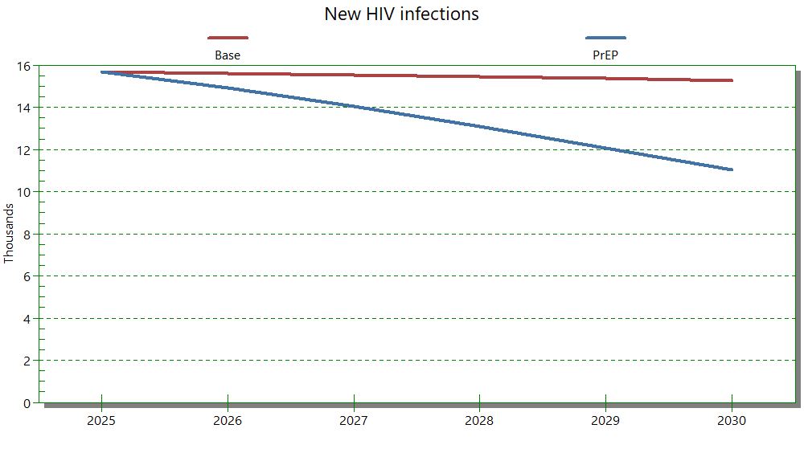
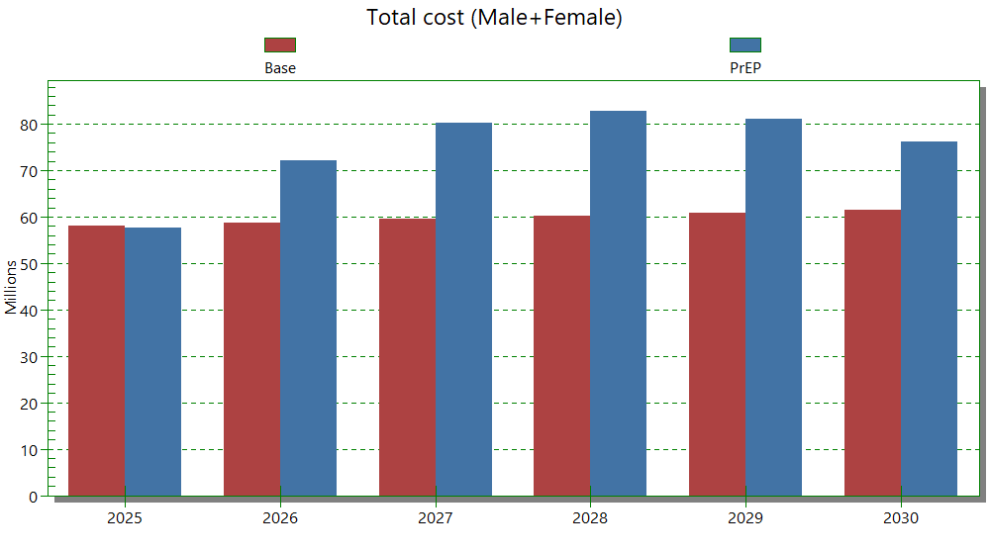
Example of impact analysis
Compare two scenarios, with and without PrEP scale up
Calculate infections, deaths and DALYs averted
Calculate incremental costs
Calculate cost per infection averted
$91 million / 12,000 = $7600/IA
12,000 infections averted 2026-2030
Incremental cost = US$ 91 million

Slide 8
The cost-effectiveness tool in Goals can be used to assess the cost and impact of individual interventions. This information can be used to determine optimal allocation of a given amount of funding.
AGYW PrEP
Economic empowerment
FSW PrEP
OAT
MSM PrEP
MSM
N&S
Condoms
ART
VMMC
CSE
FSW
Results vary by context, current coverage, unit costs and degree of targeting

Slide 9
Uses of modeling for prioritization for GC8
Use cost-effectiveness analysis to assist with resource allocation decisions
Estimate the expected impact of your funding request
Show the cost-effectiveness of your proposed allocation of funds
Estimate resource gaps
To achieve target coverage levels
To reach epidemic control

Slide 10
How to conduct these analyses
Conduct your own analysis
Goals software is free. Enter your own data, calibrate the model and conduct analyses. Or request pre-calibrated model from Avenir Health
Get technical assistance from Avenir Health
Avenir Health is supported by Gates Foundation to work with countries to conduct Goals analyses. We are currently working with 10 countries.
Use another simulation model you may already be working with
Optima, EMOD, HIV Synthesis, PopART-IBM, Thanzi la Onse

Slide 11
For More Information
Download the Spectrum program which includes the Goals model at:
https://avenirhealth.org/software-spectrum.php
To see the equations and more details on the methods see the Goals manual by clicking (?) in the Spectrum software
For information about the application to the UNAIDS Global Strategy 2021-2026 see:
Stover J, Glaubius R, Teng Y, Kelly S, Brown T, Hallett TB, et al. (2021) Modeling the epidemiological impact of the UNAIDS 2025 targets to end AIDS as a public health threat by 2030. PLoS Med 18(10): e1003831. https://doi.org/10.1371/journal.pmed.1003831
By email:
Rglaubius@AvenirHealth.org
JStover@AvenirHealth.org

