Slide 1





Synthesis of HIV Prevention Data & Cascades for Ghana
Dr Nii Nortey Hanson-Nortey
Principal Consultant
Hilly Consult

Slide 2
Where Are We?
Treatment cascade (or care continuum) is one method for monitoring progress in preventing secondary transmission
There is no similar, uniform, framework yet for monitoring progress in HIV primary prevention programme implementation.
Several HIV prevention cascade approaches have been proposed
Data used have been focused on prevention methods and population groups in specific settings around the world.
There is growing consensus that some standardization would be useful for accurately measuring and comparing the success of prevention programmes and for monitoring progress to meet global HIV prevention targets.

Slide 3
Promoting HIV Prevention
HIV prevention programmes must:
  Operate in social contexts that affect their ability to reach those most at risk and to provide appropriate services to them.
  Provide enabling environment for the uptake of prevention interventions not only availability of individual HIV prevention services.
  Be focused on, accessible to, and taken up by the people most at risk of acquiring infection (primary prevention).
  Prevent onward transmission of HIV (secondary prevention), through ART care to achieve undetectable viral loads.
  Be monitored using methods that can provide timely and actionable information.
HIV prevention interventions are complex because of differences within at-risk populations, periodicity of risk, and overlapping risks and vulnerabilities for individuals and populations.
So, one size does not fit all ……….
Notes:
The focus of the current guidance is on programme coverage and performance with the endpoint as correct/consistent use of the prevention methods NOT not HIV incidence
Correct/consistent use of the method should ultimately lead to a lowering of the number of new infections because of infections averted

Slide 4


The Five Pillars of Combination HIV Prevention
Pillar 1
Pillar 2
Pillar 3
Pillar 4
Pillar 5
Key Populations
Combination prevention and harm reduction packages for and with
Sex workers
Gay men and other men who have sex with men
People who inject drugs
Transgender people
Prisoners
Adolescent Girls & Young Women
Combination prevention packages in settings with high HIV incidence (based on differentiated, layered packages).
Adolescent Boys & Men
Combination prevention packages in settings with high HIV incidence (including voluntary medical male circumcision and promoting access to testing and treatment).
Condom Programming
Promotion and distribution of male and female condoms as well as lubricants.
ARV-based Prevention
Pre-exposure prophylaxis (PrEP), post-exposure prophylaxis (PEP), treatment as prevention including for elimination of vertical transmission.

Slide 5
HIV Prevention Intervention Classes
Behavioral Interventions: Applied to promote change in sexual behaviour, and to increase HIV service utilization and adherence to HIV services and behaviours – educational activities to address knowledge, attitudes, risk perception, norms, HIV service demand and skills.
Biomedical Interventions: The use of medical treatments such as ARVs for prevention or post-exposure prophylaxis, barrier methods such as male and female condoms, medical male circumcision or other methods to reduce the chance of transmission of HIV.
Structural Interventions: Effecting policy or legal changes; enabling environmental changes; shifting harmful social and community norms; changing systems of care and/or power structures; catalyzing social and political change; and empowering communities and groups to reduce HIV acquisition and transmission.

Slide 6
Value of Cascades
Though complex to develop, these cascades do have multiple potential (and sometimes overlapping) uses, including:
  Informing programme management and improvement by analyzing bottlenecks;
  Assessing progress toward prevention goals (sub-national, national, and ultimately global);
  Generating research questions (e.g., about why gaps in coverage and uptake are occurring);
  Supporting advocacy for sustaining or expanding prevention services to ensure effectiveness; and
  Providing transparency about how prevention funds are being spent and with what effect at the service provision level.
Prevention cascades provide a tool for monitoring progress in HIV prevention programmes implementation and should be complemented by other data analysis efforts to obtain a detailed understanding of the overall state of HIV prevention within a population.

Slide 7
Difference between Treatment & Prevention Cascades
 | Treatment Cascade | Prevention Cascade
Core intervention | Antiretroviral treatment (singular option) | Multiple interventions (each as single intervention, but preferably in combination) with different frequencies (daily or non-daily oral PrEP), event driven (condoms, needles and syringes), and with varying efficacy and acceptability/preference
Population in need | All people living with HIV | At risk HIV negative individuals, e.g., living in a high incidence area and/or part of a population group at high risk, and/or with specific individual risk/vulnerability factors
Intervention timing | Always | When at high risk (individuals can move in and out periods of risk over time/life course)

Slide 8
Data Sources
Survey Data
  IBBSS (2019) and GMS III (2023)
  Population size estimates for FSW and MSM based on 3 source capture recapture (3SCRC) method in surveys
  Condom use with last client/partner & consistent condom use
Programme Data
  Reports from implementors on numbers of KPs reached
  Programme reach, peer contact, condom distribution
  PreP interventions
  Combination prevention’ interventions

Slide 9
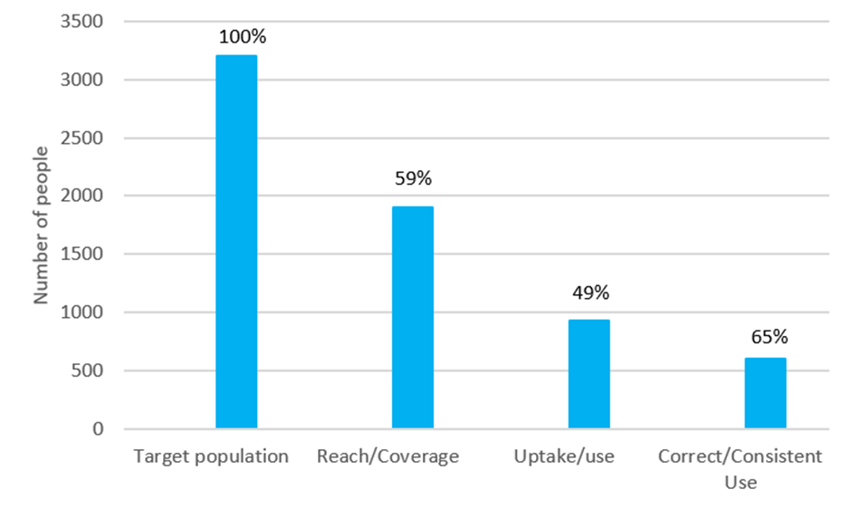
The HIV Prevention Cascade
Target Population: The total focus group population (100%).
Reach/Coverage: Percentage of the focus population reached/covered by the prevention method(s).
Uptake/Use: Percentage of those who are reached/covered by the prevention method(s) who are actually taking it up/using it.
Correct/Consistent Use: Percentage of those who are taking it up/using it, who are correctly/consistently using the prevention method(s).
E.g. the largest gap is in the uptake/use of the prevention methods.

Slide 10
Interpreting the HIV Prevention Cascade
Is the picture being seen plausible given what is generally known about HIV prevention for this focus population?
Identify the gaps and think about why the gaps identified between the different cascade steps occur?
Based on the reasons for gaps identified, what possible solutions should be sought and tested?
NB:
What denominators are being used? What is the difficulty in measurement.
Capturing “consistent use” may be difficult when data comes from different sources
What other things may be going on in the environment besides the prevention programme being monitored that may contribute to outcomes that might erroneously be attributed to that prevention programme

Slide 11
National FSW Prevention Cascades

Slide 12
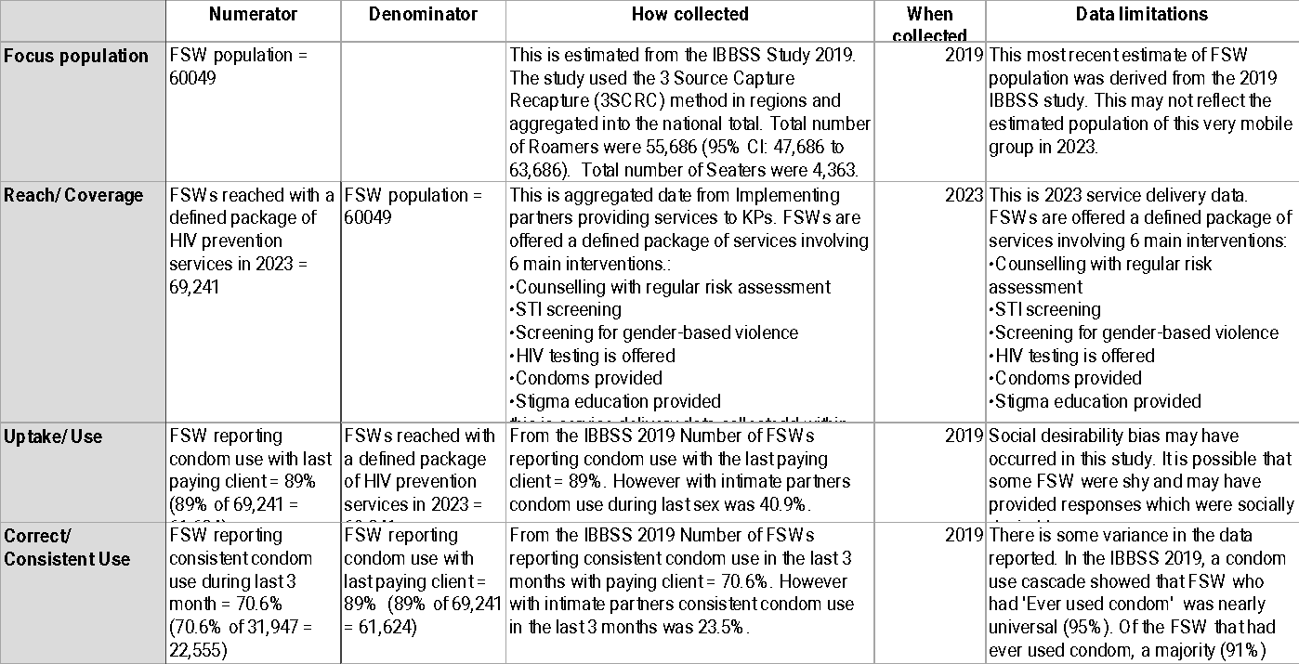

Slide 13
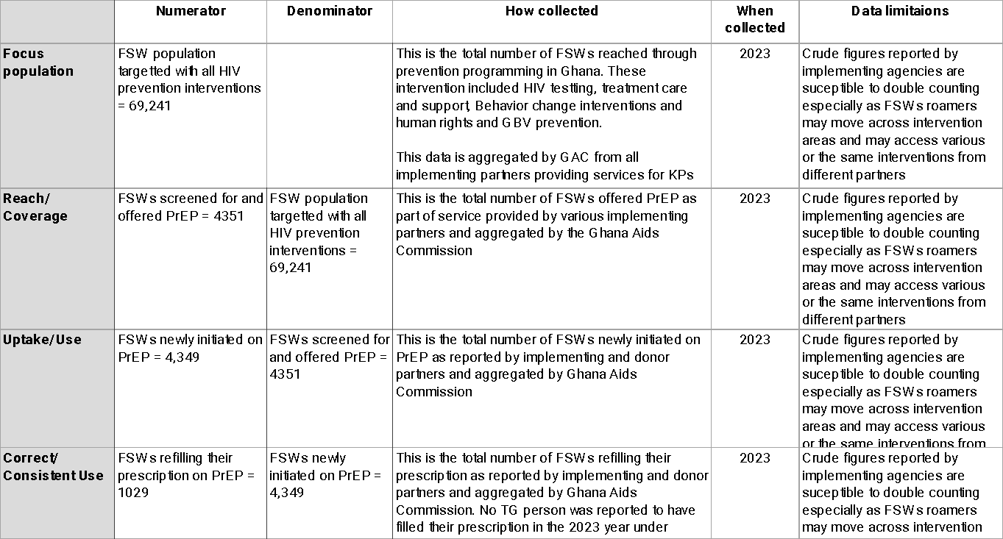

Slide 14
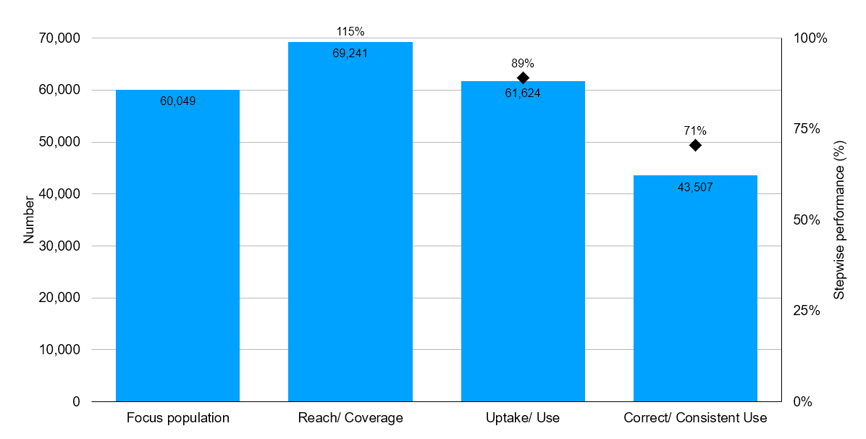
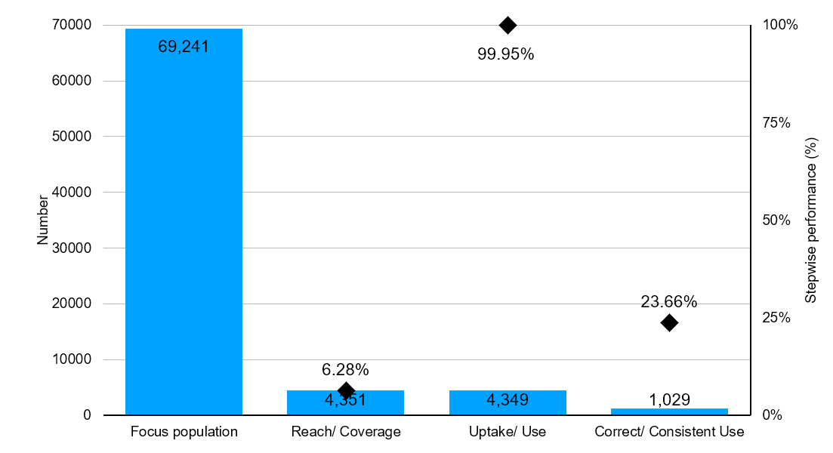
FSW Condom 2023
FSW PreP 2023
Notes:
During the implementation period, the above-mentioned Key Population implementers reached a total of 119,753 KPs comprising 69,241 Female Sex Workers and 50,512 Men who have Sex with Men. In the same period, a total of 106,075 KPs were tested comprising 63,454 FSW and 42,621 MSM. 2,625 KPs made up of 1,218 FSW and 1,407 MSM tested positive. A total of 2,529 KPs constituting 96.3% out of those who tested positive were newly initiated on Treatment comprising of 1,175 FSW and 1,354 MSM. The coverage rate for the period recorded 115% FSW and 106% for MSM. A test rate of 80% and 72% was recorded for FSW and MSM respectively. The period recorded a Yield of 2% for FSW and 3% for MSM.

Slide 15
National MSM Prevention Cascades

Slide 16
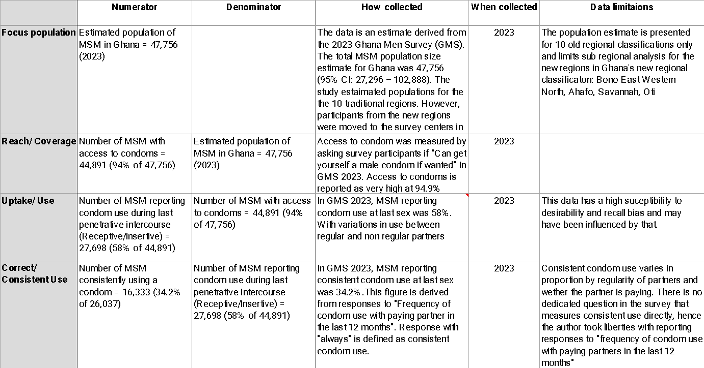

Slide 17
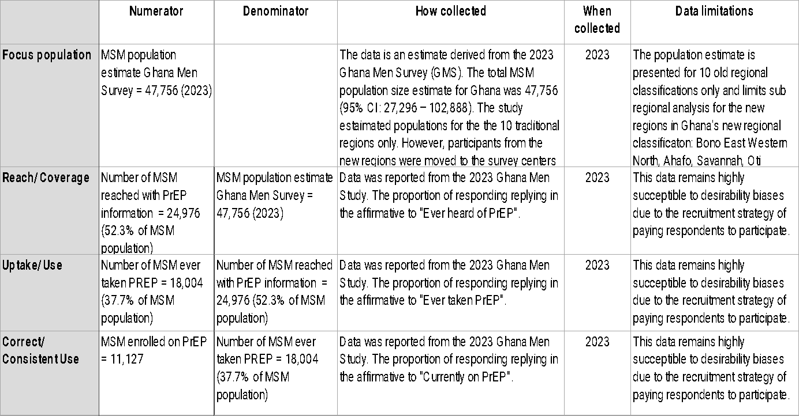

Slide 18
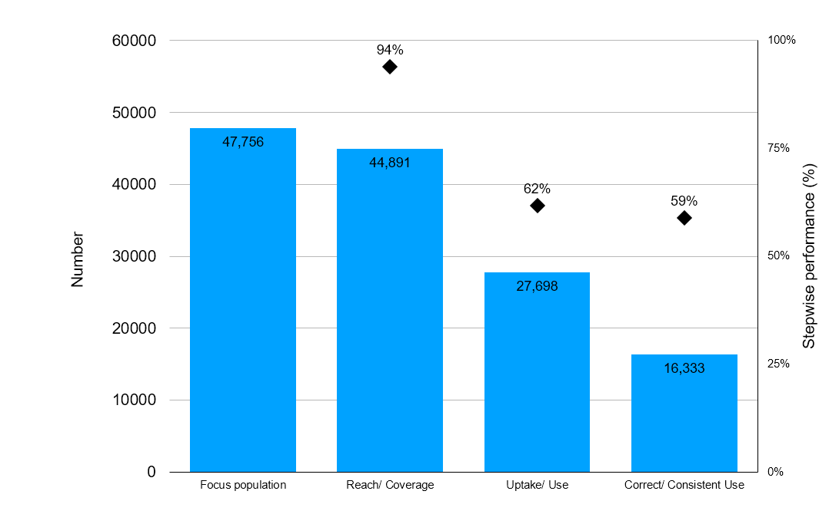
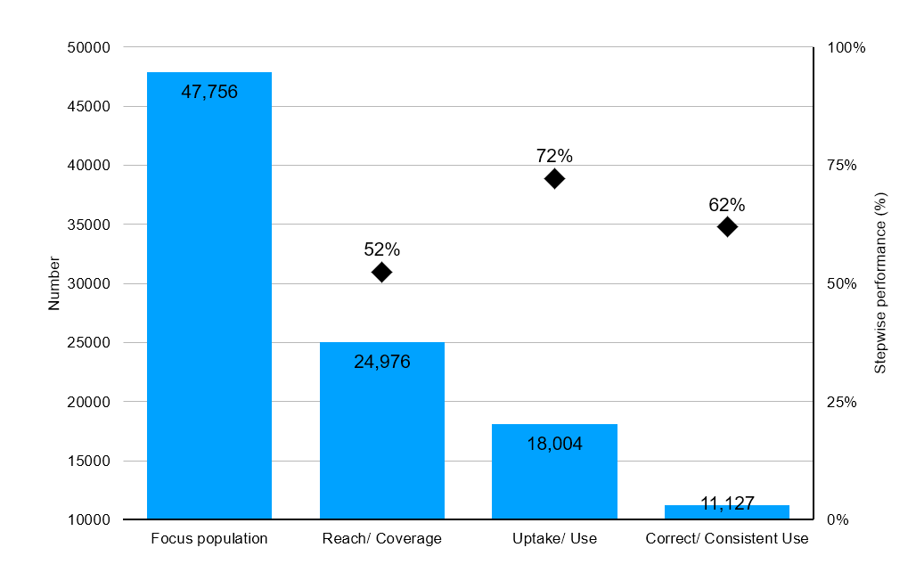
MSM Condom
MSM PreP

Slide 19
National KP PreP Cascades

Slide 20
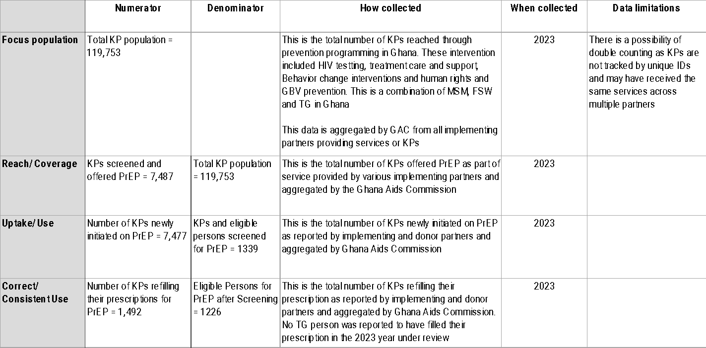

Slide 21
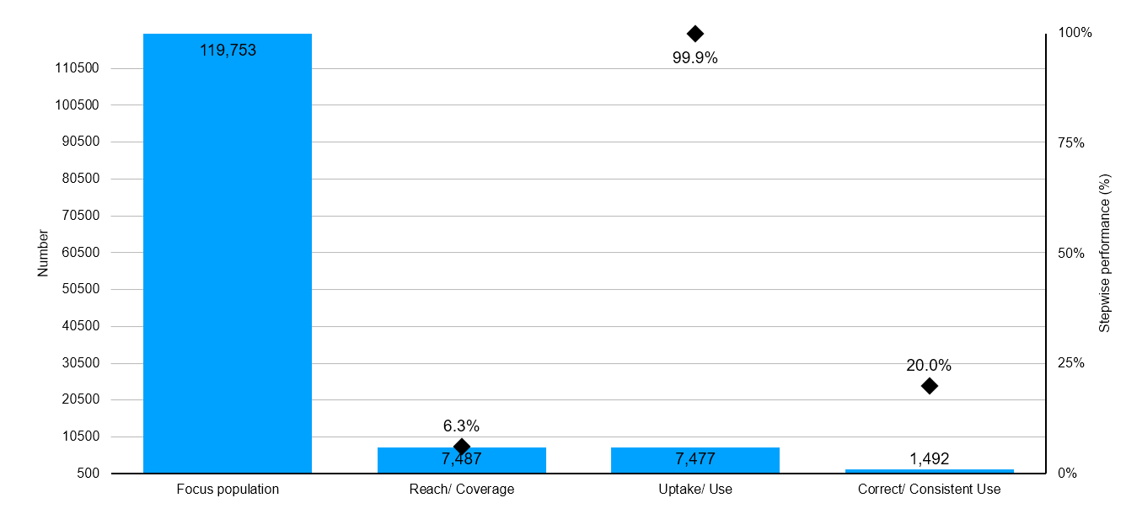
KP Prep Cascade
Notes:
Key Population implementers reached a total of 119,753 KPs comprising 69,241 Female Sex Workers and 50,512 Men who have Sex with Men.
In addition, 7,487 KPs (4351 FSW, 3127 MSM, and 9 TG) were offered PrEP with 7,477 (4,359 FSW, 3123 MSM, and 5 TG) newly initiated on PrEP. Moreover, 1,492 KPs (1029 FSW and 463 MSM) returned for a refill of PrEP during the same period.

Slide 22
National TGW Prevention Cascades

Slide 23
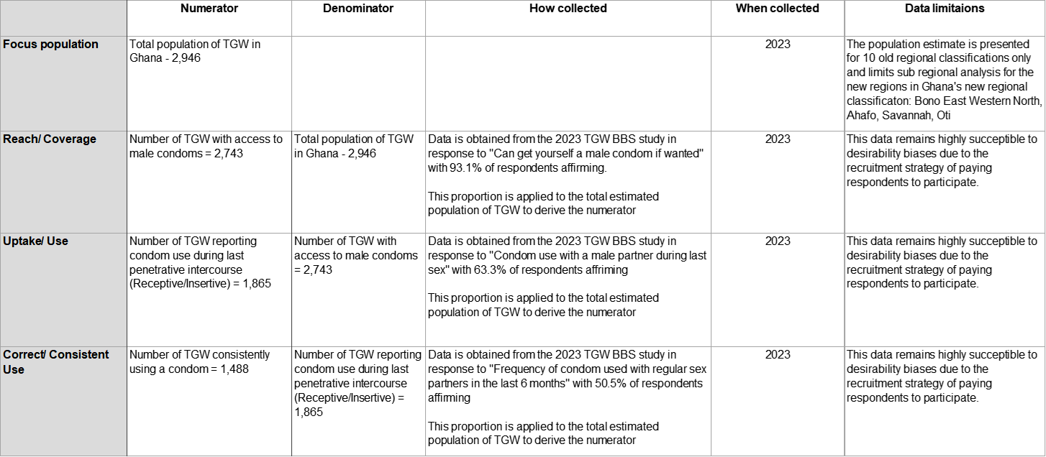

Slide 24
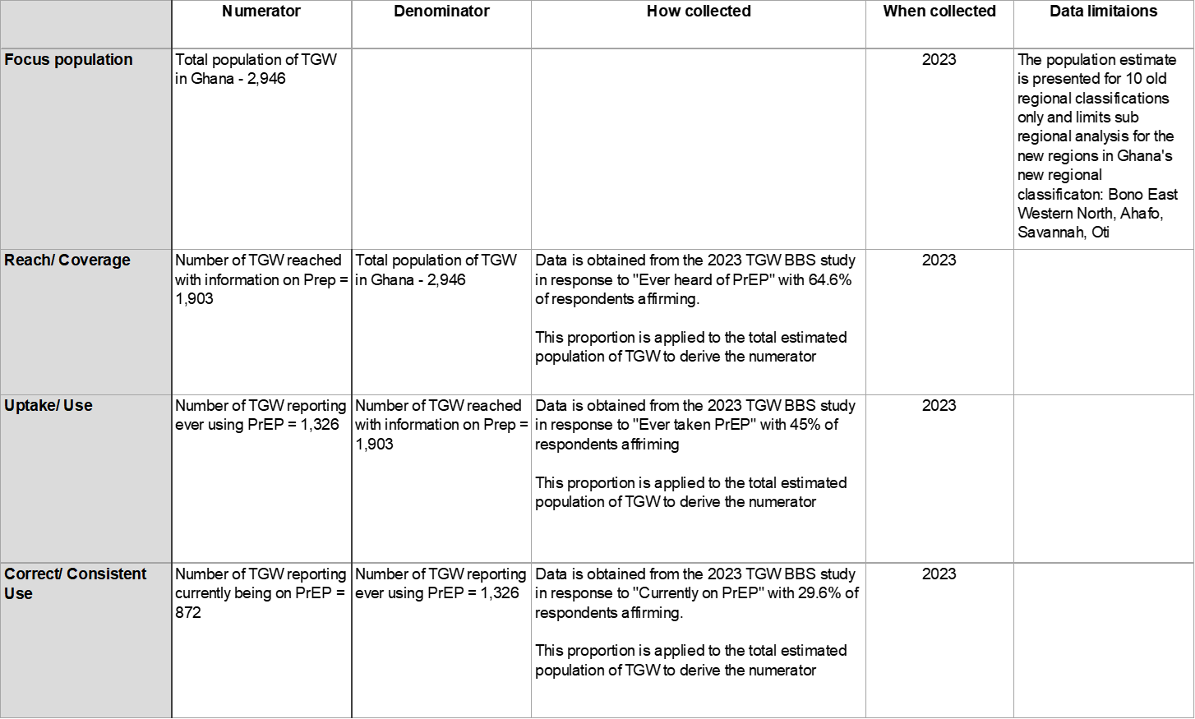

Slide 25
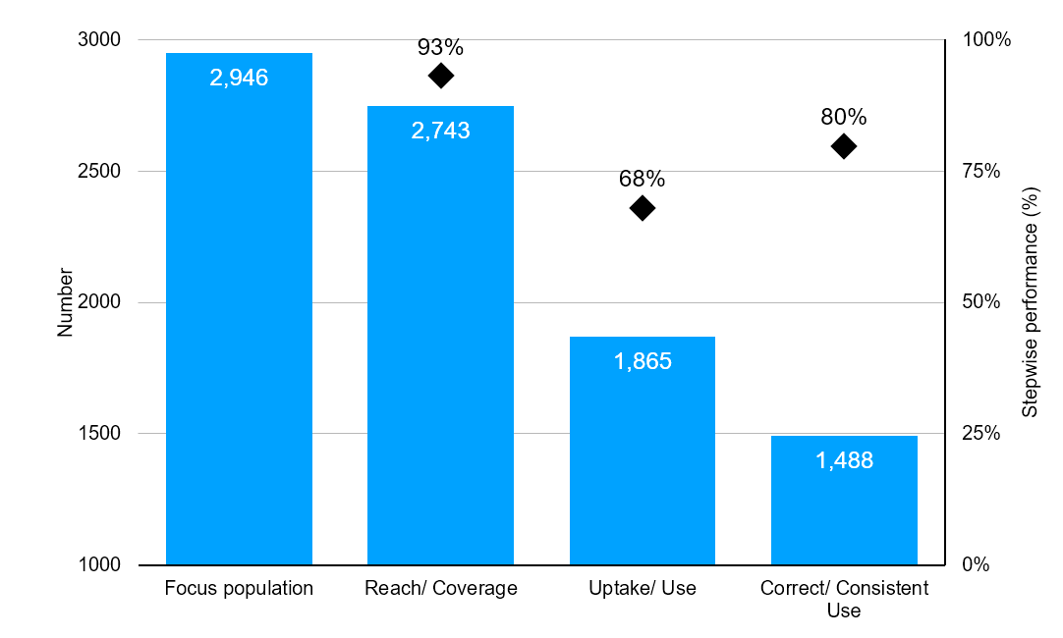
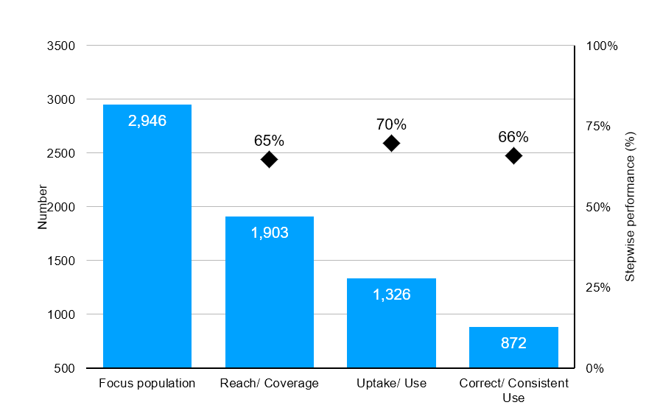
National TGW Condom
National TGW PreP

Slide 26
JSI Prevention Cascades

Slide 27
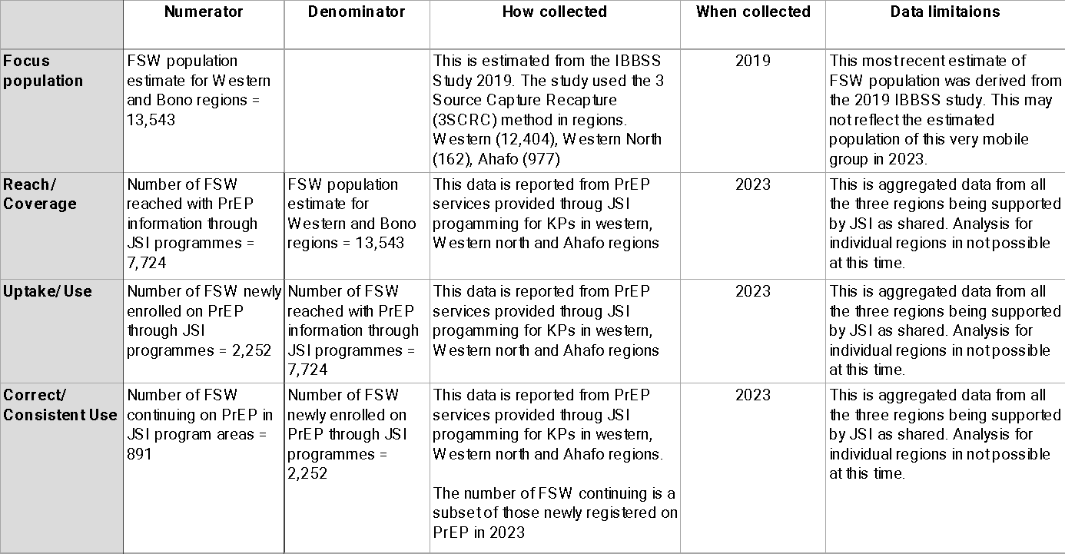

Slide 28
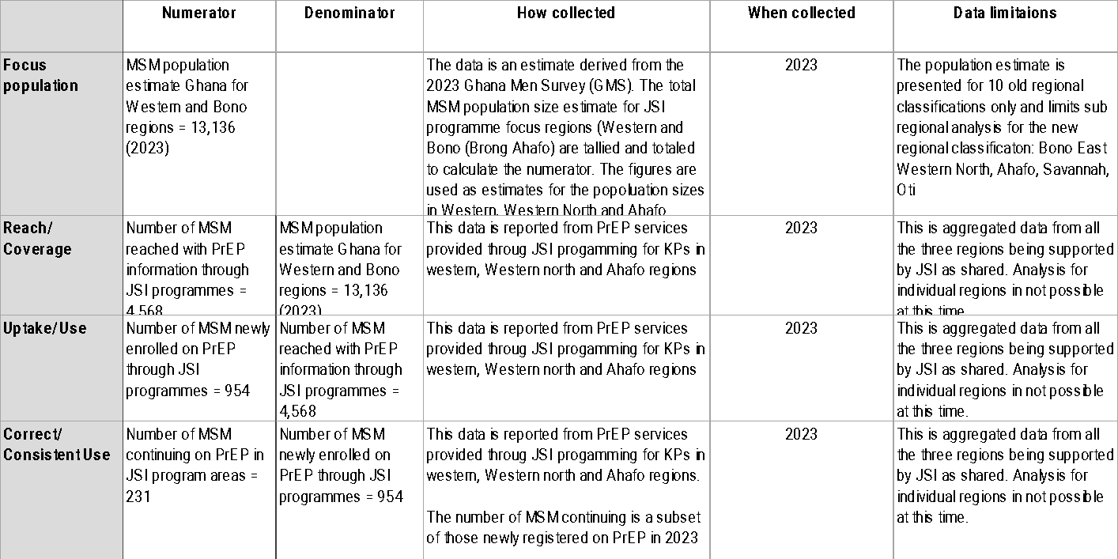

Slide 29
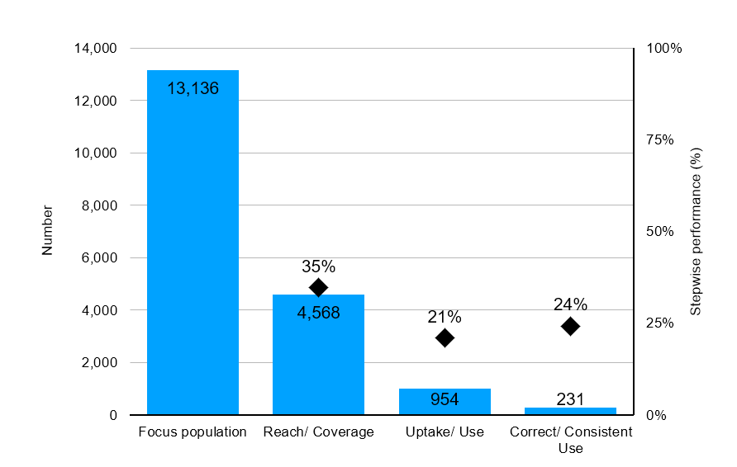
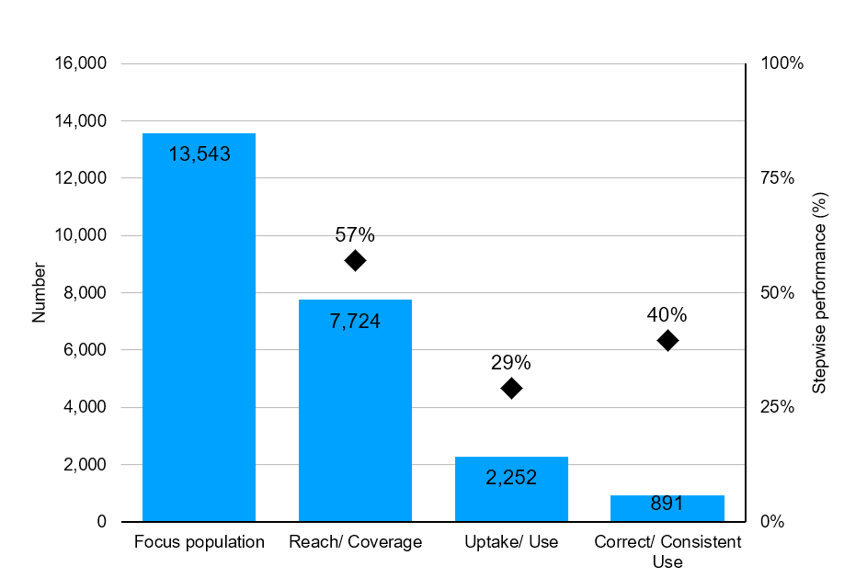
JSI MSM PreP
JSI FSW PreP
Notes:
During the implementation period, the above-mentioned Key Population implementers reached a total of 119,753 KPs comprising 69,241 Female Sex Workers and 50,512 Men who have Sex with Men. In the same period, a total of 106,075 KPs were tested comprising 63,454 FSW and 42,621 MSM. 2,625 KPs made up of 1,218 FSW and 1,407 MSM tested positive. A total of 2,529 KPs constituting 96.3% out of those who tested positive were newly initiated on Treatment comprising of 1,175 FSW and 1,354 MSM. The coverage rate for the period recorded 115% FSW and 106% for MSM. A test rate of 80% and 72% was recorded for FSW and MSM respectively. The period recorded a Yield of 2% for FSW and 3% for MSM.

Slide 30
Sub National MSM PreP Cascades

Slide 31
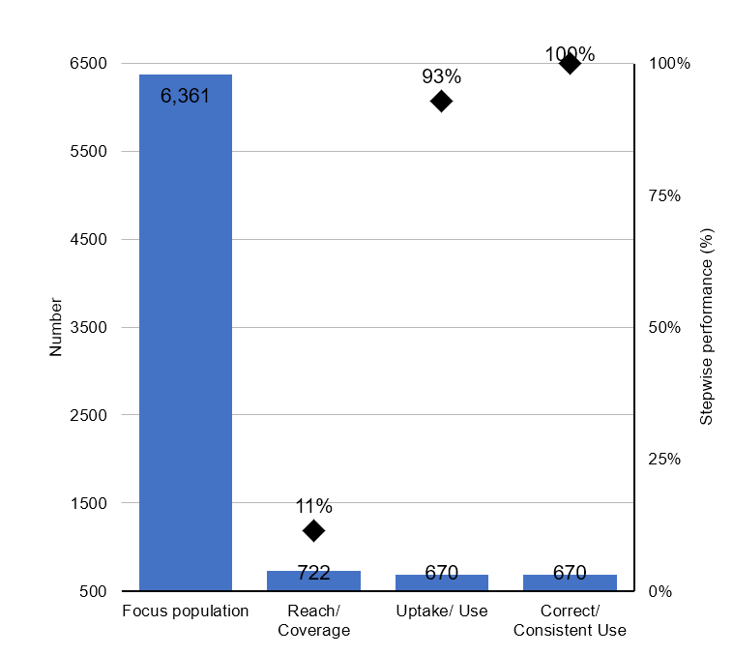
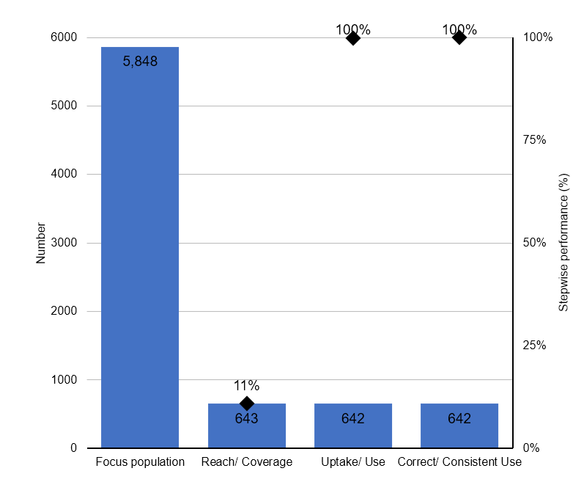
MSM PreP Sub-National Cascades by Regions – Major Drivers
Ashanti Region
Bono Region

Slide 32
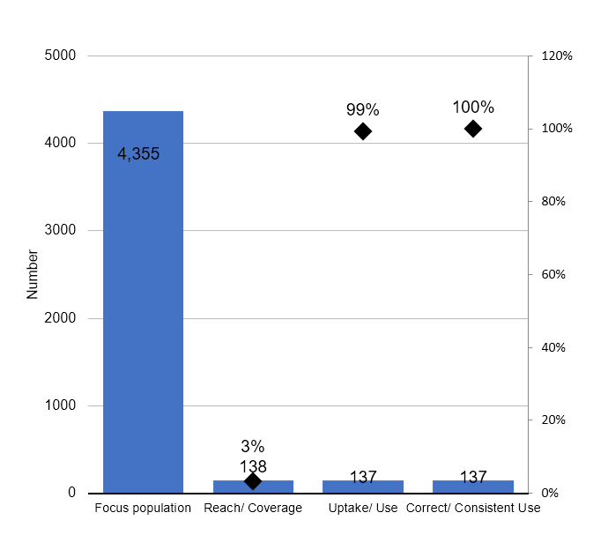
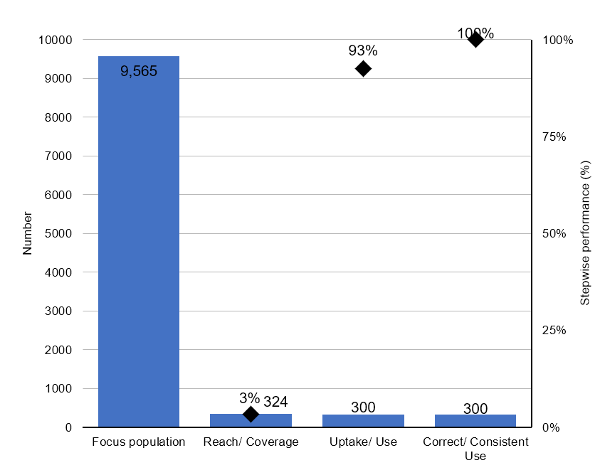
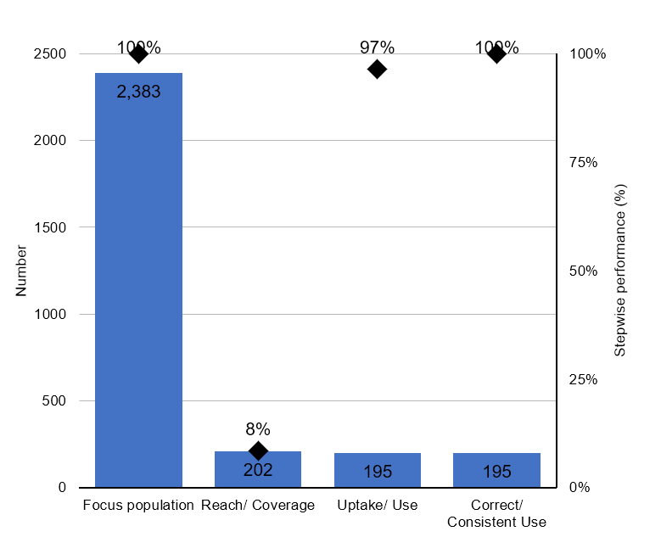
Greater Accra Region
Northern Region

Slide 33
Sub National FSW PreP Cascades

Slide 34
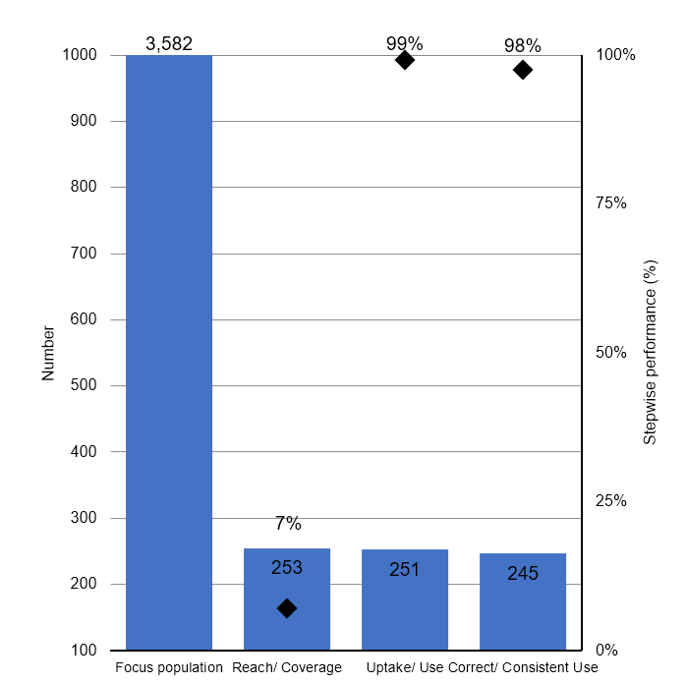
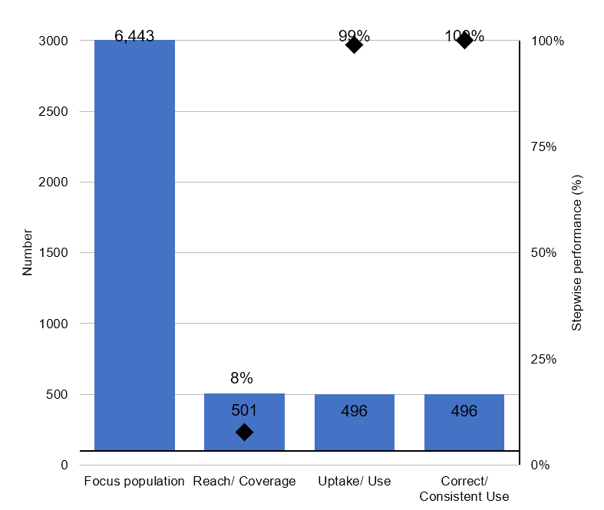
FSW PreP Cascade by Regions – Major Drivers
Ashanti Region
Bono Region

Slide 35
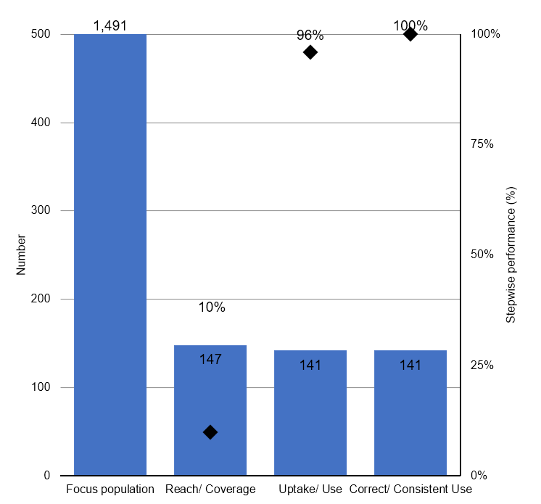
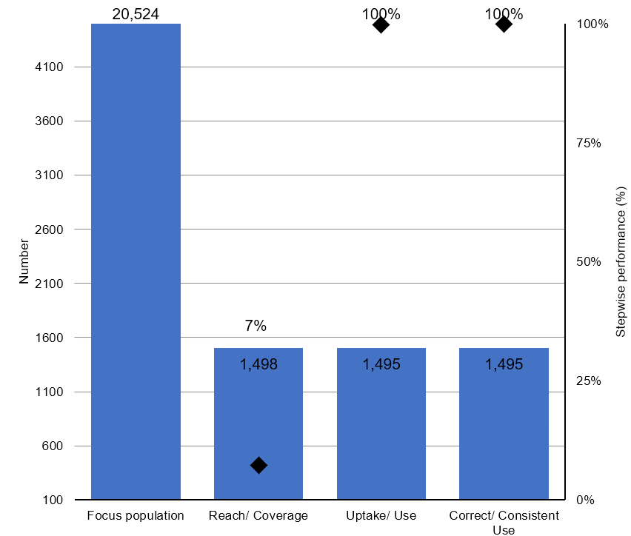
Greater Accra
Northern Region

Slide 36
FSW PreP Cascades – Monitoring PreP Uptake
National (GAC Aggregate)
JSI Supported Regions (Western, Western North and Ahafo

Slide 37
Gaps Identified
Population estimates for KPs needs regular updates
National level cascades hide a lot of detailed information & sub-national cascades reveal the intervention gaps to be addressed at level of service delivery
Access of KPs to PreP services is generally low across the country and limited to specific regions
Monitoring and reporting PreP use among FSWs need to be intensified
Quality of engagement on PreP uptake at subnational levels needs to be improved
Number of condoms distributed is not equal to number of persons receiving and using condoms
Data quality issues – number of persons vs number of attendances especially among FSWs; Access to services by clients does not disaggregate to individual client episodes.
There is no differentiation between client encounters and total client events accessing care
Supply of condoms has experienced some challenges in recent times
WAPCAS provided KP specific data on various interventions.
Data collected as a part of the package of services provided does not synchronise number of persons reached with the number of condoms distributed – number of condoms/ packs of condoms

Slide 38
Recommendations
KP populations in the regions should well delineated
Intervention approaches should be reconsidered
Unique identification needed for FSW given their highly mobile status
Standard indicators for prevention should be agreed to ensure data collected reveal robust implementation outcomes when used to develop the cascades.
Gaps identified in outcomes in the various cascades should be discussed with all stakeholders and appropriate action taken to resolve them programmatically
Methods of collecting service data at points of service delivery should be improved for interventions such as condom utilization. This could be done through anonymous exit surveys using electronic tablets at the end of each service delivery visit.
Programme implementors and Ghana Health Service should collaborate with the private sector to estimate condoms distributed through their outlets such as from pharmacies.
This activity should be conducted annually and preferably using service delivery data to reflect the true state of outcomes of interventions being implemented.

Slide 39
Acknowledgements
Ghana AIDS Commission (GAC)
National AIDS/STI Control Programme (NACP)
The Global Fund for AIDS, TB & Malaria (GFATM)
President's Emergency Plan for AIDS Relief (PEPFAR)
Global HIV Prevention Coalition (GPC)
West Africa Program to Combat AIDS and STI (WAPCAS)
FHI360
John Snow Inc. (JSI)
Hilly Consult Team

Slide 40
Thank You

