Slide 1


Virtual Interventions & AI Approaches for HIV Prevention
Purvi Shah · Regional Consultant, WHO
purvi.shah@who.int

Slide 2
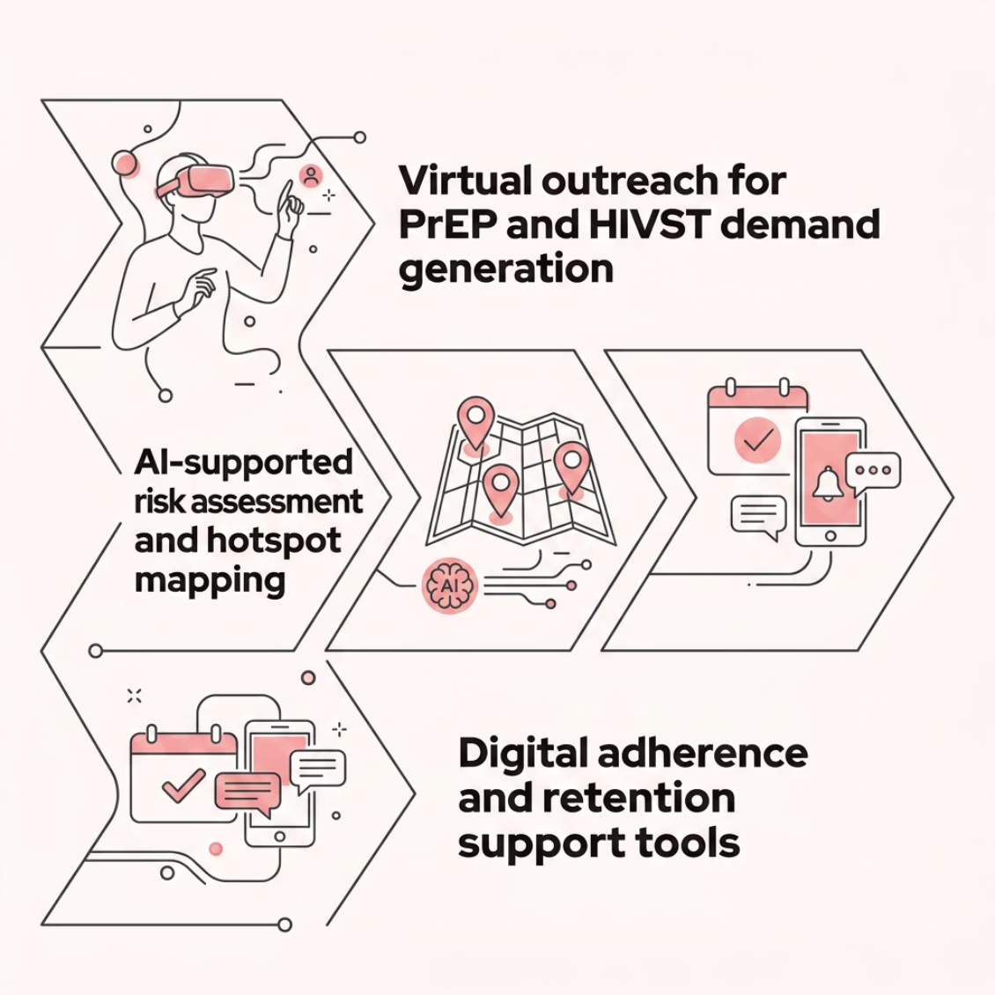

Why Digital & AI Matter for HIV Prevention
Core Mandate: Maximizing impact with constrained resources
Digital tools and AI are not just supplementary; they are delivery
platforms and efficiency multipliers for high-impact prevention.
Digital Health and AI enable:
Precision Targeting
Demand Generation at Scale
Differentiated Service Delivery
Identify and reach key populations and hidden networks with AI-driven risk stratification and hotspot mapping.
Virtual outreach for PrEP & HIVST, especially among youth and populations with limited facility access.
Blended virtual and community-based models with digital adherence and retention tools.

Slide 3
Applying Digital & AI within Prevention Tools
Programme Design
PrEP & Prevention Implementation
Use AI and data platforms to identify high-incidence geographies and networks.
Refine micro-targeting strategies and integrate virtual interventions into outreach models for key and priority populations.
Enable digital client journeys: online risk screening → e-referral → service uptake.
AI-powered chatbots and reminders support adherence, while predictive analytics drive commodity demand planning.
Resource Estimation & Optimization
Monitoring & Accountability
Model cost-efficiency of virtual vs. physical outreach and blended delivery.
Use data-driven insights to improve allocative efficiency across prevention programmes.
Real-time dashboards tracking uptake, retention, and drop-offs.
AI-generated early warning signals flag underperformance before it becomes a gap in coverage.

Slide 4

What Countries Should Do Now
1
2
3
4
Make It Explicit in Proposals
Prioritize High-Impact Use Cases
Ensure Enablers Are in Place
Link to Impact & Efficiency
Demonstrate how digital and AI reduce cost per person reached, improve coverage and retention, and strengthen accountability.
Include virtual interventions and AI use cases under prevention systems strengthening and demand generation.
Virtual outreach for key populations, digital PrEP pathways, and AI for targeting and programme optimization.
Data governance, ethical AI frameworks, interoperable digital systems, and capacity building at national and community levels.
Digital and AI investments must be framed as strategic, measurable, and accountable—directly tied to coverage, efficiency, and epidemic control targets.
↓
Cost per Reach
Digital pathways reduce cost per person reached vs. physical-only models

Slide 5
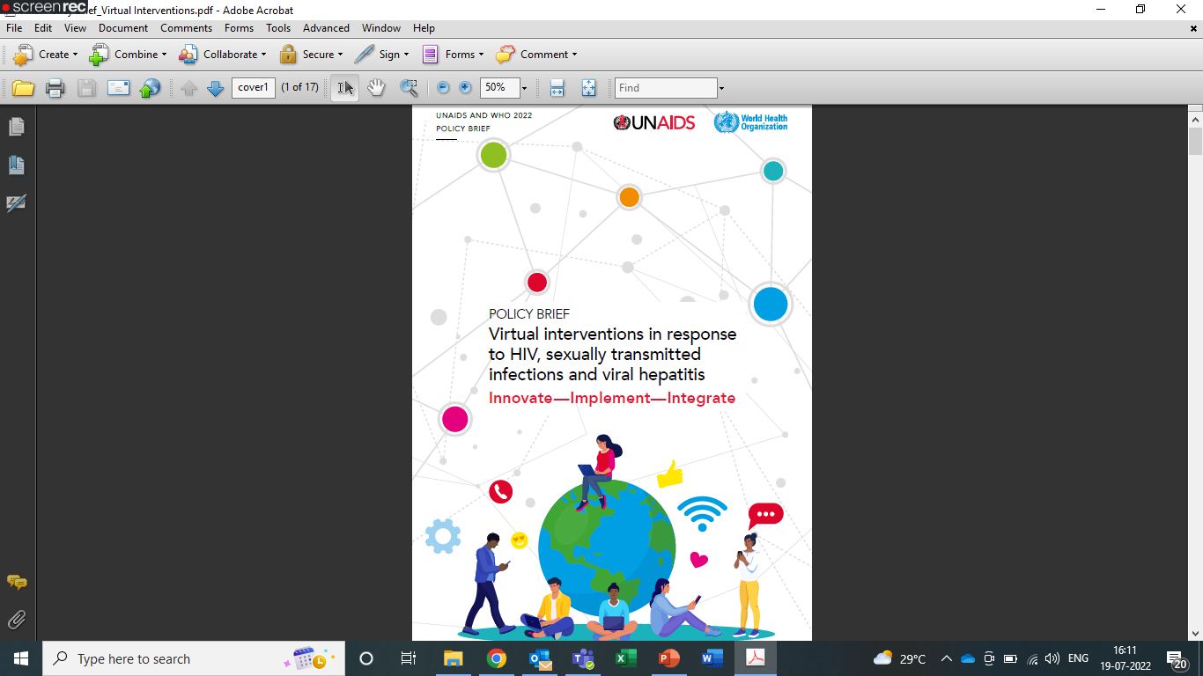
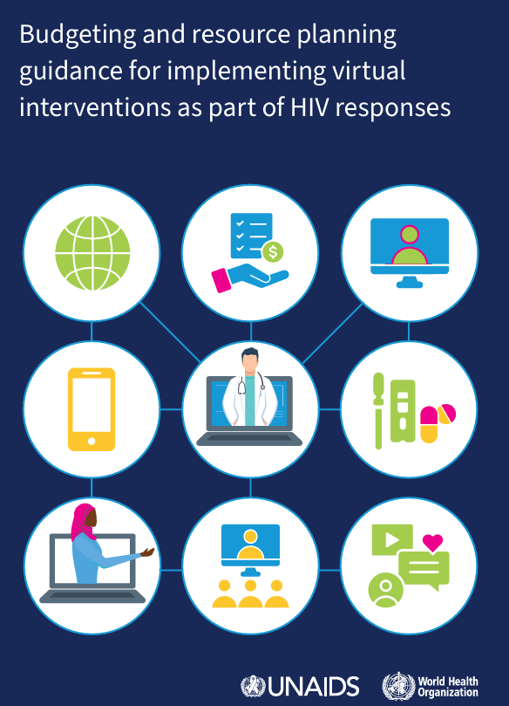

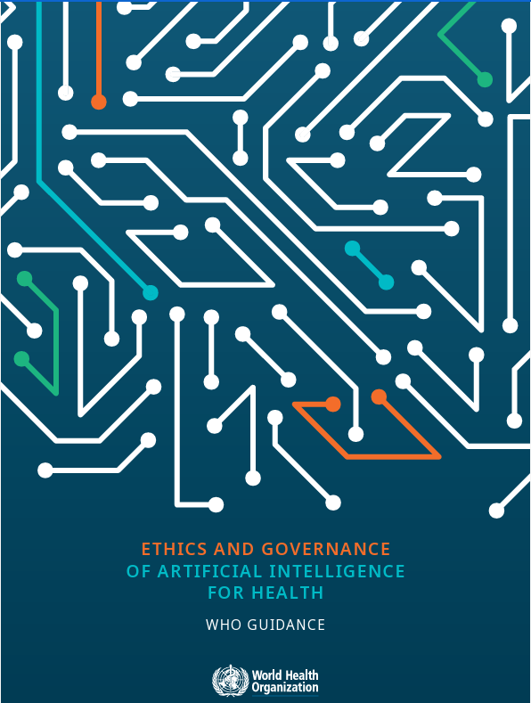
Products on Digital health by WHO

Slide 6
Thank you
Connect: purvi.shah@who.int

