Slide 1
2024/25 HIV estimates process - Tools to view current VMMC estimates - Steps to update these estimates
Ian Wanyeki
Data for Impact
UNAIDS, Geneva

Slide 2
Estimates are a cornerstone of the HIV response
2021 UN Political Declaration on HIV/AIDS
Calls on countries to end AIDS by 2030
Achieve key targets including 95-95-95
End inequalities faced by communities and people affected by HIV
The estimates are critical for understanding the HIV epidemic and guiding national responses
Tracking progress in the HIV response
Reporting on SDG 3.3
Developing national strategic plans and setting targets
Identifying inequalities in the response
Mobilizing resources
Guiding PEPFAR country operational planning
Advocacy and global reporting
Notes:
Estimates are essential for tracking progress in national HIV responses, for developing national strategic plans, reporting on Sustainable Development Goal 3.3 on HIV incidence, mobilizing resources for the HIV response, and reporting on progress to the Global Fund and other donors. For countries receiving PEPFAR funding, the workshops also produce the estimates required for country operation planning

Slide 3
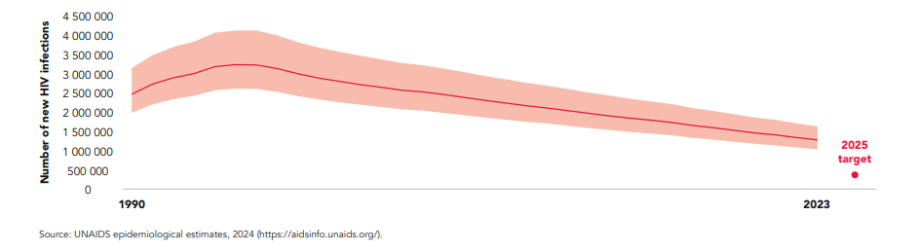
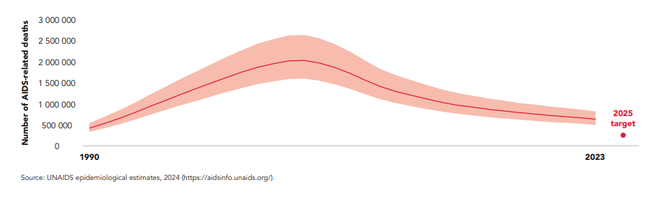
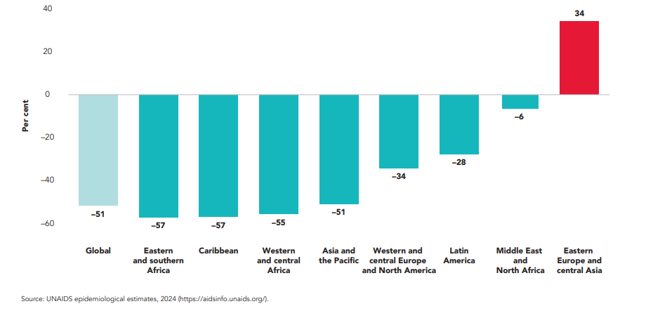
Progress in epidemic trends
Number of new HIV infections, global, 1990 – 2023
Number of AIDS-related deaths, global, 1990 – 2023
Percentage change in AIDS-related deaths between 2010 and 2023
Notes:
Reporting on Sustainable Development Goal 3.3 on HIV incidence and mortality

Slide 4
Estimation process for 2024/2025
Region | Location | Dates | Countries
ToT (generalized) | Online | 18-20 Nov 2024 | Facilitators
East Africa + WCA (anglophone) Southern Africa | Johannesburg | 2-6 Dec 2024 9-13 Dec 2024 | Eritrea, Gambia, Ghana, Liberia, Sierra Leone, Lesotho, Nigeria, Rwanda, South Sudan, South Africa, Uganda, Tanzania, Zanzibar; Angola, Ethiopia, Kenya, Malawi, Botswana, Mozambique, Namibia, Eswatini, Zambia, Zimbabwe
WCA + francophone MENA | Lomé | 27-31 Jan 2025 (generalized) 3-7 Feb. 2025 (concentrated) | Benin, Burkina Faso, Central African Republic, Chad, Congo, Equatorial Guinea, Guinea, Guinea-Bissau, Gabon, Togo, Cameroon, Cote d'Ivoire, Dem Rep Congo, Burundi, Haiti, Mali; Cape Verde, Comoros, Madagascar, Mauritius, Mauritania, Niger, Senegal, Sao Tomé, Morocco, Djibouti, Tunisia, Algeria

Slide 5
Timelines for 2024 / 2025
Oct- Jan 2024 Data prep and verification
1 Dec 2024: Updated version of Spectrum (and other supporting models/tools)
2-13 Dec 2024: First workshops in Johannesburg
30 Jan 2025: PEPFAR supported countries: Includes all VMMC countries
Preliminary files sent to UNAIDS
20 Feb 2025: UNAIDS feedback sent so countries – information to be used in COP planning
31 March 2025: GAM submission
1 May 2025: Estimates approved by senior managers

Slide 6
The various tools and functions
# | Tool and link | Function
1 | District health information systems (DHIS) | Storage and management of aggregate health data disaggregated by subnational units
2 | AIDS data repository | A centralised platform with tools to help countries manage and share their HIV and VMMC related data used for national HIV estimations
3 | Spectrum AIDS impact model (AIM) EPP Shiny 90 | Generates national HIV estimates. Projects the consequences of the HIV epidemic, including the # of people living with HIV, new infections, and AIDS deaths by age and sex A model used in generalised epidemic countries to estimate incidence trends from prevalence Generates estimates of the 1st 90 “ what % of people living with HIV know their status”
6 | Naomi | Generates sub national HIV estimates using small area estimates principles. Also generates key indicators used in the PEPFAR datapack (target setting tool) Reviews trends in subnational ART and ANC data to be used within Naomi and provides visual quality checks
7 | DMPPT | A monitoring and planning tool that generates coverage estimates and target impact projections for VMMC programs
8 | Target setting tool | Assists PEPFAR country teams in setting targets for COP
9 | HIV sub-national estimates viewer | Allows viewing of final approved subnational estimates on an annual basis. Includes circumcision indicators
Pull from DHIS to ADR

Slide 7
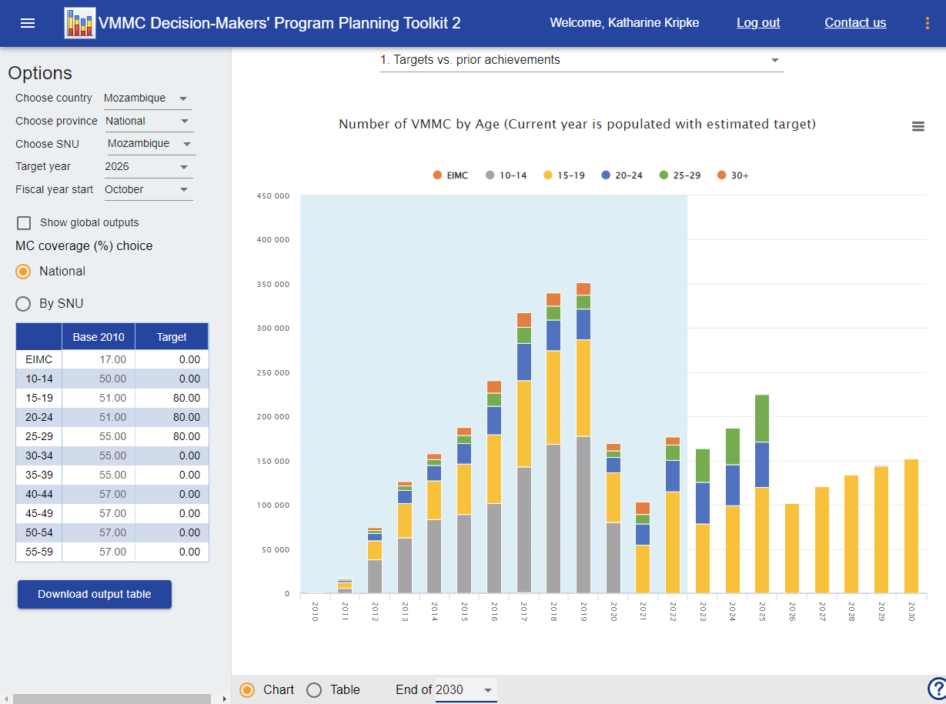

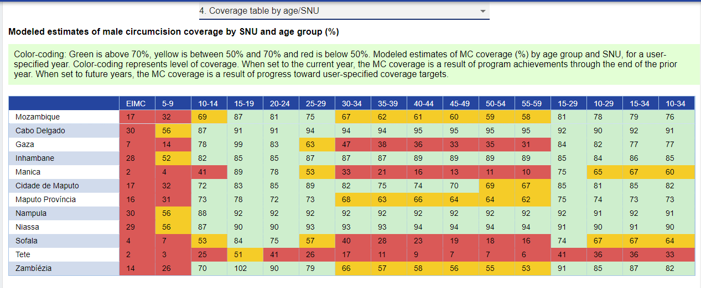
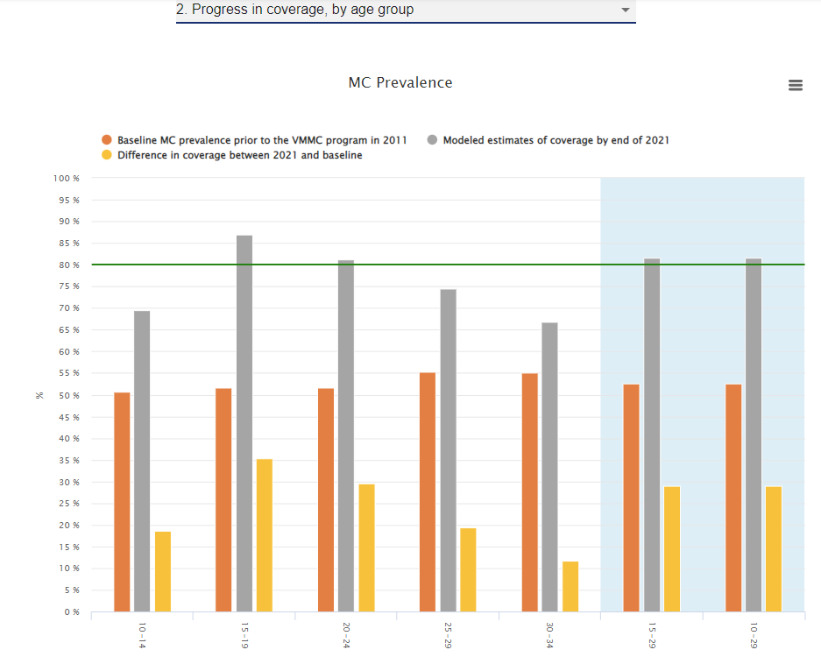
The DMPPT 2 Online allows country teams to generate VMMC targets and analyses
Freely available at
www.vmmcipt.org
Maintained by Avenir Health
For questions, contact
VMMC-Avenir@GoogleGroups.com
The Decision Makers’ Program Planning Toolkit (DMPPT) 2 Online
Notes:
After years of development in collaboration with users in VMMC priority countries, an online version of the DMPPT 2 was launched in 2017.

Slide 8
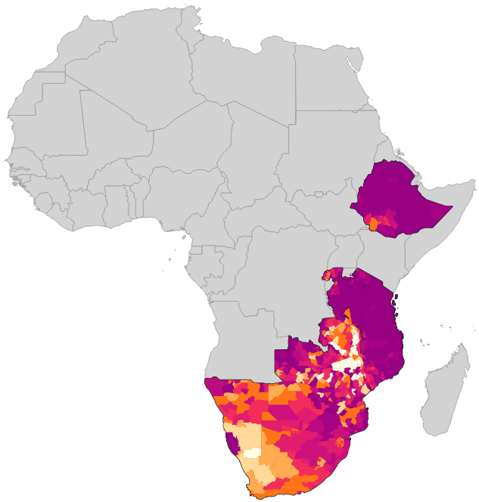
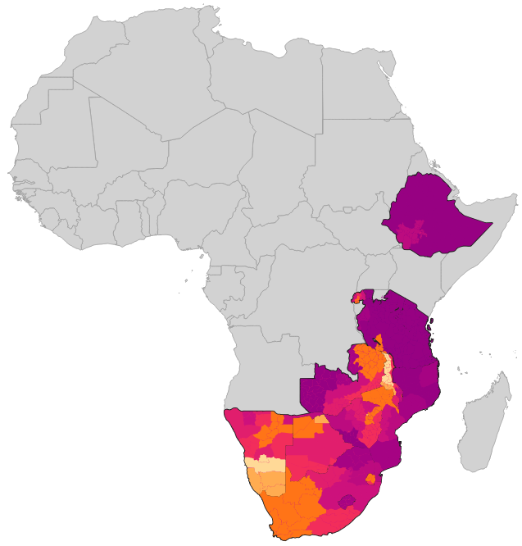
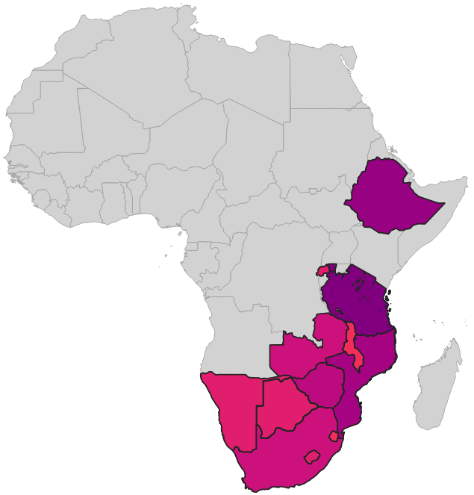
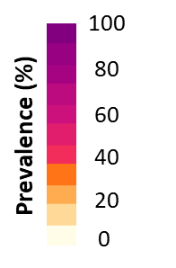
HIV sub-national estimates viewer
VMMC coverage at the national and subnational levels in VMMC priority countries, data from 2021
Admin level 2
Admin level 1
National
Source: Special analysis by Avenir Health using the DMPPT2. VMMC and estimates data source
Note: Countries with available data: Botswana, Eswatini, Kenya, Lesotho, Mozambique, Rwanda, South Sudan, United Republic of Tanzania, Zambia, Zimbabwe.
Notes:
A significant number of districts or subnational areas are still far from reaching the VMMC 90% coverage

Slide 9
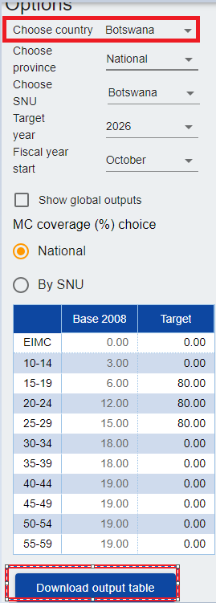
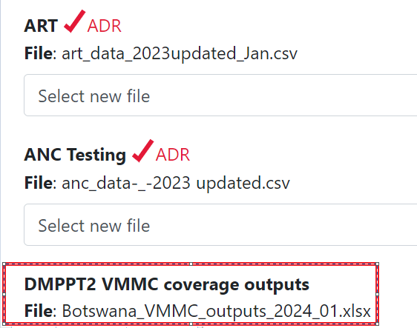
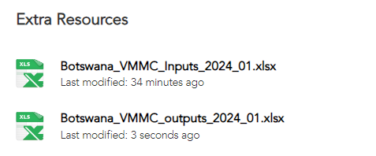
Upload the completed VMMC output file to ADR, run Naomi and generate your datapack
Run Naomi and ensure the VMMC file is loaded at step 1
Load the output VMMC file back into ADR
Use the Output file during the subnational estimation process to generate a data pack which include VMMC indicators

