Slide 1
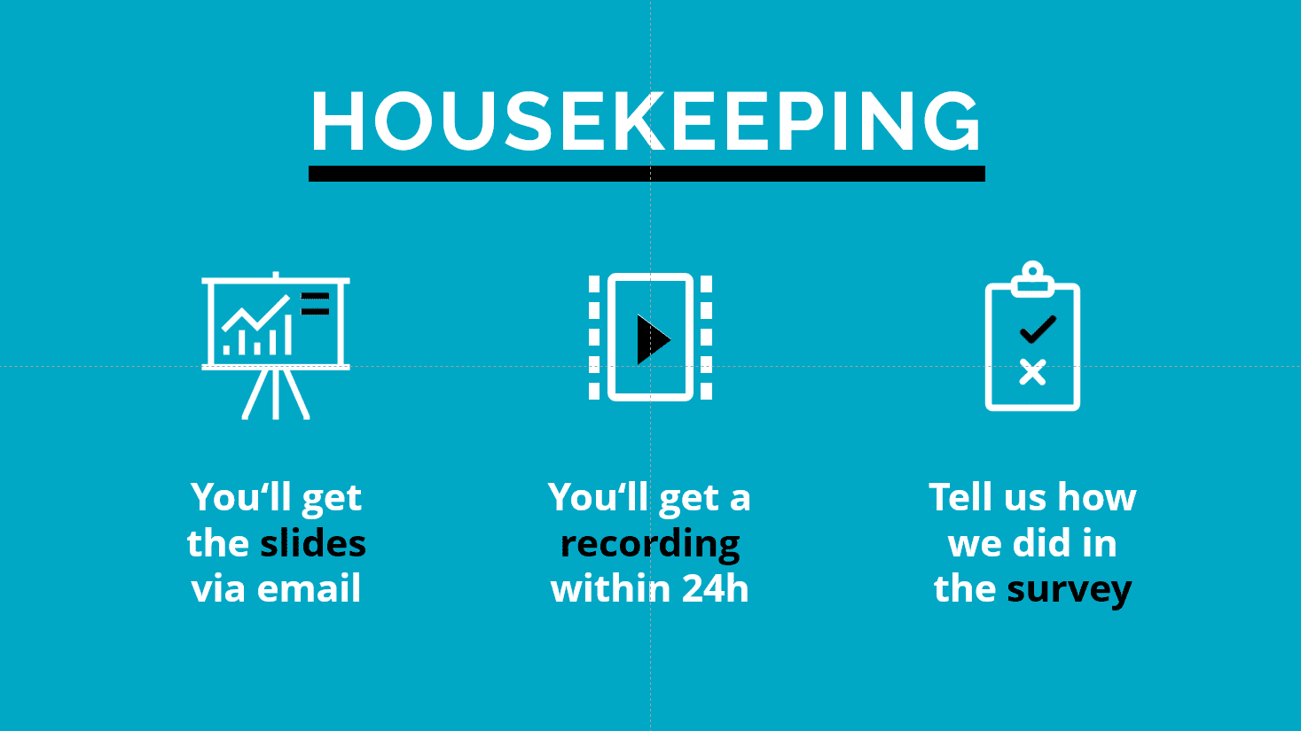





Modeling the Impact and Cost-Effectiveness of VMMC in HIV Prevention
Welcome
You will get all the slides after the webinar
Let us all engage and have a good discussion
Date: 21 November 2024
Time: 14h00 – 16h00 CET
Languages: English

Slide 2
This webinar aims to
  Present the results of VMMC modeling work, highlighting its impact, cost-effectiveness, and projected future role in HIV prevention.
  Facilitate dialogue among VMMC stakeholders, including global health organizations, donors, government representatives, and program implementers, to discuss the implications of these results.
  Identify opportunities for aligning VMMC efforts with other biomedical and behavioral prevention interventions while addressing sustainability and funding challenges within the evolving landscape of HIV prevention strategies to ensure optimal outcomes.

Slide 3


Webinar outline
1
Welcome and opening remarks – Lycias Zembe, GPC, UNAIDS
2
Impact and Cost-Effectiveness of VMMC: Key Findings from the Modeling Work– John Stover, Avenir Health
3
Country Perspectives:
VMMC in National HIV Prevention Strategies – Sinokuthemba Xaba, Zimbabwe and Peter Mudiope, Uganda
Analyses to inform a sustainable VMMC program in Kenya– John Davis, Avenir Health
5
Panel Discussion: Implications for VMMC Programs and the Future of HIV Prevention– WHO (Ameyan Wole), UNAIDS (Lycias Zembe), PEPFAR (Sarah Nabukera) , Havard University (Jeff Eaton), Avenir Health (John Davis and Katharine Kripke), Bill and Melinda Gates Foundation (Maaya Sundaram), Kenya MoH (Ambrose Juma)- Facilitated by Angelo Kaggwa, AVAC
6
Q & A– Facilitated by Angelo Kaggwa, AVAC
7
Closing remarks –Teboho Madidimalo, WHO, AFRO, Botswana

Slide 4
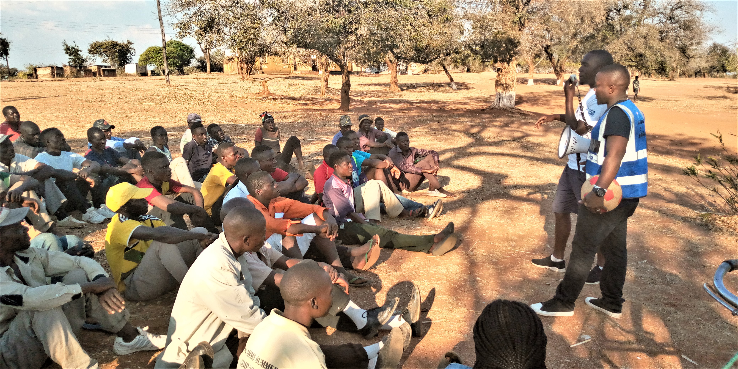
VMMC is an empowering intervention for men
VMMC decreases a man's risk of acquiring HIV through heterosexual intercourse by approximately 60%, making it a proven, cost-effective, and one-time intervention that offers:
Lifetime protection for the individual, requiring no ongoing effort or behavioral change from the client or additional resources from the healthcare system.
Significant population-level impact, enhancing HIV prevention outcomes regardless of shifts in the broader HIV prevention and treatment environment.
Men empowerment on
  Safer sex
  Condom education and provision,
  Knowledge of their HIV status through HIV testing and linkage to care and treatment if found positive
  Managing sexually transmitted infections

Slide 5
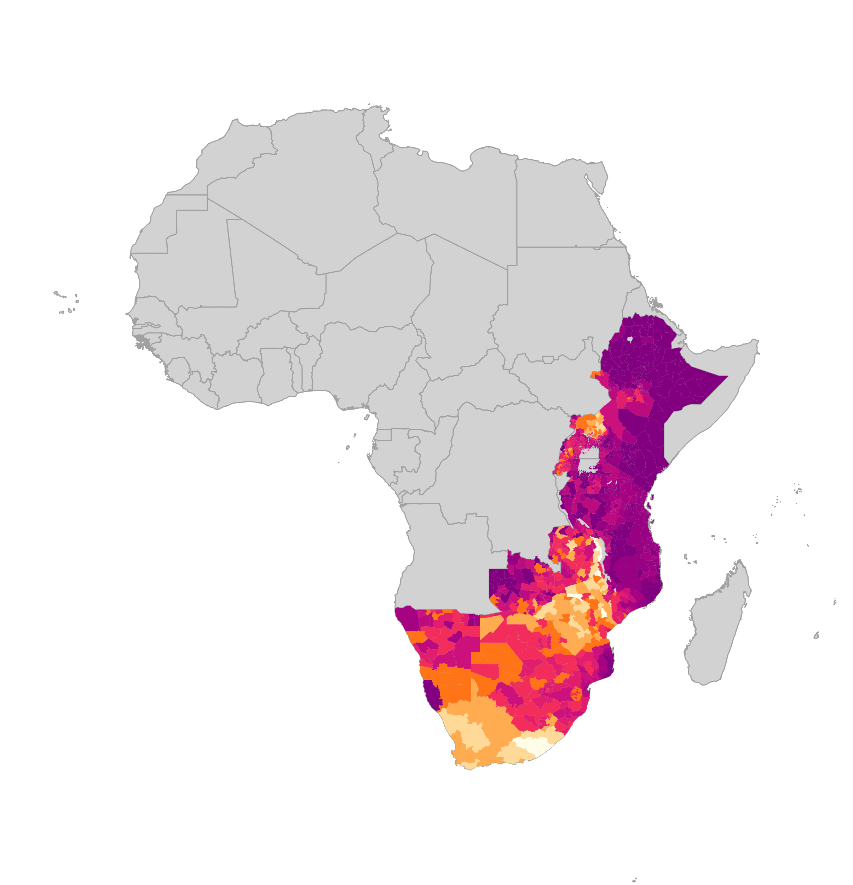
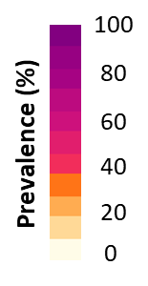

37.5 million men and boys accessed VMMC package of services by 2023 - But VMMC, coverage for men & boys remains far from global targets
Number of men and boys accessing VMMC package of services
Estimated coverage of VMMC among men 15-49
Global HIV Prevention Coalition promotes an integrated combination and male SRH pillar approach for boys and men including HTS/ART and gender-transformative approaches
VMMC coverage remains far from reaching the 90% 2025 targets –and no full recovery after COVID-19 in terms of uptake and persistent funding gaps
Sources: Coverage maps- special analysis by Avernir Health through the UNAIDS-led VMMC data workstream. Analysis done using DMPPT2 Tool and integrated 3MC model using data up and until 2023. VMMC progress over time: UNAIDS Global AIDS Monitoring, 2023; www.aidsinfo.unaids.org)

Slide 6
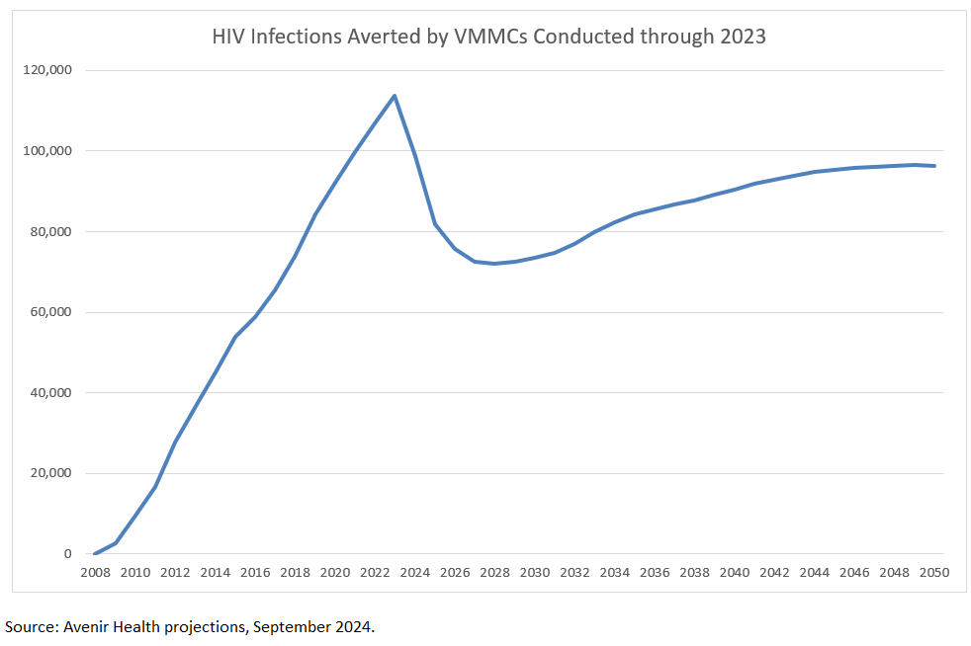
Close to a million new HIV infections have been averted through VMMCs conducted to date (2023) since programme inception in 2008
New HIV infections averted by VMMC conducted through 3023
886,495 new HIV infections averted between 2008 and 2023 by the 37 million circumcisions conducted during that period – this represents one infection averted for every 42 VMMC conducted
Through 2030 the number of infections averted from the circumcisions already conducted will climb to 1.4 million – this represents one infection averted for every 26 VMMCs conducted
The benefits of circumcisions already conducted will continue far into the future – by 2050 the cumulative impact will reach 3.2 million infections averted – representing 12 VMMCs per infection averted
The results are based on applying the GOALS HIV model in 13 countries (Botswana, Eswatini, Kenya, Lesotho, Malawi, Mozambique, Namibia, Rwanda, South Africa, Tanzania, Uganda, Zambia and Zimbabwe. The projection for each country uses circumcisions through 2023 and assumes no more VMMC after 2023. The counterfactual scenario assumes that no VMMC program ever existed. Infections averted are the difference in new infections between the two scenarios.
Both scenarios include actual number of ART patients through 2023. After 2023, both scenarios assume the same constant ART coverage. There are more PLHIV in the counterfactual due to absence of VMMC. If we were to assume lower ART coverage in the counterfactual due to limited treatment capacity, our calculated VMMC impact would be nearly 50% greater. Therefore, our results may be conservative.

Slide 7
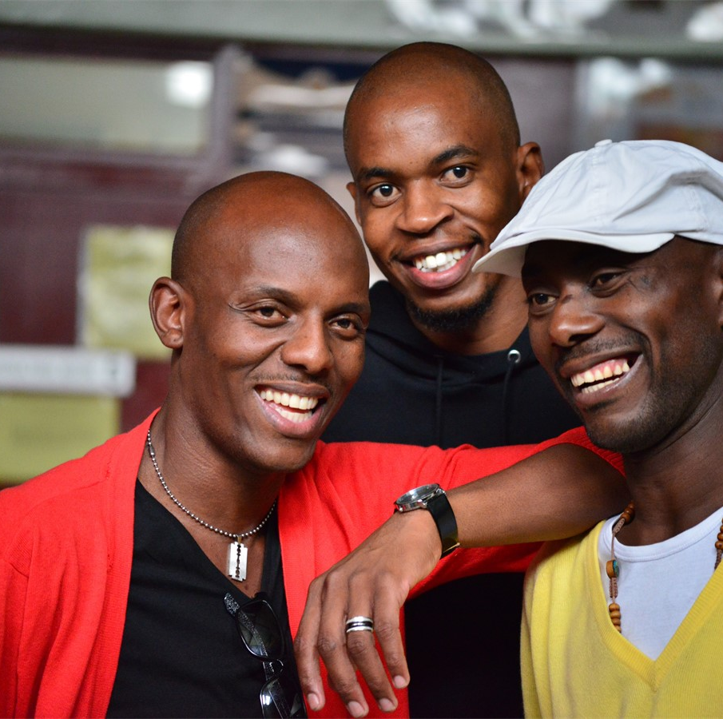
Integration of VMMC data with HIV estimates
UNAIDS supports countries to produce HIV estimates every year between December and February.
The process starts with a thorough review of the data being entered into the models during the first weeks of the year as the HMIS data are available.
At that point UNAIDS and partners support country estimates teams to use Spectrum to produce modelled estimates. Every other year UNAIDS hosts workshops (from January to February) to train country teams on how to use the estimates models.
The timeline allows the country teams to have the data available for NSPs, PEPFAR Country Operational Planning and Global Fund applications in early February.
The UNAIDS HIV epidemiological estimates use district level population data to estimate PLHIV, antiretroviral treatment coverage, HIV incidence, and other indicators. VMMC data would improve the incidence estimates for recent years, especially for men (given the indirect and delayed effect on women).
Based on discussions with partners, the UNAIDS Reference Group on Estimates Modeling and Projection has recommended to include the development of estimates of VMMC coverage into the HIV estimates process.

Slide 8
VMMC data workstream objectives
  To conduct a unified VMMC programme data review (including data quality review) and coverage estimation process that includes stakeholders, is validated, and cross-harmonized
  To produce annual district level coverage estimates of VMMC among men 15-49, including disaggregations, that are readily available for country and supporting partner programme planning and decision making

Slide 9
QUESTIONS

