Slide 1

VMMC In HIV Prevention – Perspectives from Zimbabwe
Presented by Sinokuthemba Xaba
Deputy HIV Prevention Coordinator
Ministry of Health and Child Care
November 2024

Slide 2
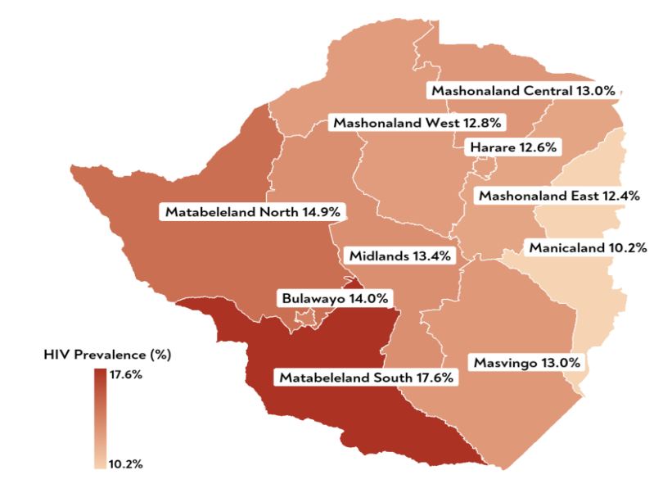
Snapshot of the HIV Epidemic in Zimbabwe
HIV and AIDS emerged as a public health threat in Zimbabwe in the mid-1980s and remains one of the top heavily burdened countries. In Zimbabwe the epidemic is largely driven by unprotected heterosexual sex, with growing epidemics among key population groups at higher risk of HIV.
Key Epidemic Metrics (2020)¹
People Living with HIV – 1.3 million
HIV Prevalence (adults 15+) – 12.6% Young women aged 15-24 – 5.6% (young men – 3.0%) Key Populations- disproportionally high
New HIV Infections – 25,000 Young women aged 15-24 – 7,200 Young men aged 15-24 – 2,300
AIDS related deaths – 22,000
HIV Prevalence by Province²
¹ UNAIDS AIDSInfo, 2020
² Zimphia, 2020

Slide 3
Epidemic Profile | Zimbabwe has reached epidemic control
Key Observations
The country has an estimated 1.3 million people living with HIV (PLHIV), of which 60% are females, 6% are children aged 0-14 years old, and 9% are adolescents and young people aged 15-24 years.
Key populations reported a higher HIV prevalence: sex workers (42.2%), transgender people (27.5%), and men who have sex with men (21%) (UNAIDS,2022)

Slide 4
Overview of HIV Prevention Interventions Available in Zimbabwe
Dapivirine Vaginal Ring (DVR)
MCAZ approved DVR for women in July 2021, and MOHCC recommends that it should be implemented under research.The flexible silicone ring slowly releases the ARV drug dapivirine in the vagina, with minimal absorption elsewhere in the body.
PEP programme Established in 2016
PEP is the only way to reduce the risk of HIV infection in an individual who has been exposed to HIV. PEP can reduce the risk of HIV infection by over 80% .
2020
2016
Daily Oral PrEP programme Established in 2016
High adherence to daily oral PrEP reduces the risk of HIV by over 90%. Daily oral PrEP cumulative initiations have exceeded 79,918, as at 2022.
HIVST programme Established in 2015
57 out of 63 districts are implementing HIVST as an innovative approach to expand the reach of HIV testing services.
2015
VMMC programme Established in 2009
VMMC reduces the risk for heterosexually acquired HIV infection among males by ~60%. Impact modeling conducted in 2016 showed 2,600-12,200 infections (among men and women combined) had been averted and this was expected to grow.
2009
Treatment programme Established in 2004
Zimbabwe is on track to reaching the 95-95-95 target by 2030, with 97.0% of PLHIV initiated on ART and of those initiated 90.3% had suppressed viral loads.
2004
PMTCT programme Established in 2002
Zimbabwe has achieved 99% testing coverage of all pregnant women and 93.5% of HIV-positive pregnant women on ART in 2019.
2002
HTS programme Established in 1992
HTS is the entry point to all HIV prevention programmes. There is increased acceptance of HTS, with 86.3% of PLHIV knowing their status in 2020.
1992
Condoms programme Established in 1990
Consistent and correct use of condoms can reduce HIV acquisition by up to 97%. Uptake of female condoms remains low at 0.1%. Zimbabwe is one of only five countries to meet or exceed UNFPA’s regional benchmark of 30 condoms/man/year.
STI programme Established in 1990
The presence of an untreated STI increases the risk of HIV infection. Integration of routine STI management with reported cases declining by 70% in 2020.
1990

Slide 5
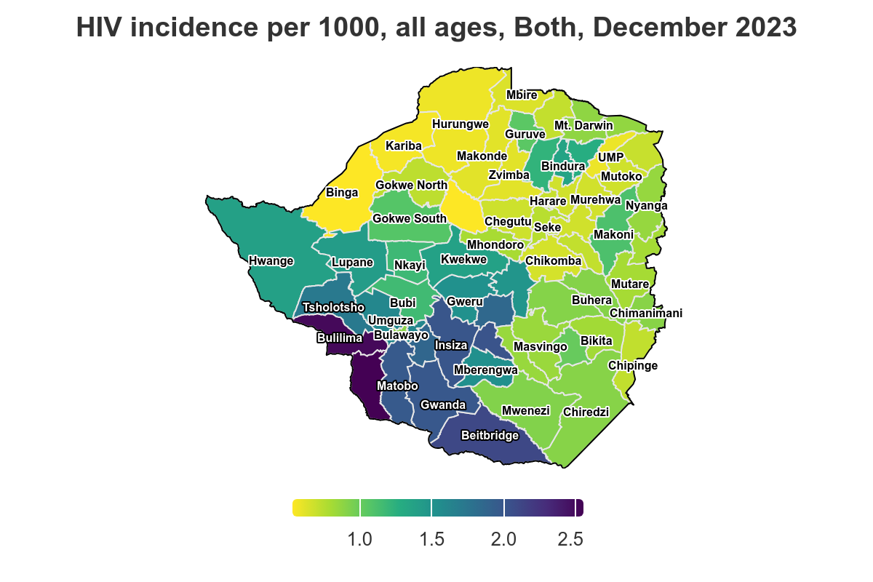
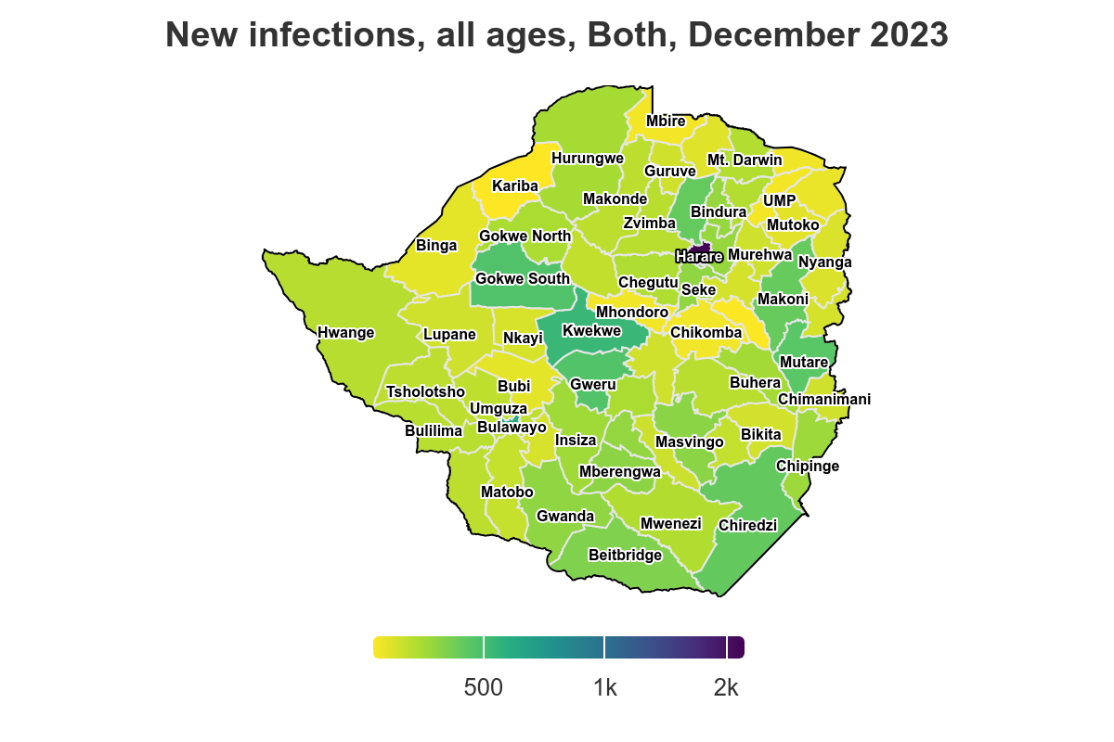
Disease Burden| There is further variation in HIV incidence and the volume of new infections by geography
Key Observations
High HIV incidence districts (southern region) do not have an absolute burden of new infections. HIV incidence ranged from 2.55 (Mangwe) to 0.53 (Sanyati).
In 2023 15,574 new HIV infections were report, with children (0-14) accounting for 23%, total females (all ages) accounting for 60%, and adolescent girls and young women (AGYW 15-24) contributing 22%.
Notes:
Source: Naomi Spectrum September 2023

Slide 6
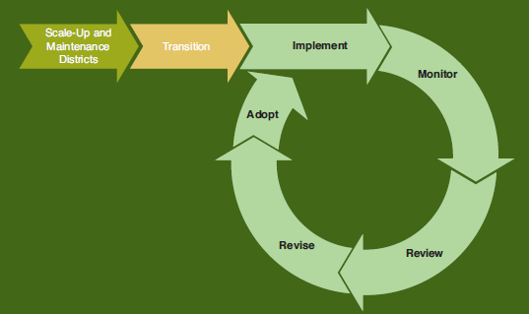
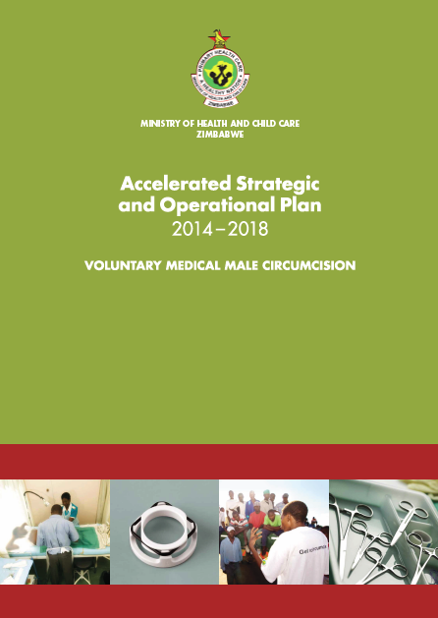
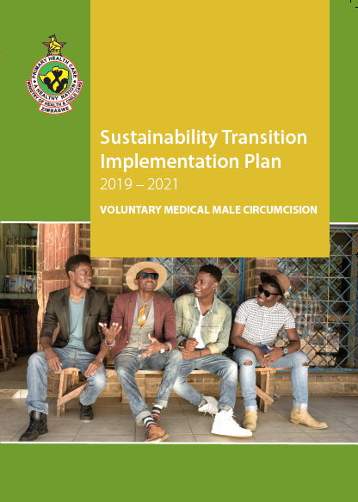

From a Vertical MC Program to Integrated Px Programming
2014: VMMC Accelerated Strategic Costed Operational Plan, focused on increasing MC coverage to 80% in the priority age groups
2019: Sustainability Transition Implementation Plan (STIP) 2019 – 2021), aimed to maximize the long-term impact of VMMC through scale-up targets and sustainable coverage.
From a vertical VMMC implementation to integrated, government-led biomedical prevention
Notes:
his approach sought to expand VMMC service coverage at the PHC-level, guide the shift to decentralized and integrated service and demand models, and learn ways for managing the transition from partner-led and vertical program management to integrated MoHCC-led program management across the core health system pillars as outlined in the STI

Slide 7
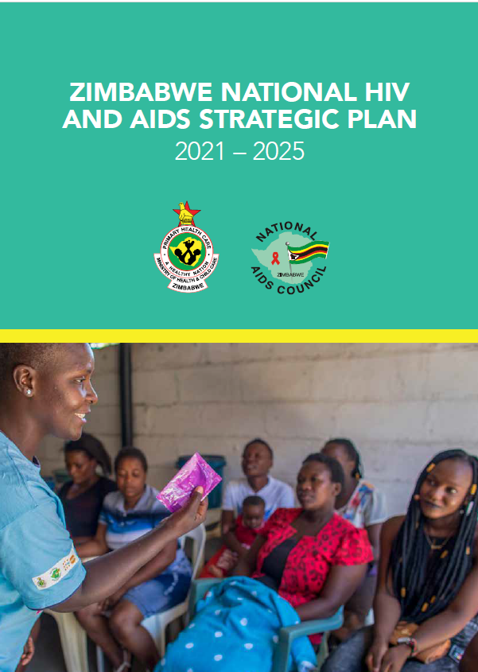



Combined HIV/STI Strategy
Vision | An AIDS free Zimbabwe generation where all populations have healthy lives and wellbeing.
Goal | To accelerate country's response towards ending AIDS as a public health problem in Zimbabwe by 2030.
Sub-Goals | To reduce HIV incidence in Zimbabwe by 50% from 0.5 in 2018 to less than 0.25 by 2025. To reduce AIDS related deaths in Zimbabwe by 60% from 21,800 in 2018 to less than 10,000 in 2025. Significantly reduce HIV and AIDS related stigma and discrimination among all populations by 2025.
From a vertical VMMC implementation to integrated, government-led biomedical prevention

Slide 8





Differentiated Prevention | The HIV Prevention Programming Mix
● For The Right People ● In The Right Locations ● With The Right Interventions ● At The Right Time ● In The Right Way ● At The Right Cost
Policy/Enabling Environment
(national, state, local laws)
Organisational
(organisations and social institutions)
The right combination and balance to inform optimal decision making for reducing HIV incidence and thereby for health impact
Community
(relationships between organisations)
Interpersonal
(families, friends, social networks)
Individual
(knowledge, attitude, behaviours)
8

Slide 9
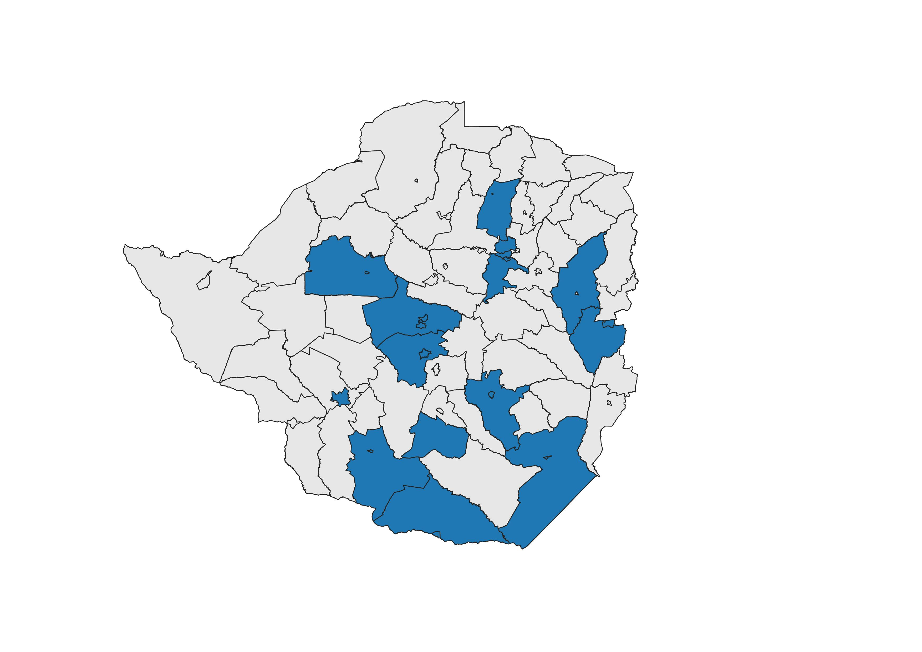
Disease Burden| Districts Contributing to the
Top 15 Districts by New HIV Infections
Key Observations
Disease burden is concentrated where there is highest population (urban areas).
The top 15 districts contribute to 48% of the total new HIV Infections.
Notes:
Source: Naomi Spectrum September 2023

Slide 10
In conclusion
VMMC remains critical to the HIV prevention package
Main avenue that reaches out to men who ordinarily have suboptimal health seeking behaviour
Its benefits transcend beyond HIV prevention to include HPV , Hygiene and some STIs
Relatively cost effective though modelling has shown reduced cost effectiveness when considered for HIV prevention only
VMMC needs to be tailored to according to the incidence
Delivery in combination with other prevention services is central to long term sustainability and effectiveness
Integration in pre-service training as well as online training approaches will be important for cost reduction and routinisation

Slide 11
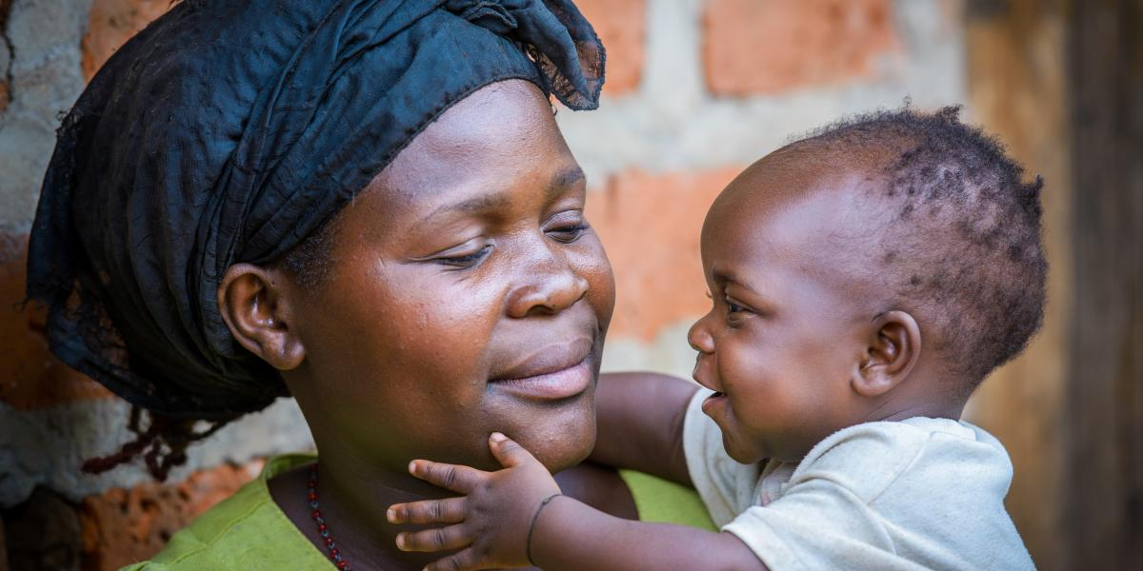
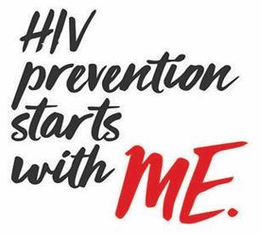
Thank You!

