Slide 1
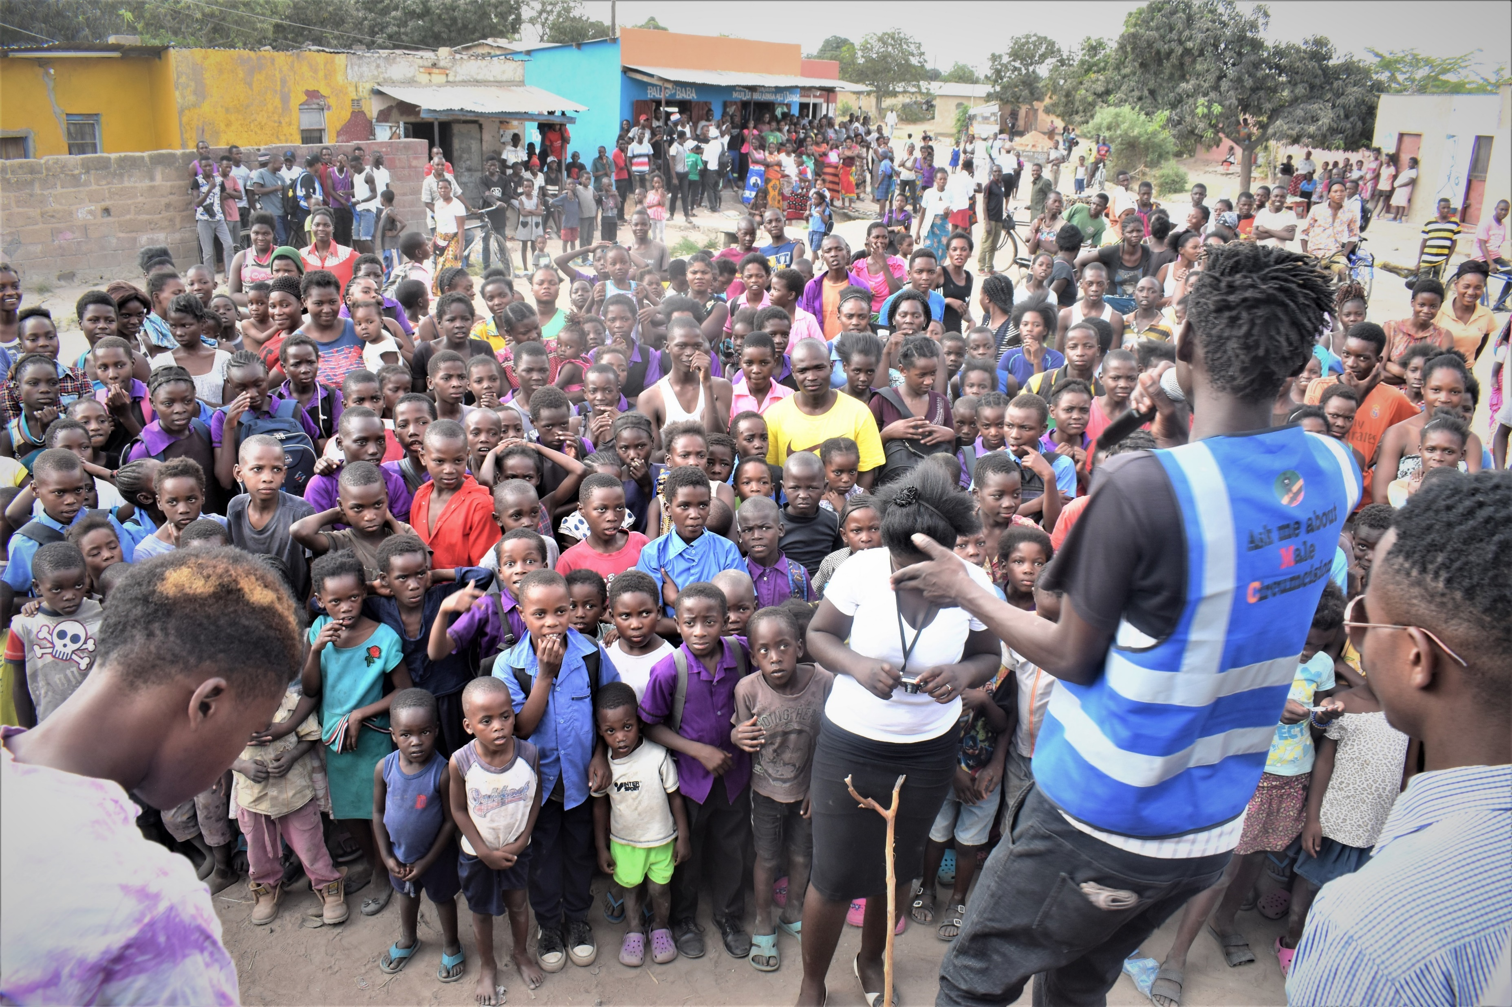

Adolescent boys and men
Combination HIV prevention packages in settings with high HIV incidence
(including voluntary medical male circumcision and linking to testing and treatment)
HIV Prevention Learning Pack: Adolescent Boys and Men

Slide 2
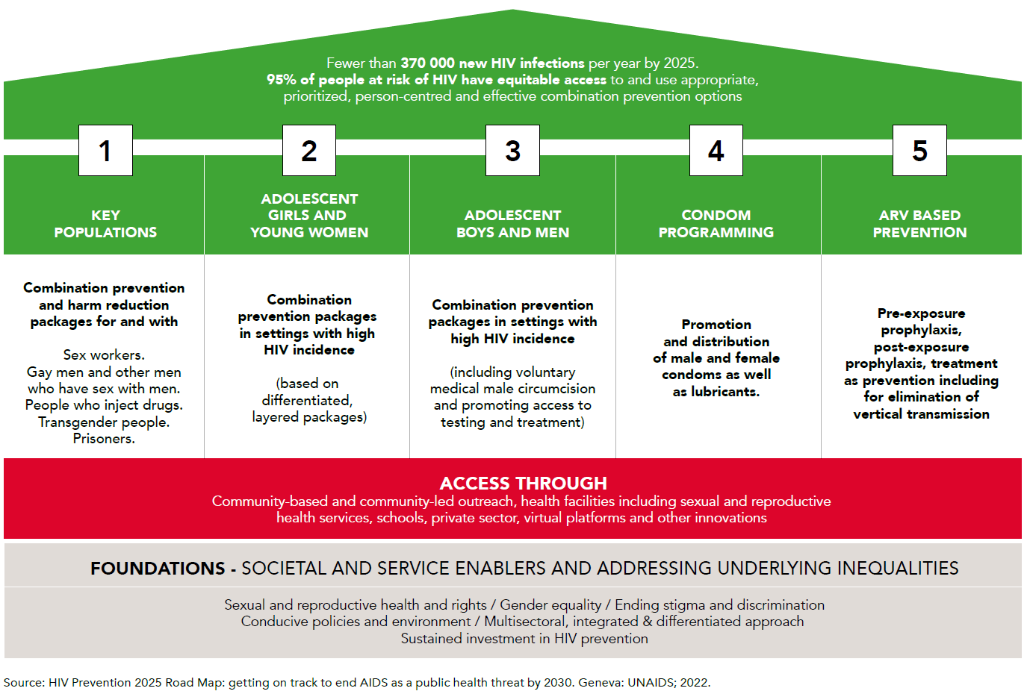
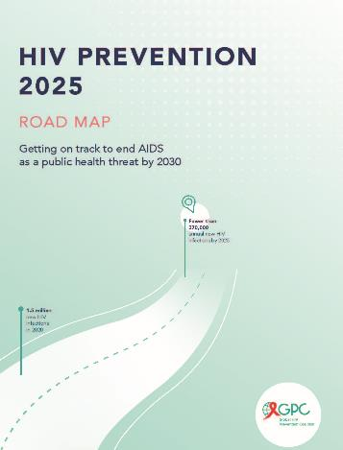
Adolescent boys and men is one of the five priority pillars in the Global HIV Prevention 2025 Road Map

Slide 3
Key Clinical Trials Leading to VMMC Recommendation for HIV Prevention (2007)
Randomized Controlled Trials (RCTs)
Orange Farm, South Africa (Auvert et al., PLOS Medicine, 2005)
  Population: 3,274 uncircumcised men
  Findings: 60% reduction in HIV acquisition among circumcised men
Kisumu, Kenya (bailey et al., The Lancet, 2007)
  Population: 2,784 men aged 18-24
  Findings: 53% reduction in HIV acquisition among circumcised men
Rakai, Uganda (Gray et al., The Lancet, 2007)
  Population: 4,996 men aged 15-49
  Findings: 51% reduction in HIV acquisition among circumcised men
Conclusive Evidence and Meta-Analysis
  Combined Analysis: Overall 55-60% reduction in HIV risk
  Consistency: Strong, statistically significant results across diverse populations
  Validation: Results supported by observational studies and biological plausibility
WHO and UNAIDS Recommendations in 2007
  Policy Implication: VMMC recommended as part of comprehensive HIV prevention strategy
  Impact: Targeted high HIV prevalence regions in Sub-Saharan Africa

Slide 4
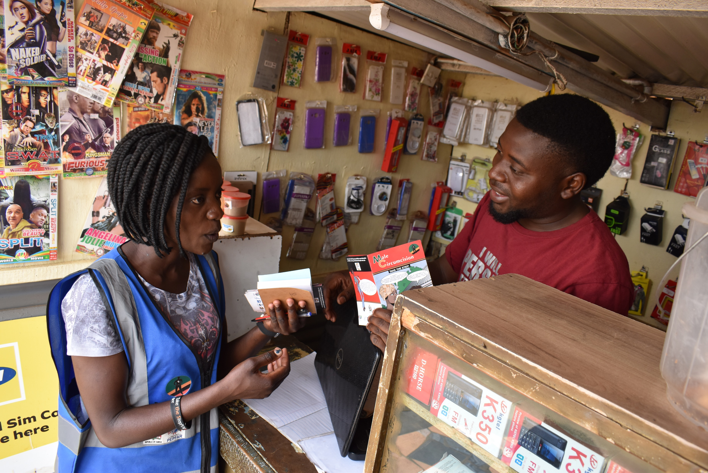
VMMC Bottom Line
VMMC reduces a man’s risk of heterosexual HIV acquisition by ~60% and is an evidence-based, cost-effective, one-and-done intervention providing
life-long individual benefit without any subsequent behavior or action on the part of the client or health care system, and
exponential population-level effects regardless of change elsewhere in the HIV treatment and prevention landscape.

Slide 5
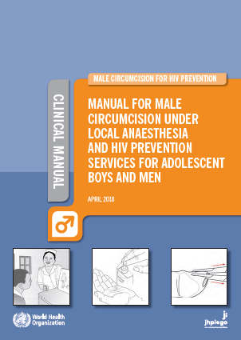
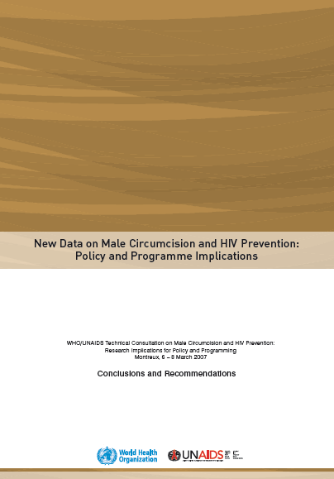
VMMC Program Arc
2007-2009: Translation of WHO guidance into national policies and standards of care
2007: WHO issued VMMC for HIV prevention recommendations
2005-2007: Gold-standard evidence of efficacy from 3 Randomized Control Trials
1990-2000: Decade of ecological/observational data suggesting protective effect; provided basis for RCTs
2009-Current:
Translation of national policies into practice and expansion to public health scale
RCTs in South Africa, Kenya and Uganda found approximately 60% reduction in risk of female-to-male HIV transmission
Meta-analysis of 15 studies established protective effect

Slide 6
VMMC Program Arc
2013-Current: Expansion to public health scale
EFFICIENCY
Demand
Supply
Clear Targets
Funding Commitment

Slide 7
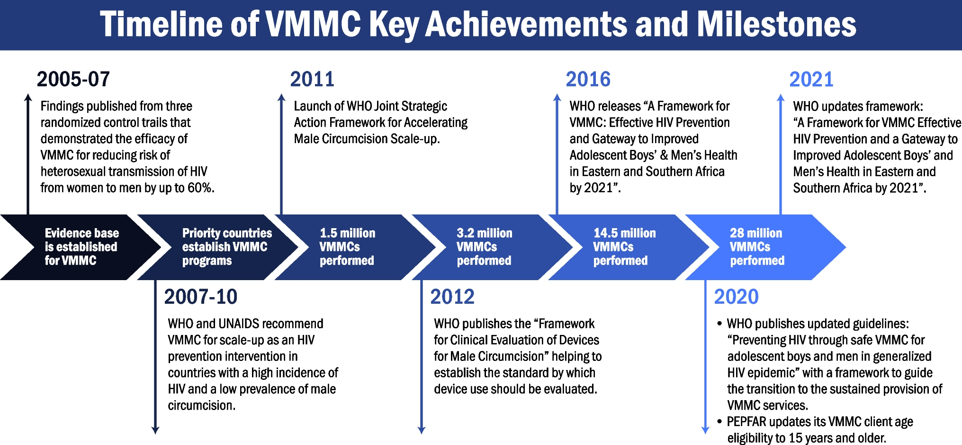
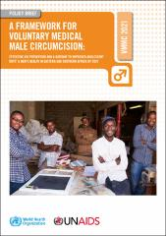
Towards sustaining VMMC

Slide 8
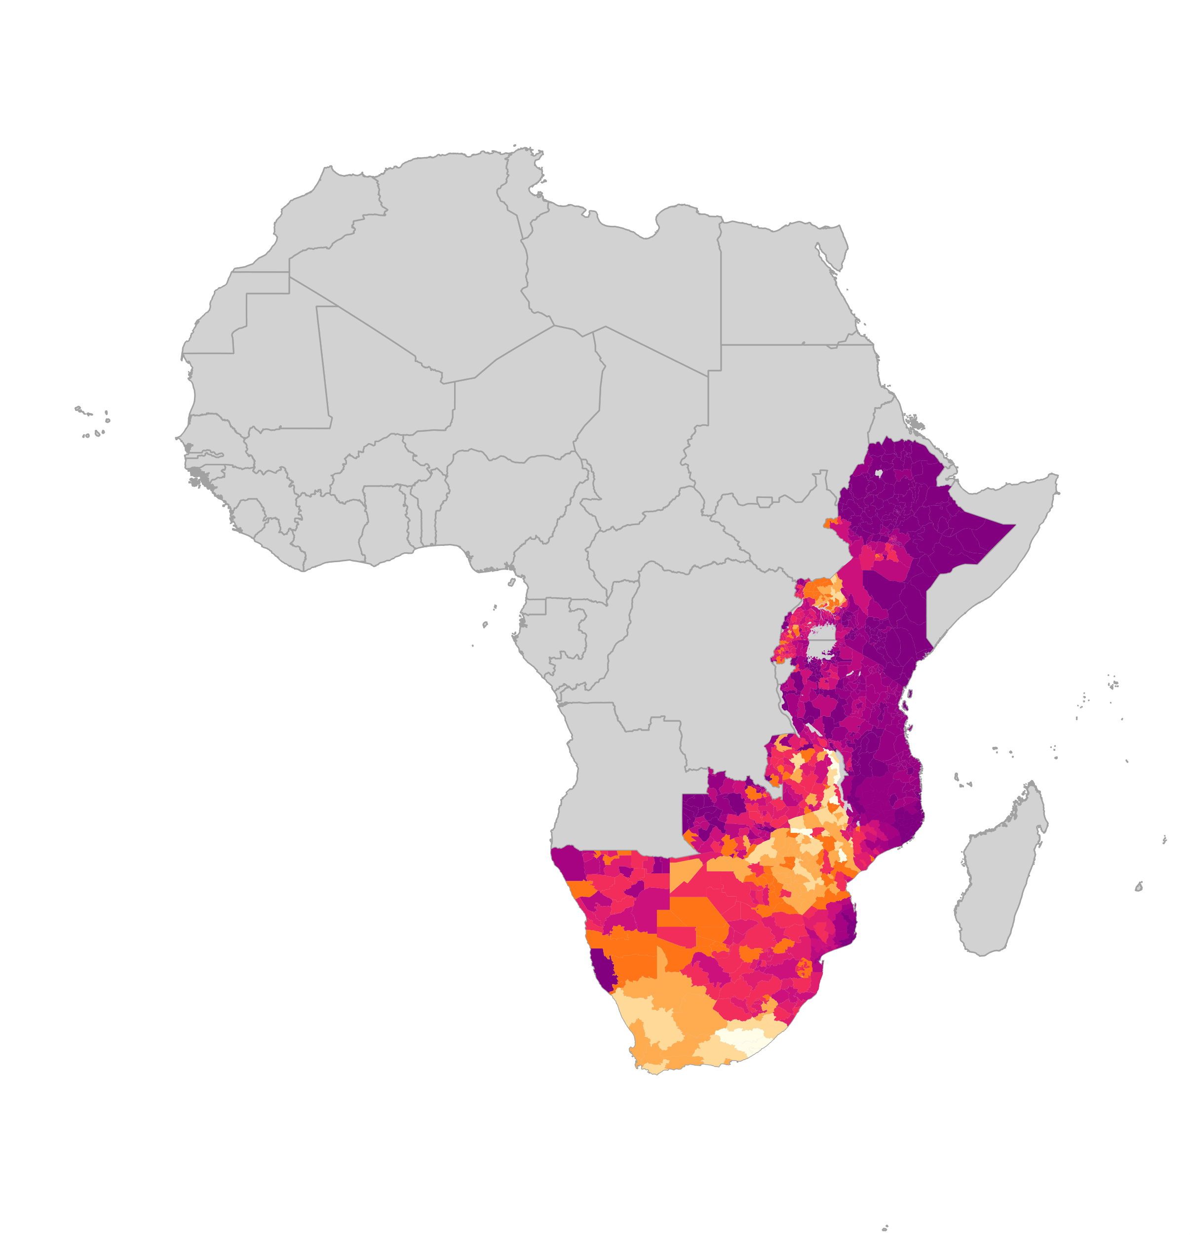
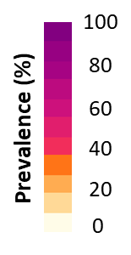
37.5 million men and boys accessed VMMC package of services by 2023 -
But VMMC, other prevention and treatment coverage for men & boys remains far from targets
Number of men and boys accessing VMMC package of services
Estimated coverage of VMMC among men 15-49
Global HIV Prevention Coalition promotes an integrated combination and male SRH pillar approach for boys and men including HTS/ART and gender-transformative approaches
VMMC coverage remains far from reaching the 90% 2025 targets –and no full recovery after COVID-19 in terms of uptake and persistent funding gaps
Sources: Coverage maps- special analysis by Avernir Health through the UNAIDS-led VMMC data workstream. Analysis done using DMPPT2 Tool and integrated 3MC model using data up and until 2023. VMMC progress over time: UNAIDS Global AIDS Monitoring, 2023; www.aidsinfo.unaids.org)

Slide 9
Voluntary medical male circumcision more often
reaches men in higher wealth strata
Self-reported medical circumcision among men aged 15 years and older, by wealth status, priority countries with available data, 2015–2019
Source: Population-based HIV Impact Assessments 2015–2019.

Slide 10
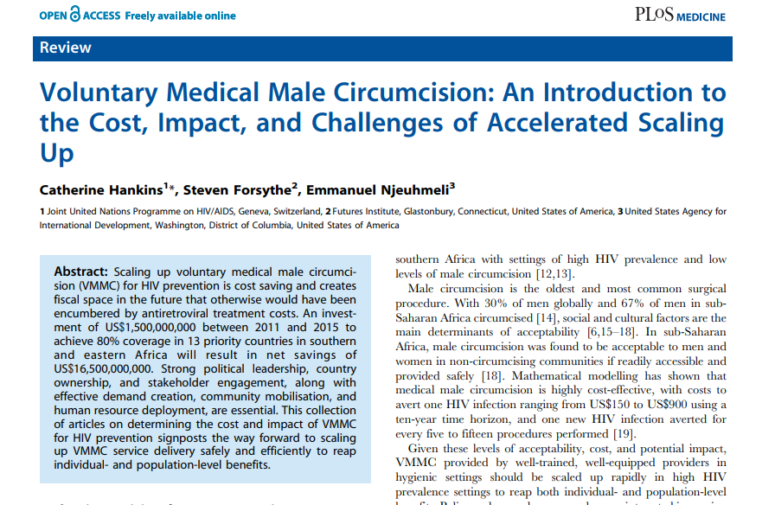
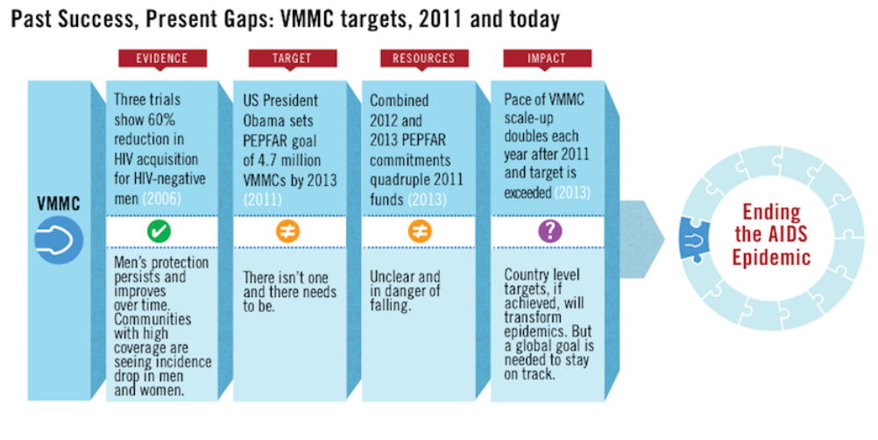
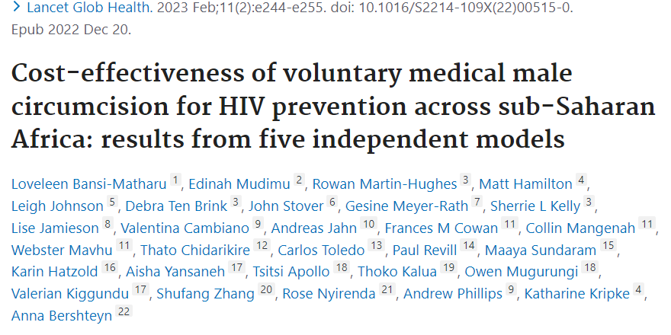
Aiming for Impact – VMMC is a best buy for HIV prevention in high incidence settings
Models established that scaling up VMMC for HIV prevention was cost saving
An investment of $1.5B between 2011-2015 to achieve 80% coverage in 13 priority countries in priority countries will result in net savings of $16,5B
Advocacy led to funding allocation to reach coverage targets

Slide 11
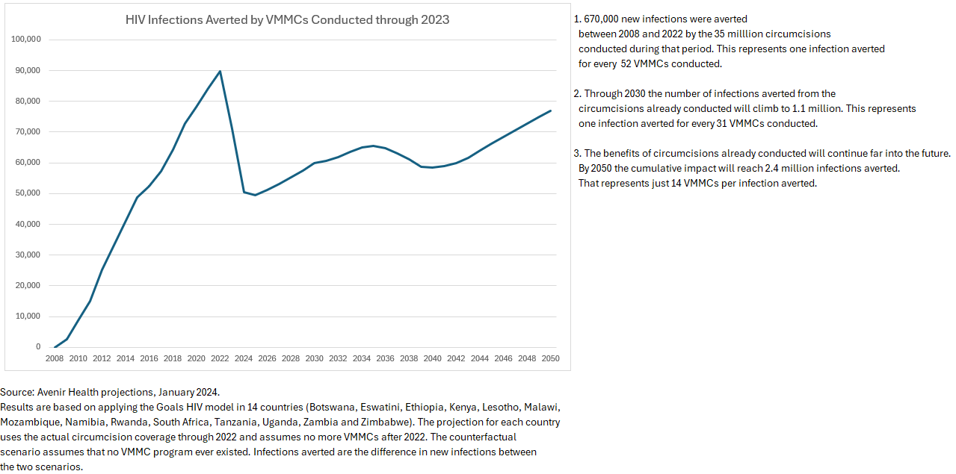

VMMC impact – new HIV infections averted

Slide 12

Reaching men with services the art of demand creation
Strength and weakness of the program from the outset
Poor existing evidence base to inform demand creation
Psychology, behavioral economics, commercial marketing disciplines have increased our understanding of male behavior, helping to:
  (1) segment population across a number of socioeconomic and “psychographic” variables
  (2) identify each segment’s path to VMMC – demand creation as a journey, not a single event

Slide 13

Need for supply and demand-focused interventions
Supply
  Making services available closer to clients (e.g., mobile services, roving teams, make-shift sites)
  Focus on providers (one size does not fit all)
  Differentiation of services (young men vs. 30+; VIP)
  Focus on quality
  Men’s health services
Demand
  1:1 mobilization (one size does not fit all)
  Incentivizing mobilization
  Involving community leaders and gatekeepers
  Campaigns
  Using female partners
  Incentives
  Use of sports
  “Selling” other aspects of VMMC beyond HIV prevention (e.g., STIs)
  Digital tools for innovation

Slide 14
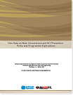
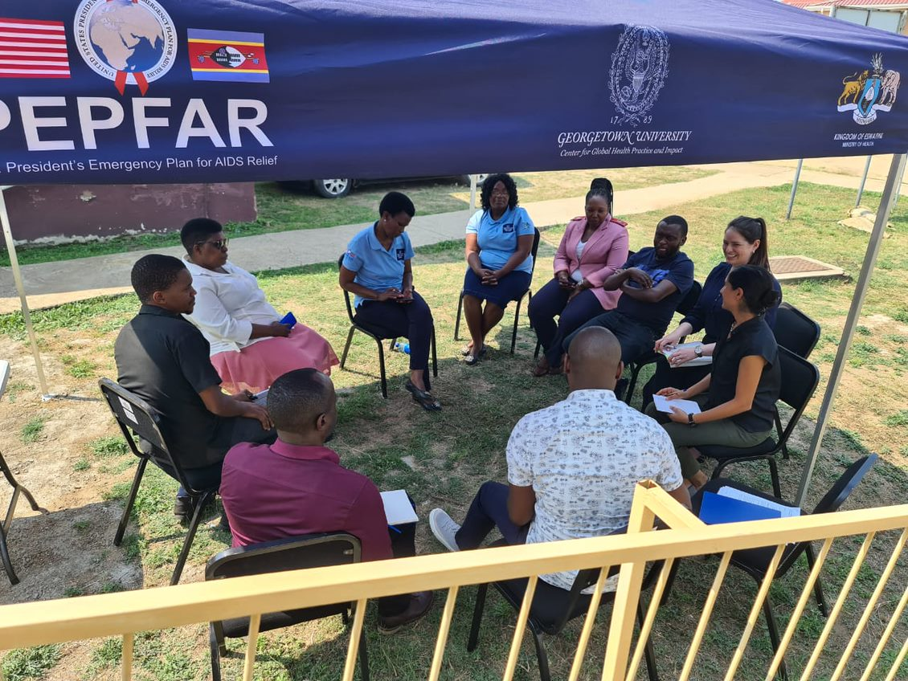
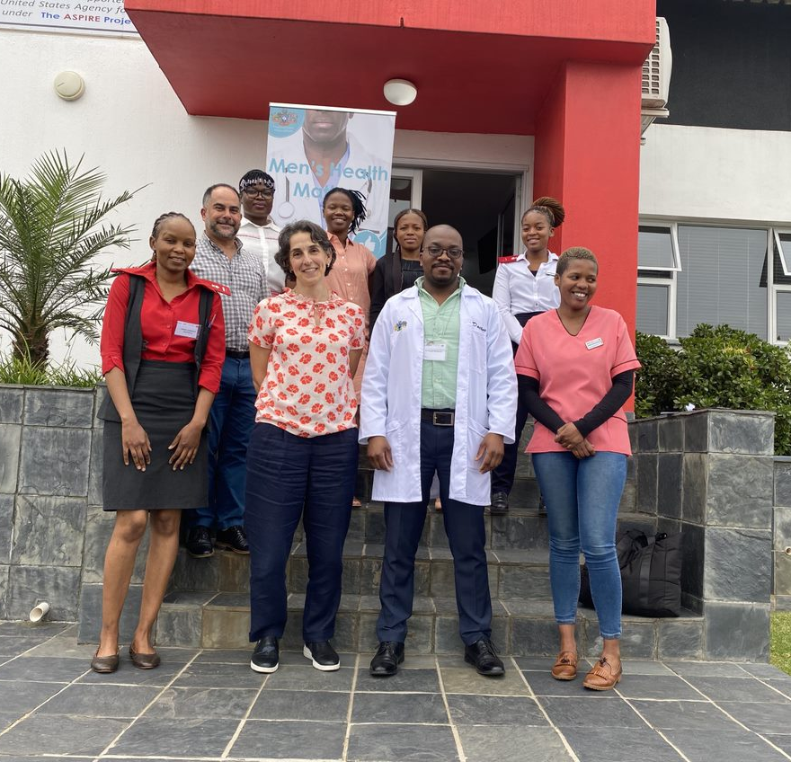
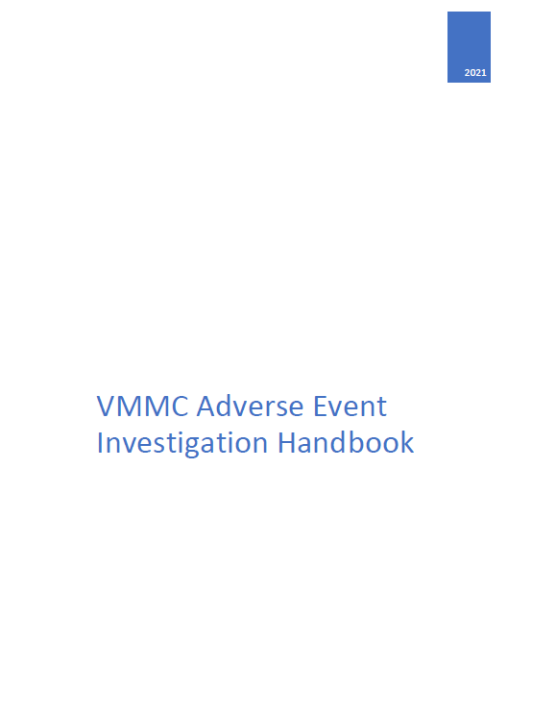
Quality is a non-negotiable for VMMC services
WHO established quality standards at the onset of the program
Routine quality assurance and quality improvements assessments are program requirements
  In addition to procedure, standards include demand creation, M&E, site operations, etc
Aim to establish culture of quality and safety
  AEs are expected to happen
  Not reporting not having AEs
  Minimize the number and severity of AEs by constantly improving program quality

Slide 15
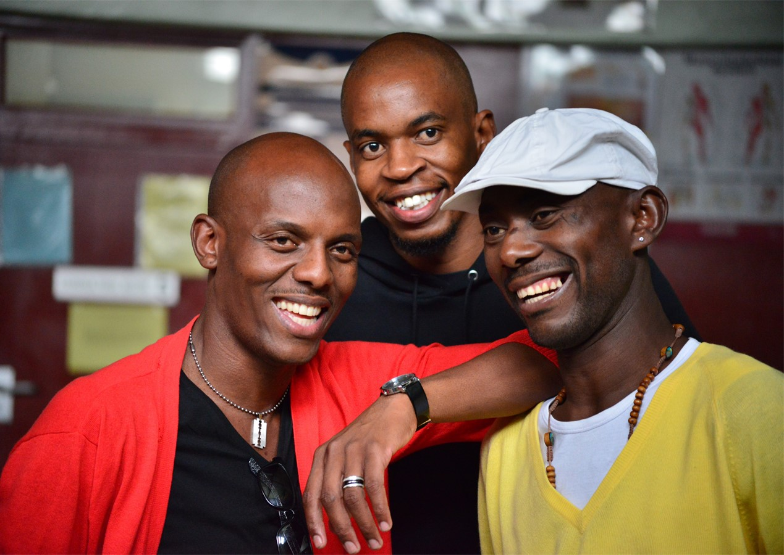


About MENHT
The Global Men and HIV Technical Working Group
To coordinate activities related to improving outcomes for men across the HIV cascade and support advocacy efforts with global partners and key stakeholders
To support the development of operational guidance for improving HIV services for men, including identifying interventions and review of technical documents
Identify, collect, and share best practices, case examples, and tools for reaching men
For the dissemination of guidance, briefs, and lessons learned and support scale-up of effective interventions, including providing technical assistance
Coordinated by UNAIDS and WHO
A standing body of stakeholders and partners to support global and country engagement and galvanize action to mitigate the men gap

Slide 16
Conclusions
Continued scale up in nearly all countries with some reaching high-levels of MC coverage (nationally or in specific SNUs); but gaps remain
Modeling confirms that VMMC continues to be cost effective and cost saving, including under circumstances of low HIV incidence and increasing ART treatment
In the absence of a highly-effective, durable vaccine, it’s difficult to imagine a prevention intervention that would have comparable impact
Men have additional HIV prevention options
Declining VMMC funding threatens to reverse previous gains
Integration into broader men’s health framework
Sustaining VMMC services, will take more than resources (e.g., leadership, capacity, and demand [and others])
Success of the program has also meant lack of attention

Slide 17
Some links to resources
VMMC 2007 recommendation - WHO and UNAIDS announce recommendations from expert consultation on male circumcision for HIV prevention
VMMC framework, 2021 - A Framework for Voluntary Medical Male Circumcision: Effective HIV Prevention and a Gateway to Improved Adolescent Boys’ and Men’s Health in Eastern and Southern Africa by 2021 – Overview | GPC (unaids.org)
Men and HIV Framework - Men and HIV: evidence-based approaches and interventions | GPC (unaids.org)
Men and HIV Framework, ESA – Male engagement in HIV testing, treatment and prevention in eastern and southern Africa — A framework for action | UNAIDS
Adolescent boys and men pillar on the new GPC resource hub - Adolescent Boys & Men | GPC (unaids.org)
VMMC clearinghouse on the new GPC resource hub -https://hivpreventioncoalition.unaids.org/resources?f[0]=topics:115

Slide 18
THANK YOU
Contact: zembel@unaids.org

