Slide 1
Cost-Effectiveness of Sustaining Support for VMMC Programs
John Stover, Yu Teng, Robert Glaubius
Modeling the Impact and Cost-Effectiveness of VMMC for Prevention
21 November 2024

Slide 2
Background
When VMMC programs started in 2008 several studies estimated that they would be highly cost-effective and even cost-saving.
  Uthman et al. Economic Evaluations of Adult Male Circumcision for Prevention in Heterosexual Acquisition of HIV in Men in Sub-Saharan Africa: A Systematic Review PLoS One March 10, 2010. https://doi.org/10.1371/journal.pone.0009628
Recent modeling analysis has shown that VMMC continues to be cost-effective in most settings in the short-term
  Bansu-Matharu et al. Cost-effectiveness of voluntary medical male circumcision for HIV prevention across Sub-Saharan Africa: results from five independent models Lancet Global Health 2023;11:e244-55
However, the HIV epidemic is much different today than in 2008

Slide 3
Incidence is much lower today compared to 2010, with an average decline of 67% from 2010-2023
Source: UNAIDS aidsinfo online

Slide 4
Many countries are close to global treatment targets
On average, 80% of PLHIV are virally suppressed
Source: UNAIDS aidsinfo online

Slide 5
Male Circumcision Coverage
Ethiopia
Kenya
Tanzania
Mozambique
Lesotho
South Africa
Botswana
Uganda
Rwanda
Namibia
Zambia
Malawi
Eswatini
Zimbabwe

Slide 6
Will VMMC programs be cost-effective in the future? For how long?
The cost-effectiveness of VMMC depends on incidence. That determines how many boys and men need to be circumcised to avert one HIV infection.
If incidence continues to decline, at some point VMMC will no longer be cost-effective.
High levels of treatment coverage and viral suppression, if sustained, may lead to continued incidence decline.
Is it still cost-effective to scale up VMMC to reach global targets? If so, how long should VMMC programs be sustained?

Slide 7
Scaling Up VMMC to meet Global Targets by 2030 is cost-effective in most settings
Discounted (at 3%) net cost per infection averted from 2022-2090 of scaling up male circumcision coverage from 2021 levels to 90% of all men 15-49 by 2030 compared to no further VMMC program. All other interventions are held constant. Net costs include the cost of the VMMC program minus any savings in treatment costs. Projections based on the Goals ASM model.

Slide 8
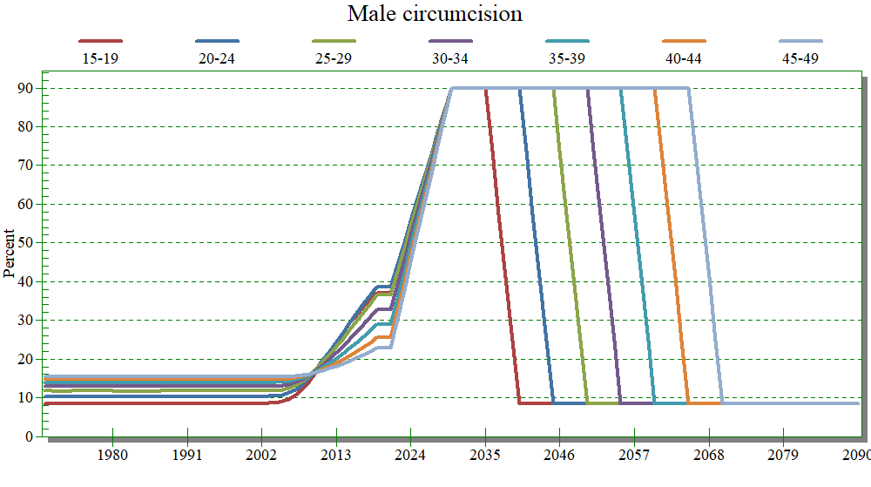
Should VMMC support continue after 2030?
Sustainability analysis assumptions
After 2030 support for the VMMC program continues for 0, 5, 10, 15, 20 or 25 years
Circumcision rates for 15-year-olds return to 2008 levels once the VMMC program stops
Coverage for all other interventions is constant at 2021 levels
Discounting at 3% per year
Evaluation period: 2022 – 2090

Slide 9
Incremental cost per infection averted increases with longer duration of support due to declining incidence
Incremental cost per infection averted by duration of support after target coverage is reached in 2030. Costs and infections are cumulative from 2022-2090 discounted at 3% per year. Costs include VMMC and ART.
Incidence among 15–49-year-old adults projected by the Goals ASM model under the assumption of constant coverage of all interventions. As incidence drops due to high viral suppression the PLHIV population ages and average (age-weighted) risk drops.

Slide 10
In many settings VMMC costs are likely to exceed cost-effectiveness thresholds at some point in the next 25 years
DALY thresholds are based on health spending 2000-2016 per DALY gained as estimated by Daroudi et al. (Cost Eff Resour Alloc (2021) 19:7) based on GBD estimates of DALYS and health expenditures. They are only used to illustrate the concept that VMMC programs will need to compete with other health priorities as HIV incidence declines in the future.

Slide 11
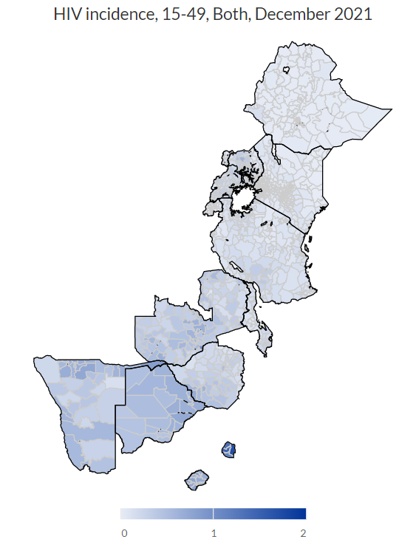
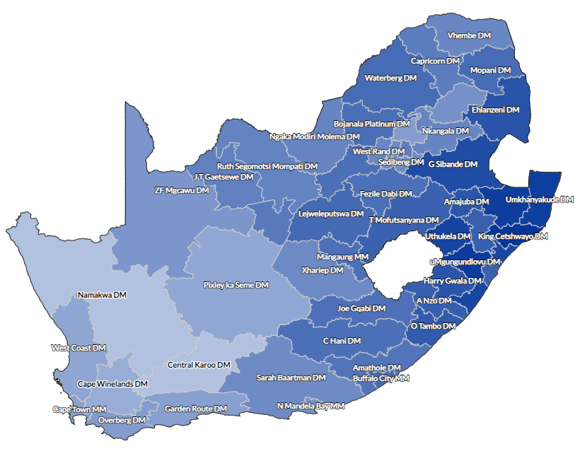
Incidence varies significantly across the region. Areas of high incidence still remain.
For 29% of population, incidence < 0.05%, for 25% it is 0.05%-0.10%, for 23% it is 0.10% - 0.35%, for 23% it is >0.35%
UNAIDS 2022 estimates from Naomi Model

Slide 12
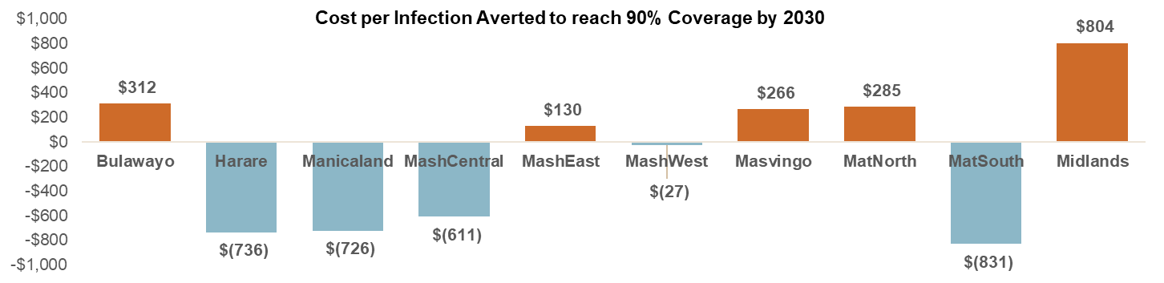
Scaling up VMMC to achieve targets would be cost-saving or cost-effective in most provinces in Zimbabwe

Slide 13
Summary
The HIV epidemic is very different today from 2008 when VMMC programs were just getting started. Incidence is lower and ART coverage is higher.
VMMC programs remain cost-effective in most settings and will remain cost-effective for the next 10 years. There are important differences across countries and sub-national regions.
Cost-effectiveness will decline as incidence drops.
Programs and donors need to develop plans to address these changes. For example, responses might include accelerates short-term response, sub-national focus and integration with routine health services.

