Slide 1
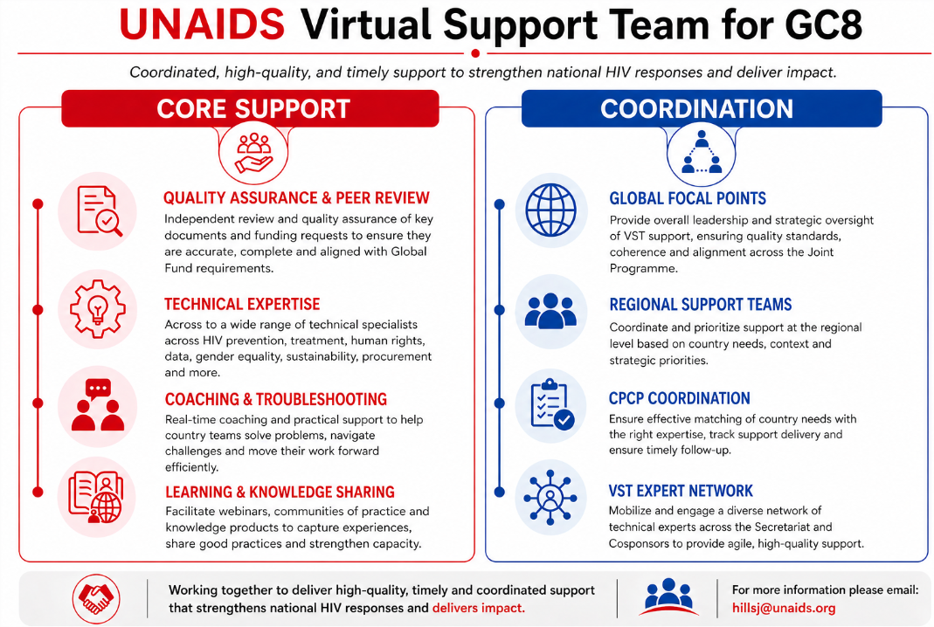


QUALITY ASSURANCE & PEER REVIEW
GLOBAL FOCAL POINTS (Country Partnership Team)
TECHNICAL EXPERTISE
Across a wide range of technical specialists from multiple regions providing support across communities, prioritization/integration, systems strengthening, HIV prevention, sustainability, human rights, procurement and more.
REGIONAL AND THEMATIC SUPPORT TEAMS
Coordinate and prioritize support at the regional level and across different thematic areas, country needs and priorities, in collaboration with UNAIDS regional, thematic focal points and co-sponsors..
REGIONAL SUPPORT TEAMS
PARTNERING & TROUBLESHOOTING
Real-time mentoring and practical support to help country teams solve problems, navigate challenges and move their work forward efficiently.
VST EXPERT NETWORK
Mobilize and engage a diverse network of technical experts across the secretariat and co-sponsors to provide agile, high-quality support.
COUNTRY PARTNERSHIPS AND COORDINATION
Ensure effective matching of country needs with the right expertise, track support delivery, and ensure timely follow-up.
LEARNING & KNOWLEDGE SHARING
For more information, please contact:
Julianna Hills hillsj@unaids.org
Kate Ray: rayk@unaids.org

