Slide 1

ZAMBIA’S EXPERIENCE ON INTEGRATING HIV PREVENTION IN THE GC7 & GC8 FOCUS
Dr. Peter Ndemena – Director Policy & Planning: NAC

Slide 2
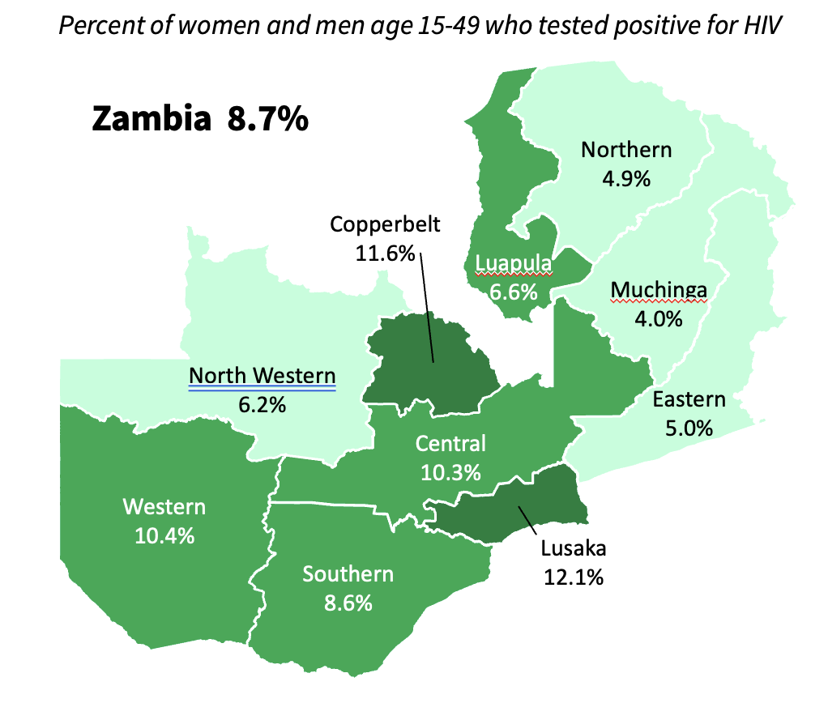
HIV Prevalence By Province

Slide 3
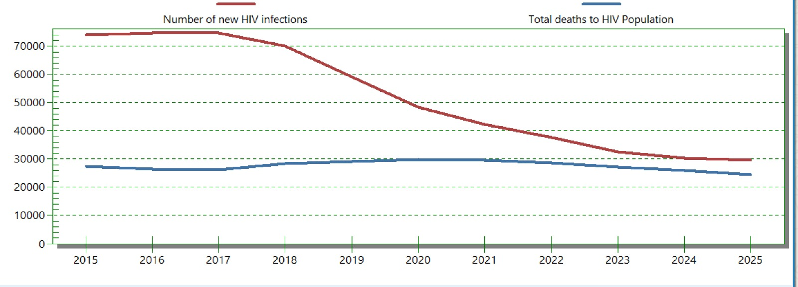
Zambia HIV Epidemic Curve
(Spectrum output 2025)

Slide 4
Zambia’s Experience on Integrating HIV Prevention in the GC7 & GC8 Focus
In Zambia, HIV prevention was integrated into the GC7 funding request by shifting toward a precision prevention approach that targeted specific geographic areas and key populations experiencing the highest incidence.
Grant aimed at addressing the new annual infections with a strong focus on AYP and KPs.
Integration in the GC7 included using updated incidence data to identify "hotspots" for focused intervention, ensuring resources were channeled to areas of highest need (25 districts).
For the GC8, Zambia through the HIV Prevention TWG has agreed to focus on addressing high incidence rates among AYP and KPs while scaling up innovative, long-acting prevention methods.
GC8 will focus on Key initiatives such as scaling up PrEP, including Lenacapavir, condom last mile distribution and combining HIV services with SRHR, and mental health services, particularly for AYP & KPs.

Slide 5
THANKS!!

